Slide 1
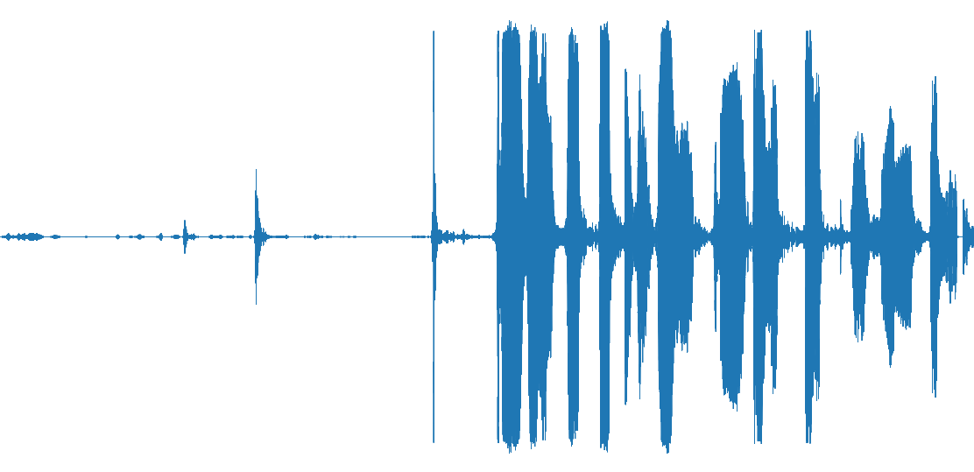
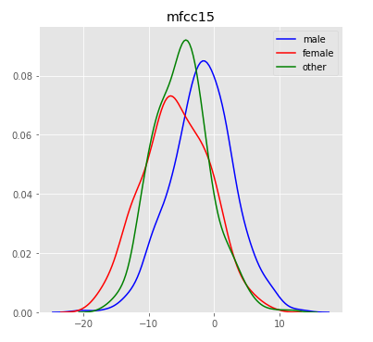
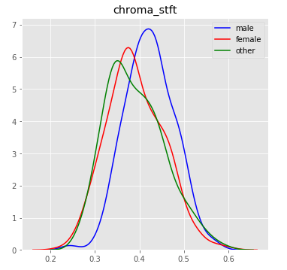
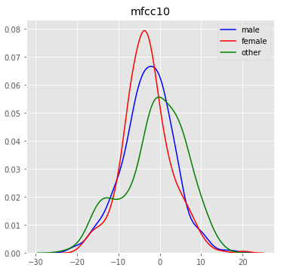

Speaker Recognition
Gender and Accent Classification Based on the Speaker’s Voice
By Risto Rahulan & Frederik Raud
Introduction:
The goal of this project was to explore Mozilla’s Common Voice datasets and to use them to both study the relationships between gender, accent and voice, and model their classification.
Data:
Findings and Models:
Common Voice by Mozilla
Datasets include mp3 audio files and tsv-files relating the audio files to words, the speaker, including their accent, age, and gender.
Data Validation
The correspondence of the spoken words to the mp3-files is validated by online contributors through their website, by up- or down-voting a given pair of words and audio. Only clips with at least two up-votes and no more than one down-vote make it into the Common Voice datasets. The up-vote and down-vote counts are also included in the tsv-file.
Description of The Original Datasets
English dataset (30GB)
1087 hours of audio, 780 hours of it validated
39 577 different voices
More than 80000 audio files
Includes accents
Additional Datasets
German (9GB)
French (5GB)
Italian (1GB)
Russian (850MB)
Chinese (China) (359MB)
Estonian (358MB)
Turkish (288MB)
Sakha (173MB)
Swedish (89MB)
Features found more relevant by the Random Forest algorithm for Gender Classification (Accuracy 82.53%) based on balanced data of the gender classes “male”, “female” and “other” (1239 rows)
In order of relevance and from left to right: frequency plots of MFCC, 5th shortest frequency bin, mean spectral Chroma feature (mean pitch, with higher pitch on the right) MFCC, 10th shortest frequency bin.
According to this data, English men speak with a higher pitch than women and others.
Gender
We trained our models on the English dataset. By just keeping gender classes “male” and “female” we could get a balanced dataset with 11583 rows. This gave us accuracy of 91.80% using the Random Forest algorithm and 81.24% accuracy using linear SVM.
We also used the same models on different language datasets:
Estonian – RF accuracy: 87.92% , SVM(Linear) accuracy: 86.22%
Swedish – RF accuracy: 89.72% , SVM(Linear) accuracy: 84.64%
Russian – RF accuracy: 90.78% , SVM(Linear) accuracy: 87.24%
Chinese – RF accuracy: 91.03% , SVM(Linear) accuracy: 86.98%
Italian – RF accuracy: 80.51% , SVM(Linear) accuracy: 85.43%
Feature Extraction:
Accent
---
---
In order for audio features to be extracted from the clips, they first needed to be converted into a .wav file format. Due to resource limitations, only a 100K clips from the 800K total of the English dataset were converted and studied.
Due to the inclusion of gender and accent data being optional, only 36K rows of speech features were extracted in the end.
Mean zero-crossing rate
Mean spectral roll-off
Mean spectral centroid
Mean spectral bandwidth
Mean chromagram
Mean spectral root-mean-square
20 bins from the Mel-frequency cepstral coefficients
References:
Mel-Frequency Cepstral Coefficient plot. On the vertical axis: Frequency bins. A redder indicates a larger amount of frequencies in that bin. Bins near the bottom correspond to a shorter wavelength. On the horizontal axis: time.
[1] The Mozilla Voice Dataset: https://voice.mozilla.org/en/datasets
[2] Some audio features https://towardsdatascience.com/extract-features-of-music-75a3f9bc265d
[3] Audio feature extraction LibROSA: https://librosa.github.io/librosa/
[4] Modelling with SKLearn: Scikit-learn: Machine Learning in Python, Pedregosa et al., JMLR 12, pp. 2825-2830, 2011.
[5] Help with LibROSA: https://towardsdatascience.com/extract-features-of-music-75a3f9bc265d

