Slide 1
硬體描述語言
Homework 02
班級：資工二
學號：S1254040
姓名：羅章弘
日期：2024/12/12

Slide 2
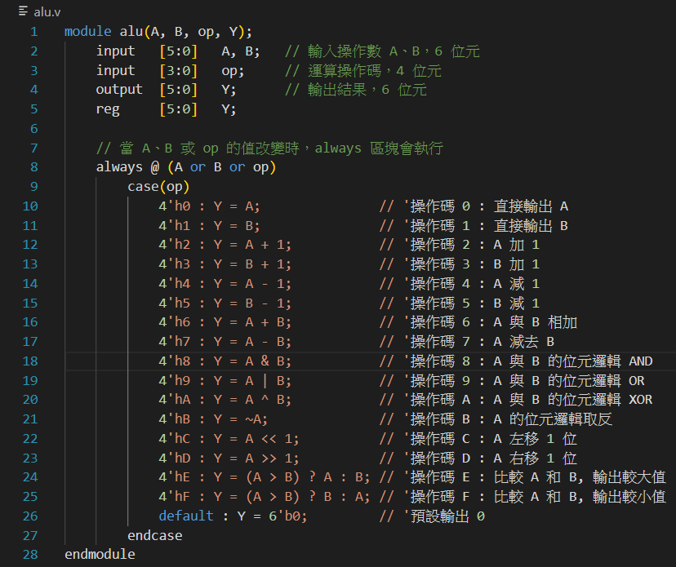
Verilog Code (alu.v)

Slide 3
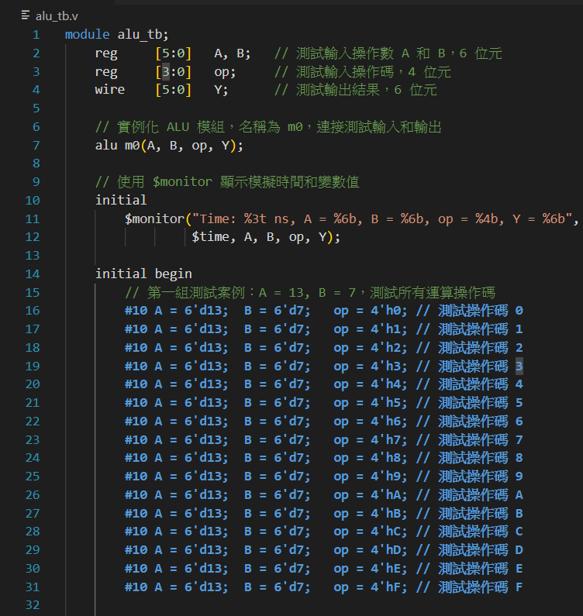
Verilog Code (alu_tb.v)

Slide 4
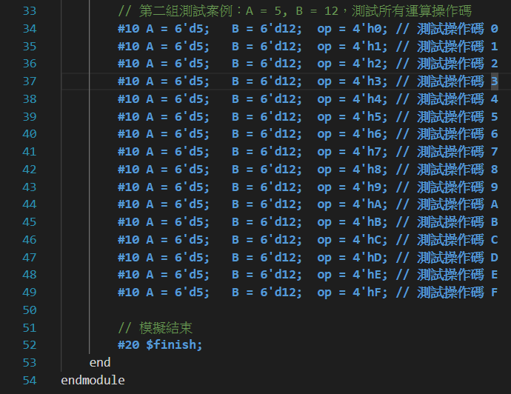
Verilog Code (alu_tb.v)

Slide 5
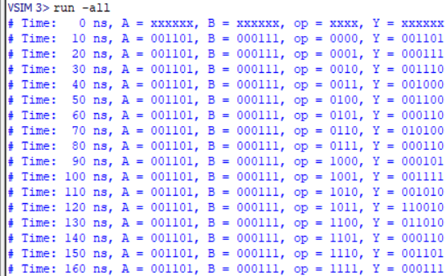
Text Message Output (1/2)
A = 6’b001100 (6’d12), B = 6’b000101 (6’d5), op = 4’h0~4’hF

Slide 6
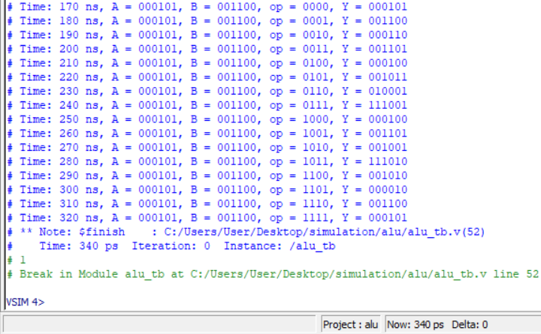
Text Message Output (2/2)
A = 6’b000111 (6’d7), B = 6’b001011 (6’d11), op = 4’h0~4’hF

Slide 7
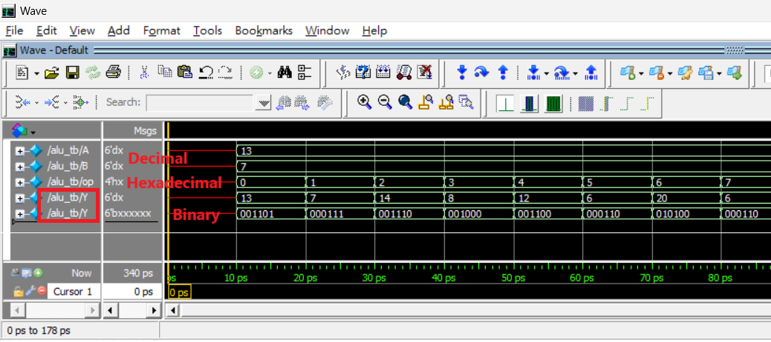
Simulation Waveform (1/2)
A = 6’b001100 (6’d12), B = 6’b000101 (6’d5), op = 4’h0~4’h7

Slide 8
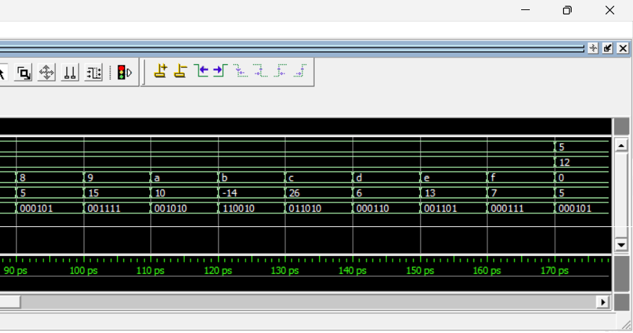
Simulation Waveform (1/2)
A = 6’b001100 (6’d12), B = 6’b000101 (6’d5), op = 4’h8~4’hF

Slide 9
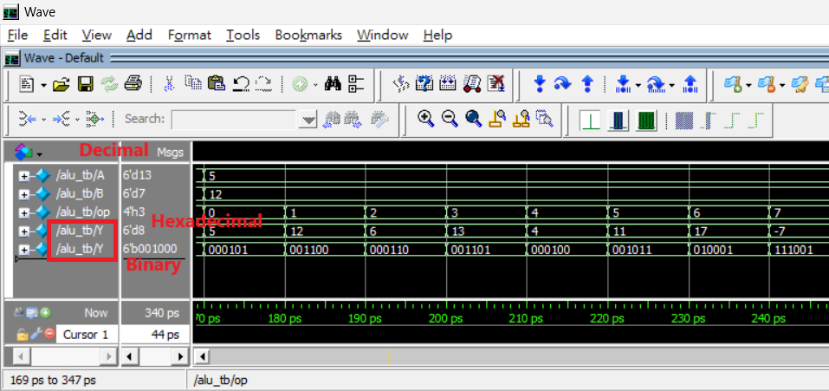
Simulation Waveform (2/2)
A = 6’b000111 (6’d7), B = 6’b001011 (6’d11), op = 4’h0~4’h7

Slide 10
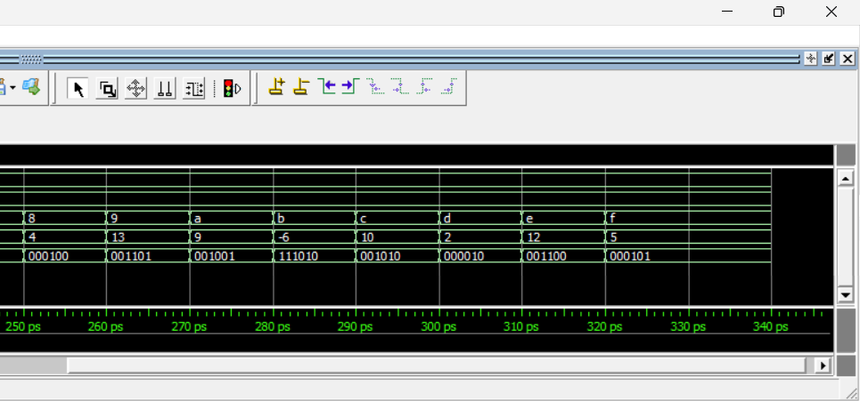
Simulation Waveform (2/2)
A = 6’b000111 (6’d7), B = 6’b001011 (6’d11), op = 4’h8~4’hF

Slide 11
結論

