Slide 1

Midterm 1 Assignment 6
Alessandro Ristori
Intelligent Systems for Pattern Recognition
Master Degree in Computer Science, AI Curriculum
A.Y. 2020/2021
Edge Detection

Slide 2
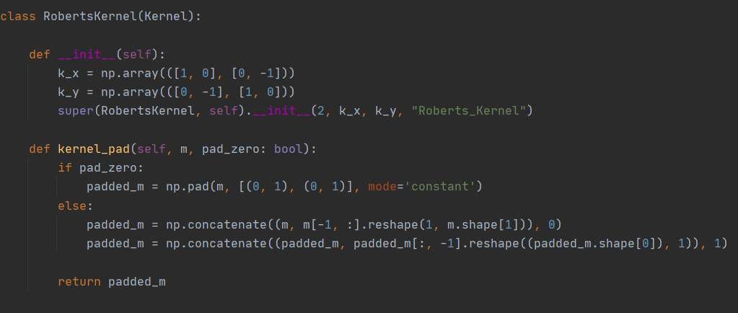
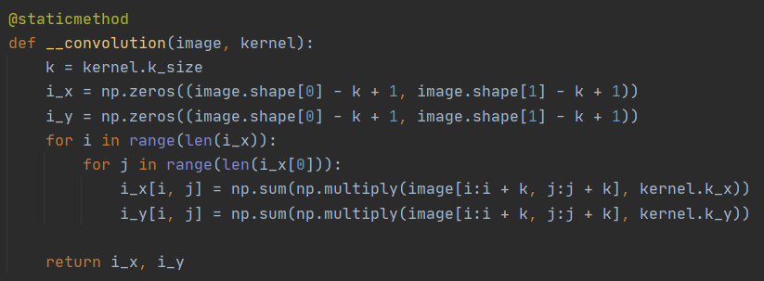
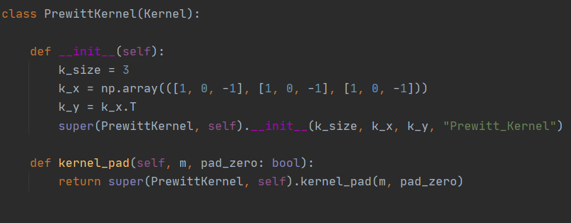
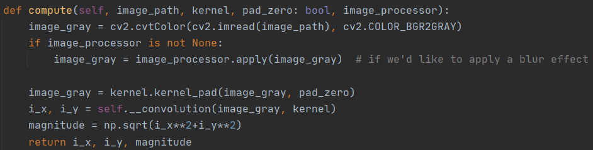
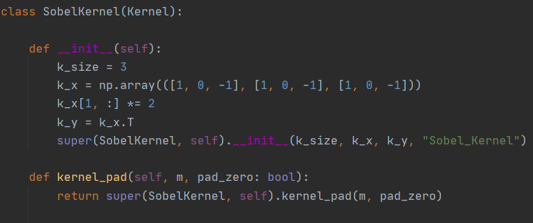
Kernels
Convolution

Slide 3
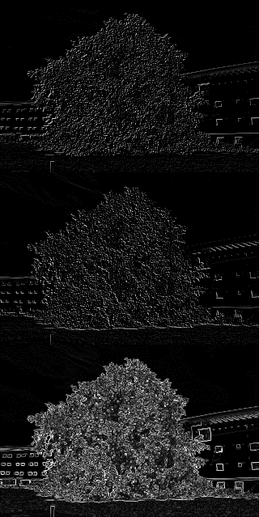
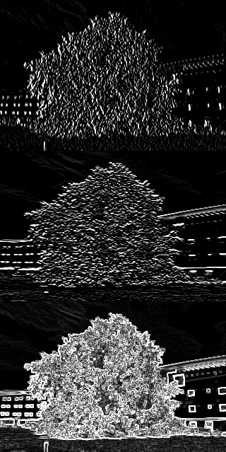
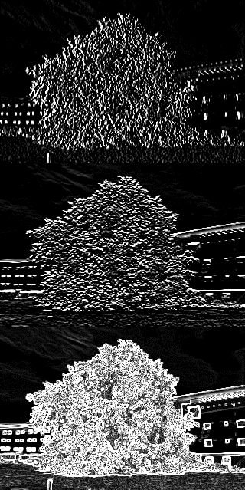
Tree
Roberts
Prewitt
Sobel
Gx
Gy
Magn.

Slide 4
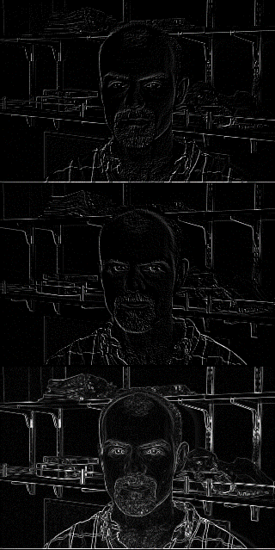
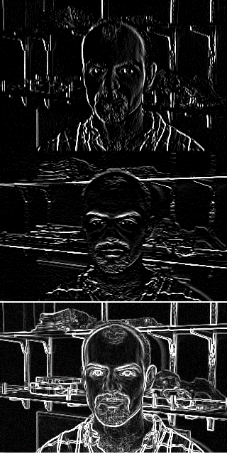
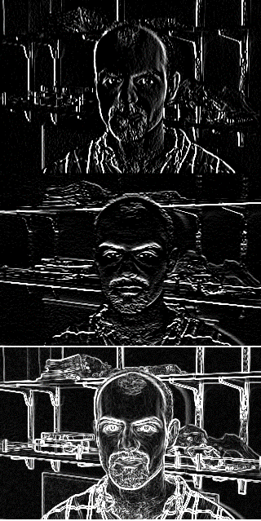
Face
Roberts
Prewitt
Sobel
Gx
Gy
Magn.

Slide 5
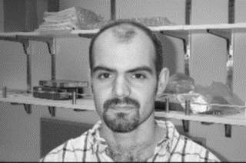
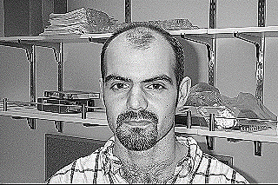

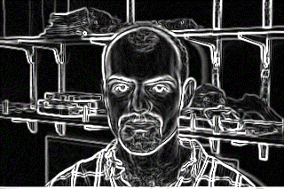
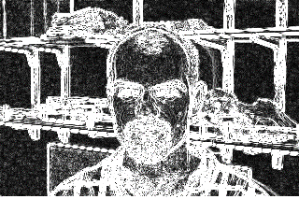


What if we blur or sharpen the initial image?
Gaussian Blur
$$\begin{matrix}1/16 & 1/8 & 1/16 \\ 1/8 & 1/4 & 1/8 \\ 1/16 & 1/8 & 1/16\end{matrix}$$
Sharperner
$$\begin{matrix}0 & −1 & 0 \\ −1 & 5 & −1 \\ 0 & −1 & 0\end{matrix}$$
Applying the blur or the sharperner before or after the convolution doesn’t change the final result
It seems that we get better results by applying the blur, but we can’t say the same for the sharpener… i’m not an expert by the way

Slide 6

Final considerations and improvements
Padding is not necessary
Using a bigger blur processor reduces the image’s noise, with the consequence of detecting only the most important edges
Convolution can be done more efficiently and quickly with parallellization
Kernels of bigger sizes give a worse result than smaller ones, the image becomes more confused/hazy
Image’s borders can be ignored, they are not very meaningful in the grand scheme of things
Thanks for your attention

