Slide 1

Midterm 3 Assignment 2
Intelligent Systems for Pattern Recognition
Master Degree in Computer Science, AI Curriculum
A.Y. 2020/2021
Alessandro Ristori

Slide 2
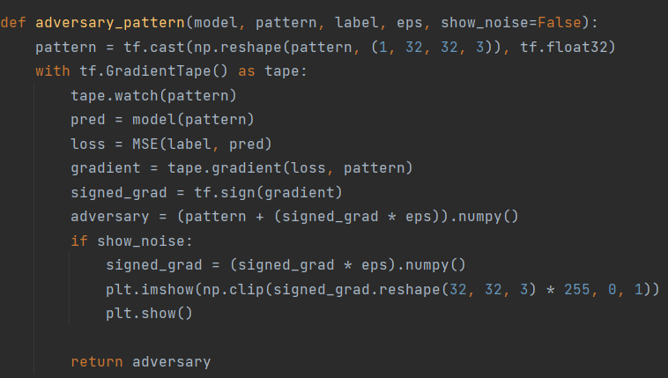
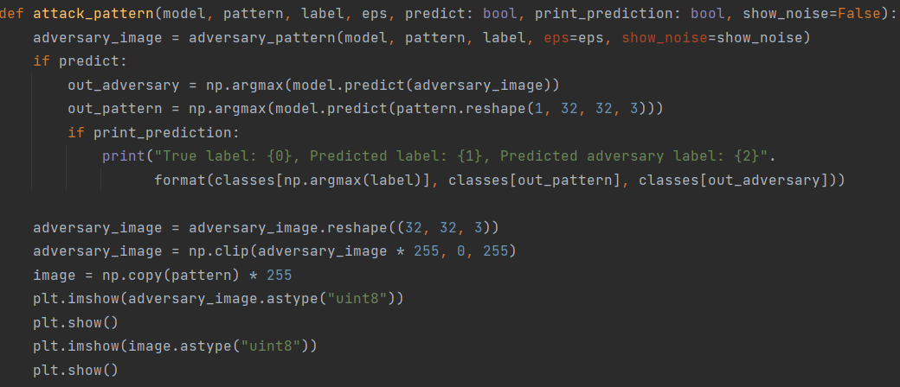
Code snippets

Slide 3
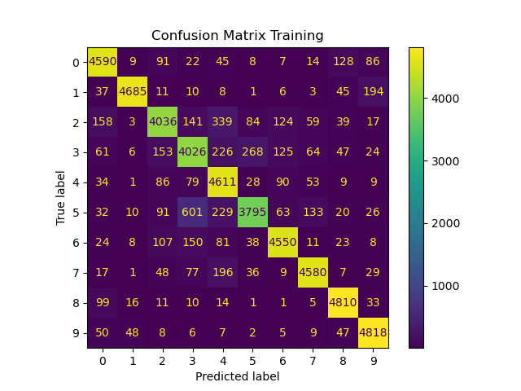
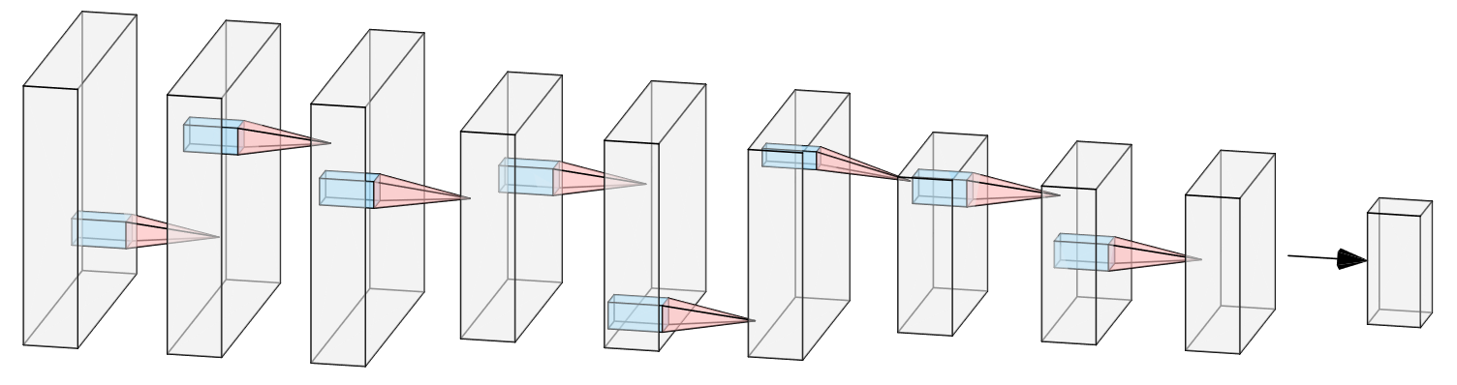
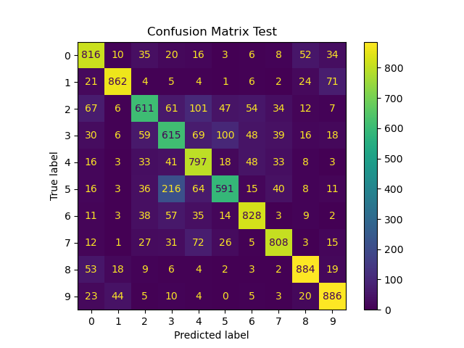
The network and the results
For the network’s structure i took inspiration from VGG16 since a simple cnn didn’t perform well.
Kernel size: (3, 3)
Pooling Stride: 2
Pooling: MaxPooling (2, 2)
Dropout: 0.3
Activation: ReLU
Batch nomalization after each convolution
Convolution
MaxPooling
Convolution
MaxPooling
Convolution
MaxPooling
Softmax

Slide 4
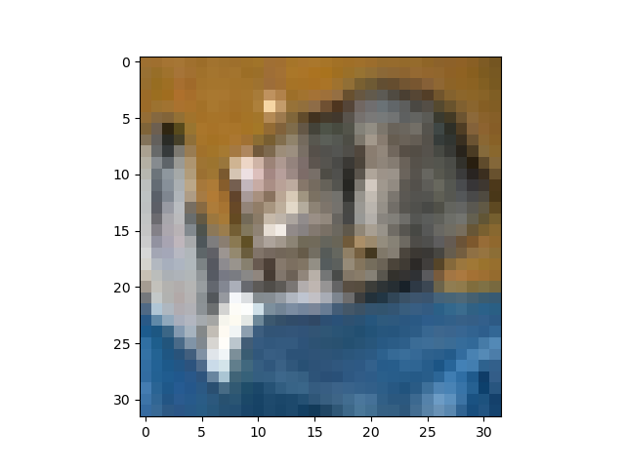
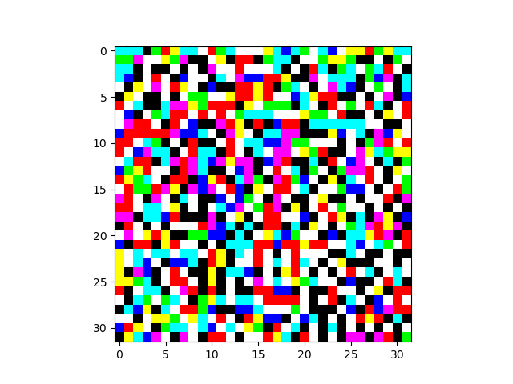
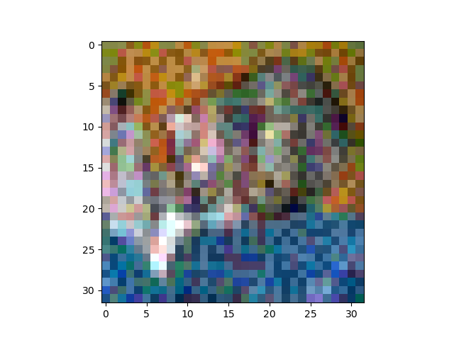
Adversarial attack, FGSM
Predicted: cat
Predicted: dog
+
=
Original image
Noise
Attacked image
How can we defend from such attacks?

Slide 5
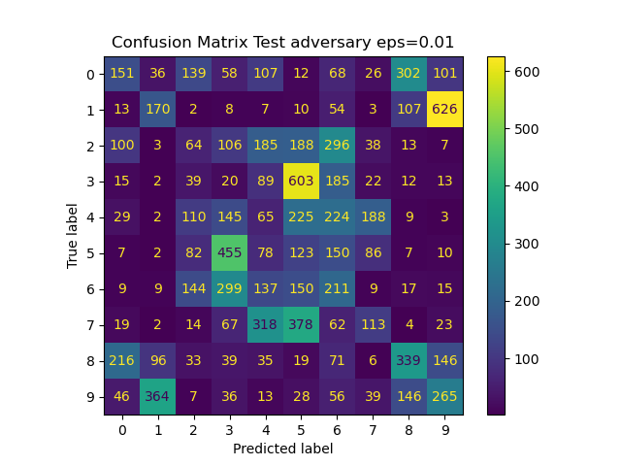
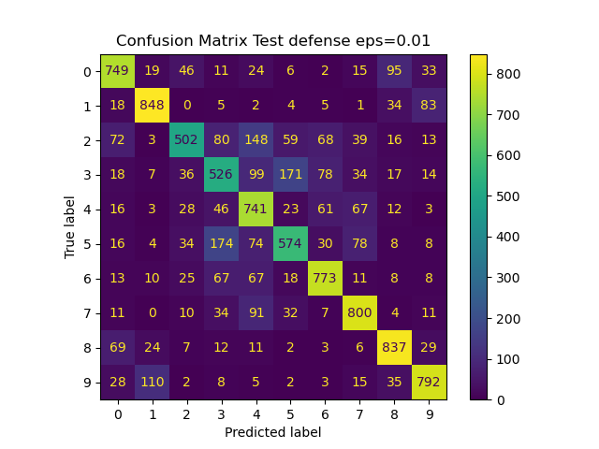
Adversarial training
The most simple idea was augmenting the training set with adversarial patterns (each one with random noise);
It makes the model more robust but makes the training more complex (and longer) and it doesn’t always guarantee success.
Eps (noise) | No adv. Training | Adv. Training
0.001 | 0.7432 | 0.7886
0.005 | 0.37 | 0.7559
0.01 | 0.1520 | 0.7142
0.05 | 0.0535 | 0.4271
0.1 | 0.0891 | 0.2813
Test accuracy at different eps values, showing the difference beetween a network that wasn’t trained on adversarial pattern and one that was.

Slide 6
Final considerations
Using more filters as the we go deeper in the network gives better results in terms of accuracy;
MaxPooling performed a little better than AvgPooling, it highlights the most important features (like edges), but the gap in terms of accuracy wasn’t that much;
Simple data augmentation is not the best solution for adversarial training, more sophisticated approaches could perform better, such as distillation, and gaussian augmentation.
Thanks for the attention

