Slide 1

SERVICE MANAGEMENT PORTAL – 4B
Presented By -
RISWAN BASHA SALEEM BASHA (1440928)
SHIVAKUMAR VEERAPUR (1445680)
AMITH NAIR (1428869)
JISHNU SHIVARAMAN (1440698)
VASANTHAKUMAR RAMESH LAKSHMI (1439256)
Examined by – Prof. Dr. Patrick Wacht

Slide 2
Agenda
1. Problem Statement
2.Introduction
3.Working Principles of Agile
4.Scrum as Agile
5.User Component Discussion
6.Admin Component Discussion
7.Deployment
8.Conclusion

Slide 3
1. Problem Statement
This project is positioned to transform the field of IT service requests and provider
partnerships by implementing Agile approaches that give priority to flexibility, customer
involvement, and iterative development
Implement the component by sharing and fetching APIs from other groups

Slide 4

2. Working Principles of Agile
Figure 2.1 : Process of Agile
Customer Satisfaction through Early and Continuous Delivery: Agile focuses on delivering valuable features to customers frequently, from a few weeks to a couple of months, with a preference for shorter timescales.
Welcome Changing Requirements: Agile processes harness change for the customer's competitive advantage. Even late in the development process, Agile welcomes changes in requirements.

Slide 5
3. Working Priciple of Agile
Deliver Working Software Frequently: The primary measure of progress in Agile is the delivery of working software, which is delivered regularly, from a few weeks to a couple of months, with a preference for the shorter scale.
Collaboration between Businesspeople and Developers: Throughout the project, business stakeholders and developers must work together daily to ensure alignment and mutual understanding of the project goals and requirements.
Motivated Individuals: Projects are built around motivated individuals who should be trusted to get the job done. Providing them with the environment and support they need and trust them to complete their tasks.

Slide 6
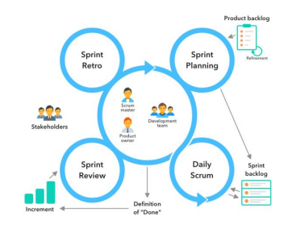
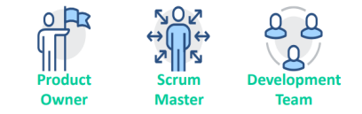
4. Scrum as Agile
The Agile Scrum technique was successfully applied in our project to improve software development and project management procedures. Throughout several sprints, the Scrum Master adeptly oversaw team availability and skill sets, converting project requirements into user stories.
For this project, each group member has followed SCRUM methodology such as: •Attending Scrum meetings, e.g. Sprint planning, Sprint review and Sprint retrospective •Choosing agile roles (Product Owner)
We followed 5 Sprints with each 2 weeks
Regular Scrum meetings were conducted to ensure effective communication and collaboration within the team. Bi-weekly stand-up meetings were held to discuss progress, challenges, and plans for the week
Figure 4.1 : Scrum as Agile & Figure 4.2 : Sprint Planning and Review

Slide 7
5. User Component Discussion
Home Page: First point of interaction, showcasing service highlights and access to main features.
Customer Signup/Login: Secure entry point for users to access personalized services and features. It has been integrated from the API of 1A for both signup and login where the successful login credentials will automatically be stored in their respective Database.
User Dashboard: Central hub for users to view, manage, and track service requests and interactions.
Request Submission: Interface for users to submit new service requests with detailed specifications. Agreement name has been populated form Team2Bs API and integrated in our form.
View Pending Requests: Allows users to monitor the status of their submitted requests and any pending actions.
Manage Requests: Features for users to modify, cancel, or update their service requests as needed.
Feedback: Enables users to provide feedback on services received, enhancing quality and trust.
Offers: API Fetched from Team3B and populated in our Offers page to accept it or decline it with reason
Let’s look into a short Demo…………..

Slide 8
6. Admin Component Discussion
Admin Login Page: A secure entry point designed specifically for system administrators, distinct from user login, ensuring the integrity and smooth operation of the platform.
Admin Dashboard: Provides a comprehensive overview of platform activities, including total users, current job offers, active requests, and ongoing negotiations, enhancing management efficiency and user experience.
View All Users: Lists all registered users with their profile information, offering management options such as updates and deletions to maintain up-to-date user records.
Update User/Customer: Allows administrators to modify user account details, ensuring the platform's user information remains current and accurate.
View All Requests: A comprehensive record of job applications and requests, presenting details like job titles, project descriptions, and engagement specifics, pivotal for monitoring the job request lifecycle.
Update Request: Enables admins to oversee and adjust the status of job requests, managing request parameters and lifecycle, and ensuring relevance and currency of active requests.
Let’s look into a short Demo…………..

Slide 9
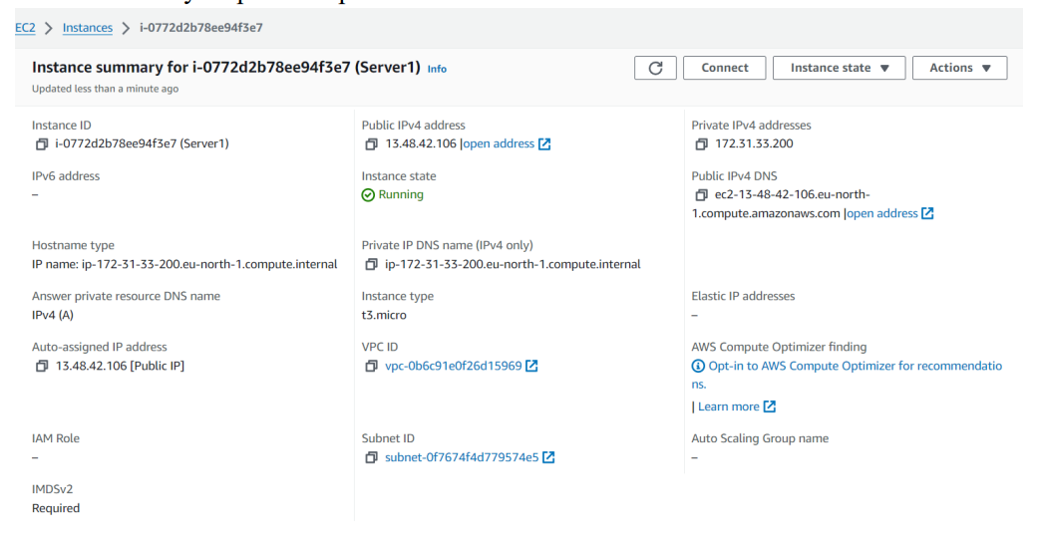
7. Deployment
Amazon Web Services (AWS), which combines scalability, resilience, and efficiency, hosts our website. Our website is always dependable and responsive thanks to AWS's cloud architecture, which easily adjusts to different traffic volumes and applications can be published directly from GitHub.. This deployment decision demonstrates our dedication to providing the best possible performance, security, and user experience while utilizing AWS's widely renowned and environmentally responsible platform.
Figure 7.1 : AWS EC2 Instance of our SMP Portal

Slide 10
8. Conclusion
The Presentation on "AGILE Development In Cloud Computing Environments" presents an in-depth study of the Agile methodology and its application in IT service requests and provider partnerships. It emphasizes flexibility, customer involvement, and iterative development. The report details the Agile principles such as prioritizing people over processes, welcoming change, and delivering incremental value. It also examines the use of Agile frameworks like Kanban and Scrum in project management, highlighting their roles in enhancing efficiency, transparency, and customer satisfaction. The project's journey is narrated through various sprints, showcasing the development of a Service Management Component that integrates real-time tracking, user authentication, and API integration, culminating in a user-centric and flexible solution that revolutionizes the IT service sector.

Slide 11

Thank You

