Slide 1
Work Flow of Infinity Books Application

Slide 2
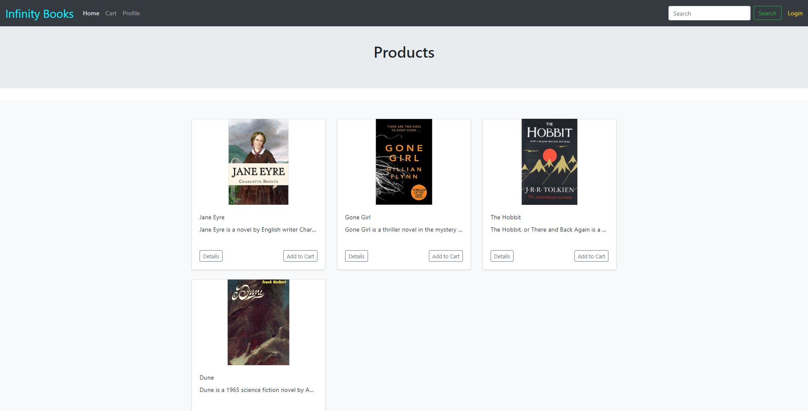
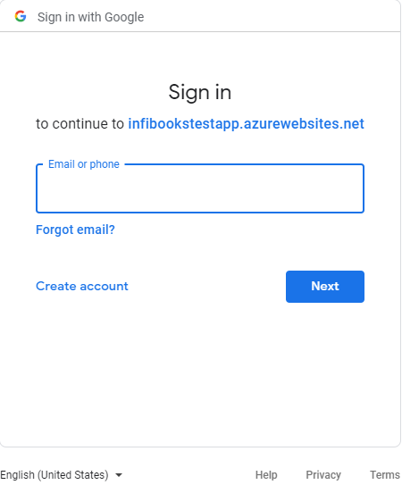
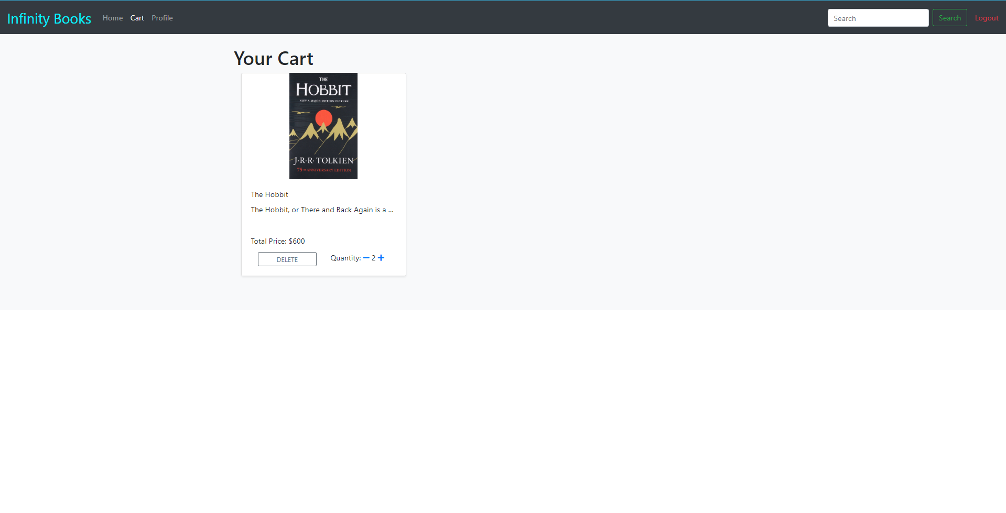
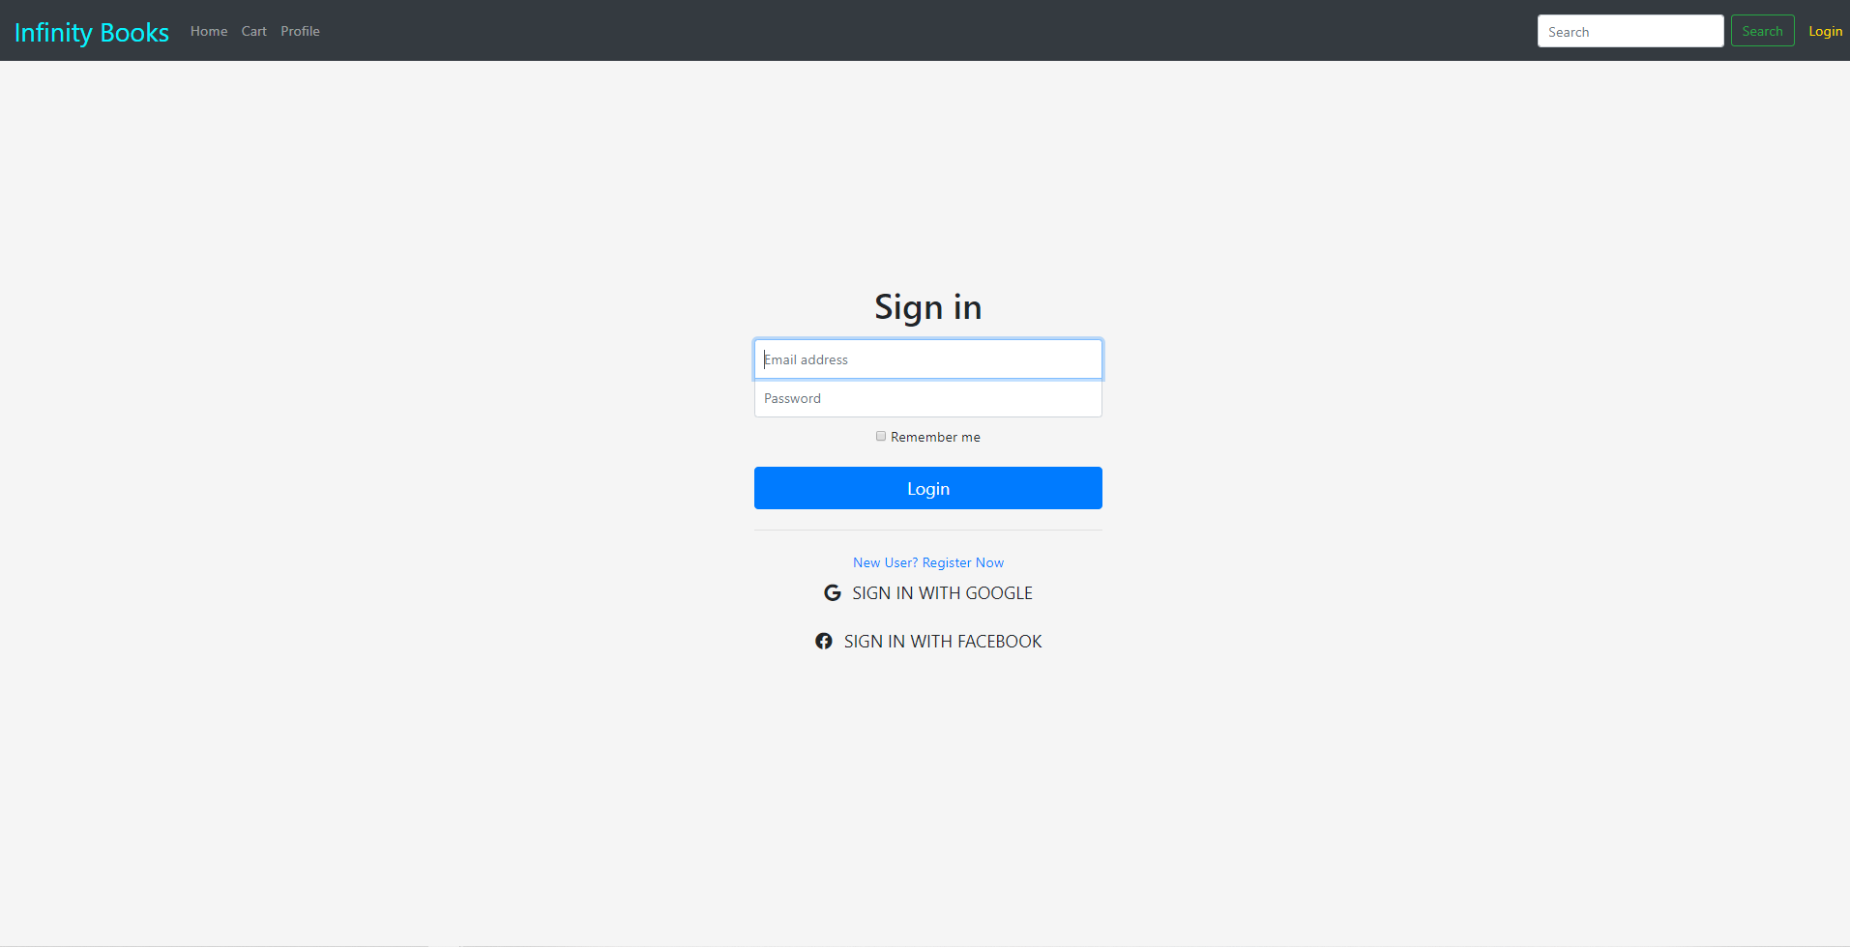
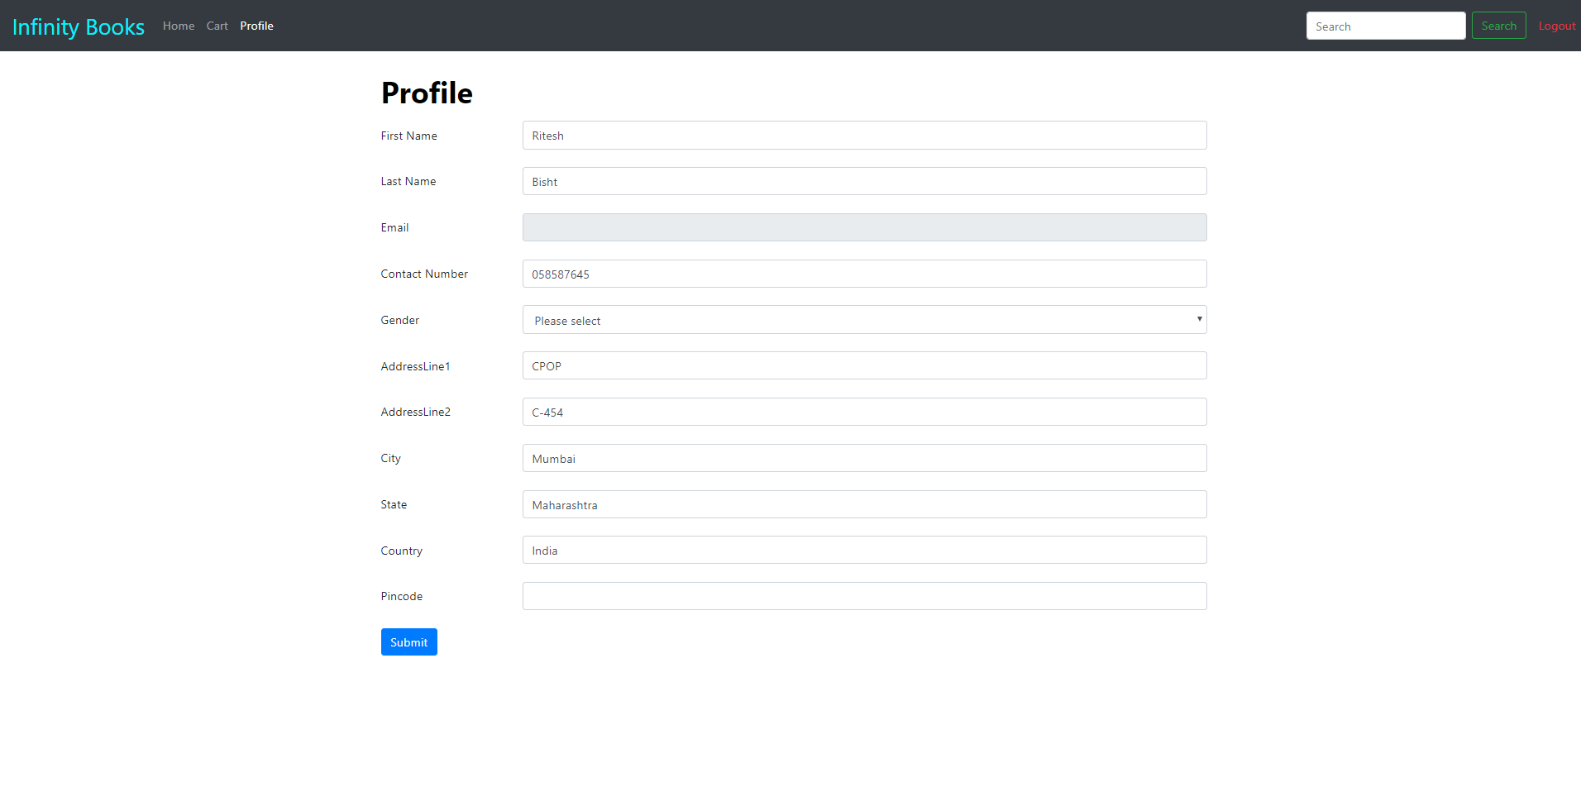
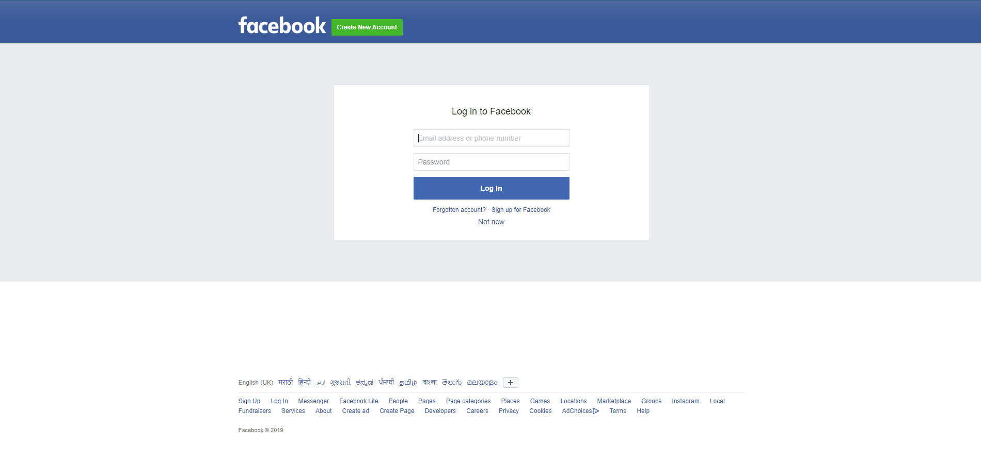
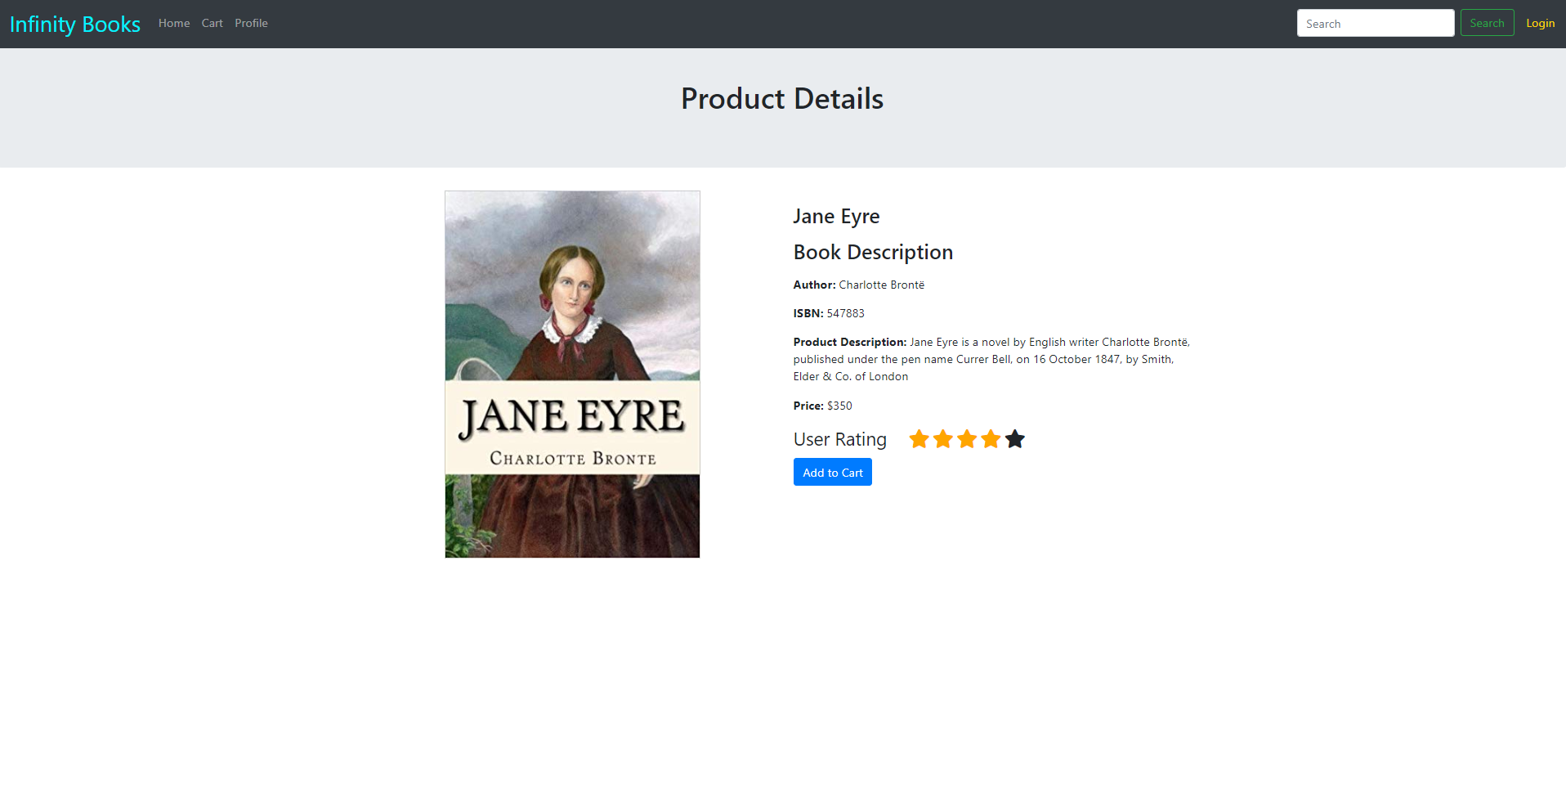
Home/Product
Google Login
Delete
User Cart
Quantity-
Quantity +
Home, Infinity Books
Login (Successful)
Search
Logout(Successful)
Cart, Add to Cart
Sign in with Google
Home/Product
Login
Home/Product
Request to site
Add to Cart, Cart, Login, Profile
Login (Successful)
Logout(Successful)
Profile
Login (Failed)
Profile
Login (Successful)
Logout(Successful)
Home, Infinity Books
Sign in with Facebook
Submit
Product Details
Add to Cart, Cart, Login, Profile
User Profile
Facebook Login
Product Details

Slide 3
Technical Flow of Infinity Books Application

Slide 4




User Login
Azure function search the pass data in DB if found send user details back
Web app send user detail to azure function
Fetch List detail from DB
Return with users authorization result
InfinityBooksWebApp
InfinityBooksSQL
InfinityBooksAzureApp

Slide 5


Facebook Login
InfinityBooksKeyVault
Facebook graph apis
Gets Google client Id and client secret from keyvault
Use clientId and client secret to redirect to facebook login portal
after successful login web app fetch the user data
Azure function search the user data in DB if found send user details back otherwise save the user data and return new stored data
User data is passed to azure function through Api Managaement
Fetch User detail from DB
Azure function returns the user data to web app
InfinityBooksWebApp
InfiBooksAPIManagement
InfinityBooksAzureApp
InfinityBooksSQL
Azure functions are getting exposed through API Management

Slide 6

Google Login
InfinityBooksKeyVault
Google graph apis
Gets Google client Id and client secret from keyvault
Use clientId and client secret to redirect to google login portal
after successful login web app fetch the user data
Azure function search the user data in DB if found send user details back otherwise save the user data and return new stored data
User data is passed to azure function through Api Managaement
Fetch User detail from DB
Azure function returns the user data to web app
InfiBooksAPIManagement
InfinityBooksAzureApp
InfinityBooksSQL
InfinityBooksWebApp
Azure functions are getting exposed through API Management

Slide 7

Products/Product Details
BlobStorage
Get book images using SAS token
Azure function search the pass data in DB if found send user details back
Fetch List detail from DB
Return with users authorization result
InfiBooksAPIManagement
InfinityBooksAzureApp
InfinityBooksSQL
InfinityBooksWebApp
Azure functions are getting exposed through API Management
Get blob SAS token from vault
InfinityBooksKeyVault

