Slide 1
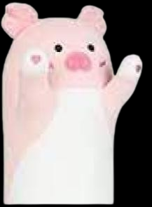



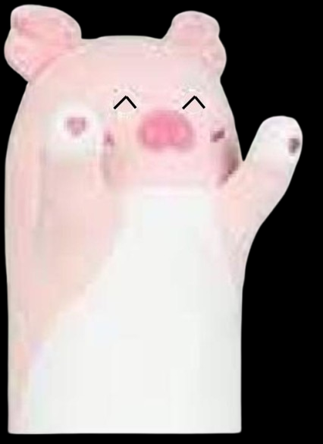
poagy.gs Home
You are on rolling release. Some things will not work as expected.
Play

Slide 2
Game selection
Happy Poagy conversation
Happy Poagy conversation
ultra realistic poagy getting lost simulator
v1.0
Last updated: Oct 6th, 2026
Added to catalog: Oct 6th, 2026
News
Badges
No news.
Play
Back
Processing, please wait.

Slide 3
Game selection
Happy Poagy conversation
Happy Poagy conversation
ultra realistic poagy getting lost simulator
v1.0
Last updated: Oct 6th, 2026
Added to catalog: Oct 6th, 2026
News
Badges
No badges.
Play
Back

Slide 4
Game selection
Happy Poagy conversation
ultra realistic poagy getting lost simulator
ultra realistic poagy getting lost simulator
v1.5
Last updated: Jan 11th, 2026
Added to catalog: Oct 7th, 2026
News
Badges
No news.
Play
Back

Slide 5
Game selection
Happy Poagy conversation
ultra realistic poagy getting lost simulator
ultra realistic poagy getting lost simulator
v1.5
Last updated: Jan 11th, 2026
Added to catalog: Oct 7th, 2026
News
Badges
No badges.
Play
Back

Slide 6
The news page isn’t finished yet.
In the meantime, check out our blog!
poagy.gs Home
News

Slide 7
20261013.0
13th October 2026
Ports some conversations from poagy.gs classic.
Previous update (20261012.1):
Fixes some UI alignment issues.
poagy.gs Home
Changelog
Rolling
Dev Release

Slide 8
No data.
poagy.gs Home
Changelog
Rolling
Dev Release

Slide 9


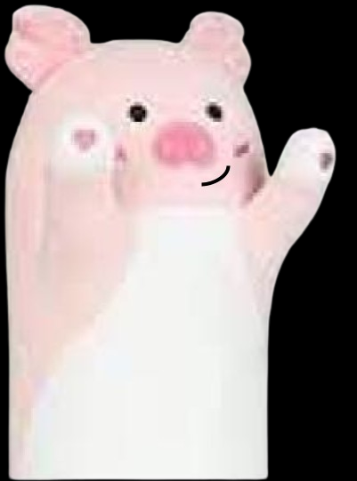
poagy.gs Home
poagy.gs+
A poagy game library.
Site
Learn more about poagy.gs+
Try the original poagy.gs
Play
20261013.0-rolling
PoweredByPoag 2025-2026

Slide 10
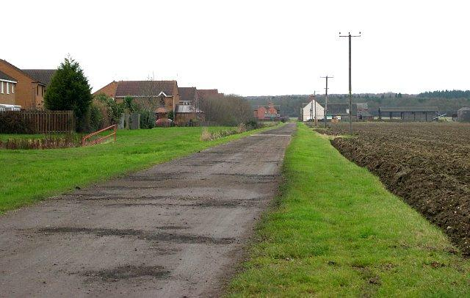
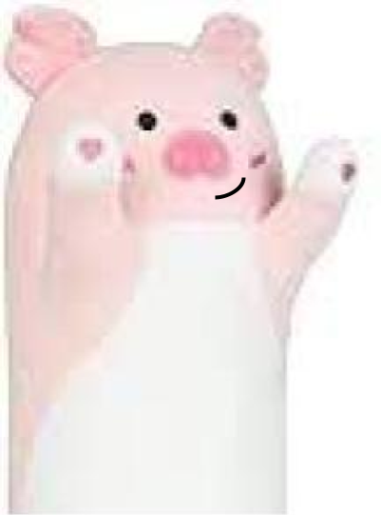
Hi
Happy Poagy: Hi!
Notes:
start

Slide 11
…ok
Why?
Happy Poagy: You know, my name is Poagy!
Notes:
Hi

Slide 12
…
Christmas?
Happy Poagy: …
Notes:
…ok

Slide 13
Next
Happy Poagy: Yeah, you know, I heard of another poag called “Christmas Poagy”. I remember when I met him for the first time we-
Notes:
Christmas?

Slide 14
Cya
Sorry, but we ran out of budget for this.
Notes:
Next

Slide 15
Cya
Happy Poagy just leaves.
Notes:
…

Slide 16
What movies do you like?
Happy Poagy: I mean, if you think that I’m basically the default poagy (I’m not btw), then that’s why.
Notes:
Why?

Slide 17
Next
Happy Poagy: Some of my favorites movies are
Notes:
What movies do you like?

Slide 18
Cya
Happy Poagy appears to have crashed… great job.
Notes:
Next

Slide 19
Hi
Happy Poagy: Hi!
Notes:
start

Slide 20
…ok
Why?
Happy Poagy: You know, my name is Poagy!
Notes:
Hi

Slide 21
…
Christmas?
Happy Poagy: …
Notes:
…ok

Slide 22
Next
Happy Poagy: Yeah, you know, I heard of another poag called “Christmas Poagy”. I remember when I met him for the first time we-
Notes:
Christmas?

Slide 23
Cya
Sorry, but we ran out of budget for this.
Notes:
Next

Slide 24
Cya
Happy Poagy just leaves.
Notes:
…

Slide 25
What movies do you like?
Happy Poagy: I mean, if you think that I’m basically the default poagy (I’m not btw), then that’s why.
Notes:
Why?

Slide 26
Next
Happy Poagy: Some of my favorites movies are
Notes:
What movies do you like?

Slide 27
Cya
Happy Poagy appears to have crashed… great job.
Notes:
Next

Slide 28
v1.5
Ultra Realistic Poagy getting lost simulator
Click to proceed

Slide 29
Part Selection
Part 1
Poagy’s Road Dilema
Part 2
Housing Issues

Slide 30

Road Rd
Part 1
Left
Right
Straight
???
You arrive at a 4 way intersection. You can go right, which looks like a nice clean path, left, a path with a tree you have to climb over, and straight, a path with a door at the end labeled “pantry”. What do you choose?

Slide 31
Git Gud
Poagy is bad at climbing. What did you expect?
Close
Left
Right
Straight
???
Poagy moves left… and shuts down because climbing is too hard.
Garden Opening
Part 1/3

Slide 32
Git Gud
Poagy is lazy.
Close
Left
Right
Straight
???
Poagy moves right… and just flops over
Garden Opening
Part 1/3

Slide 33
Git Gud
Poagy is practically a pantry vacuum.
Close
Left
Right
Straight
???
Poagy moves straight… and gets distracted by the lure of an amazing exquisite pantry full of food.
Garden Opening
Part 1/3

Slide 34
Nice one
Poagy successfully made it!
Continue
Left
Right
Straight
???
You throw a piece of food down the clean path, and Poagy makes it!
Garden Opening
Part 1/3

Slide 35
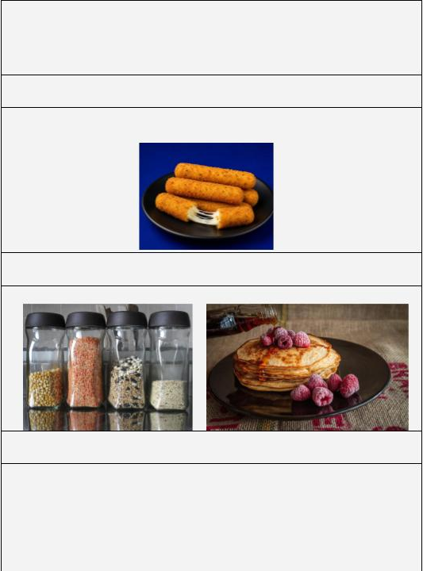


Early title screen. Not for final release.
Happy Poagy conversation
Protect the pantry from the poags!
Play!
Notes:
Title screen test for Happy Poagy conversation.

