Slide 1


Selecting the Best Warehouse Location
A Data-Driven Approach to Enhance Farm-to-Community Connections
Presented by Group 13

Slide 2
01
Context Set Up
02
Approach & Methodology
Agenda
03
Final Location
04
Benefits and Consumption

Slide 3
What brings us here ?
We support local farmers by connecting them with local demand.
To scale our impact, we plan to open new warehouses in Minnesota for agricultural aggregation and distribution.
The evaluation of potential locations is multifaceted.
Evaluating locations involves analyzing farm density and economic activity such as Revenue.
Which of the five proposed locations should we choose?
What distinguishes the proposed county from the others.
Self-Serve dashboard that visually represents our results.

Slide 4





Attribute Selection
Proposed Location
Self-Serve Dashboard
This is where we finalized our parameters after iterating through the several datasets and attributes at our disposal.
Using the composite score we rank the counties from highest to lowest score and pick the best county.
A self-serve dashboard to adjust weights of the attributes and view dynamic county rankings.
Methodology
Conclusive Evidence
Combining all the selected parameters along with their weights to create a composite score.
Here emphasizing on why the county selected is in fact the best option

Slide 5
Attribute Selection
Proposed Location
Self-Serve Dashboard
This is where we finalized our parameters after iterating through the several datasets and attributes at our disposal.
Using the composite score we rank the counties from highest to lowest score and pick the best county.
A self-serve dashboard to adjust weights of the attributes and view dynamic county rankings.
Methodology
Conclusive Evidence
Combining all the selected parameters along with their weights to create a composite score.
Here emphasizing on why the county selected is in fact the best option

Slide 6
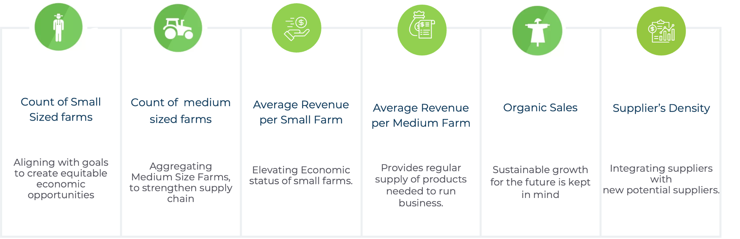
The Attributes were selected keeping in mind the larger goal of sustainable economic growth by empowering small scale and medium scale farmers

Slide 7
Attribute Selection
Proposed Location
Self-Serve Dashboard
This is where we finalized our parameters after iterating through the several datasets and attributes at our disposal.
Using the composite score we rank the counties from highest to lowest score and pick the best county.
A self-serve dashboard to adjust weights of the attributes and view dynamic county rankings.
Methodology
Conclusive Evidence
Combining all the selected parameters along with their weights to create a composite score.
Here emphasizing on why the county selected is in fact the best option

Slide 8
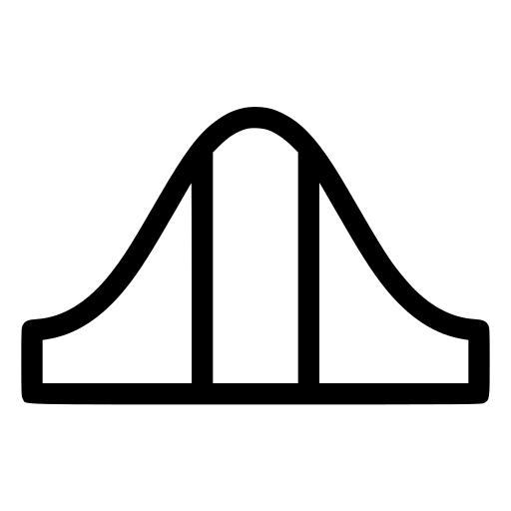
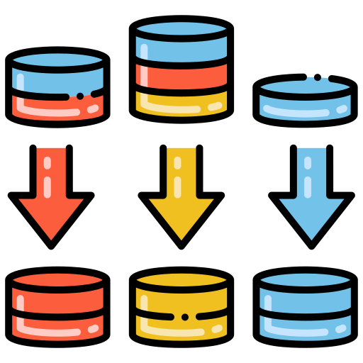



Normalization
Attributes * Weights
Propose Location
Helps to bring the selected attributes to the same scale
We multiply the scaled attributes with their respective weights
Otter Tail is our proposed location after ranking
Weights
Score & Ranking
Selecting weights for each attribute based on the importance of the attribute
Ranking the final score from highest to lowest

Slide 9
Attribute Selection
Proposed Location
Self-Serve Dashboard
This is where we finalized our parameters after iterating through the several datasets and attributes at our disposal.
Using the composite score we rank the counties from highest to lowest score and pick the best county.
A self-serve dashboard to adjust weights of the attributes and view dynamic county rankings.
Methodology
Conclusive Evidence
Combining all the selected parameters along with their weights to create a composite score.
Here emphasizing on why the county selected is in fact the best option

Slide 10
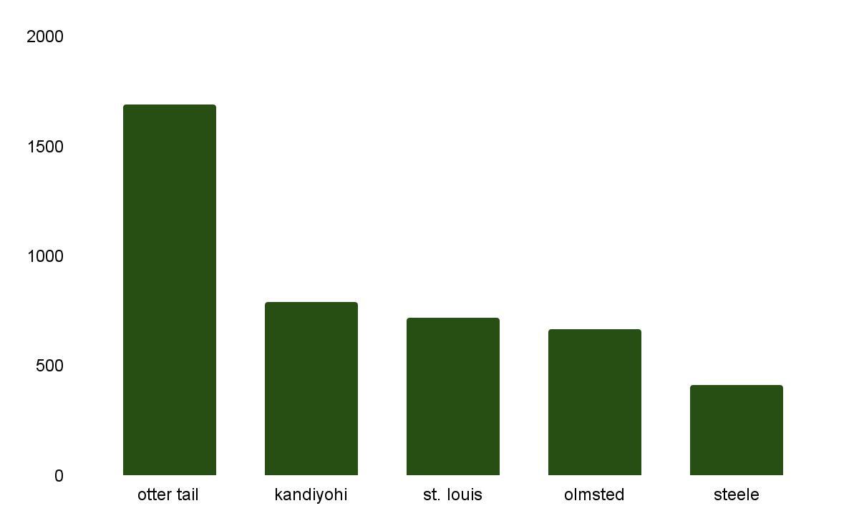
Otter Tail has the most number of small scaled farms (0$-49999$)

Slide 11
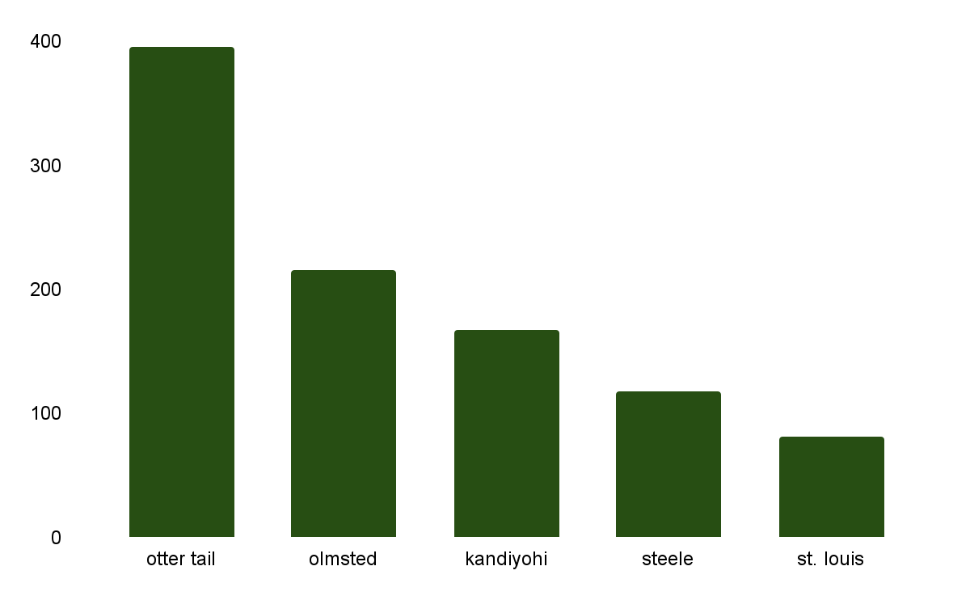
Otter Tail has the most number of medium scaled farms
(50000$-249000$)

Slide 12
Otter Tail is the best location to start a new warehouse and the below matrix compares counties for each parameter
 |  | OTTER TAIL |  | OLMSTED |  | KANDIYOHI |  | ST. LOUIS |  | STEELE
Attributes | Weights | Value | Rank | Value | Rank | Value | Rank | Value | Rank | Value | Rank
Small Farm Lands (count)) | 0.25 | 1,693 | 1 | 669 | 4 | 791 | 2 | 718 | 3 | 411 | 5
Medium Farm Lands (count) | 0.25 | 396 | 1 | 215 | 2 | 168 | 3 | 82 | 5 | 118 | 4
Small Farm land Avg Revenue ($) | 0.15 | 7,677 | 3 | 8,072 | 2 | 4,889 | 5 | 8,407 | 1 | 4,968 | 4
Medium Farm land Avg Revenue ($) | 0.15 | 120.8K | 4 | 126.2K | 3 | 126.9K | 2 | 99.1K | 5 | 131.7K | 1
Organic Farm Land (Count) | 0.15 | 20 | 1 | 8 | 2 | 7 | 3 | 4 | 5 | 5 | 4
Supplier Density | 0.05 | 0 | 4 | 1 | 3 | 5 | 2 | 8 | 1 | 0 | 4
Composite Ranking |  |  | 1 |  | 3 |  | 2 | 4 |  | 4.3 | 5

Slide 13



Our goal was to choose a county that provides the best opportunity at sustainable economic growth while empowering marginalized farmers and we believe succeeding at that due to the following
Otter Tail are runaway with the most small scaled and medium scaled farms in comparison to the other 4 counties
Otter Tail has slightly lesser but comparable average revenue per farm for both small and medium scale farmers. This shows that they have the potential to improve and improve their average per farm
Otter Tail has the most organic farms by a large margin in comparison to the other 4 counties
Otter Tail is has the highest composite score based on the above attributes and is the ideal county to start the new warehouse location

Slide 14
Attribute Selection
Proposed Location
Self-Serve Dashboard
This is where we finalized our parameters after iterating through the several datasets and attributes at our disposal.
Using the composite score we rank the counties from highest to lowest score and pick the best county.
A self-serve dashboard to adjust weights of the attributes and view dynamic county rankings.
Methodology
Conclusive Evidence
Combining all the selected parameters along with their weights to create a composite score.
Here emphasizing on why the county selected is in fact the best option

Slide 15
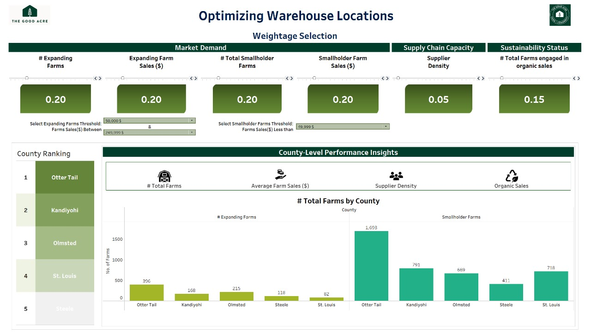
Selecting Warehouse Location
To make our solution even more adaptable, we developed a self-serve dashboard. This tool allows users to adjust the weights assigned to each parameter dynamically.
For example, if a user prioritizes proximity to demand centers over farm density, they can tweak the settings and see how the rankings change.

Slide 16
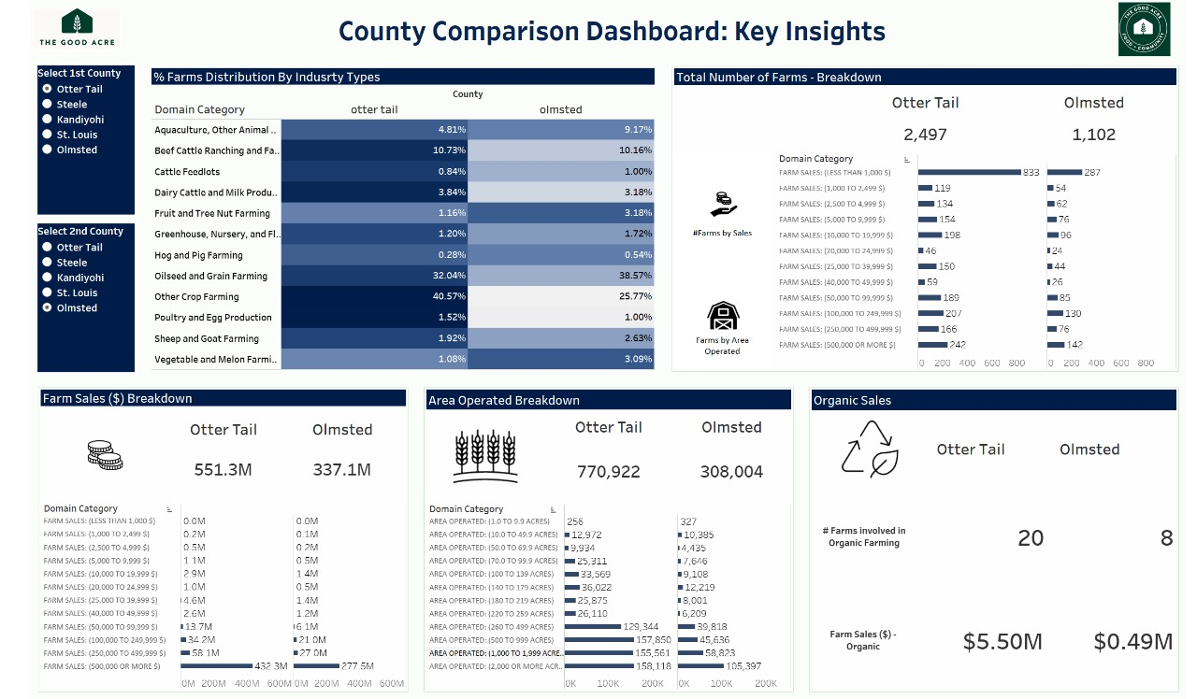
Comparative Analysis View
This additional view gives the user flexibility to compare counties against each other by comparing their attributes.
The view provides information on attributes beyond the 6 attributes that we focused on during our methodology. This enables the users to use the dashboard beyond our existing methodology.

Slide 17
Thank you
Presented by Aurosikha
Rita
Aditya
Dhairya
Abhinav

