Slide 1
ENT303TC 2026/27 A1
U Use
Campus item access at SIP and XEC
Borrow, rent, buy or swap an item for a specific need.
A working local prototype with demand still to validate.
6 October 2026 | Group details to confirm
1 / 6
Notes:
ENT303TC A1. Exactly six slides, including this cover, with no appendix. Prepared 6 October 2026. Group number and official member identifiers require confirmation. All planning values are assumptions. H1, handbook pp. 5-6.

Slide 2
ENT303TC 2026/27 A1
The problem hypothesis
A short-term need
Coordination adds friction
A student needs an item for an event, a trip or a project.
Availability, the meeting place and return terms require agreement.
Buying may be unnecessary. Borrowing depends on finding an owner with compatible dates.
Some students prefer to keep their location private.
Hypotheses from product planning. No completed participant study is claimed.
2 / 6
Notes:
We hypothesise that coordination, not only item discovery, creates friction. We will ask about the last real incident before presenting the solution. We have no verified interview quotes or market validation yet.

Slide 3
ENT303TC 2026/27 A1
Market and alternatives
26,000+ XJTLU students provide institutional context.
Initial scenario: invite 60-180 reachable students over four weeks.
Base case: 120 invited, 18 activated, about 7 completed trades.
Alternative | Established purpose | U Use hypothesis
Goofish | Second-hand marketplace | Campus date coordination
Renrenzu | Rental marketplace | Peer access for a short need
Aihuishou | Recycling and resale | Local temporary use
Scenario assumptions, not a forecast. Campus-specific reachable population remains unverified.
3 / 6
Notes:
S1: https://www.xjtlu.edu.cn/en/overview, updated May 2026, checked 6 October 2026. 26,000+ is institution-wide and must not be substituted for reachable SIP/XEC students. S2 https://www.goofish.com/; S3 https://www.rrzu.com/home/index; S4 https://www.aihuishou.com/. We compare their stated purpose, not unverified feature absences. Scenario: 120*15%=18 activated, 18*40%=7.2 expected completed transactions over four weeks. Model outputs are expectations, not observed counts.

Slide 4
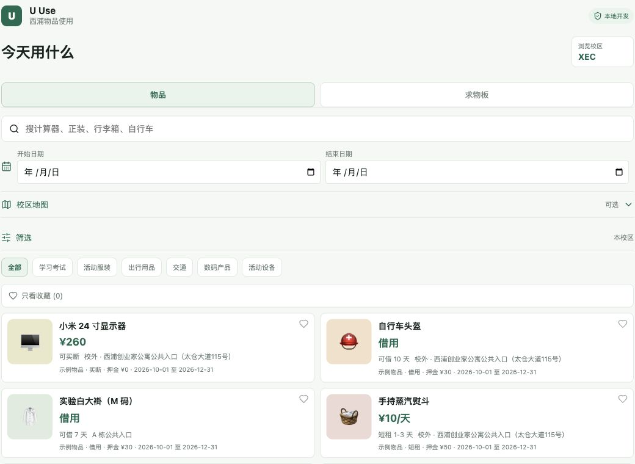
ENT303TC 2026/27 A1
The product
Date-aware discovery checks item availability.
The needs board lets an owner respond to a specific request.
Each user can review their own imported timetable.
Maps and nearby sharing remain optional.
Actual local interface. Displayed inventory and accounts are synthetic demo data.
4 / 6
Notes:
Local code demonstrates discovery, needs, personal schedule review, booking and messaging. OCR requires user correction. Student email verification is implemented, but production SMTP/HTTPS remain deployment tasks. No SSO, escrow or insured transactions are claimed.

Slide 5
ENT303TC 2026/27 A1
Business model and feasibility
A narrow first service
Economics to test
Students with occasional needs and owners of idle items.
Base case GMV: CNY 216 over four weeks.
Recruit through a permitted class or society channel.
Pilot fee revenue: CNY 0. Refundable deposits excluded.
Free pilot. Manual moderation and dispute review.
Planned cash cost: CNY 180, plus team time.
A later 5% fee would yield CNY 10.80, before costs.
Illustrative assumptions. No paying users, signed partners or institutional endorsement.
5 / 6
Notes:
BMC in support dossier covers all nine blocks. Economics: 7.2 expected transactions*30 average transaction consideration=216 GMV. Refundable deposits, free borrowing and swap values are excluded. Pilot fee=0. Optional 5% fee later is a hypothesis, not an implemented charge. Planned hosting 60+email 20+materials 50+contingency 50=180. Labour valued separately at 7 people*2 h/week*4 weeks*20 CNY/h=1120, opportunity cost only.

Slide 6
ENT303TC 2026/27 A1
Validation and next decisions
Evidence today
Before A1 submission
Local code, regression tests and a working demo.
Pilot the research instrument, then retain 3-5 anonymised interactions.
Official market sources and a transparent scenario model.
Trace three insights to raw evidence and revise the concept choice.
User demand, task success and willingness to pay remain untested.
Rehearse, verify the group details and retain both LMO receipts.
A1 deadline: 6 November 2026, 23:59. Six slides total, no appendix.
6 / 6
Notes:
Team: 郭宇璇（Rita）, 汪睿, 黄禹轩, 汤鋆秋, 毛相宜, 黄俊杰, 李元龙. Responsibilities are proposed, not verified contribution records. H1 weekly checkpoints pp. 3-5 and assessment p.6. Separate assessment brief takes precedence. Prepared 6 October 2026. A1 must refresh with actual research before submission.

