Slide 1
ENT303TC 2026/27 A3
U Use
Campus item access at SIP and XEC
A venture proposal built around a useful first transaction.
A3 working deck, prepared 6 October 2026.
6 October 2026 | Group details to confirm
1 / 12
Notes:
A3 has 12 slides including the cover. Due 21 March 2027 at 23:59 Beijing, live presentation 22-26 March. This is a current baseline, not evidence of future validation. Refresh all research, model and release facts before the 2027 submission.

Slide 2
ENT303TC 2026/27 A3
Problem and audience
Students with an occasional need
Owners with a usable item
An event, project or trip creates a time-limited need.
An owner needs clear dates and return terms.
The student may prefer borrowing or renting to ownership.
Both parties need an acceptable handoff without public location tracking.
Persona and problem statements are hypotheses pending primary research.
2 / 12
Notes:
The two-sided marketplace needs both relevant supply and demand. Initial categories should follow real requests rather than an arbitrary large catalogue. Dormitories are off-campus. XEC uses named A-G buildings, with no invented generic teaching-building pins.

Slide 3
ENT303TC 2026/27 A3
Evidence and remaining gaps
Claim | Current basis | Next evidence
Workflow operates locally | Code and isolated tests | Real-device pilot
Students experience friction | Planning hypothesis | Recent incident interviews
Differentiation improves a task | Implemented features | Comparative usability test
Economics can sustain service | Scenario model | Observed costs and trades
Automated tests establish technical behaviour, not demand or participant satisfaction.
3 / 12
Notes:
E1 scripts/test-bookings.mjs, test-timetable.mjs, test-session.mjs, test-discovery.mjs, test-messages.mjs, test-api.mjs. No research participants, survey percentages, revenue or university endorsement are fabricated.

Slide 4
ENT303TC 2026/27 A3
Bottom-up market scenario
Institutional context: 26,000+ XJTLU students.
Provisional serviceable cohort: 60-180 reachable invitees.
Base: 120 invitees, 15% activation, 40% completing a trade.
Expected base output: 7.2 trades and CNY 216 GMV in four weeks.
Scenario, not observed traction. Zero demand remains a possible outcome.
4 / 12
Notes:
S1 https://www.xjtlu.edu.cn/en/overview. Assumed reachable cohort is a provisional pilot SAM proxy, not a measured campus SAM. SOM proxy is activated and transacting users. A monetised national TAM cannot be defensibly calculated without additional source data and usage assumptions. Model deliberately avoids that unsupported figure. Free borrowing, swaps and refundable deposits do not contribute to GMV.

Slide 5
ENT303TC 2026/27 A3
Competitors and substitutes
Alternative | Role in the task | What to compare
Goofish | General second-hand discovery | Time to find and agree a handoff
Renrenzu | Access through rental listings | Duration, total cost and terms
Aihuishou | Recycling and resale | Ownership and fulfilment process
Friends or a class group | Informal borrowing substitute | Reach, clarity and follow-up
Feature absence claims require a documented task-level review.
5 / 12
Notes:
S2 https://www.goofish.com/, S3 https://www.rrzu.com/home/index, S4 https://www.aihuishou.com/. Informal borrowing is a conceptual substitute, not a measured claim about a specific student group. Compare the same item/date task, consent to any group observation and retain dated notes.

Slide 6
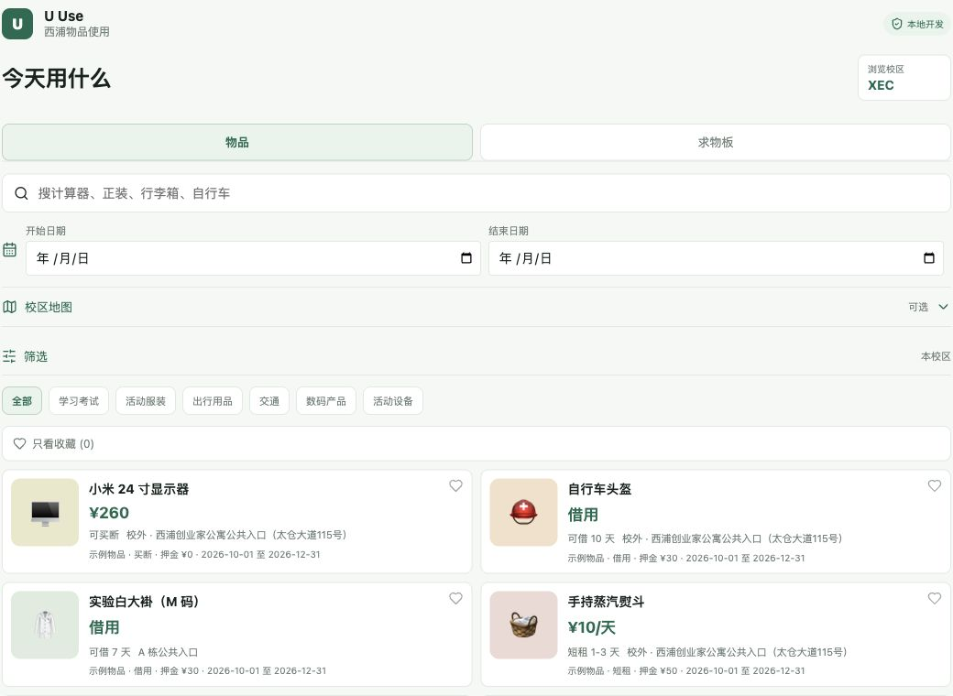
ENT303TC 2026/27 A3
Date-aware discovery
Choose the dates when the item is needed.
Filter out unavailable periods and overlapping bookings.
Use specific campus meeting labels.
Keep location sharing optional.
Actual prototype with synthetic inventory. Availability still depends on owners maintaining listings.
6 / 12
Notes:
Scheduling and booking checks operate on the server within transactions. TAICANG remains an internal identifier displayed as XEC. The map is collapsed by default and loads external tiles only when opened. No precise real-user coordinates appear in this demo.

Slide 7
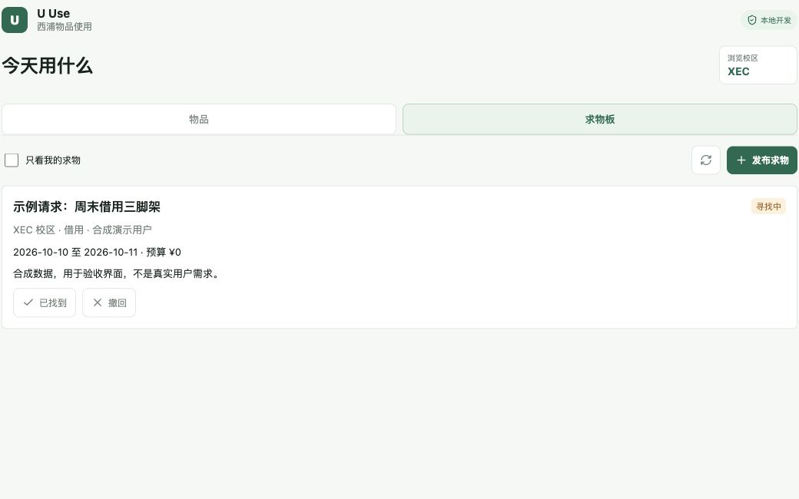
ENT303TC 2026/27 A3
The needs board
Post a dated request with campus and budget.
Owners respond with their own eligible item.
Review the offer before beginning a booking.
Measure useful responses and completed trades.
Request-first matching is implemented. Its effect on liquidity remains a testable hypothesis.
7 / 12
Notes:
Needs responses enforce item ownership, budget, campus, expiry and duplicate checks. Discovery and conversation use synthetic fixtures for demonstrations. Success metric: useful responses / eligible real requests within 48 hours. Do not count test requests as traction.

Slide 8
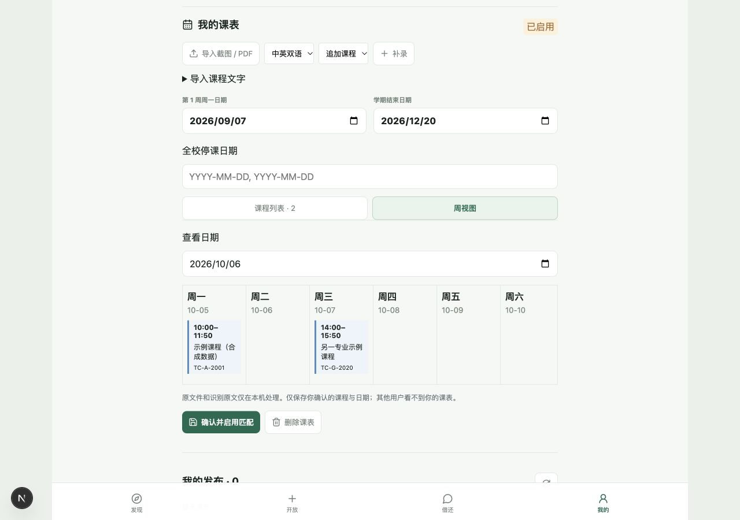
ENT303TC 2026/27 A3
Personal schedules and privacy
Import a screenshot or PDF, or add classes manually.
Confirm each person's term, weeks and exceptions.
Suggest a mutually available time and meeting place.
Share neither the full timetable nor live GPS by default.
OCR can misread a table. Manual review remains mandatory.
8 / 12
Notes:
Each user has an independent timetable. The supplied seven-course screenshot is only a format example. Term start is individual. 7 September 2026 is Monday but cannot be treated as every user's term start. Timetables are private. Approximate nearby presence uses an explicit opt-in and short expiry. This is privacy-aware design, not a legal-compliance certification.

Slide 9
ENT303TC 2026/27 A3
Engineering and operating limits
Implemented safeguards
Before public deployment
Student-email verification and private session cookies.
Production SMTP, HTTPS and PostgreSQL acceptance.
Ownership checks, stock/date validation and retry deduplication.
Backup restore, real-device tests and moderator ownership.
Photo review, participant confirmation and disputes.
Payment and deposit policy reviewed with appropriate support.
Stable chat and notification history.
A controlled release with incident reporting.
No SSO, payment escrow, insured trades or zero-bug guarantee.
9 / 12
Notes:
Verified local tests do not certify the external SMTP provider, live PostgreSQL configuration, real campus GPS accuracy or operational support capacity. Keep the existing deployment guide and run its acceptance checks. Off-platform payments require both parties' confirmation and cannot be guaranteed by the application.

Slide 10
ENT303TC 2026/27 A3
Business model and costs
Nine-block service model
Four-week base scenario
Segments: occasional users and item owners.
GMV CNY 216. Pilot revenue CNY 0.
Value: compatible dates and a clear local agreement.
Planned cash cost CNY 180.
Channels: permitted classes and societies.
Team time 56 hours, assumed value CNY 1,120.
Activities/resources: moderation, code and evidence.
Later 5% fee: CNY 10.80 before costs.
Partners: prospective, none signed.
Economics favour a small supported service.
Relationship: responsive support. Costs and revenue are assumptions, not actuals.
10 / 12
Notes:
Model provides complete nine-block BMC in dossier. Relationships: clear terms and manual help. Inputs in Market_and_Costs.xlsx. Planned cash expense=60 hosting+20 email+50 materials+50 contingency. Economic contribution includes assumed labour opportunity cost. Fee-bearing GMV excludes deposits, swaps and free borrowing.

Slide 11
ENT303TC 2026/27 A3
Pilot, decision gates and risks
Question | Proposed gate | Response if unmet
Can users finish the key task? | At least 4 of 5 finish unaided | Fix the flow before recruitment
Can real requests find supply? | 3 useful replies within 48 hours | Reduce categories or change service
Can initial trades complete? | 3 completed pilot trades | Study failures, avoid paid growth
Can the team operate safely? | Named moderator and restore test | Delay public launch
Decision gates are planning judgments, not statistically representative findings.
11 / 12
Notes:
Pilot gates require independent authentic users and raw records. Three completed trades indicate initial fulfilment, not retention; repeat use requires separately observing returning participants. At 5 users, report counts not campus-wide percentages. Pause for severe privacy incidents, unresolved losses, inability to moderate or missing production controls. Stop broad marketing until an actual fulfilled need can be demonstrated.

Slide 12
ENT303TC 2026/27 A3
Team and next commitments
Seven-member team
Resources requested
Rita: product coordination. Wang Rui: presentation.
Access to a permitted recruitment channel.
Huang Yuxuan: evidence. Tang Yinqiu: market model.
Mentor review of assumptions and operating boundaries.
Mao Xiangyi: positioning. Huang Junjie: research.
Five volunteers for the first consented usability round.
Li Yuanlong: competitor review.
A4 reflections based on each member's actual work.
Proposed role allocation requires team confirmation. A3 due 21 March 2027, 23:59 Beijing.
12 / 12
Notes:
Names supplied by the user: 郭宇璇（Rita）, 汪睿, 黄禹轩, 汤鋆秋, 毛相宜, 黄俊杰, 李元龙. No signatures, participant consent, contribution history or institutional support claimed. A4 due 16 April 2027, individual. Official word count and detailed assessment rubric are absent from the handbook and require the separate brief.

