Slide 1

SQL analysis of Hotel Data
A research project by RITA BEHARA
ID No. 7073

Slide 2

Contents
Objective
Data Analysis
Table analysis
Important factor to optimize business
Findings
Conclusion

Slide 3
Objective
The objective of this analysis is to identify key
business insights from hotel and city data from MakeMyTrip.
The primary focus is to determine the factors that
affect business performance such as hotel prices,
tax implications, reviews, ratings and revenue.
Specifically, this analysis aims to:
Assess the distribution and affordability of hotel prices.
Calculate and rank cities based on total hotel revenue (price + tax).
Understand hotel ratings, reviews and customer preferences.
Identify opportunities for optimizing business operations based
on revenue insights.

Slide 4
Data Analysis
For analyzing the data, various factors affecting the business(i.e. the important attributes) should be listed out.
In this case study, there are 2 tables hotels (consisting of various details) and city (consisting of city code and city name which the hotel is located).

Slide 5
Table analysis
This dataset consists of 2 tables
Table 1 – “Hotels” and Table 2 – “City”
Table 1 consists of 580 different hotels data like (city_code,Hotel_Name,Rating, Rating_Description, Reviews, Star_Rating, Location, Nearest_Landmark, Distance_to_Landmark,Price,Tax) across 6 different cities.
Table 2 consists of city name and city code.

Slide 6
Important factor to optimize business
1. Basic Hotel Statistics
Hotel Prices and Affordability
Revenue and Tax Insights
Hotel Reviews & Popularity
Hotel Ratings & Customer Feedback
Advanced Insights and Comparisons
Percentages and Summaries

Slide 8

Total Number Of Hotels in Each City
INTERPRETATION
Delhi has the highest number of hotels, with 89.
Hyderabad has the lowest number of hotels, with 67.
Bangalore and Mumbai are tied with 86 hotels each.
Kolkata is slightly behind, with 80 hotels.
Chennai has fewer hotels compared to the other metro cities, with 77 hotels

Slide 9

Number of Hotels by Star Rating in
Each City
INTERPRETATION
Delhi has the highest number of 5* hotels.
Chennai has the lowest number of 5* hotels.
Bangalore has the highest number of 4* hotels.
Kolkata has highest number of 3* hotels.
Only Chennai and Hyderabad contents 2* hotels.

Slide 10

number of hotels by rating description in
each city
INTERPRETATION
Kolkata has the highest number of VERY GOOD rating hotels.
Mumbai has the highest number of EXCELLENT rating hotels.
Only Hyderabad and Delhi contents few number of AVERAGE rating hotels.

Slide 12

Average Price of Hotels in each city
INTERPRETATION
Mumbai has very high average price.
Kolkata has lowest rank average price.
Chennai and Delhi has tied in average price.

Slide 13
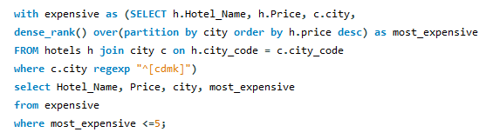
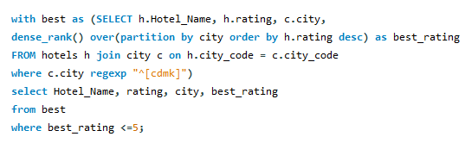
Top 5 Most Expensive Hotels in big 4 metropolitan city
Top 5 Best Hotels in big 4 metropolitan city

Slide 14
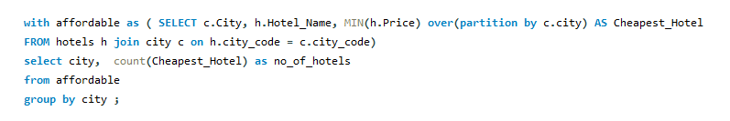
no. of Cheapest Hotel in Each City
INTERPRETATION
Delhi has highest number of cheapest hotels.
Hyderabad has lowest number of cheapest hotels.
Bangalore and Mumbai has tied in cheapest price of hotels.

Slide 16
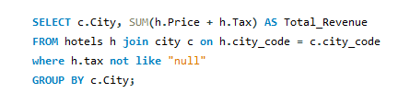
Total Revenue for Each City (Price + Tax)
INTERPRETATION
Kolkata has highest number of revenue earnings.
Mumbai has lowest number of revenue earnings.
Bangalore and Delhi and Hyderabad has mostly similar in revenue earnings.

Slide 17
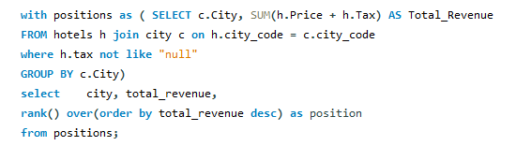

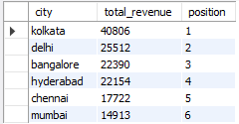
Ranking based on revenue
Hotels with Tax Information Missing

Slide 19
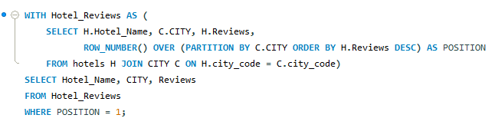
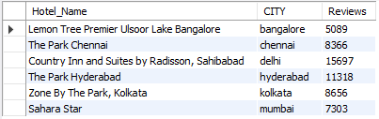
the hotel with the highest number
of reviews in each city

Slide 20
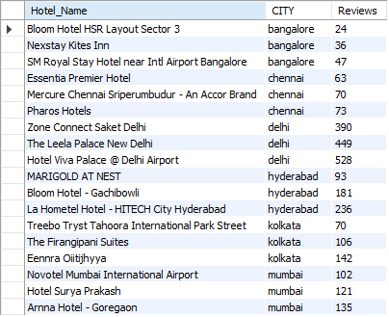
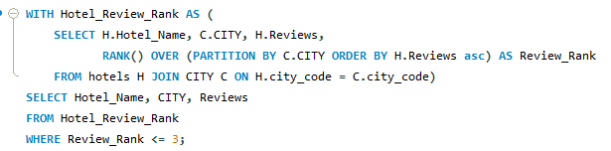
Retrieve the top 3 most reviewed hotels
in each city

Slide 22
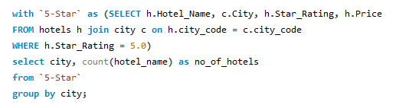
List of Hotels with a 5-Star
Rating in each city
INTERPRETATION
Delhi has the strongest luxury hotel market, followed by Mumbai and Bangalore.
Chennai has a significant luxury market but slightly smaller than the top three cities.
Hyderabad and Kolkata are developing luxury markets, with fewer 5-star hotels, indicating a greater focus on affordability or a growing market for luxury accommodations.

Slide 23

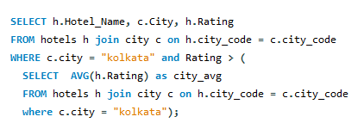
Hotels with Rating Greater Than 4.0 in Bangalore, Chennai, and Hyderabad
Find Hotels with Rating Above the City Average in kolkata

Slide 25

Calculate Price Range (Min and Max Price)
for Each City
INTERPRETATION
Hyderabad and Delhi have the lowest minimum prices, making them the most affordable options overall.
Bangalore and Mumbai seem to have the most expensive high-end options.
The cities show a wide disparity between low and high-end prices, indicating that within each city, there are options that cater to both budget-conscious consumers and those looking for premium offerings.

Slide 26
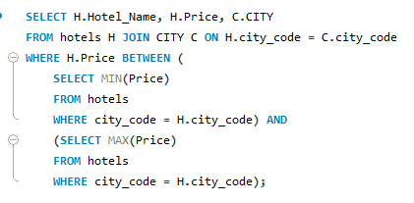

List Hotels Whose Prices are Between
the Minimum and Maximum Price
in Their City
Rank Hotels by Price in Each City Using Window Functions

Slide 28
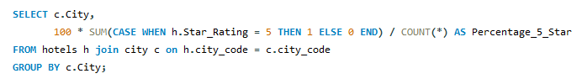
Calculate the Percentage of 5-Star Hotels
in Each City
INTERPRETATION
Bangalore has a solid presence of 5-star hotels, likely reflecting the international corporate traffic due to its position as a tech hub.
Hyderabad and Kolkata have lower percentages of 5-star hotels, indicating that their hotel markets may focus more on affordable or mid-range accommodations, though both cities still offer few luxury options.
Delhi leads in luxury accommodation options, followed by Mumbai. These two cities stand out as the primary destinations for high-end travelers.

Slide 29

Calculate the Average Price of Hotels
Grouped by Rating Description
INTERPRETATION
Mumbai is the most expensive city across all hotel rating categories, reflecting its premium market.
Bangalore and Chennai also show higher pricing in premium categories, driven by business travel.
Delhi maintains competitive pricing in both mid-range and luxury categories, but its budget hotels are still relatively expensive.
Hyderabad and Kolkata offer more affordable hotel options across all categories, making them attractive destinations for budget-travelers.

Slide 30
FINDINGS
The revenue calculation for each city reveals significant differences, with some cities generating more from their hotels due to higher prices and taxes
Cities with higher hotel prices and complete tax data rank higher in total revenue, allowing for targeted business strategies in top-performing cities.
There's variation in hotel pricing across different cities, with a few cities having a concentration of expensive hotels, while others offer more budget-friendly options.
Some hotels have missing tax information, which affects the accuracy of total revenue calculation and could potentially hide important revenue insights.
Cities with more 5-star or highly-rated hotels tend to have higher total revenue, indicating that customer satisfaction and hotel quality correlate with financial performance.

Slide 31
CONCLUSION
The analysis highlights the importance of pricing and tax strategies in driving hotel revenue.
Cities with higher average hotel prices and comprehensive tax reporting show stronger revenue performance.
Furthermore, enhancing customer satisfaction through better hotel ratings and service can lead to increased revenue.
Optimizing hotel pricing strategies and ensuring all tax data is captured will be crucial for further business improvement.

