Slide 1
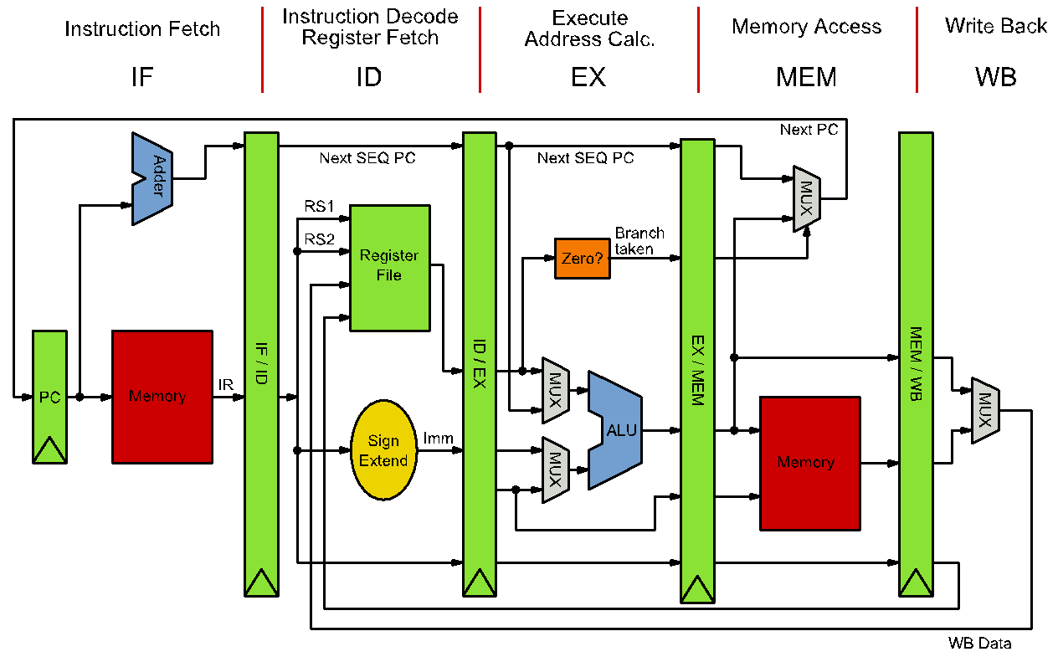
Preparing Your Poster for the 13th IEEE CASS Rio Grande do Sul Workshop
First Author, Second Author, and Third Author
Introduction
Suggested font sizes
Posters should be prepared over an A4 page (21 x 29.7 cm) PDF; the event organization will take care of the printing process;
Stick to the template in the following areas: main title, author list, affiliation and contact sections;
The remaining can be freely modified to suit your needs.
Element | A4 Font size | A0 resulting Font size
Main Title | 24 | 96
Section Title | 16 | 64
Section Text | 14 | 56
Author list | 14 | 56
Affiliation | 9 | 36
Sources | 6 | 24
Suggested Structure
Introduction
Methodology
Results
Conclusions
Tips
Source: Wikipedia
Go straight to the point;
Be simple and clear in your statements;
Prefer images to text;
Credit your sources;
Remember you’ll be there to provide further explanation
Logo 1
Logo 2
Affiliation
Graduate program or undergraduate course
Address information
Contact: name@name.com | website address
13th IEEE CASS Rio Grande do Sul Workshop – November 16-17, 2023 – Porto Alegre, Brazil

