Slide 1
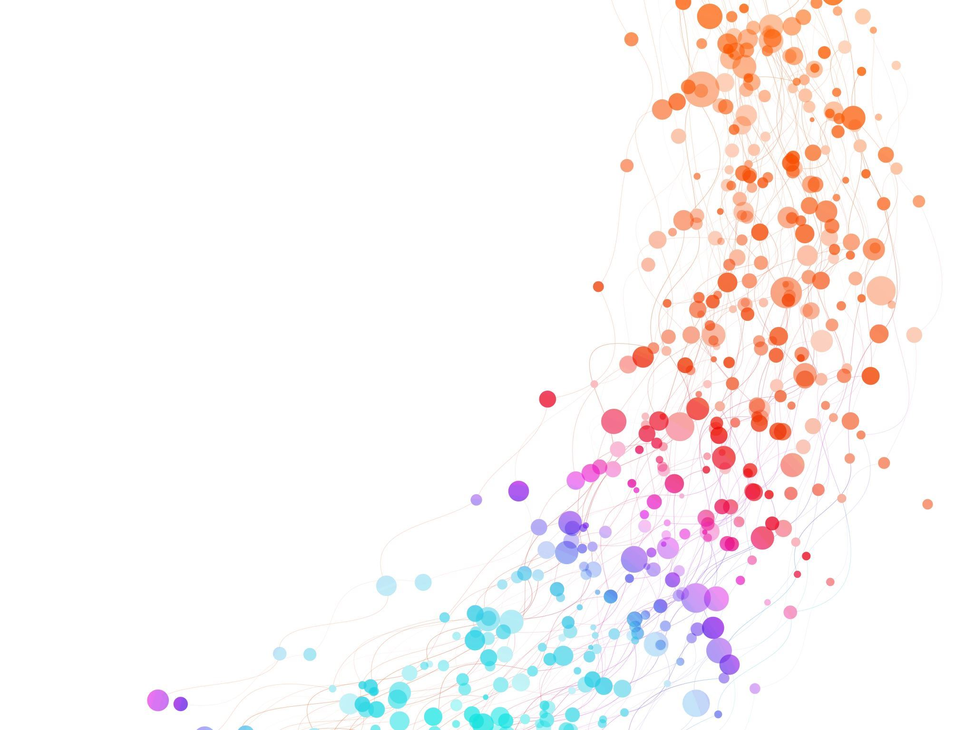
Customer Retention
Customer Retention use case
The factors that influence the online customers repeat purchase intention.Result indicate the e-retail success factors,which are very much critical for customer satisfaction.
Data Description
Customer satisfaction has emerged as one of the important factors that contribute for the success of online store.Five major factors that contributed to the success of an e-commerce store have been identified as :service quality,system quality,information quality,trust and net benefit. The task is to train a e-retail success, which are very critical for customer satisfaction.
Target
Our target is variable class which contains e-retail success factors,net benefit and repeated purchase of customer.

Slide 2
About the Columns:
1. (column no.6)How many times you have made an online purchase in the past 1 year: This Column Shows that how many times customer did the online purchase 2. (column no.24) User friendly Interface of the website: This Column shows that system quality rating.How user friendly the website is for customer. 3. (column no.27) Empathy (readiness to assist with queries) towards the customers: This Column shows that service quality provided to the customer.i.e.rating for customer queries resoluation. 4. (column no.28) Being able to guarantee the privacy of the customer: This Column shows the trust the customer will do on the website while purchasing any product. 5. (column no.35) Displaying quality Information on the website improves satisfaction of customers: This column shows the information quality i.e. information about the product how much the information about the products on the web site is reliable in context of quality,material,price,value for money. 7. (column no. 37)Net Benefit derived from shopping online can lead to users satisfaction: This column shows the rating for customer satisfaction for purchasing the products from the website.The maximum purchase rating ie.maximum sale .This is our Outcome Variable class.

Slide 3
Bar plot and observations
Check is there any null value present in our DataFrame the we did BarPlot
BarPlot:(1) Bar plot the User friendly Interface of the website with the Outcome i.e.Net Benefit derived from shopping online can lead to users satisfaction.
We can see the RepeatPurchase is equally distributed in the range of 0 to 2.8
We can see the System Quality is equally distributed in the range of 0 to 4.2
We can see the ServiceQuality is equally distributed in the range of 0 to 4.3
We can see the Customer Trust is equally distributed in the range of 0 to 4.5
We can see the Information Quality is equally distributed in the range of 0 to 4.1
We can see the Outcome is equally distributed in the range of 0 to 4.4
We can see the User satisfaction is equally distributed with System Quality,Service Quality,Customer Trust,Information Quality. The Sale maximization is online purchase is highly depend on Customer Trust.If website guarantee the privacy of the customer is given then Sale can be maximize.4.5
After Customer Trust,Serive Quality contribute to the success of e-purchase and sale maximization.
We can see that User satisfaction is dependency on SystemQuality,Service Quality,CustomerTrust,Information Quality.

Slide 4
Then we check correlation between the variables.
Plot heatmap
OutCome of Correlation:
All the Columns of dataset is positively correlated with the target column. Max col :Customer Trust Min col :RepeatPurchase(in_last_1YR)

Slide 5
Outcome of describe of dataset:
From the above plotting we are determing mean,standard deviation,minimum and maximum value of each column.It help us further in data cleaning. 1.269 rows 2.6 cloumns RepeatPurchase(in_last_1YR): Outcome (User satisfaction): 1. Mean = 4.379182 2. std = 0.883775 3. max_value = 5.000000 4. min_value = 2.000000
1. Mean = 2.672862 2. std = 1.651788 3. max_value = 5.000000 4. min_value = 1.000000 System Quality: 1. Mean = 4.394052 2. std = 1.162586 3. max_value = 5.000000 4. min_value = 1.000000 Service Quality: 1. Mean = 4.464684 2. std = 1.080551 3. max_value = 5.000000 4. min_value = 1.000000 Customer Trust: 1. Mean = 4.591078 2. std = 0.660785 3. max_value = 5.000000 4. min_value =3.000000 Information Quality: 1. Mean = 4.286245 2. std = 0.789292 3. max_value = 5.000000 4. min_value = 3.000000 Outcome (User satisfaction): 1. Mean = 4.379182 2. std = 0.883775 3. max_value = 5.000000 4. min_value = 2.000000

Slide 6
Checking for outliers:
From the above outcome we can see that columns['RepeatPurchase(in_last_1YR)'] has maximum outliers columns['System Quality', 'Service Quality', 'Customer Trust', 'Information Quality']has less outliers and Outcome(User satisfaction) has min outliers.

Slide 7
Checking for the skewness
Outcome of the skewness:Skewness threshold is taken is -1.10.Columns which are having skewewss: System Quality Service Quality Customer Trust Information Quality Outcome(User satisfaction)

Slide 8
Then we will plot
Normal Distribution Curve¶
The data of the column is not normalised .The bulding blocks is out of the normalised curve. The normal distribution curve of Outcome is irrelevant.
The normal distribution shows that the data is skewed
Then did Datacleaning
After that we did remove the outliers present.
Then calculated percentage data loss

Slide 9
Then splitting the data set
Did Cross validtion score for logistic regression
since cross validation score accuracy score are almost same. We are heading with a good approch.

