Slide 1






Operating System
Mouse mode
NN Model1
Web Cam
Image
Keyboard mode
NN Model2
LSTM Model
Rest mode
Gesture Recognition
GUI Monitor
Notes:
在電腦眼裡的樣子

Slide 2
Operating System
One
Control mouse
Web Cam
Image
Most common label1
NN Model1
Which label
Scissor
Click
NN Model2
Close
LSTM Model
DoubleClick
Most common label2
Which label
Six
Change mode
Good
OK
Most common label3
Down
Scroll up
Scroll down
Last page
Mouse mode
Gesture Recognition
Notes:
在電腦眼裡的樣子

Slide 3
Operating System
Web Cam
Image
Pause/
Play
NN Model2
Most common label2
Scissor
LSTM Model
OK
Subtitle
NN Model1
Which label
Up
Volume up
Most common label3
Down
Volume down
Speed up
Most common label1
Clockwise
Six
Change mode
Which label
Close
forward
5 s
Counter clockwise
Speed down
Open
backward 5 s
Keyboard mode
Gesture Recognition
Notes:
在電腦眼裡的樣子

Slide 4
Operating System
Web Cam
Image
NN Model1
Most common label1
NN Model2
Do nothing
LSTM Model
No
Is label six?
Yes
Change mode
Most common label3
Most common label2
Rest mode
Gesture Recognition
Notes:
在電腦眼裡的樣子

Slide 5

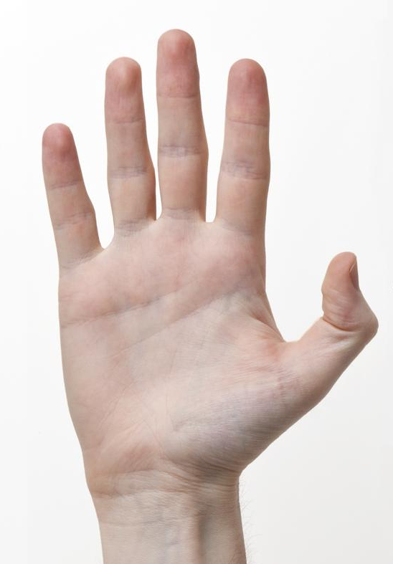
AI model
Input
X
Open
Output Y
AI Models
Gesture Recognition
Notes:
在電腦眼裡的樣子

Slide 6
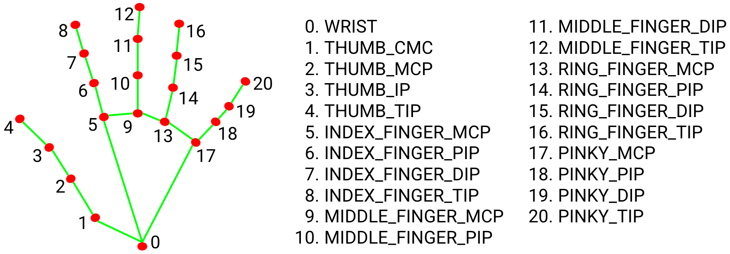

AI model
AI Models
DNN Model1
Deque1
0 | 1 | 2 | 3 | 4 | …
One | One | One | One | One | …
One
…
…
DNN Model2
Open
Deque2
0 | 1 | 2 | 3 | 4
Open | Open | Open | Open | Open
LSTM Model
(timestep=16)
Stop
Deque3
0 | 1 | 2 | 3 | 4
Stop | Stop | Stop | Stop | Stop
Notes:
在電腦眼裡的樣子

Slide 7
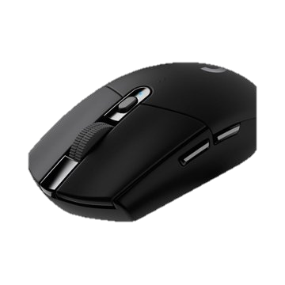
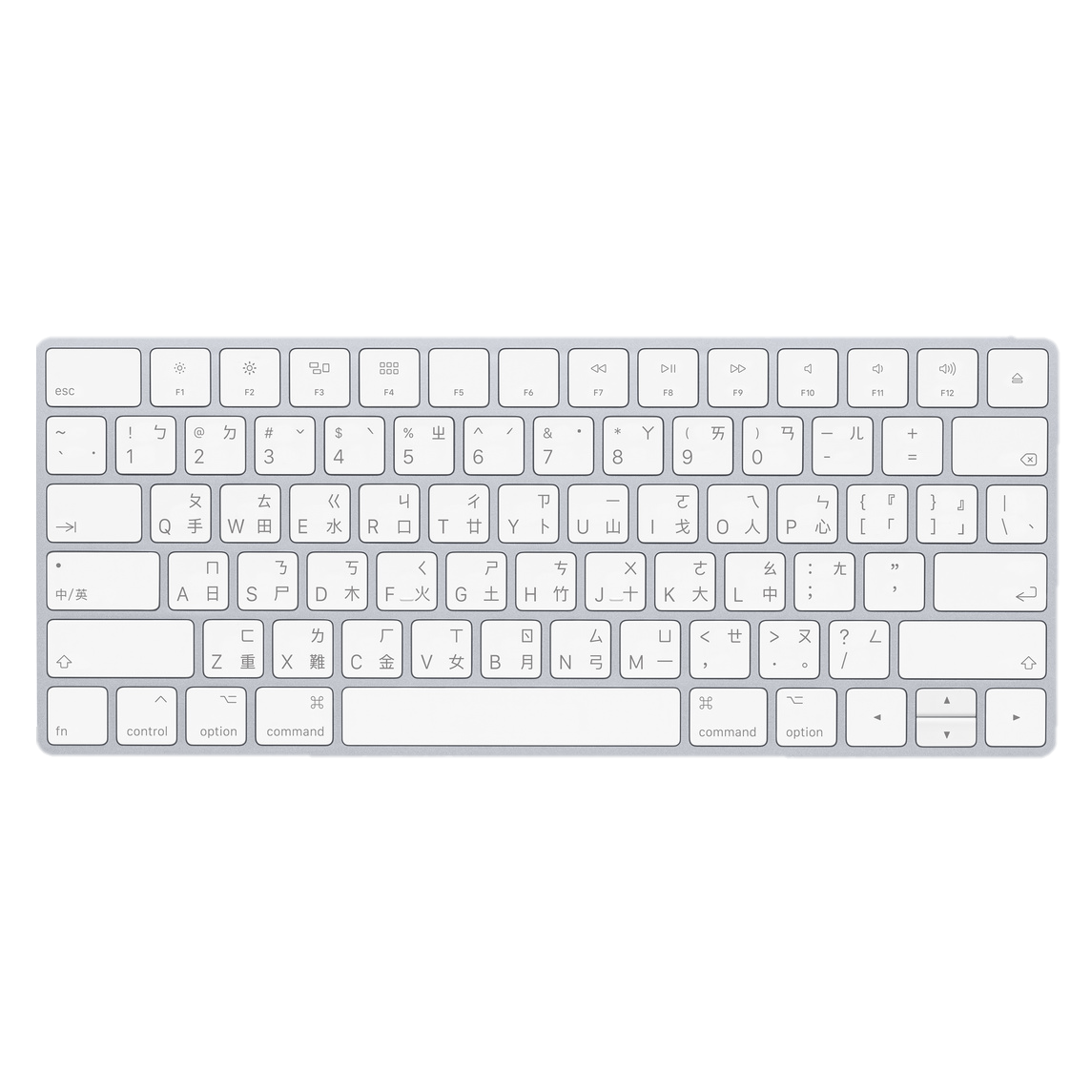
OperatingSystem
Mouse
Web Cam
Image
AI Model
Gesture Recognition
Instruction
Output Y
Instruction
Keyboard
Instruction
Monitor icon
`
Run
Run
Run
Notes:
在電腦眼裡的樣子

Slide 8
OperatingSystem
Mouse
Web Cam
Image
AI Model
Gesture Recognition
Output Y
Instruction
deques
0 | 1 | 2 | 3 | 4
open | open | open | open | open
0 | 1 | 2 | 3 | 4
open | open | open | open | open
0 | 1 | 2 | 3 | 4
open | open | open | open | open
Keyboard
Instruction
Instruction
Monitor icon
`
Run
Run
Run
Notes:
在電腦眼裡的樣子

Slide 9



OperatingSystem
Web Cam
Image
Mouse
AI Model
Gesture Recognition
Output Y
Instruction
Instruction
modes
Keyboard
Monitor icon
`
Run
Instruction
Run
Run
Notes:
在電腦眼裡的樣子

