Slide 1
A Brief History of Computers
By
Debdeep Mukhopadhyay
Assistant Professor
Dept of Computer Sc and Engg
IIT Madras

Slide 2
Pre-Mechanical Computing:
Notes:
Before humans invented “machines” to help them count or do math, they used whatever was at hand (pardon the pun!).
It’s possible the human facility in math is the most significant difference between us and other species. The capability is a two-edged sword. We’re able to dream up and implement advances in technology which have led to all kinds of wonderful improvements in our lives. But we’re also the one species which, because of this capability, has the power to destroy our world.
Now that’s a scary thought that should give us all pause…..

Slide 3
Mechanical computers
From
The Abacus
c. 4000 BCE
to
Charles Babbage
and his Difference Engine (1812)
Notes:
BCE (Before Common Era) is the now correct term in place of the more traditional BC (Before Christ). CE (Common Era) replaces AD (Anno Domini). After all, not everyone has a Christo-centric view of the world.

Slide 4
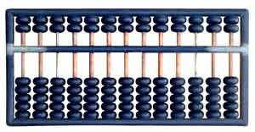
Mechanical computers:
The Abacus (c. 3000 BC)
Notes:
The abacus is still a mainstay of basic computation in some societies. Slide the beads up and down on the rods to add and subtract.

Slide 5
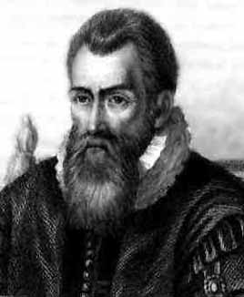
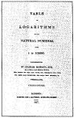
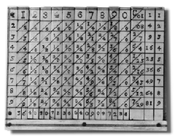
Napier’s Bones and
Logarithms (1617)
Picture courtesy IBM
Notes:
John Napier, a Scotsman, invented logarithms which use lookup tables to find the solution to otherwise tedious and error-prone mathematical calculations. To quote Napier himself:
Seeing there is nothing (right well-beloved Students of the Mathematics) that is so troublesome to mathematical practice, nor that doth more molest and hinder calculators, than the multiplications, divisions, square and cubical extractions of great numbers, which besides the tedious expense of time are for the most part subject to many slippery errors, I began therefore to consider in my mind by what certain and ready art I might remove those hindrances. And having thought upon many things to this purpose, I found at length some excellent brief rules to be treated of (perhaps) hereafter. But amongst all, none more profitable than this which together with the hard and tedious multiplications, divisions, and extractions of roots, doth also cast away from the work itself even the very numbers themselves that are to be multiplied, divided and resolved into roots, and putteth other numbers in their place which perform as much as they can do, only by addition and subtraction, division by two or division by three.

Slide 6
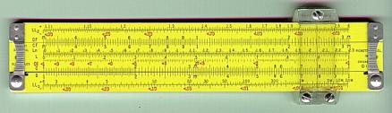
Oughtred’s (1621) and
Schickard‘s (1623] slide rule
Notes:
This is a slide rule from the collection of Phil Scholl whose homepage can be visited at http://www.angelfire.com/ego/philster/sliderule/main.html. The slide rule works on the basis of logarithms.

Slide 7
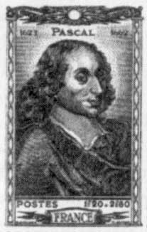
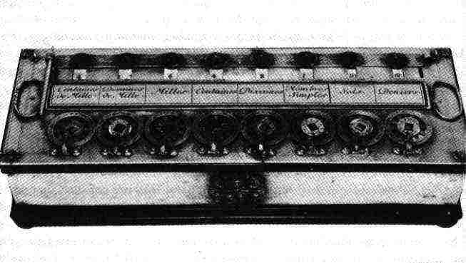
Blaise Pascal’s
Pascaline (1645)
Notes:
This famous French philosopher and mathematician invented the first digital calculator to help his father with his work collecting taxes. He worked on it for three years between 1642 and 1645. The device, called the Pascaline, resembled a mechanical calculator of the 1940's. It could add and subtract by the simple rotation of dials on the machine’s face.

Slide 8
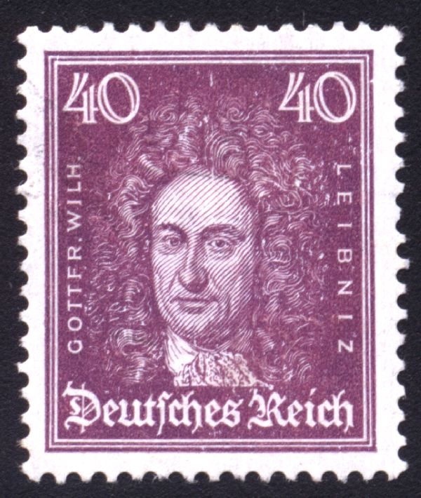
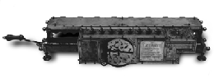
Gottfried Wilhelm von Leibnitz’s
Stepped Reckoner (1674)
Notes:
Leibnitz’s Stepped Reckoner could not only add and subtract, but multiply and divide as well. Interesting thing about the Stepped Reckoner is that Leibnitz’s design was way ahead of his time. A working model of the machine didn’t appear till 1791, long after the inventor was dead and gone.

Slide 9
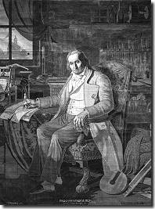
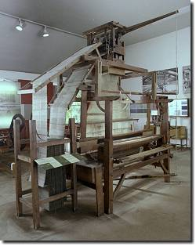
Joseph-Marie Jacquard and his punched card controlled looms (1804)
Notes:
Joseph-Marie Jacquard was a weaver. He was very familiar with the mechanical music boxes and pianolas, pianos played by punched paper tape, which had been around for some time. One day he got the bright idea of adapting the use of punched cards to control his looms. If you look carefully at the picture on the right, and those on the following slide, you can see a continuous roll of these cards, each linked to the other, the holes in them punched strategically to control the pattern of the weave in the cloth produced by the loom. All the weaver had to do was work the loom without needing to think about the design of the cloth. Brilliant! Jacquard revolutionized patterned textile weaving. His invention also provided a model for the input and output of data in the electro-mechanical and electronic computing industry.
The picture of Jacquard on the left, based on a copper portrait, was woven with the aid of one of his machines!

Slide 10
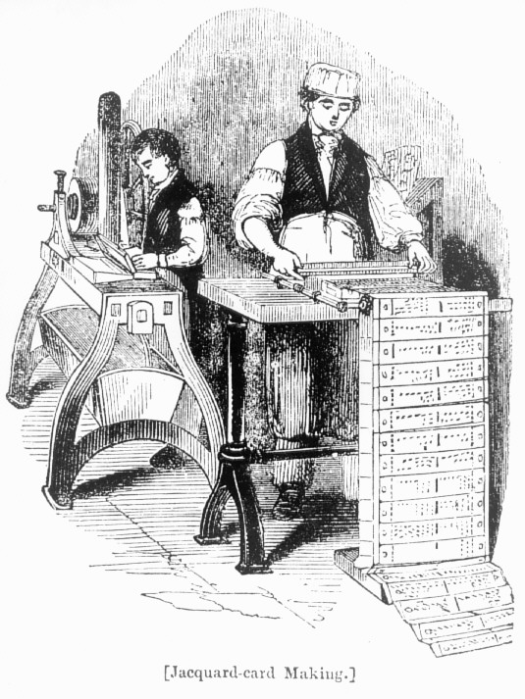
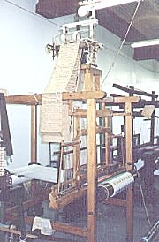
Preparing the cards with the pattern for the cloth to be woven
Notes:
Here you see Jacquard’s workers preparing the cards for the looms. The looms became known as Jacquard looms, and today one of the premier fabric manufacturers is named after Joseph-Marie Jacquard.

Slide 11
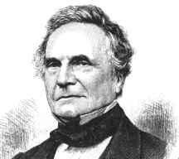
Charles Babbage (1791-1871)
The Father of Computers
Notes:
Charles Babbage is recognized today as the Father of Computers because his impressive designs for the Difference Engine and Analytical Engine foreshadowed the invention of the modern electronic digital computer. Try and get a biography of Babbage if you can. He led a fascinating life, as did all the folks involved in the history of computers. He also invented the cowcatcher, dynamometer, standard railroad gauge, uniform postal rates, occulting lights for lighthouses, Greenwich time signals, heliograph opthalmoscope. He also had an interest in cyphers and lock-picking, but abhorred street musicians.

Slide 12
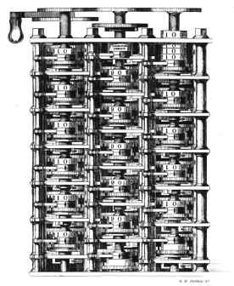
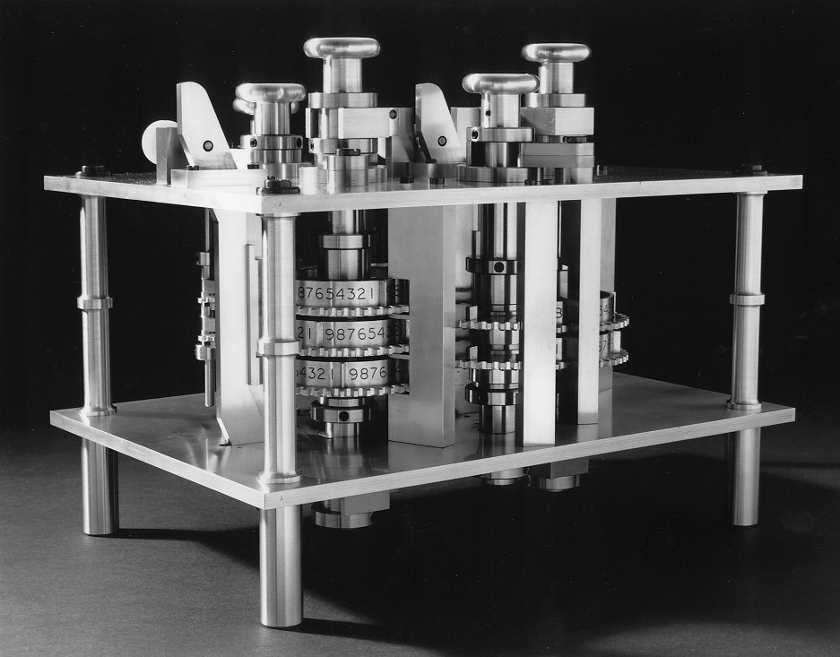
Charles Babbage’s Difference Engine
Notes:
The precision machine tooling that produced these intricate machines could not have been achieved in an earlier age. Babbage’s inventions were born of the advances in technology that accompanied the Industrial Revolution. The Difference Engine was never fully built. Babbage drew up the blueprints for it while still an undergrad at Cambridge University in England. But while it was in process of being manufactured, he got a better idea and left this work unfinished in favor of the Analytical Engine illustrated on the next slide. The Analytical Engine was eventually built completely in the latter half of the 19th century, by Georg and Edvard Schuetz as per Babbage’s blueprints. Film footage exists of the machine in operation, and it is truly a sight to behold, a testament not only to Babbage’s genius, but also to the manufacturing prowess of the age.

Slide 13
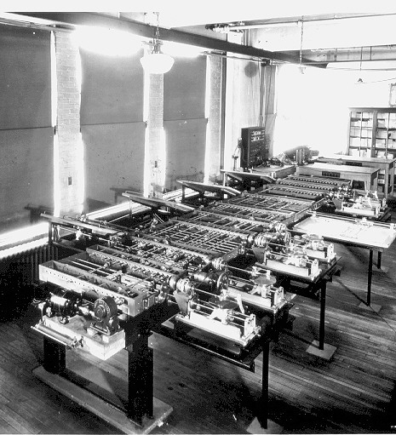
Charles Babbage’s Analytical Engine
Notes:
Beautiful display of man’s power of thought

Slide 14
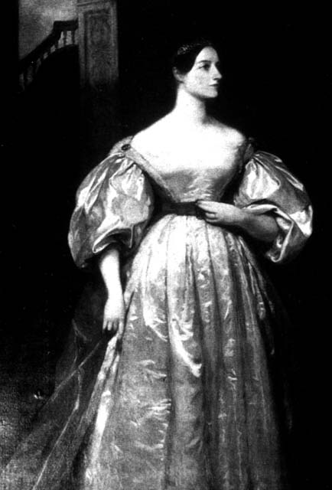
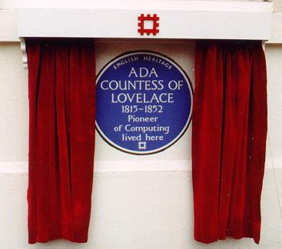
Lady Augusta Ada_x000b_Countess of Lovelace
Notes:
Babbage owes a great debt to Lady Augusta Ada, Countess of Lovelace. Daughter of the famous romantic poet, Lord Byron, she was a brilliant mathematician who helped Babbage in his work. Above all, she documented his work, which Babbage never could bother to do. As a result we know about Babbage at all. Lady Augusta Ada also wrote programs to be run on Babbage’s machines. For this, she is recognized as the first computer programmer. Remember that guys. Women are just as talented as men when it comes to math, science, and engineering, and society should recognize that and do its utmost to encourage girls to get into these important, lucrative and creative fields.

Slide 15
Electro-mechanical computers
From
Herman Hollerith’s
1890
Census Counting Machine
to
Howard Aiken
and the Harvard Mark I (1944)
Notes:
Electricity was discovered long before it was actually named as such. One Sir Thomas Browne is supposed to have come up with the term “electricity”. It was a while before electricity was used to power computing machines. This section tells that story.

Slide 16
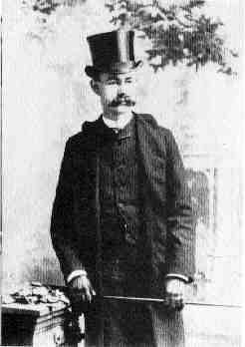
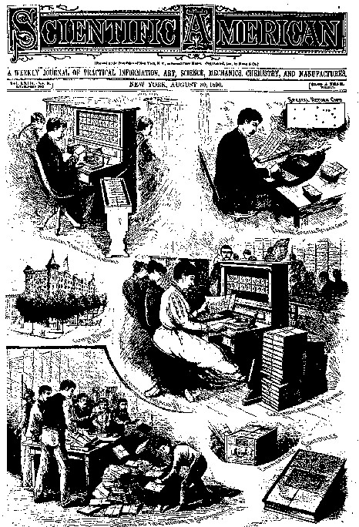
Herman Hollerith and his
Census Tabulating Machine (1884)
Notes:
Herman Hollerith worked as a statistician for the U.S. Census Bureau in the 1880s and 1890s. The U.S. Constitution requires a census count every ten years so that the membership of the House of Representatives will be proportional to the population of each state. This is always a moving target, hence the ten year review of the current state of demographic affairs. The 1880 census took seven years to process. The end of the 19th/beginning of the 20th centuries was the period of highest rate of immigration to the United States. Hollerith deduced that the next census would take longer than ten years, the results not available before the whole census counting thing had to start again.
So, as the saying goes, “necessity became the mother of invention” and Hollerith designed and built the Census Counting Machine illustrated here and in the next slide. Punched cards (a la Jacquard looms) were used to collect the census data (the origin of the IBM punched cards) and the cards were fed into a sorting machine before being read by the census counting machine which recorded and tabulated the results. Each card was laid on an open grid. A matrix of wires was lowered onto the card and wherever there was a hole in the card, a wire fell through, making an electrical connection which triggered a count on the appropriate dial(s) in the face of the machine. Very simple, very effective. The 1890 census took just three months to process even though quite a bit more data was collected than ever before.
Hollerith was the first American associated with the history of computers. As you might expect, he was also the first to make a bunch of money at it. His company, the Tabulating Machine Company, became the Computer Tabulating Recording Company in 1913 after struggling in the market and merging with another company that produced a similar product. The company hired a gentleman named Thomas J. Watson in 1918 who was primarily instrumental in turning the company around. In 1924, the company was renamed International Business machines (IBM) Corporation. The rest, as they say, is history…

Slide 17
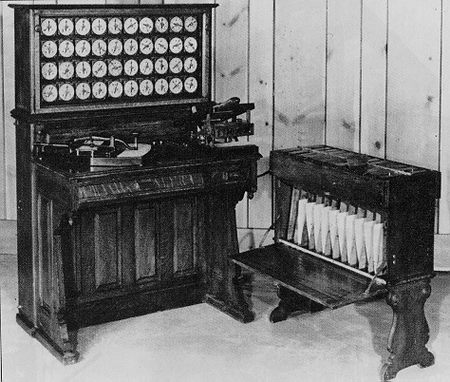
A closer look at the Census Tabulating Machine
Notes:
Here you can see the sorter on the right and the census counting machine on the left.

Slide 18
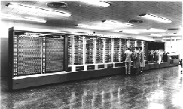
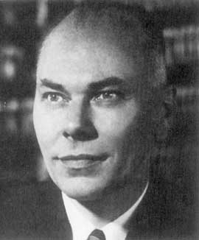
The Harvard Mark I (1944) aka IBM’s Automatic Sequence Controlled Calculator (ASCC)
Howard Aiken
Notes:
While a professor of Physics at Harvard, Howard Aiken, illustrated above, was supported by IBM to build the ASCC computer (Automatic Sequence Controlled Calculator). The computer had mechanical relays (switches) which flip-flopped back and forth to represent mathematical data. It was huge (of course), weighting some 35 tons with 500 miles of wiring.

Slide 19
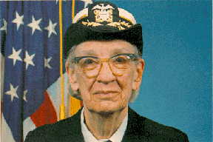
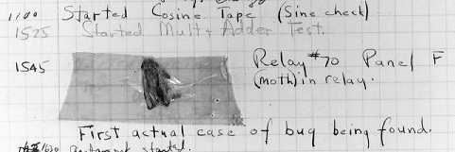
The first computer bug
Rear Admiral Dr. Grace Murray Hopper
Notes:
The is a picture of the first computer bug. The lady is U.S. Rear Admiral Dr. Grace Murray Hopper, who worked with Howard Aiken from 1944 and used his machine for gunnery and ballistics calculation for the US Bureau of Ordnance’s Computation project. One day, the program she was running gave incorrect results and, upon examination, a moth was found blocking one of the relays. The bug was removed and the program performed to perfection. Since then, a program error in a computer has been called a bug, even though it would take a mighty tiny bug to interfere with the workings of a modern microscopic microprocessor.
Nancy Head has contributed the following additional information about Dr. Hopper:
Dr. Hopper greatly simplified programming through the COBOL language which was the first programming language to allow the use of regular English for variable names and logical operations. She also introduced the concept and standardization of "compilers“, now a standard feature of programming languages. The compiler translates the programmer’s code into machine language, thus sparing the programmer the onerous task of doing it it herself. This contributed to business use of computers and modern data processing because regular businesspersons and scientists (not just mathematicians and computer scientists) could learn to program computers.

Slide 20
Electronic digital computers
From
John Vincent Atanasoff’s
1939
Atanasoff-Berry Computer (ABC)
to
the present day
Notes:
John Vincent Atanasoff’s contribution to the history of computers is little known, thanks to the preoccupations of his university and the shenanigans of two rival inventors of electronic digital machines. Read on to find out more…

Slide 21
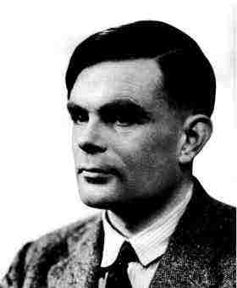
Alan Turing_x000b_1912-1954
The Turing Machine
Aka
The Universal Machine
1936
Notes:
The story of modern electronic digital computing should start with Alan Turing who published a paper in 1936 On Computable Numbers, with an application to the Entscheidungsproblem. The paper proved that a machine capable of processing a stream of 1s and 0s according to programmed instructions would be capable of solving any problem that would count as a 'definite method.' As it happens, the set of problems included in this definition is the universe of mechanically solvable problems. Hence, the Turing Machine is also known as the Universal Machine, the theoretical precursor to the electronic digital computer which Atanasoff was soon to invent.

Slide 22
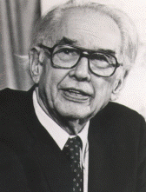
John Vincent Atanasoff (1903-1995)
Physics Prof
At
Iowa State
University,
Ames, IA
Notes:
Interesting story of how Atanasoff came up the stroke of genius to design his computer the way he did. He’d been thinking about it for a long time, convinced there had to be a way of doing math mechanically and thus save his PhD students at Iowa State College (now Iowa State University) in Ames, Iowa, from wasting time on math when they could be doing more interesting work in Physics. One evening in the winter of 1937, the problem proved particularly taxing for him, so he did what he was accustomed to doing in situations such as this: he got into his car and drove at high speeds for several hours, thus effectively clearing his mind. Eventually he crossed into the neighboring state of Illinois and stopped at a bar where he ordered a draft of liquid refreshment (bourbon). This had a wondrous effect on his state of mind, enabling him to think with a calm clarity that led step-by-step to coherent conclusions about the design of his electronic digital computer.
Back at the lab, in the Spring of 1939, he hired Clifford Berry, an bright electrical engineering student, and together they invented the Atanasoff-Berry Computer, the ABC. Within a year, the basic machine was completed and a paper written documenting its design. The paper was forwarded to the university’s patent lawyer. With World War II well underway, Atanasoff was given leave from the university to join the Naval Ordnance Laboratory for defense-related work. Work on the ABC came to a halt. The patent was never filed….

Slide 23
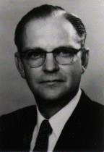
Clifford Berry (1918-1963)
PhD student
of
Dr. Atanasoff’s
Notes:
Dr. Clifford Berry had a distinguished career of his own outside of contribution in the invention of the electronic digital computer. He was issued 19 patents in the area of mass spectrometry, 11 patents in various areas of vacuum and electronics and, at the time of his death, had 13 patents pending. He died suddenly on October 30, 1963.

Slide 24
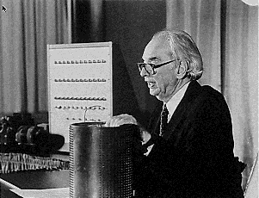
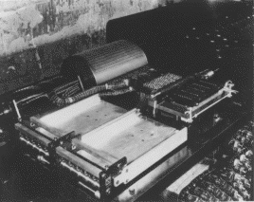
1939
The Atanasoff-Berry Computer (ABC)
The ABC was the first electronic digital computer, invented by John Vincent Atanasoff
Notes:
The ABC was a digital computer, so-called because it processed data in discrete, digital units (the digits 1 and 0). It also used the binary (base 2) number system in computation, the results being converted to and from decimal (base 10) for the purposes of human consumption. Being binary, the data could easily be represented electronically since switches naturally have two states—on and off—which lend themselves to representing the numbers or values 1 and 0. The ABC used vacuum tubes, punched cards and a memory device that looked like a drum (shown in the pictures on the slide being held by Atanasoff and as it was located in the working machine).

Slide 25
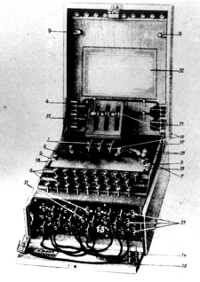
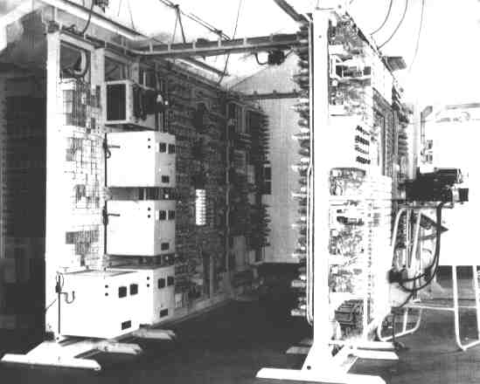
1943
Bletchley Park’s Colossus
The Enigma
Machine
Notes:
Another little known story in the history of computers relates the work of the government boffins in World War II Britain, Turing included. Turing made a major contribution to the development of a sophisticated computing machine called the Colossus which was used to help crack the codes of the German Enigma Machine. The story didn’t come out till the 1970s because it was top secret, for obvious reasons.
You can read more about cryptography in a fascinating book written by Simon Singh: THE CODE BOOK. The Secret History of Codes and Code-Breaking.
Those of you interested in learning more about cryptography and even using cryptography to protect your privacy can work your way through our tutorial on PGP (Pretty Good Privacy) which you will find available free of charge online at http://www.pitt.edu/~poole/PGPintro.htm.

Slide 26
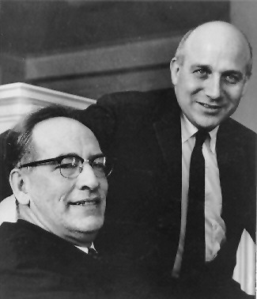
1946
The ENIAC
--Electronic Numerical
Integrator and Computer
John Presper Eckert
(1919-1995)
and
John Mauchly
(1907-1980)
of the
University of Pennsylvania Moore School of Engineering
Notes:
J. Presper Eckert (at right in the picture on this slide) and John Mauchly were professors in the Moore School of Engineering at the University of Pennsylvania. Mauchly invited himself to Atanasoff’s home for a long weekend in order to check our the ABC. Atanasoff made him welcome, showed him his machine, and gave him a copy of the paper describing the workings of the machine that already had been filed with the Iowa State College’s patent lawyer. Mauchly returned to Pennsylvania and, together with Eckert, designed and built the ENIAC (Electronic Numerical Integrator and Computer) which was commissioned by the U.S. Department of Defense and delivered in 1946.
Eckert and Mauchly successfully filed for the patent as inventors of the electronic digital computer, ignoring Atanasoff’s work. Some thirty years later, in 1972, this injustice was rectified when Honeywell (for Atanasoff) successfully challenged Sperry Rand (the company that acquired Eckert and Mauchly’s patent), and Atanasoff and Berry were duly credited as being the inventors of the electronic digital computer.
Mauchly died in 1980. Eckert died in 1995, one week before the nonogenarian Atanasoff. You might say that Atanasoff had the last laugh.

Slide 27
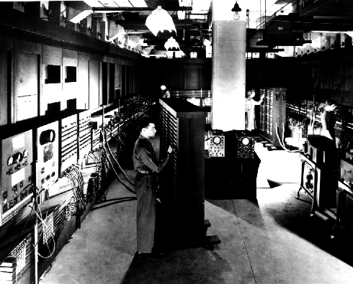
The ENIAC:
Electronic Numerical Integrator and Computer
30 tons,
18,000 vacuum
Tubes
(little powerful
than the
modern
Calculator)
Notes:
The ENIAC: 30 tons, 18,000 vacuum tubes, with the computing power of little more than the modern calculator…..

Slide 28
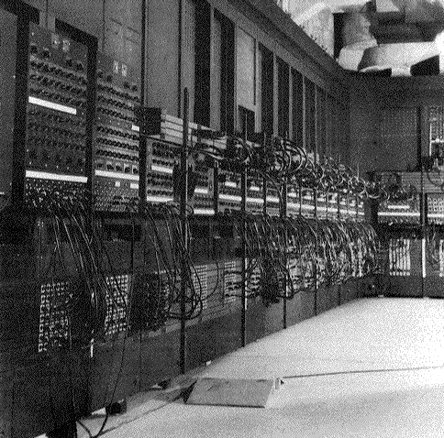
ENIAC’s Wiring!

Slide 29
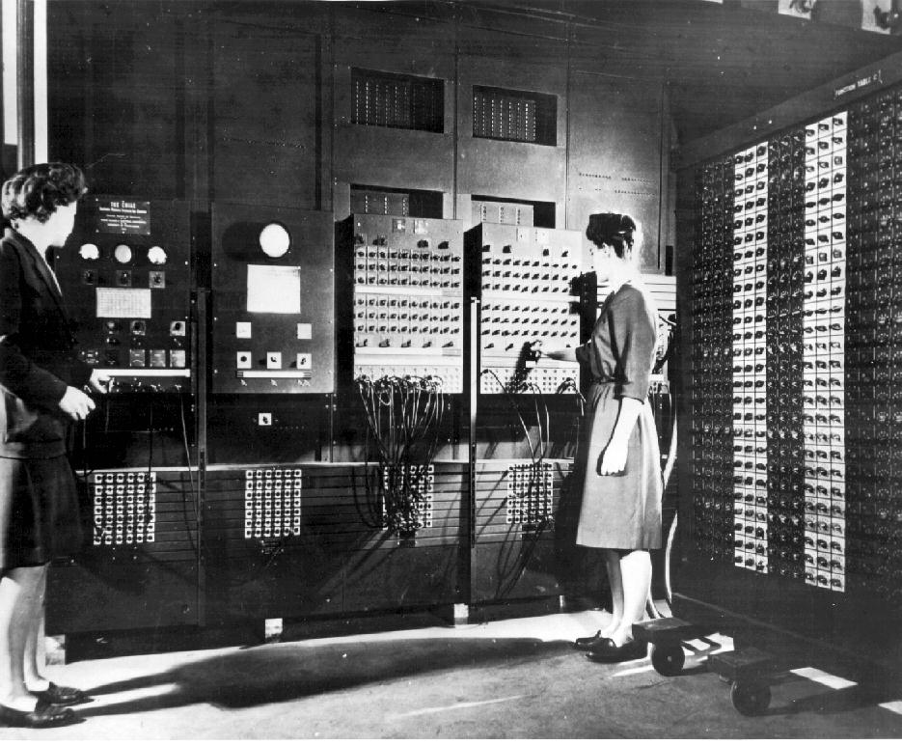
Programming the ENIAC
Notes:
The ENIAC was programmed by rewiring the machine, instruction by instruction, tedious work carried out mostly by women working for the U.S. Ordnance Office. The machine was intended for use in the calculation of ballistics trajectories for the big guns of World War II. It was ready a bit late for that, but nonetheless was an immensely significant achievement on Eckert and Mauchly’s part. Such a shame they neglected to recognize Atanasoff’s contribution to their endeavors.
The lady programmers were known as computers, for a while at least…..

Slide 30
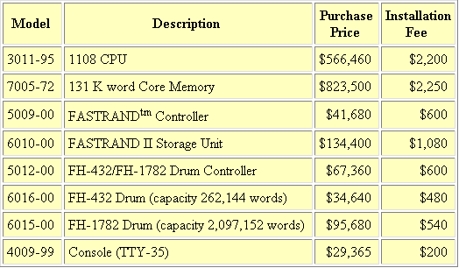
1951
Univac
$40 millions for a calculator!!!
Typical 1968 prices—EX-cluding maintenance & support!
Notes:
Tote it up… $1,801,035 in 1968 dollars. According to The Inflation Calculator found at http://www.westegg.com/inflation/, it would be about $8,973,207 in year 2000 dollars. So you’d have to multiply that by five, easy, in today’s money, and all for the equivalent of the calculator you keep in your school bag.

Slide 31
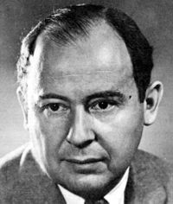
First Generation: Vonn Neuman
Machine
1948 and beyond…
1903-1957

Slide 32
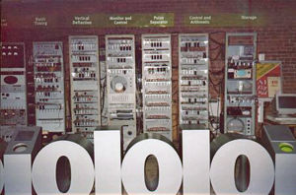
"Baby" at the Museum of Science and Industry in Manchester (MSIM), England

Slide 33
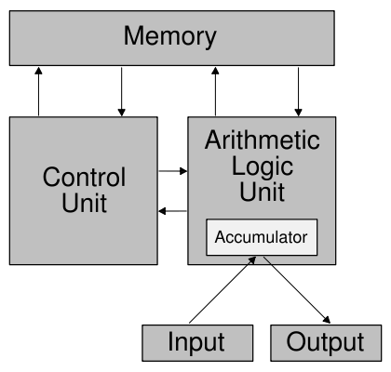
Vonn Neuman Architecture
Stored Program Computer
Programmable
Instruction Set
Architecture
Memory bandwidth
Notes:
An instruction set is (a list of) all instructions, and all their variations, that a processor can execute, like add, subtract (arithmetic ), and, or (logical)
, load, store (data), goto (control)

Slide 34
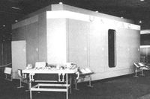
UNIVAC-I: First Mass Produced Computer : Generation 2
Universal Automatic Computer
Originally made by Remington Rand
Sold 46 machines at $1 million each
1900 operations per second in a smaller and more efficient package than ENIAC.

Slide 35
The IBM Main Frame computers
1952, IBM announced the 701 Electronic Data Processing Machine
First of its successful 700/7000 Mainframe computers
Fortran was developed during 1955 and 56
Microprogramming was invented during this time

Slide 36
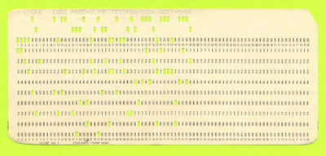
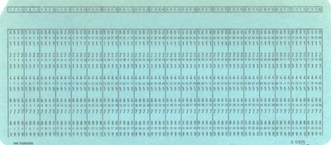
Punched Cards
A punch card or punched card is a piece of stiff paper that contains digital information represented by the presence or absence of holes in predefined positions

Slide 37
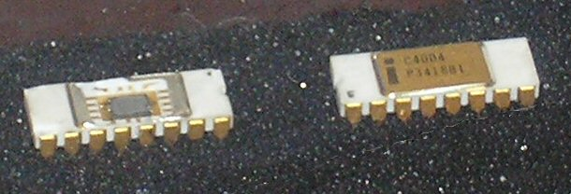
Generation 3: Post-1960
Jack St. Clair Kilby's and Robert Noyce's independent invention of the integrated circuit
Invention of the microprocessor, by Ted Hoff and Federico Faggin at Intel.
Steve Wozniak, co-founder of Apple Computer, is credited with developing the first mass-market home computers.

Slide 38
Future???
Nano-technology
Quantum Computing…
Your mind (if applied)…

