Slide 1

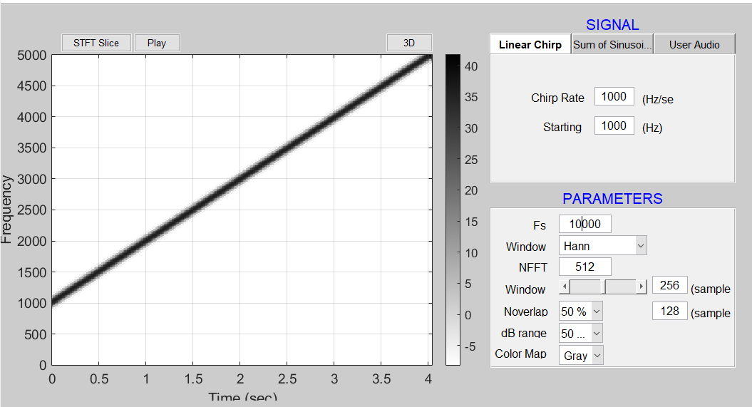
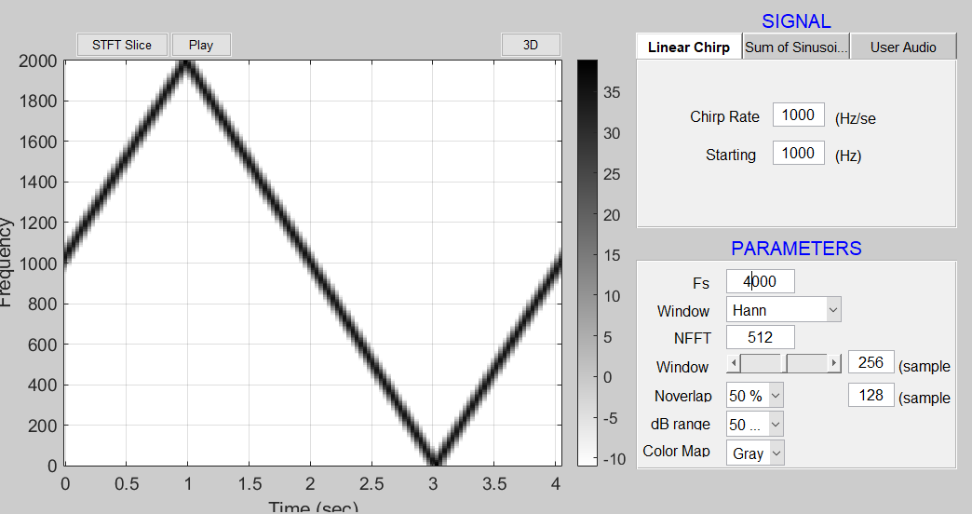
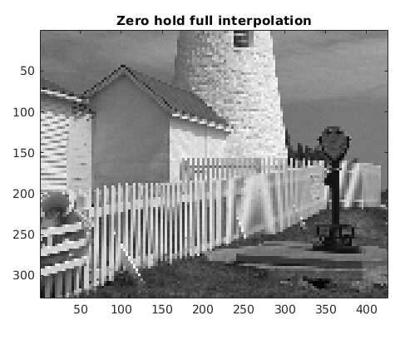
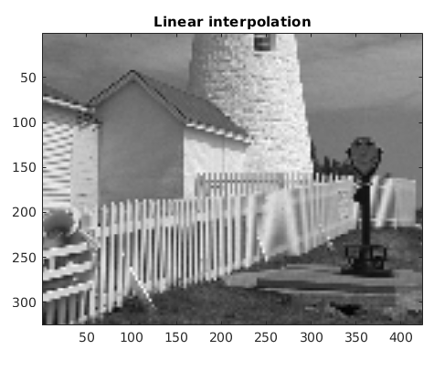
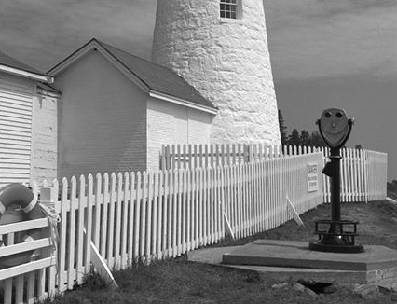
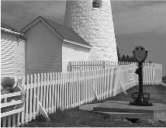
SAMPLING AND ALIASING
Ekata Mitra, Ritaja Das, Elias Skinner, Joshua Jacob, Dr. Neda Nategh
Department of Electrical Engineering, University of Utah
ADEMIC RESEARCH POSTER TEMPLATE
Subtitle for Academic Research Poster (48x36 inches)
Your names and the names of the people who contributed to this presentation
Background
Data Analysis
Results
Conclusions
With the speed and computational power of modern computers, it is advantageous to process signals in the digital domain. This is done by taking a continuous-time and continuous-amplitude signal and converting it into a discrete-time and discrete-amplitude signal. For these conversions to be done properly, as to not corrupt the captured data, certain precautions and design practices need to be used. In presence of aliasing, some fixes can be performed.
Temporal Signal Analysis: A linear-FM (chirp) signal is an ideal test signal to explore the concept of aliasing due to sampling.(Matlab Demo)
Chirp signal that was sampled at too low of a frequency did not capture proper frequency content.
Signals containing harmonic frequencies above Nyquist did not display all frequencies on spectrogram.
Down-sampled image produced geometric artifacts on spatial frequencies that were close to Nyquist before down-sampling.
No form of reconstruction can perfectly recreate our original image
Using Zero-Hold interpolation produces sharper jagged artifacts in reconstruction while linear interpolation “smooths out” the unknown
When designing an analog-to-digital conversion system, it is pertinent to have a specified maximum frequency for the system. The sampling frequency of the system should be, in the absolute worst case, at least twice the highest desired frequency. If not, the discrete signal could be corrupted with artifacts due to aliasing. A good way of avoiding aliasing is to implement an anti-aliasing filter to ensure that frequencies out of the system’s range is eliminated. If aliasing still occurs, there are reconstruction methods that can be implemented. However, any reconstruction of an undersampled signal regardless of AA techniques will carry imperfections.
Key Points
Analog to Digital Conversion: System Implementation
Sampling Criteria
Discrete-time Signals
Problems of Aliasing: Temporal and Spatial
Reconstruction
Figure A: neque dignissim, and in aliquet nisl et umis.
Figure 1
Graphic Elements
Graphic Elements
Methods
An audio and visual signal were both observed, sampled, and reconstructed using MATLAB. A variety of techniques were used including down-sampling, interpolation, and filtering. Our reconstructed signals were then observed for their strengths and weaknesses.
Figure 2
Figure 3
Figure 4
Figure 5
Spatial Signal Analysis: An image of a lighthouse was loaded into MATLAB and plotted. The white fence in the photo provides a “chirp” type signal with the spatial frequency of the fence’s posts increasing towards the right-hand side of the image.
Acknowledgements
References
Dr. Neda Nategh
McClellan, James H., Schafer, Ronald W., and Yoder, M. A. Signal Processing First. 2003. Print.
Department of Geography
buffalo.edu

