Slide 1
Project : TOPSI
A3 Report
Presented by : Rita Kushwaha

Slide 2
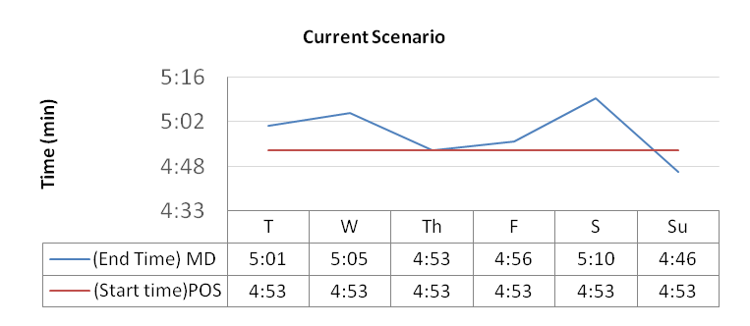
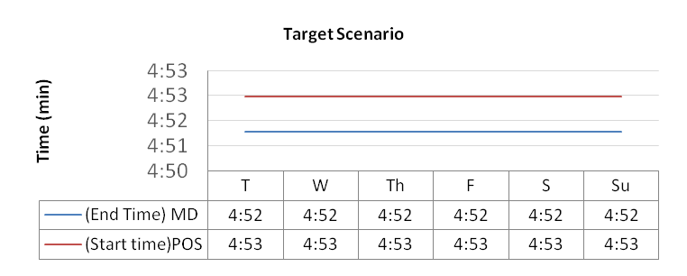
1. TITLE:
POS Job failure due to Mahti delta backup High run
2. LEADER: Rita Kushwaha
LAUNCH DATE: 25.06.2020
3. PROBLEM DESCRIPTION:
PMg010j005MAHTI_delta_Backup almost everyday crosses 4:47EET and results in high run and because of that the one of the Tuhti 512 batch job i.e, PMg512j009POS_yoajo gets aborted which is one of the critical job for TUHTI.
We have to wait for the PMg010j005MAHTI_delta_Backup completion post that only we can rerun the PMg512j009POS_yoajo.
Because of this POS data gets updated later in the POS system which is not the expected time to be updated.
9. CURRENT SITUATION:
4. SCOPE:
In scope: We can see the progress of the PMg010j005MAHTI_delta_Backup via command –
db2 list utilities show detail
We can estimate the end time of Mahti delta backup and after that manually rerun the PMg512j009POS_yoajo.
We cannot reschedule the POS job as data should be updated at POS system before the business hours, but we can reschedule the MAHTI delta backup.
Out of scope: As per the netbackup team – The job is running in a “shared“ environment and more jobs (another customer) affecting the performance of your jobs, and there is nothing to do!
10. TARGET SITUATION:
5. OBJECTIVES:
Mahti delta backup of 4:00 EET instance should get complete before 4:53EET, so it will not effect the start of the PMg512j009POS_yoajo and will not lead to PMg512j009POS_yoajo job fail again.
To reduce the manual efforts of rerunning the POS job again.
6. MEASURES:
# | 6a. MEASURE INDICATORS | 6b. BASELINE PERFORMANCE | 6c. TARGET RESULTS | 12. ACHIEVED RESULTS
1 | Rescheduling the time of Mahti delta may help the completion of job before Pos job start.
2 | When Mahti delta backup crosses the POS job start time contact DB2 team, for the cause.
11. IMPLEMENTATION PLAN:
# | Activity | W1 | W2 | W3 | W4 | W5 | W6 | W7 | W8 | W9 | W10 | W11 | W12 | Responsible
1 | Investigation why Mahti delta backup always go on high run. |  |  |  |  |  |  |  |  |  |  |  |  | DB2
2 | We can check if rescheduling the time of the Mahti delta backup is not causing any problem to POS job..
7. SPONSOR: 8. TEAM MEMBERS: Topsi , DB2, Netbackup team

Slide 3
Thank You

