Slide 1
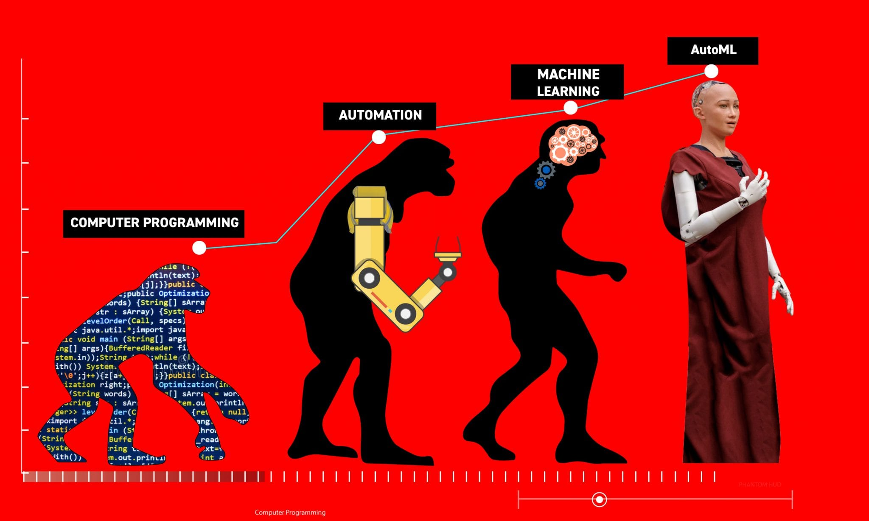
Multi-Objective AutoML-Zero
MSU DNN Group

Slide 2
Multi-Objective AutoML-Zero Outline
Progress
Further experimentation
Future Additions
Deadlines (NeurIPS)
HAPPY HOLI

Slide 3

Progress

Slide 4
Progress
Basic Principle: The goal of AutoML-Zero is to automatically discover machine learning algorithms using only basic operations.
What are we adding to that framework?
Applying the same framework over Reinforcement Learning problems.
Extending the framework to the multi-objective domain for simpler problems.
Apply multi-objective optimization to Reinforcement Learning.
Expectations:
Exceed the performance of the single-objective optimization algorithm.
Utilize the information from the multiple pareto-optimal solutions at the end.

Slide 5
Progress: Reinforcement Learning
Currently we have a way to deal with the reinforcement learning problem. It needs to collect the data from an existing algorithm.
Working Policy
State Variables
Action, Reward
x₀ | v₀
x₁ | v₁
x₂ | v₂
a₀ | r₀
a₁ | r₁
a₂ | r₂
Collect Data
……..
……..
x_{n} | v_{n}
a_{n} | r_{n}

Slide 6
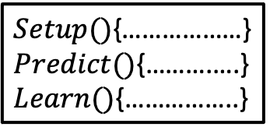
Progress: Reinforcement Learning
Currently we have a way to deal with the reinforcement learning problem. It needs to collect the data from an existing algorithm.
Collected Data
AutoML-Zero Framework
x₀ | v₀
x₁ | v₁
x₂ | v₂
a₀ | r₀
a₁ | r₁
a₂ | r₂
……..
……..
$Setup()${………………}
$Predict()${……….….}
$Learn()${……………..}
x_{n} | v_{n}
a_{n} | r_{n}
Algorithm

Slide 7
Progress: Multi-Objective
NSGA2: The NSGA2 algorithm has been implemented with customized mutation and crossover operations to search for instructions.
The multi-objective version has been applied over simple linear regression problem with feature dimensions 2, 4, 8, 16, 32 (no convergence – need to explore why).
Further, it has been applied over some reinforcement learning problems.

Slide 8

Further Experimentation

Slide 9
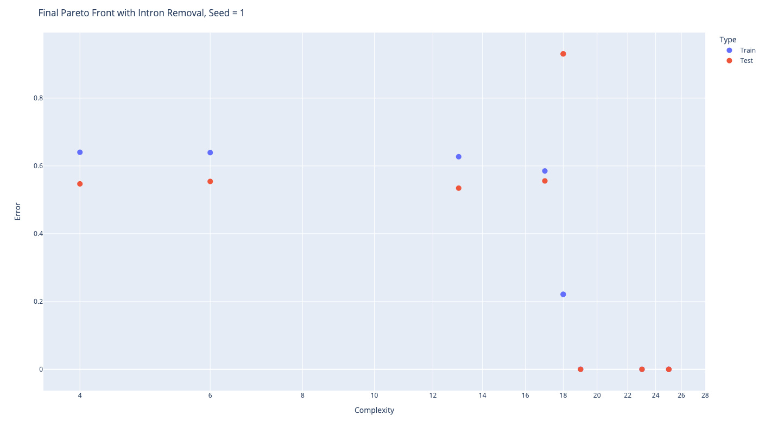
Single-Objective vs Multi-Objective
Total time required: 197.988
Complexity: 50, Training Error: 2.66235e-05, Test Error: 0
def Setup():
s3 = -0.739817
s3 = s2 * s1
s2 = s3 * s1
v1 = s2 * v2
s1 = -0.0173887
def Predict():
s1 = dot(v1, v2)
v1 = v2 + v2
s1 = s1 - s2
s2 = s2 * s3
s1 = 0.102181
v1 = v2 + v2
v1 = s1 * v1
s3 = s2 - s0
s1 = dot(v1, v0)
s2 = s2 - s0
def Learn():
s3 = s0 - s1
v1 = s3 * v0
v2 = v2 + v1
Multi-Objective Outcome
Single-Objective
Outcome
50

Slide 10
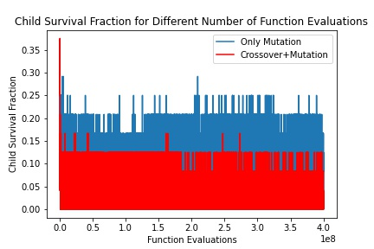
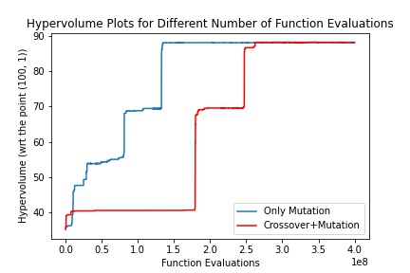
Testing Crossover
One of the ways to test the advantage of using crossover is to use get the population members, just do mutation and check what percentage of the child population are surviving and from the same population members, try crossover+mutation and check what percentage is surviving.
Need more sophisticated crossover

Slide 11
Code Refactoring
Now to run a single experiment, we need to change a lot of files
Non-effective code removal (definitions.h)
Multiple objectives (run_demo.sh)
NSGA2/RE (run_search_experiment.cc)
Linear regression/Reinforcement Learning (other files)
The goal is to include all these dependencies in a single file.
Till now I have reduced it to changing 2 files. But if all the necessary locations are not changed, it can lead to inappropriate experimentation.

Slide 12

Future Directions

Slide 13
Goals
Effectiveness of intron removal in the multi-objective search process.
Apply multi-objective search on all the RL algorithms.
Find a proper crossover operator.
Tweaking the complexity calculation.
Introduce mini-batch learning.

Slide 14

Deadlines

Slide 15
Project Deadline
July is the deadline for the submission of the paper.
We need to target to complete the experimentations within June.

