Slide 1
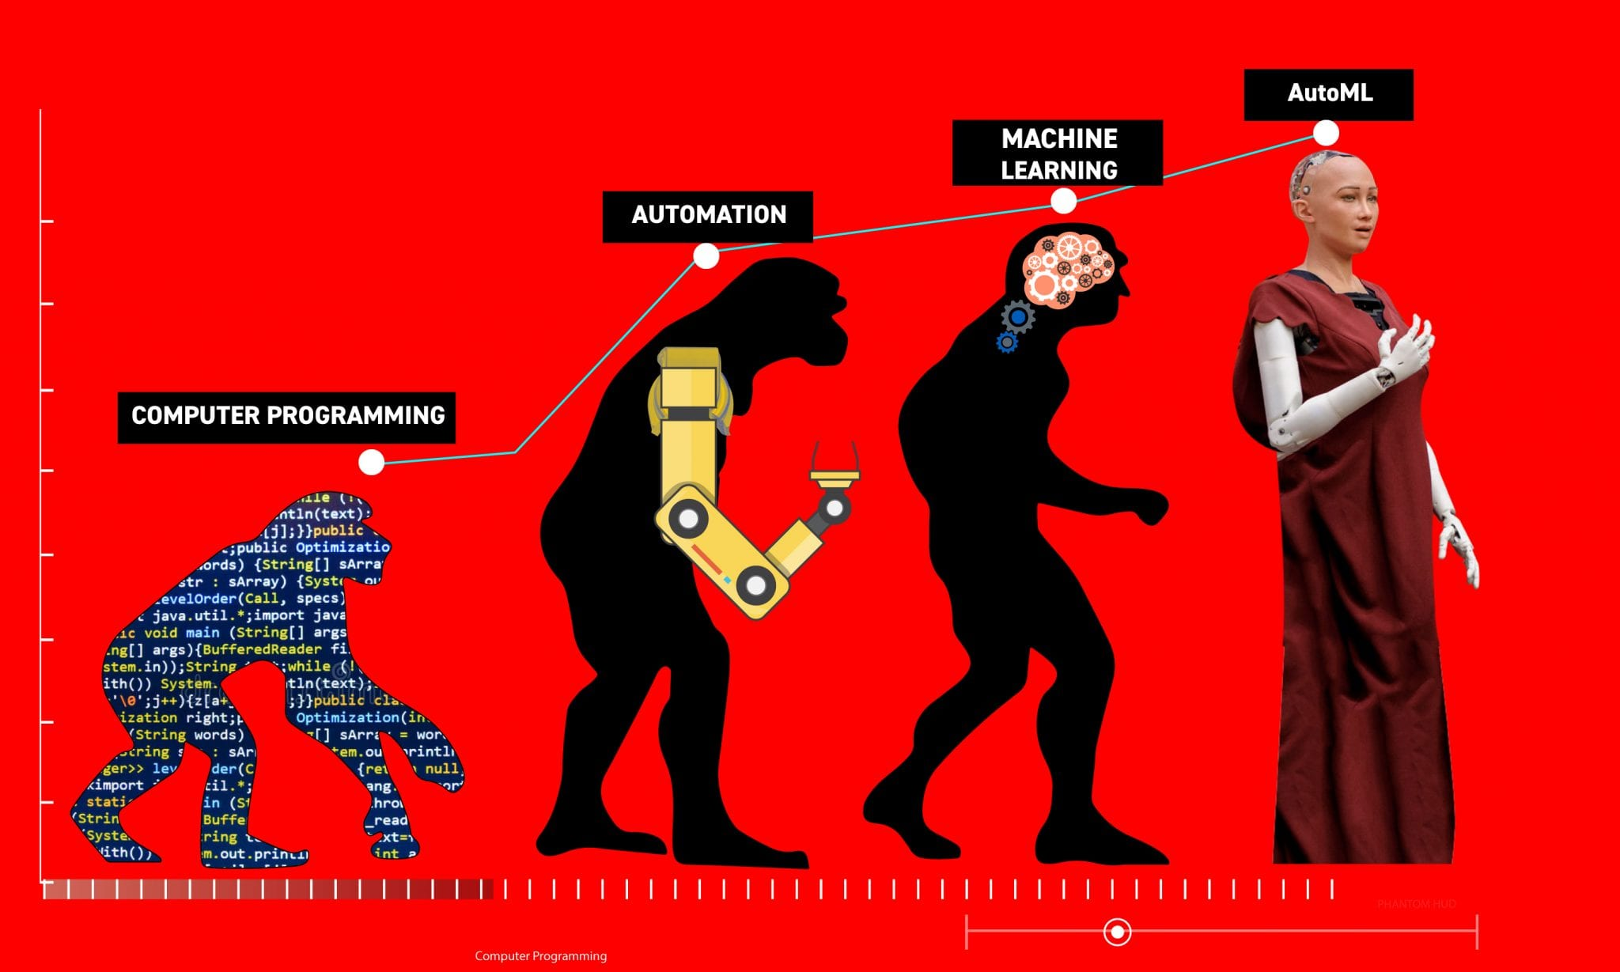
Multi-Objective AutoML-Zero
MSU DNN Group

Slide 2
Progress Outline
Practicality
Focus on the low-error region.
Single vs Multi-Objective
Convergence.
Solution Quality.
Algorithmic Manipulation
Moving towards more humanistic designs.
Noisy Evaluation

Slide 3

Progress

Slide 4
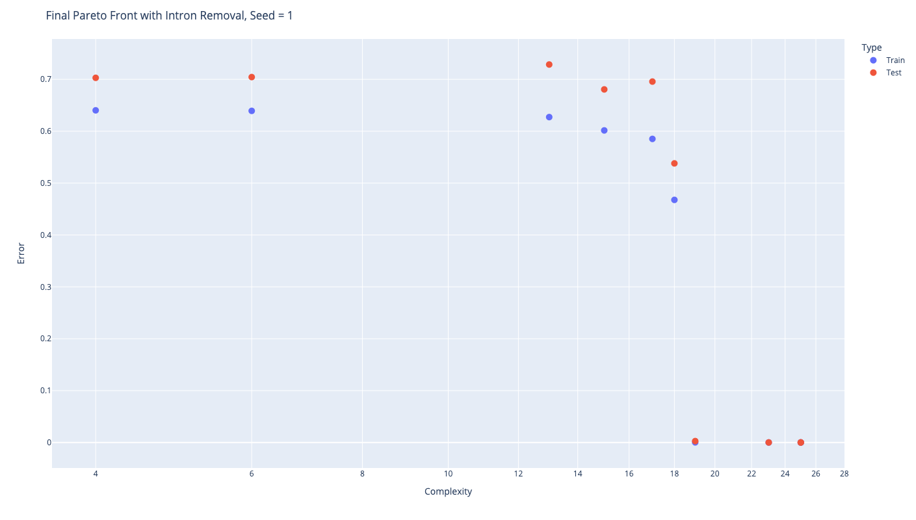
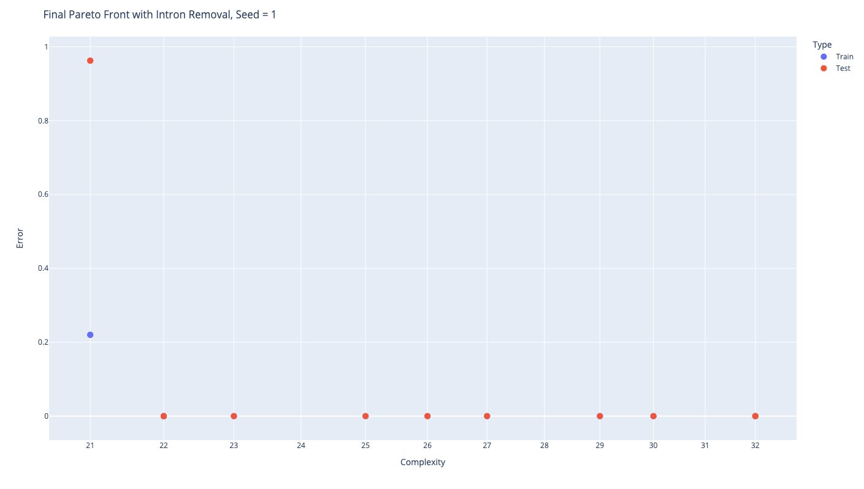
Practicality
Instead of picking only the region of interest from the final points, we can also make the algorithm focus more on the regions of interest with some constraints on the error.

Slide 5
Single vs Multi-Objective Convergence
For every problem run, there is a lower bound constraint on the objectives (like sufficient error). If any experiment finds a solution having error less than the sufficient error, the process stops.
As both RE and NSGA-2 are elite-preserving algorithms, once such a solution is obtained, it is preserved.
So, one convergence criterion can be the number of function evaluations needed to obtain the first feasible solutions.

Slide 6
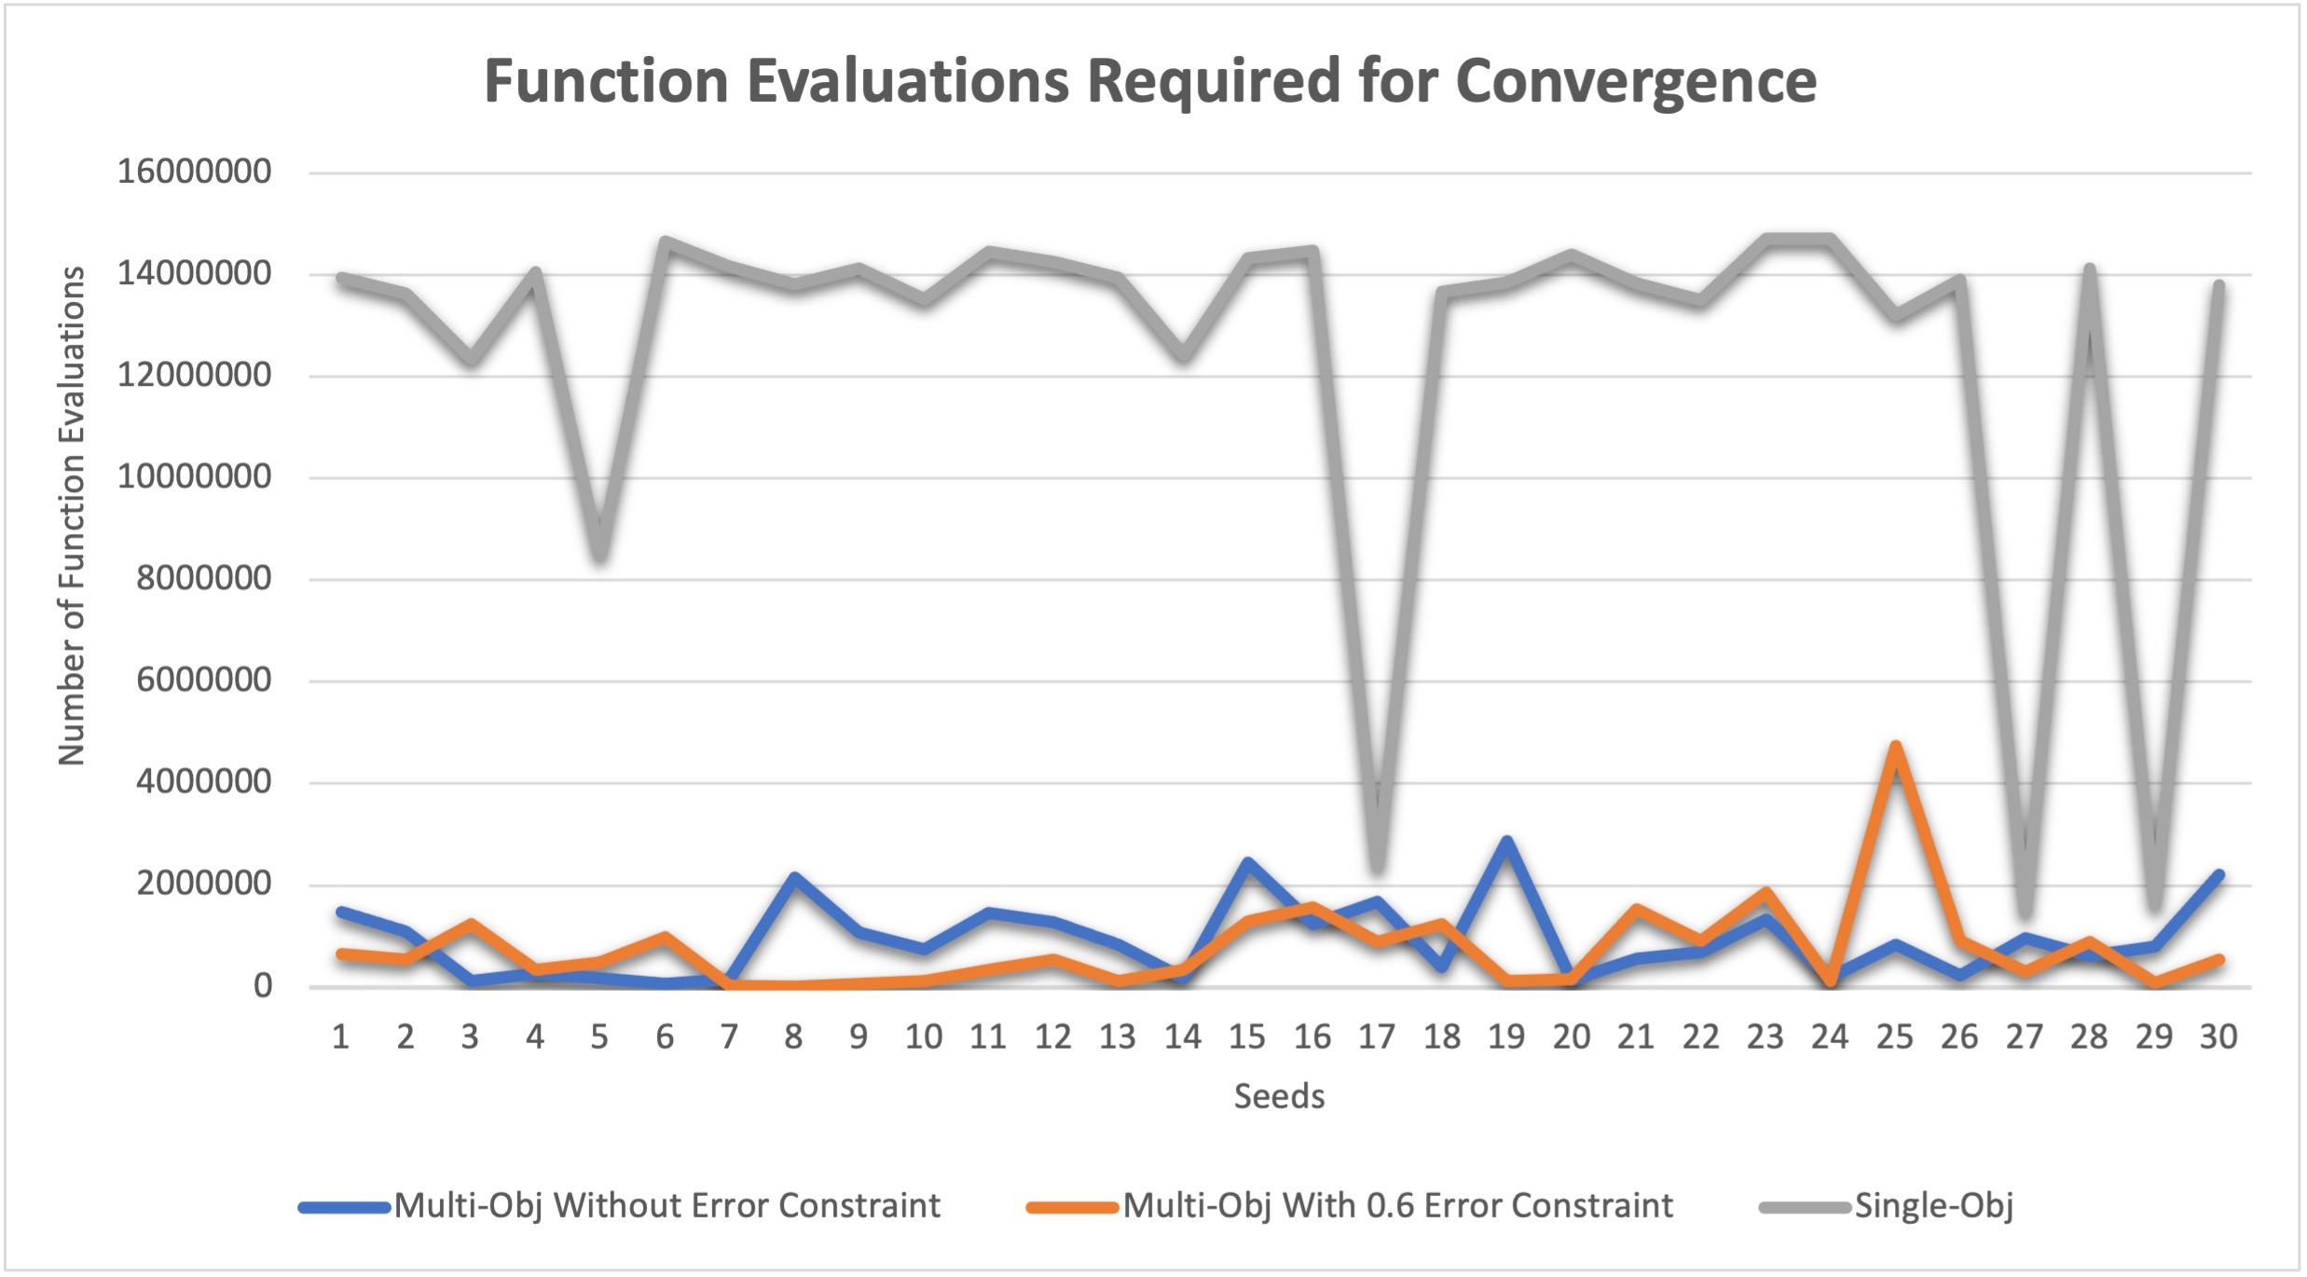
Single vs Multi-Objective Convergence
There is no visible difference between the convergence speeds of with and without error constraint scenarios.
But the difference with single-objective processes are clearly visible.

Slide 7
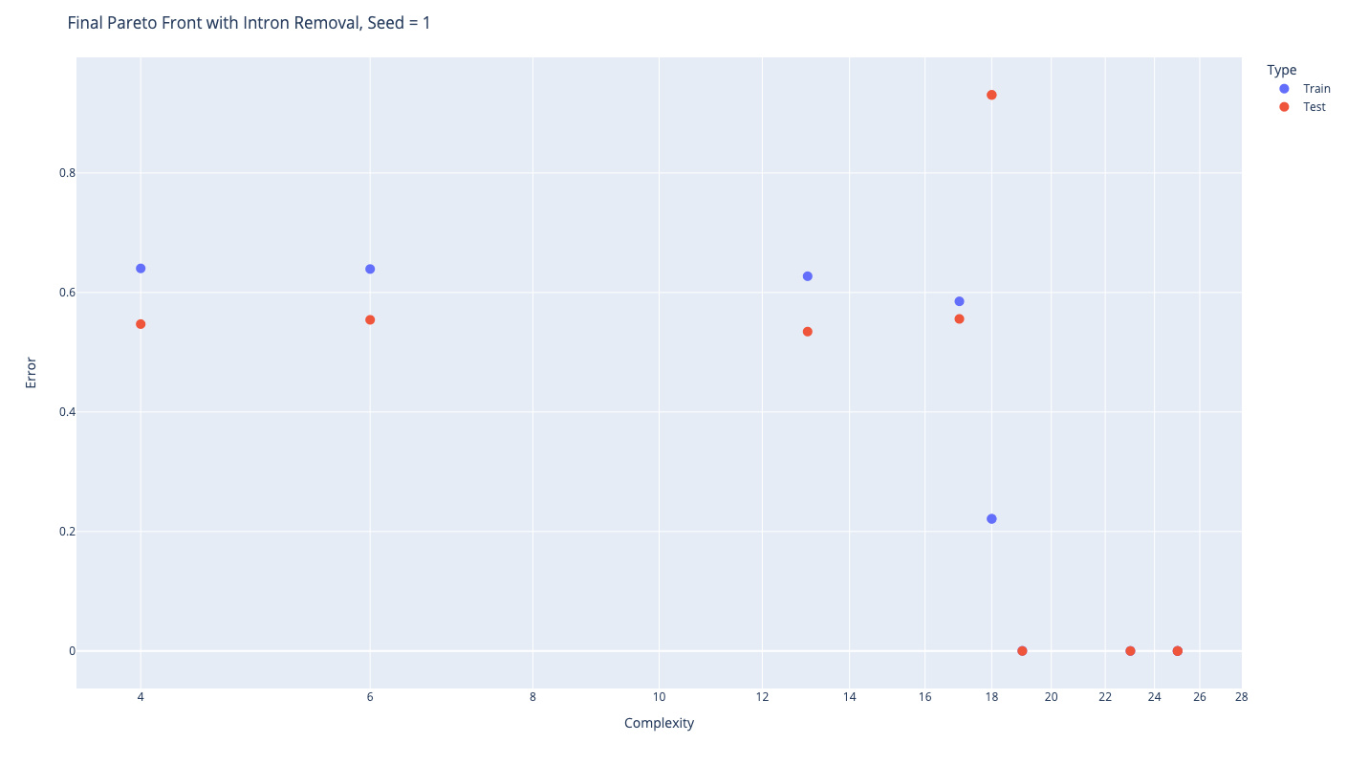
Single-Objective vs Multi-Objective Solution Quality
Total time required: 197.988
Complexity: 50, Training Error: 2.66235e-05, Test Error: 0
def Setup():
s3 = -0.739817
s3 = s2 * s1
s2 = s3 * s1
v1 = s2 * v2
s1 = -0.0173887
def Predict():
s1 = dot(v1, v2)
v1 = v2 + v2
s1 = s1 - s2
s2 = s2 * s3
s1 = 0.102181
v1 = v2 + v2
v1 = s1 * v1
s3 = s2 - s0
s1 = dot(v1, v0)
s2 = s2 - s0
def Learn():
s3 = s0 - s1
v1 = s3 * v0
v2 = v2 + v1
Multi-Objective Outcome
Single-Objective
Outcome
50

Slide 8
Algorithmic Manipulation
The most preferred algorithm in a run
def Setup():
def Predict():
v1 = s2 * v1
s3 = 0.184671
v2 = v2 + v1
s1 = dot(v0, v2)
v1 = s3 * v0
def Learn():
s2 = s0 - s1
def Setup():
s3 = 0.184671
def Predict():
s1 = dot(v0, v2)
v1 = s3 * v0
def Learn():
s2 = s0 - s1
v1 = s2 * v1
v2 = v2 + v1
Constant?
Learn?
Which one should be preferred?

Slide 9
Automate Algorithmic Manipulation
One simple way to automate the algorithmic manipulation step is by providing different weightages to different components: setup, predict and learn.
Predict instructions are used most often, followed by learn and finally setup.

Slide 10
Automate Algorithmic Manipulation
Without weighted sum
With weighted sum
def Setup():
def Predict():
v1 = s2 * v1
s3 = 0.184671
v2 = v2 + v1
s1 = dot(v0, v2)
v1 = s3 * v0
def Learn():
s2 = s0 - s1
def Setup():
s3 = 0.184671
def Predict():
s1 = dot(v0, v2)
v1 = s3 * v0
def Learn():
s2 = s0 - s1
v1 = s2 * v1
v2 = v2 + v1
def Setup():
def Predict():
v1 = s2 * v1
s3 = 0.184671
v2 = v2 + v1
s1 = dot(v0, v2)
v1 = s3 * v0
def Learn():
s2 = s0 - s1
def Setup():
s3 = 0.184671
def Predict():
s1 = dot(v0, v2)
v1 = s3 * v0
def Learn():
s2 = s0 - s1
v1 = s2 * v1
v2 = v2 + v1
EXPLICIT INCENTIVE

Slide 11
Automate Algorithmic Manipulation
One of the solutions:
For some reason, the process does not
want to add instructions to setup.
v0: input values
s0: target
s1: prediction
v1: gradient
v2: weights
def Setup():
s2 = 0.188839
def Predict():
s1 = dot(v0, v2)
s1 = s1 * s2
def Learn():
s1 = s0 - s1
v1 = s1 * v0
v2 = v1 + v2
Scaling the values
Loss Computation
If the loss was just the diff, the gradient should have been just v0
So, can it be interpreted as a MSE with a learning rate?
L = s0 – (0.2 * v0 * v2)
grad = 0.2 * v0
v2 = v2 + grad
L = (s0 – (0.2 * v0 * v2))^2
grad = 2 * L * 0.2 * v0
v2 = v2 + grad

Slide 12
How to Normalize?
If we are trying to provide different weights to different components of the algorithm, we need to first normalize the component complexities.
How to do that?
One idea: Get the most expensive operation and multiply the max number of instructions by that value.

Slide 13
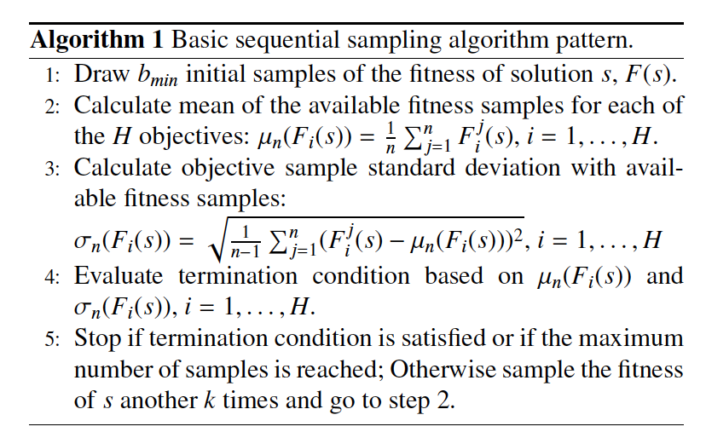
Noisy Evaluation
How to decide the quality of a solution when the evaluation function is noisy?
One idea is to use stochastic domination.
Dynamic Resampling.
It assigns every solution a different resampling scheme to get a reasonable level of confidence.
Siegmund, Florian, Amos HC Ng, and Kalyanmoy Deb. "Dynamic resampling for preference-based evolutionary multi-objective optimization of stochastic systems." In 23rd International Conference on Multiple Criteria Decision Making MCDM 2015, August 3-7, 2015, Hamburg, Germany. 2015.

Slide 14

Future Directions

Slide 15
Goals
Apply stochastic domination.
Find a proper crossover operator.
Tweaking the complexity calculation.
Wei is working on the RL stability issues - trying to tweak the objective value to prefer robust solutions which kind of aligns with the stochastic domination objective as well.

