Slide 1
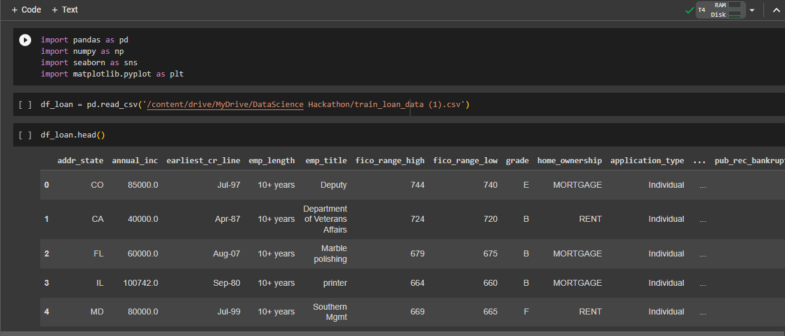
Importing libraries, loading data and view data top 5 data view

Slide 2
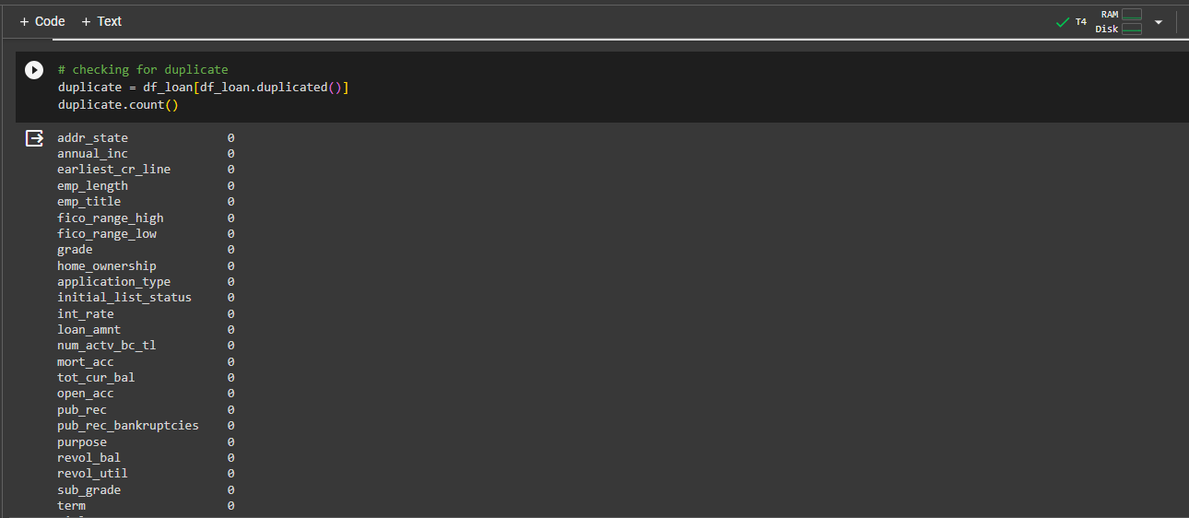
Checking for Duplicate

Slide 3
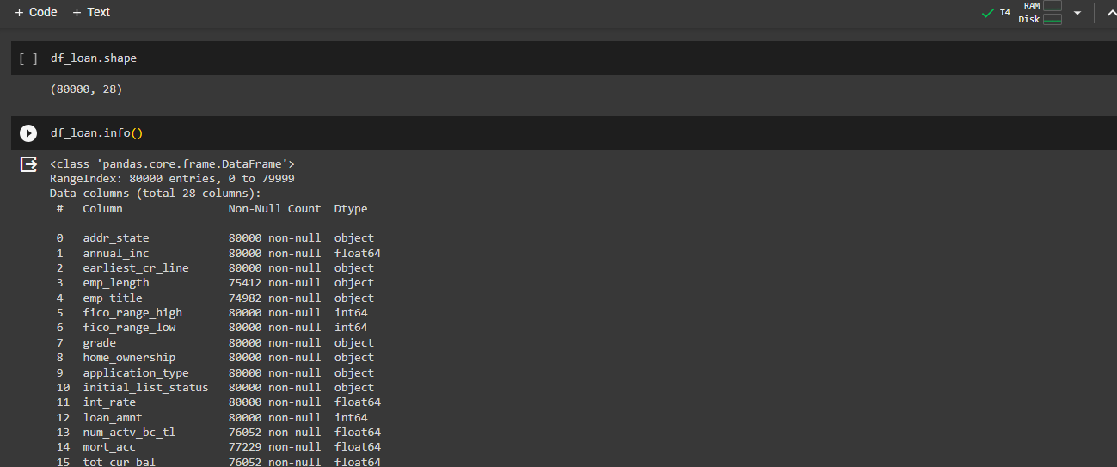
Checking for Info

Slide 4
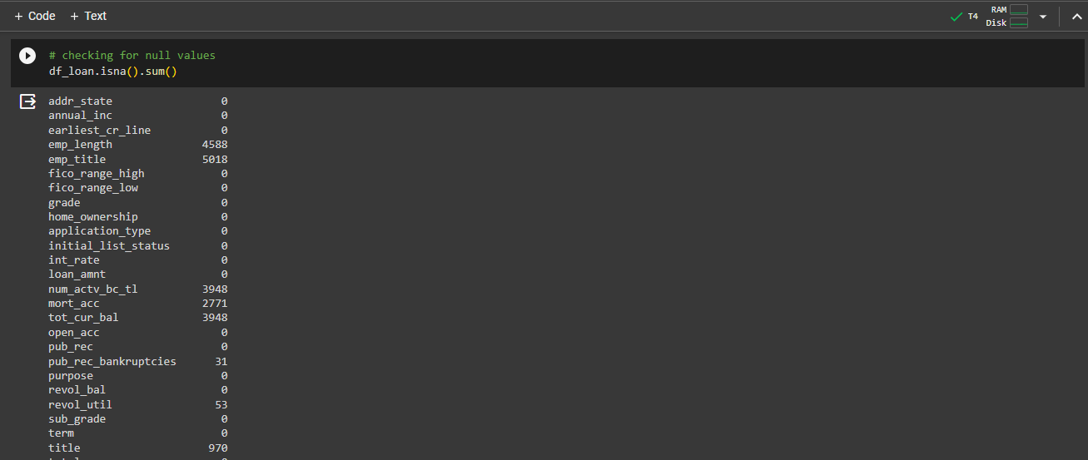
Checking for Null values

Slide 5

Feature selection and dropping those columns

Slide 6
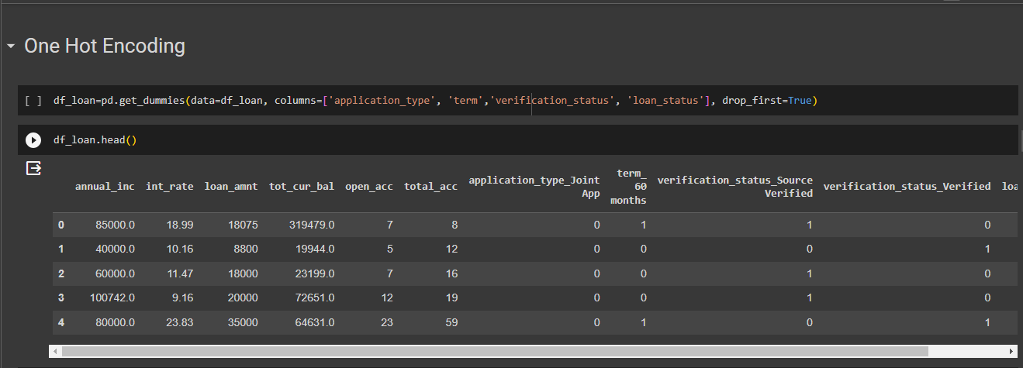
Performing one Hot Encoding

Slide 7
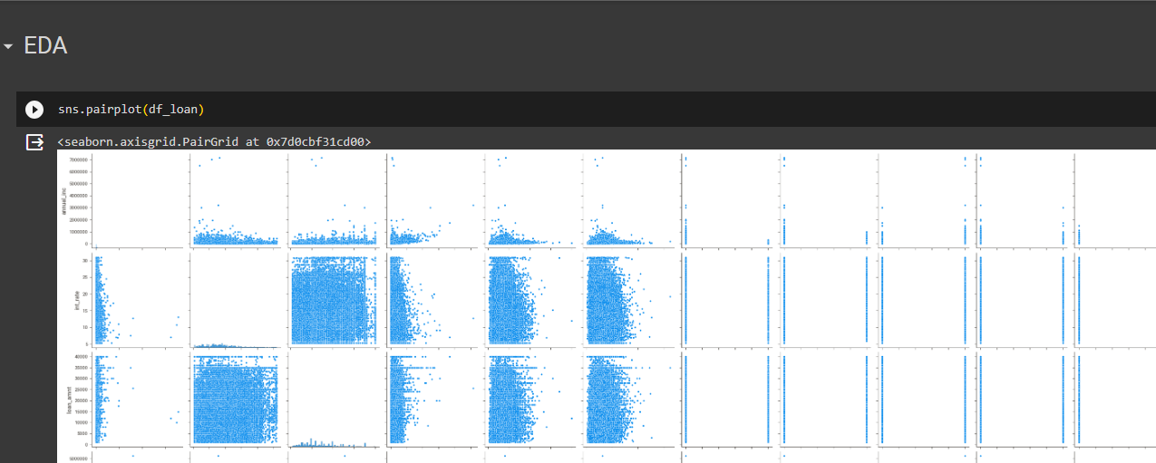
Performing EDA

Slide 8
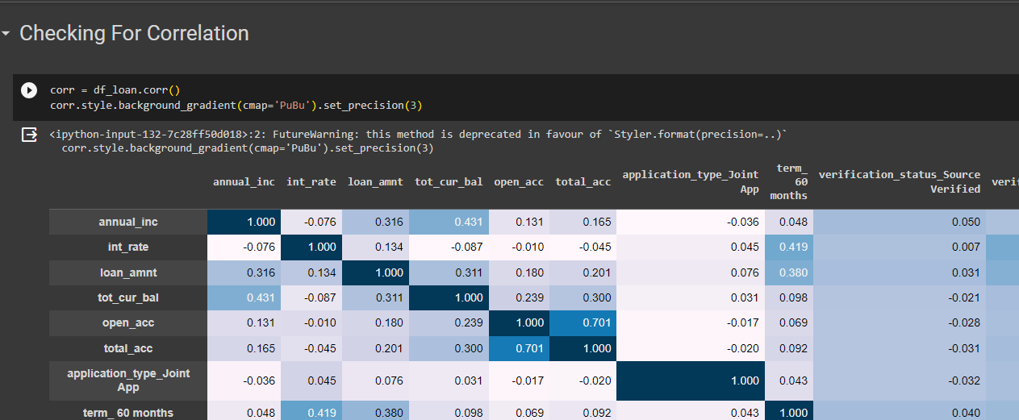
Checking for Correlation

Slide 9
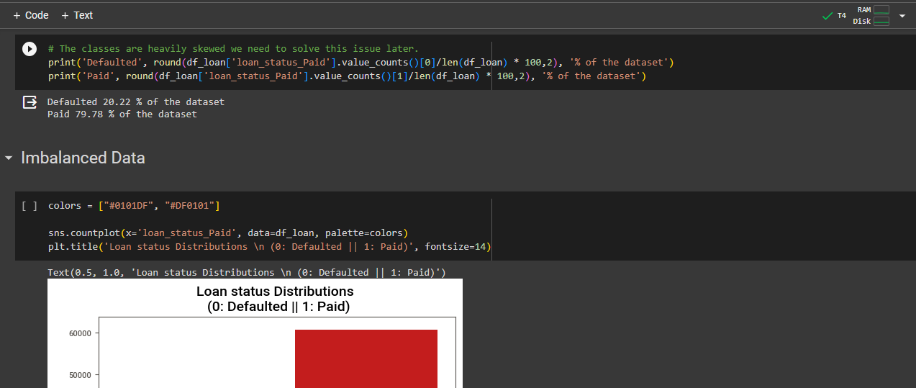
Data imbalanced

Slide 10
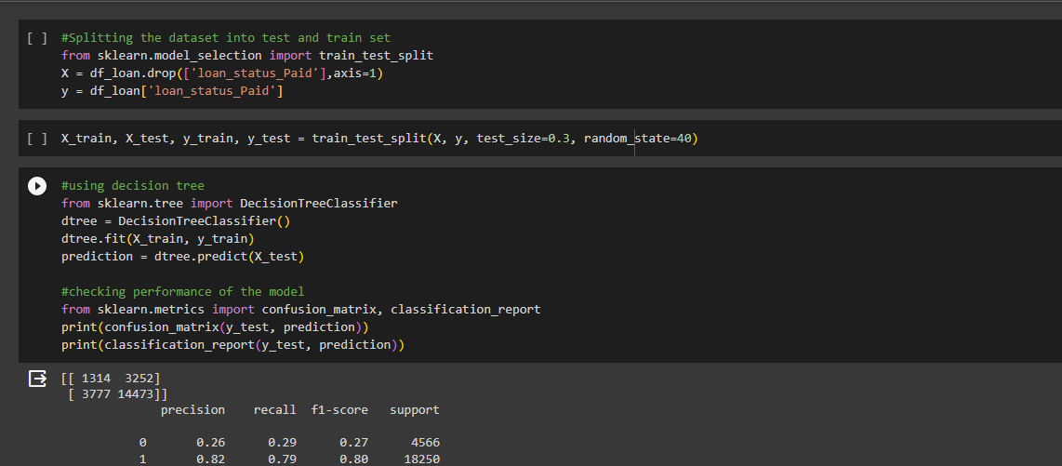
Data train test split

Slide 11
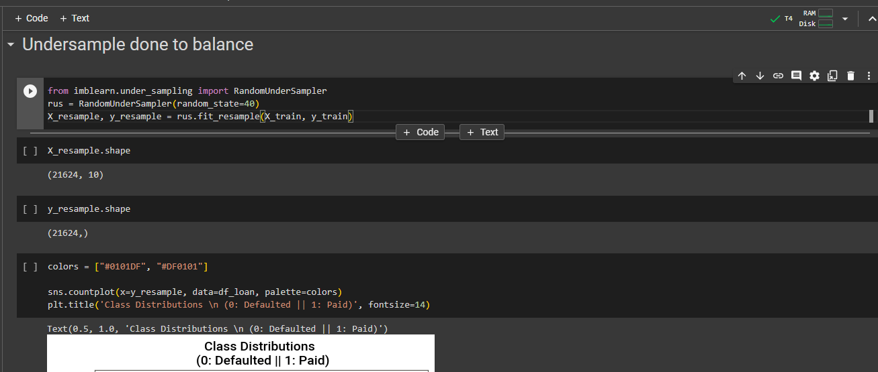

UnderSampling done

Slide 12
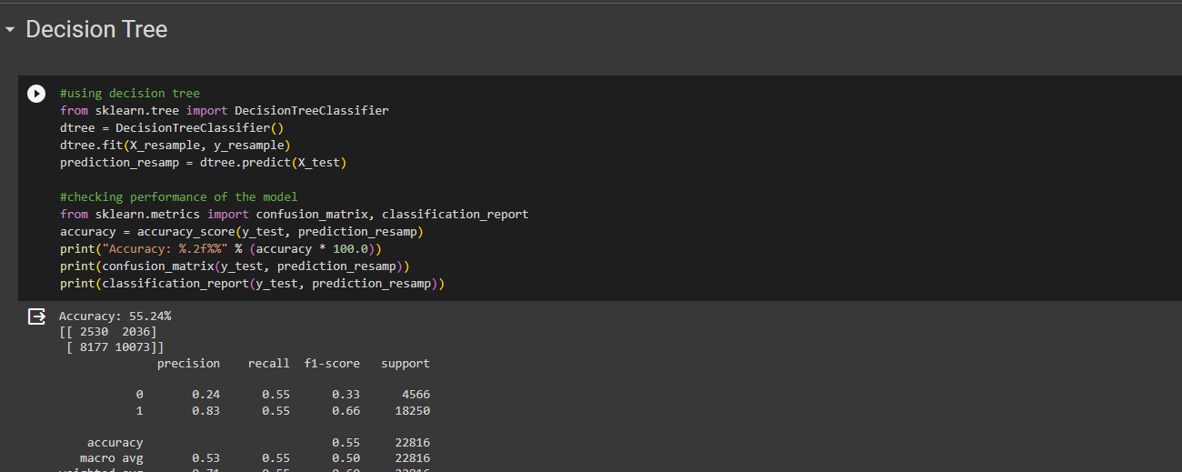
Decision Tree model with f1 score

