Slide 1

Building AI powered solution for assisting visually impaired individuals
by Ritam Paul (Intern id – IN9240185)

Slide 2
Central idea
This project aims to leverage Generative AI to assist visually impaired individuals in perceiving and interacting with their surroundings.
Visually impaired individuals often face challenges in understanding their environment, reading visual content, and performing tasks that rely on sight.
There is a need for an intelligent, adaptable, and user-friendly solution that provides:
Real-time scene understanding.
Text-to-speech conversion for reading visual content.
Object and obstacle detection for safe navigation.
Personalized assistance for daily tasks.
So, this is an AI-powered application made using Streamlit that provides assistive functionalities through image analysis. This application should allow users to upload an image and implement the following features:
Real-Time Scene Understanding Generating descriptive textual output that interprets the content of the uploaded image, enabling users to understand the scene effectively.
Object and Obstacle Detection for Safe Navigation Identifying objects or obstacles within the image and highlight them, offering insights to enhance user safety and situational awareness.

Slide 3
Tech stacks used
Langchain - LangChain is a software framework that helps facilitate the integration of large language models (LLMs) into applications. As a language model integration framework, LangChain's use-cases largely overlap with those of language models in general, including document analysis and summarization, chatbots, and code analysis.
Reference - https://www.langchain.com/
Streamlit - Streamlit is an open-source Python library that makes it easy to build beautiful custom web-apps for machine learning and data science. To use it, just pip install streamlit, then import it, write a couple lines of code, and run your script with streamlit run .. Streamlit watches for changes on each save and updates the app live while you're coding. Code runs from top to bottom, always from a clean state, and with no need for callbacks.
Reference - https://streamlit.io/
Google generative AI - Google AI is a division of Google dedicated to artificial intelligence. It was announced at Google I/O 2017 by CEO Sundar Pichai. Gemini, formerly known as Bard, is a generative artificial intelligence chatbot developed by Google. Based on the large language model (LLM) of the same name, it was launched in 2023 after being developed as a direct response to the rise of OpenAI's ChatGPT.
Reference - https://ai.google/get-started/products/

Slide 4
Methodology
System Design –
Designed a modular architecture using Streamlit for the frontend and Google Gemini API for backend processing.
Defined key features: image insight generation and obstacle detection.
Implementation –
Developed the application with Streamlit, integrating Google Gemini API for image analysis.
Utilized Langchain for managing interactions and generating natural language responses.
Testing –
Conducted unit testing on individual components and user testing for feedback.
Assessed performance regarding accuracy and response time.
Deployment –
Deployed and tested the application in local system host for accessibility.

Slide 5
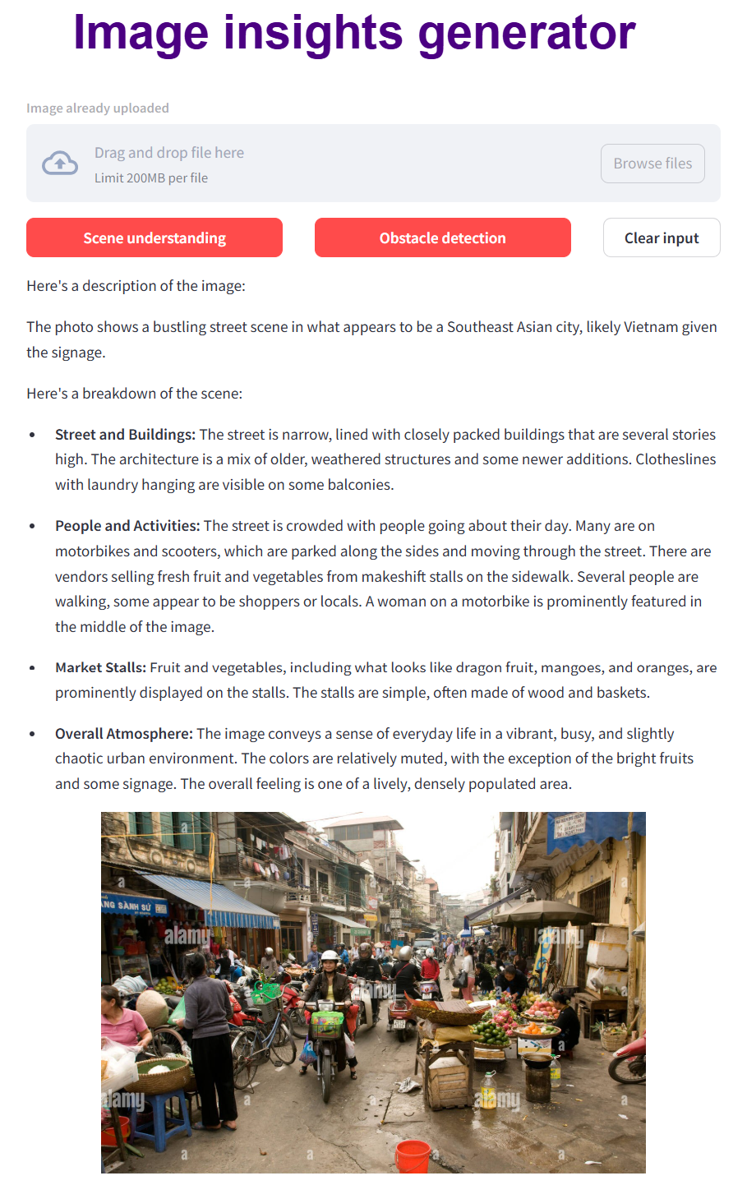
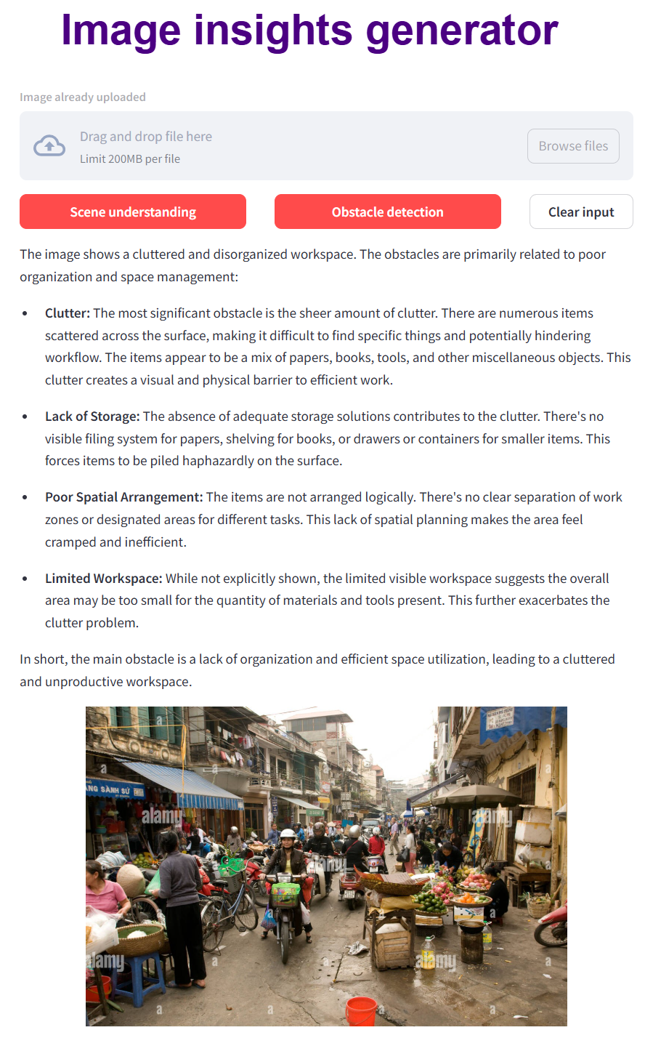
Working Images

Slide 6
Conclusion
In summary, the project developed an AI-powered solution to assist visually impaired individuals through image insights and obstacle detection.
Few features to address:
Accuracy: Ensuring reliable object and obstacle detection.
Accessibility: Creating an intuitive user interface for visually impaired users.
Real-World Testing: Validating performance for diverse inputs.
User Support: Providing training and assistance for effective use by using google’s api.
Data Privacy: Protecting user information and ensuring security.

Slide 7
Acknowledgement
I would like to express my sincere gratitude to Innomatics Research Labs for providing me with the opportunity as a Data Science with GenAI intern. I am specially thankful to Kanav Bansal Sir for his valuable guidance, support, and mentorship throughout this internship period. His insights and expertise have helped me very much in shaping my understanding of the subject and enhancing my skills.
I also appreciate the collaborative environment and resources provided by the team at Innomatics and community friends, which greatly contributed to the success of this project. Thank you to everyone who supported me directly or indirectly during this entire period.
With regards,
Ritam Paul
(IN9240185)

