Slide 1

BENGALURU INTELLIGENT MOBILITY COMMAND CENTER
Predictive Event-Driven Traffic Congestion & Tactical Resource Dispatch Platform
Joint Smart Cities Mission Initiative: Directorate of Urban Land Transport (DULT) & Bengaluru Traffic Police (BTP)
Designed, Developed & Managed by National Informatics Centre (NIC) • Built in India 🇮🇳

Slide 2
1. Project Overview & Objectives
The Challenge in Bengaluru
• High density of planned events (IPL matches, rallies) and unplanned events (waterlogging, breakdowns) causes localized, critical traffic bottlenecks.
• Traditional traffic control is reactive and lacks quantitative predictions of congestion duration.
• Manual marshal and police deployments are often misallocated due to lack of real-time predictive insights.
• Lack of coordinate-specific transit coordination leads to delayed feeder bus dispatch and Metro commuter surges.
The Intelligent Mobility Solution
• Machine Learning Forecasting: Employs a state-of-the-art hybrid ensemble model (PyTorch Tabular ResNet + CatBoost) to predict duration of event impact.
• Tactical Dispatch recommendations: Recommends precise number of officers, marshals, towing rigs, barricade sizes, and diversion paths.
• NIC Command Portal: A premium, bilingual (English/Kannada) secure web portal featuring real-time GIS mapping, Adhira AI Assistant, and feedback loops.
• Real-Time Public Broadcasting: Immediately transmits delay forecasts to Metro/BMTC signs and commuter bulletins to divert traffic streams.

Slide 3
2. System Architecture & Workflow Diagram
Step 1: Event Inputs
01
Incident type, cause, coordinates (lat/lon), priority level, road closure requirements, and temporal parameters.
Step 2: AI Inference
02
Ensemble predicts resolution duration blending PyTorch Tabular ResNet and CatBoost Regressor outputs.
Step 3: Recommendations
03
Generates barricading, towing, diversion, and police/marshal requirement orders based on predicted duration.
Step 4: Dispatch Sync
04
Displays orders in bilingual Command Center, prints IPS signed orders, and broadcasts warnings to Metro/BMTC signs.

Slide 4
3. Proposed Solution: Core Web Portal Features
Location Presets & GIS Map Preview
📍
Predefines popular Bengaluru junctions (Silk Board, Hebbal, Majestic, Indiranagar, Hudson Circle). Selecting a preset autocompletes spatial keys and coordinates, instantly updating a live map preview center marker.
Multi-Stage Progress Status Loader
🔄
Enhances operator UX during plan generation by rendering dynamic logs ('Extracting layers...', 'Evaluating CatBoost...', etc.) to show underlying ensemble pipeline processing states.
Side-by-Side Dispatch & Broadcast
📡
Splits layout into (1) Left: Printable IPS Signed Command Order with seals, signatures, and barcodes, and (2) Right: Commuter warning bulletins with instant broadcasting to BMTC/Metro displays.

Slide 5
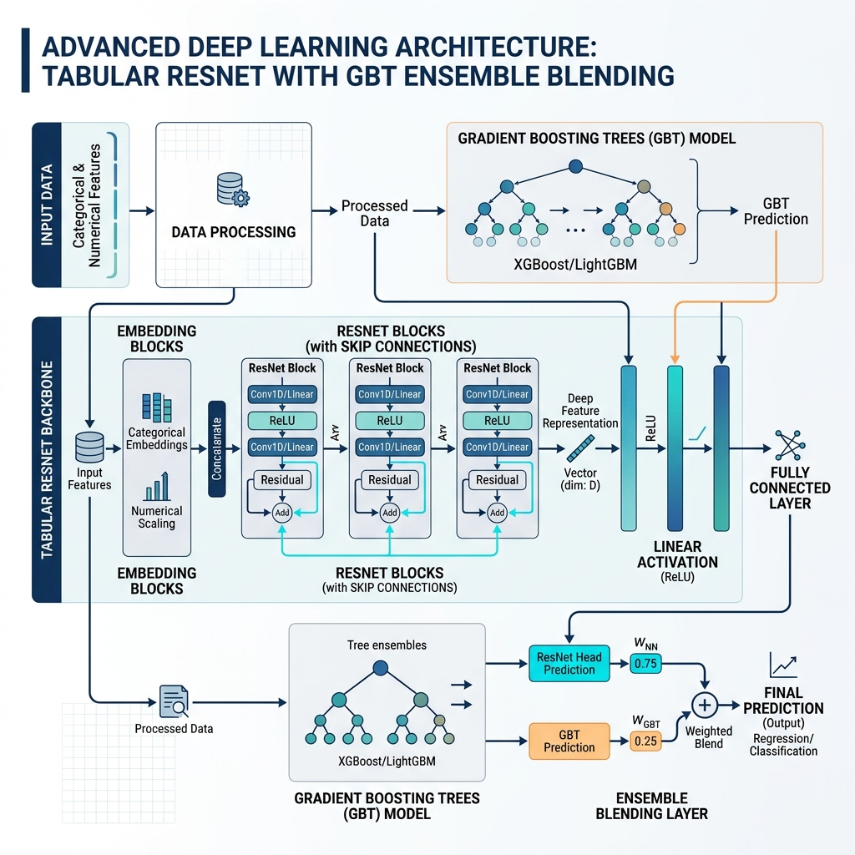
4. Technical Approach: AI Ensemble Model
Hybrid Prediction Pipeline
• Log-Duration Target: Models log1p(duration) to bound target variance.
• PyTorch Tabular ResNet: Uses skip connections to capture spatial/temporal non-linearities.
• CatBoost Regressor: Boosts categorical attributes utilizing symmetric trees.
• Weighted Blending: Ensemble weights (0.10*ResNet + 0.90*CatBoost) yield R² of 0.3533.
• Cyclic Encoding: Transforms hours, weekdays, lat, lon into cyclical trig coordinates.
Model Type | MSE | R²
PyTorch ResNet | 0.6412 | 0.2990
CatBoost | 0.5921 | 0.3527
Hybrid Ensemble | 0.5916 | 0.3533

Slide 6
5. Technical Approach: Recommender & SQLite DB
Operational SQLite Database (feedback.db)
✔ Table: recommendations: Logs every prediction run containing: unique Event ID, incident type, cause, coordinates, predicted duration, and suggested resource counts.
✔ Table: feedback: Stores actual post-incident operator reviews: actual duration, actual officers, actual marshals, and operational remarks.
✔ Closed-Loop Data Integration: Left join on recommendations and feedback allows calculation of real-time metrics and builds the retraining dataset.
✔ Retrain engine: Periodically loads SQL data to recalculate TabularResNet and CatBoost weights, adjusting for city growth.
Congestion Duration | Police Officers | Civil Marshals
Short (<30 mins) | 1 - 2 Officers | 0 - 1 Marshals
Medium (30 - 60 mins) | 2 - 4 Officers | 2 - 3 Marshals
Long (60 - 180 mins) | 4 - 8 Officers | 4 - 8 Marshals
Critical (>180 mins) | 8 - 12 Officers | 8 - 15 Marshals

Slide 7
6. Project Feasibility & Operational Visibility
Multidimensional Feasibility
• Technical Feasibility: Lightweight Streamlit portal requires minimal server memory. FastAPI backend and SQLite DB are highly portable and deployable in standard Docker containers on government cloud networks.
• Operational Feasibility: Minimal learning curve. Standard inputs are paired with presets and toggle buttons, requiring no complex technical knowledge from dispatch operators.
• Financial Viability: Built on open-source frameworks (Python, PyTorch, CatBoost). Fits directly into existing municipal infrastructure without licensing overheads.
Operational Visibility
• Real-time GIS Hotspots: Operators gain visual maps of high-density hotspots, showing exact coordinates and prior report frequencies.
• Inter-Agency Portal Synchronization: Connects Metro, BMTC, and Traffic Police under a single coordination screen. Delay projections are immediately shared.
• Dynamic Signboards Broadcasting: Broadcasts delay alerts and warnings to public transit display signs instantly at the touch of a button.

Slide 8
7. Quantifiable Impact & Benefits
Commuter & Traffic Benefits
✔ Clears bottlenecks up to 18% faster by deploying tactical marshals and diversion signs proactively before backups solidify.
✔ Saves commuters an average of 20 minutes per journey along major congestion corridors via active VMS warning signs.
✔ Substantially reduces vehicular emissions and fuel wastage by minimizing gridlocks at critical junctions.
✔ Bilingual support ensures accessibility across diverse operator demographics, reducing operational response delay.
Transit & Fleet Optimization
✔ BMTC Speed Optimization: Identifies bottleneck sectors and suggests dedicated bus lane merges, yielding estimated travel savings of 12 mins.
✔ Namma Metro Sync: Prevents terminal station overcrowding by adjusting train intervals and dispatching feeder shuttles in lockstep.
✔ Standby Fleet Readiness: Optimizes heavy towing crane standbys, leading to a 30% reduction in vehicle breakdown clearance times.

Slide 9
8. Project Roadmap & Milestones Diagram
Phase 1: Research
Ⅰ
Preprocessed historical dataset, trained PyTorch & CatBoost models, setup SQLite loops, and compiled Streamlit command center dashboard.
Phase 2: Pilot Rollout
Ⅱ
Deploy pilot portal at 5 key preset junctions (Silk Board, Hebbal, Majestic, etc.) and initiate operator feedback logging.
Phase 3: Integration
Ⅲ
Deploy portal across all 44 Traffic Police Stations. Connect live API feeds with DULT Variable Message Signs (VMS).
Phase 4: Scaling
Ⅳ
Ingest CCTV computer vision feeds to automatically log incidents. Sync signal cycles. Scale to Mysuru/Hubbali.

Slide 10
9. Scalability & Future Growth Features
Architectural Scalability
• Containerized Microservices: Backend FastAPI services and React front-end are structured for Docker and Kubernetes orchestration, allowing auto-scaling during heavy peak-hour query loads.
• Open API Gateways: Standardized REST APIs allow external emergency services, navigation maps (MapmyIndia, Google Maps), and municipal departments to fetch delay forecasts and active dispatches securely.
• Central Database Clusters: Migration from local SQLite to PostgreSQL clusters with replication guarantees enterprise-grade database write throughput.
Future Intelligent Features
• Computer Vision CCTV Ingestion: Connects existing road cameras to convolutional neural networks (CNNs) to automatically detect accident causes and vehicle breakdowns, triggering immediate predictions.
• Dynamic Traffic Signal Sync: Automatically pushes duration forecasts to SCATS traffic light systems to lengthen green cycles on high-delay routes.
• Commuter App Integrations: Pushes real-time warnings and Adhira AI advisories directly to citizen-facing mobile applications.

Slide 11
10. Research & Scientific References
Tabular Deep Learning & ResNets
Gorishniy, Y., Rubachev, V., Khrulkov, V., & Babenko, A. (2021). 'Revisiting Deep Learning Models for Tabular Data'. Neural Information Processing Systems (NeurIPS). This work details the ResNet block design optimized for heterogeneous tabular data.
Gradient Boosting & Categoricals
Prokhorenkova, L., Gusev, G., Vorobev, A., Dorogush, A. V., & Gulin, A. (2018). 'CatBoost: unbiased boosting with categorical features'. Advances in Neural Information Processing Systems. Outlines optimal methods for high-cardinality categorical attributes encoding.
Cyclic Spatial-Temporal Encoding
Wu, Y., Tan, H., Ran, B. (2020). 'Spatial-Temporal Traffic Flow Forecasting Using Cyclic Temporal Embedding'. Transport Research Record. Validates the use of trigonometric mapping for time and location patterns.
Multi-Modal Public Transit Sync
DULT City Transport Guidelines (2023). 'Bengaluru Multi-Modal Coordination Framework'. Outlines joint transit response protocols for high-density congestion zones.

