Slide 1

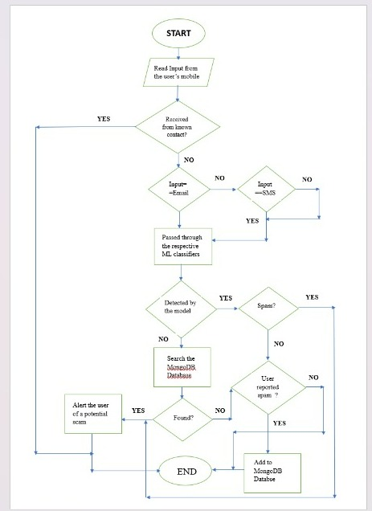
Idea/Approach Details
Some Key Points About Spam Alert System:
The system will first take any incoming call, SMS or email as input.
Incoming phone numbers will be routed through a ML model trained on a CDR dataset to classify it either as a spam or a ham
The system will pass the emails or messages though a NLP model to classify it either as spam or ham.
In case of any phone number SMS or email unknown to the datasets the system will add the same to the spam database based on the report of the user.
The system will look for the spam details both from pre-trained datasets as well as the database.
Technology stack :
Text analysis and processing: Natural language processing library NLTK
Messaging platform for sending alerts to users: Twilio
Database System for storing data : MongoDB
Model training: TensorFlow, sci-kit learn
App framework : Flutter

Slide 2
Idea/Approach Details
Use Cases
Dependencies / Show stoppers
Identifying and blocking spam calls : This system can analyse spam calls in real-time using ML algorithms like CNN, SVM Classifiers, KNN and alert users enabling them to immediately block those calls.
Identifying and blocking spam text messages : The system examines the message's content and spot patterns and traits using NLP and Regression techniques to filter those messages and block them.
Identifying and Blocking Spam Emails : This system can detect potential harmful emails like phishing attempts scams or unsolicited marketing emails and alerting the users of the same.
Reporting spam : Users can report SMS, emails or calls as spam as a result of which the senders details will be added to our database thus preventing same kind of attacks on other users.
Reducing distractions and interruptions : By screening out undesirable calls and messages, the system minimizes the interruptions , enabling users to concentrate on crucial jobs or activities.
Accuracy and false positives : The system may classify legitimate calls or emails as spam thus frustrating the user and producing excessive number of false positives.
Outdated databases and algorithms : The system might not be able to correctly identify newer spam patterns and features if these databases and algorithms are not routinely updated.
User privacy concerns : Some consumers may feel uncomfortable sharing their data with third-party platforms due to privacy concerns.
Technical limitations : The technological capabilities of the hardware, such as network connectivity, processing speed, or memory, may be restricted , affecting the system's accuracy and speed.
Cost : It can be expensive to create and maintain the system, especially for smaller businesses or service providers. Users may be charged for these expenses or the system's accessibility may be restricted in some areas.

