Slide 1
MapEdit Project Review
Game Tool Development
---王传霸 & 曹亚男

Slide 2
Outline
Project overview
Requirements mapping
Software interface
Function introduction

Slide 3
Outline
Project overview
Requirements mapping
Software interface
Function introduction

Slide 4
Project overview
Map editor is a WYSIWYG game map maker, which assists the design and output of map data
1
Generation of ground surface
2
Arrangement of map objects
3
Setting of map attributes
4
Map data output

Slide 5
Outline
Project overview
Requirements mapping
Software interface
Function introduction

Slide 6
Requirements mapping
No. | Item | Content | Execution
1 | Model loading | Loading surfaces, trees and other object models | Already completed
2 | Model rendering | Provide 3D rendering scene, support for model display and simple animation | Already completed
3 | Attributes setting | Support the basic properties of the model settings, including location, size, etc. | Already completed
4 | Model derived | Save the edited model and the scene around bin files | Hang in the air
5 | Log management | Procedures for the log output, convenient for users to operate backtracking | Already completed

Slide 7
Outline
Project overview
Requirements mapping
Software interface
Function introduction

Slide 8
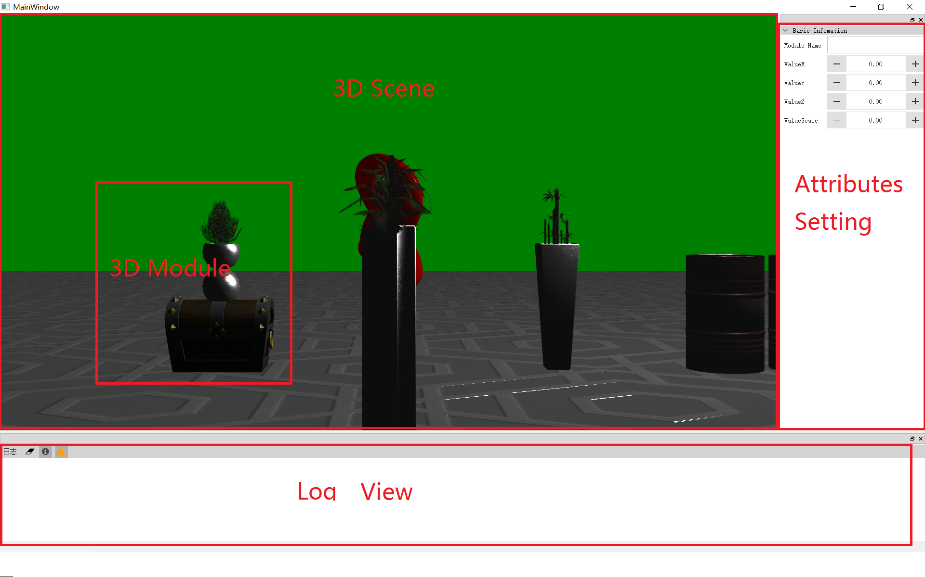
Software Interface
Contains total of 3 views, each view supports the window floating

Slide 9
Outline
Project overview
Requirements mapping
Software interface
Function introduction

Slide 10
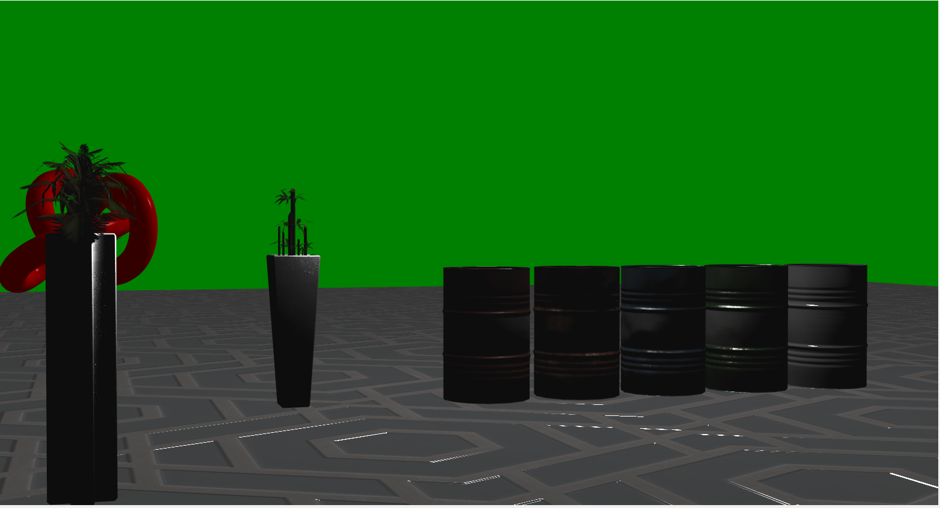
Model loading and rendering

Slide 11
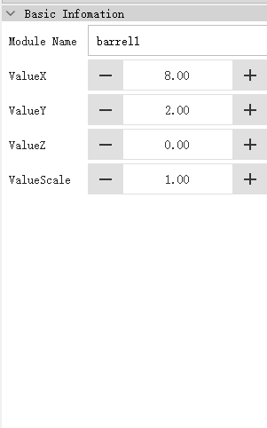
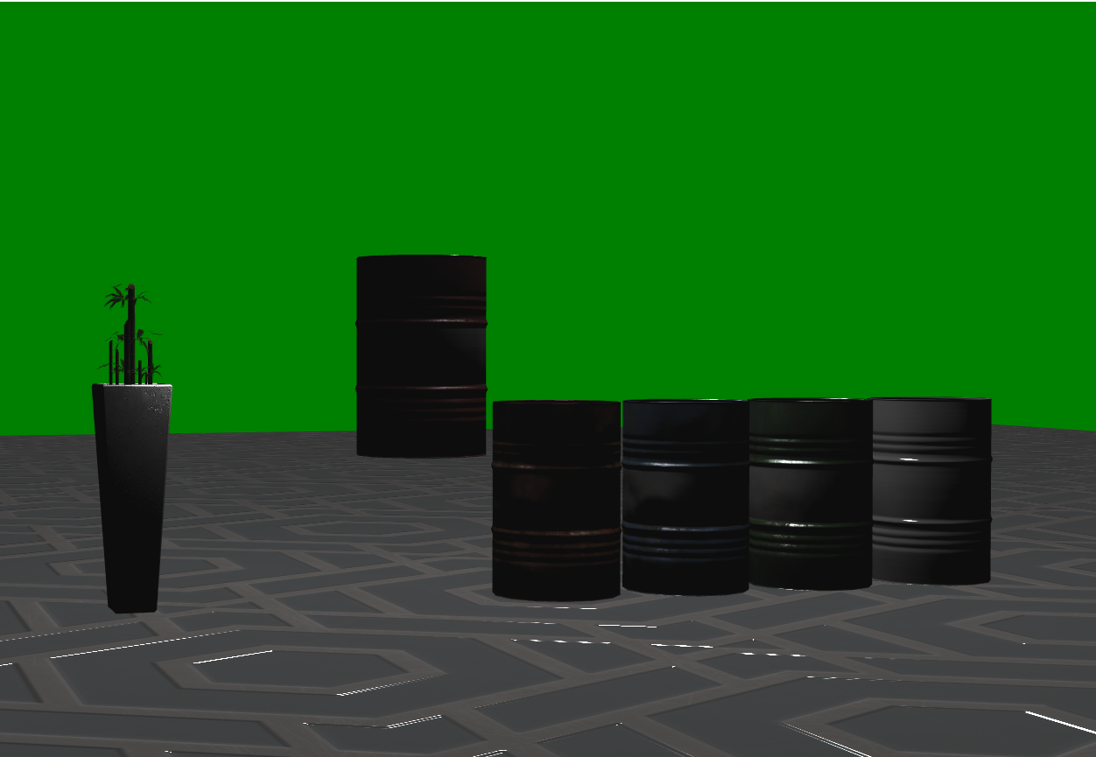
Attributes view and edit
Localtion changed

Slide 12
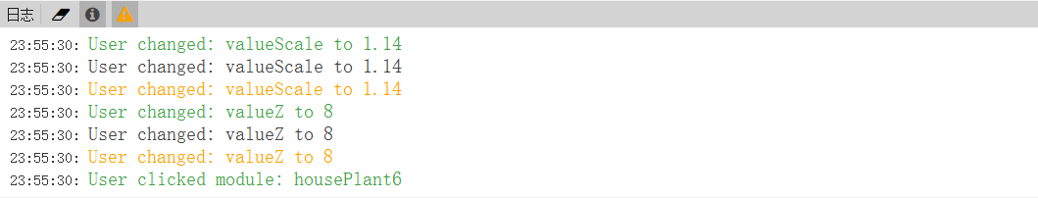
Log Management
Different colors represent different log output, include debug, error, warning and common informations

Slide 13
Thanks for listening

