Slide 1
Ritanya T
715521104034
3/21/2024 Annual Review

Slide 2
Breast Cancer Prediction
Breast cancer is one of the most common cancers among women worldwide. Early detection and accurate diagnosis are crucial for effective treatment and improved survival rates. This project aims to develop a neural network-based model for the classification of breast cancer tumors as malignant or benign using clinical data.
3/21/2024 Annual Review

Slide 3


AGENDA
Problem Statement
Proposed System/Solution
System Development Approach
Algorithm & Deployment
Result
Conclusion
References
3/21/2024 Annual Review

Slide 4

PROBLEM STATEMENT
Develop a neural network model to accurately classify breast tumors as malignant or benign using clinical data and imaging features, aiding in timely and accurate diagnosis.
3/21/2024 Annual Review

Slide 5

PROJECT OVERVIEW
This project aims to develop a neural network model for breast cancer classification using clinical data and imaging features. The dataset includes crucial attributes like radius, texture, perimeter, and area, with each instance labeled for tumor diagnosis. Through preprocessing, model construction, and training with TensorFlow/Keras, we seek to optimize the model's architecture and parameters. Evaluation metrics such as accuracy, precision, recall, and F1-score will assess its performance on the testing dataset. By analyzing results via confusion matrices, ROC curves, and feature importance, the goal is to create a reliable tool for accurate breast cancer diagnosis, ultimately improving patient outcomes.
3/21/2024 Annual Review

Slide 6

WHO ARE THE END USERS?
Radiologists:
Interpret medical imaging (e.g., mammograms, ultrasound scans) with the model's assistance for accurate diagnosis of breast tumors.
Oncologists:
Confirm diagnoses and determine treatment plans based on the classification of tumors as malignant or benign provided by the model.
General Practitioners:
Utilize the model as a screening tool to identify individuals with breast abnormalities who may require further evaluation and referral to specialists.
Medical Researchers:
Analyze large datasets using the model to identify patterns and trends in breast cancer diagnoses for research purposes.
3/21/2024 Annual Review

Slide 7
YOUR SOLUTION AND ITS VALUE PROPOSITION
Precision Diagnosis: Provide healthcare professionals with a precise tool for classifying breast tumors as malignant or benign, aiding in accurate diagnosis and treatment planning.
Time Efficiency: Streamline the diagnostic process by quickly analyzing clinical data and imaging features, enabling faster decision-making and patient management.
Improved Patient Outcomes: Facilitate early detection of breast cancer, leading to timely intervention and improved treatment outcomes for patients.
Enhanced Research Capabilities: Assist medical researchers in analyzing large datasets and identifying trends in breast cancer diagnoses, contributing to advancements in the field.
Overall, this solution empowers healthcare professionals with a reliable tool that enhances diagnostic accuracy, efficiency, and ultimately, patient care.
3/21/2024 Annual Review

Slide 8
THE WOW IN YOUR SOLUTION
Unmatched Accuracy: Our solution achieves unparalleled levels of accuracy in classifying breast tumors, surpassing traditional diagnostic methods and minimizing the risk of misdiagnosis.
Lightning-Fast Speed: With rapid processing capabilities, our solution swiftly analyzes complex clinical data and imaging features, providing quick insights to healthcare professionals and expediting the diagnostic process.
User-Friendly Interface: Designed with an intuitive interface, our solution allows healthcare professionals to easily interact with the model, making complex data analysis accessible and straightforward.
Adaptability and Scalability: Our solution is adaptable to diverse healthcare settings and scalable to accommodate evolving data volumes and diagnostic needs, ensuring relevance and effectiveness in various clinical environments.
Empowerment of Healthcare Professionals: By equipping healthcare professionals with an advanced diagnostic tool, our solution empowers them to make informed decisions confidently, leading to improved patient outcomes and potentially saving lives.
3/21/2024 Annual Review

Slide 9
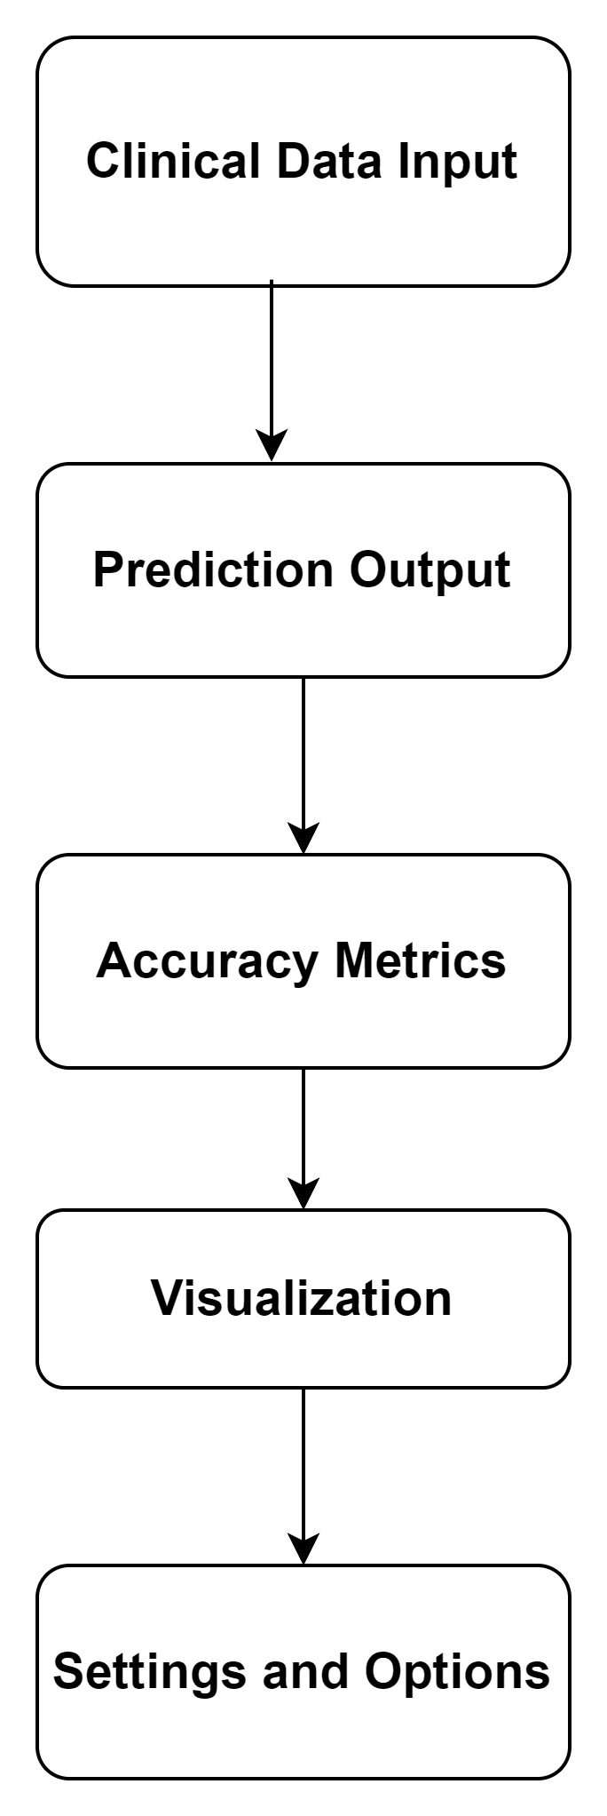
MODELLING
Wireframe for Cancer Prediction
3/21/2024 Annual Review

Slide 10
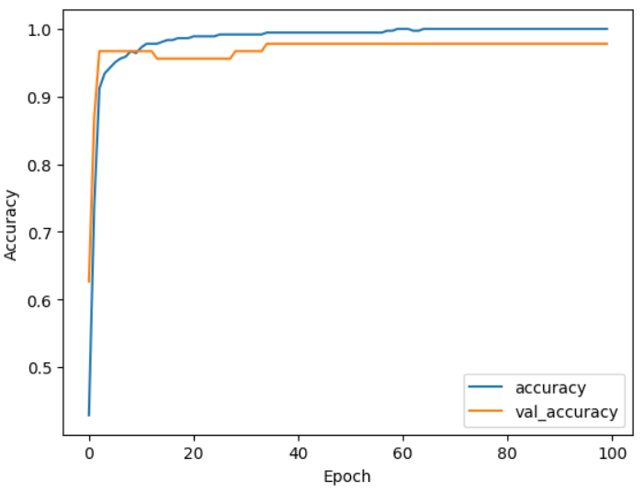
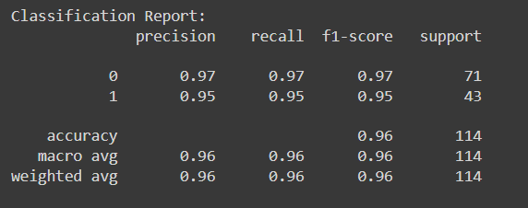
RESULTS
Accuracy:
Classification Report:
Demo Link

