Slide 1
PV Module Performance Dependence on Mounting Orientation and Axis Tracking
EE 770 Course Project Final Presentation
Saarvani Vempati : 150100001(2-8)
Ritesh Kumar : 15D070033(9-17)
7 April 2019

Slide 2
PROBLEM STATEMENT
What is the optimal tilt angle of the solar panel ?
What is the optimal azimuth angle for best performance?
How will axis tracking help?
2/17
Saarvani Vempati

Slide 3
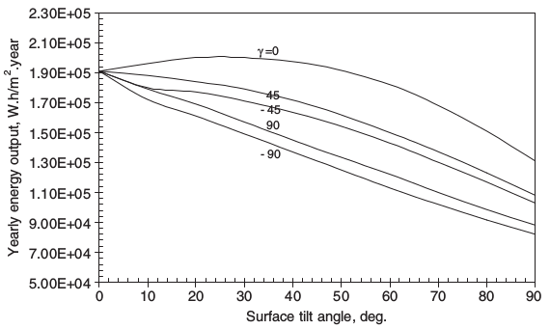
TILT ANGLE EFFECT
HYPOTHESIS :
In the paper (Ref. 1), performance parameter evaluated at different mounting orientations (loc. Egypt)
Performance deteriorates at high tilt angles
Tilt angle is equal to latitude for optimal performance
Fig.1 .Ref : Performance evaluation of photovoltaic modules at different tilt angles and orientations - H.M.S. Hussein * , G.E. Ahmad, H.H. El-Ghetany
3/17
Saarvani Vempati

Slide 4
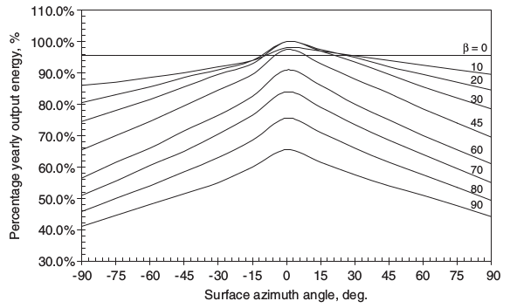
AZIMUTH ANGLE EFFECT
HYPOTHESIS :
Avg. energy output is maximum for North/South facing modules (depends on hemisphere)
Module should be facing north in southern hemisphere and south in northern hemisphere.
Fig.2 . Ref : Performance evaluation of photovoltaic modules at different tilt angles and orientations - H.M.S. Hussein * , G.E. Ahmad, H.H. El-Ghetany
4/17
Saarvani Vempati

Slide 5
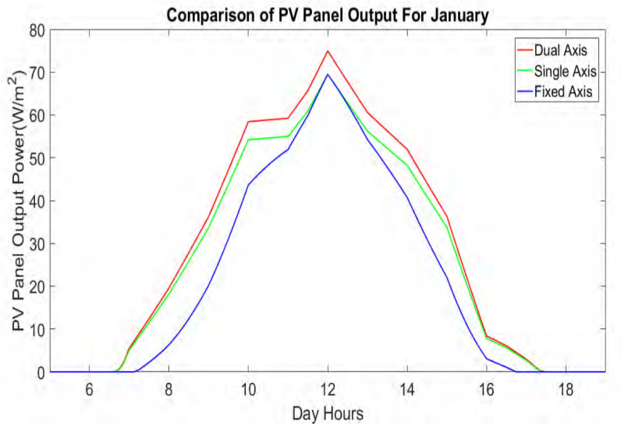
AXIS TRACKING EFFECT
HYPOTHESIS :
In the paper (Ref. 2), compared performance of single axis and dual axis tracking to fixed axis modules
Performance dependent on seasons and location
On average, axis tracking increases performance by 23 - 28 %
Fig.3 . Ref : Performance Comparison Between Fixed Panel, Single-axis
and Dual-axis Sun Tracking Solar Panel System - Kamrul Islam Chowdhury, Md.Iftekhar-ul-Alam & Promit Shams Bakshi
5/17
Ritesh Kumar

Slide 6
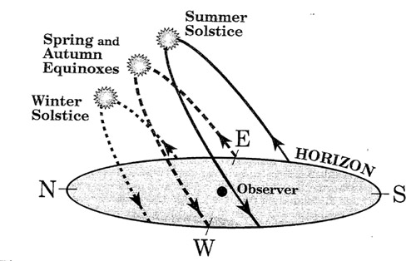
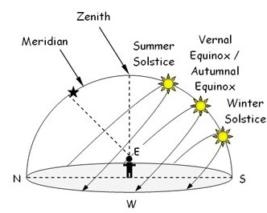
SUN PATH
Supports the hypothesis of azimuthal angle
Southern Hemisphere
Northern Hemisphere
Fig.4,5 . Ref:https://mydarksky.org/2009/12/22/solstices-and-equinoxes/
6/17
Ritesh Kumar

Slide 7
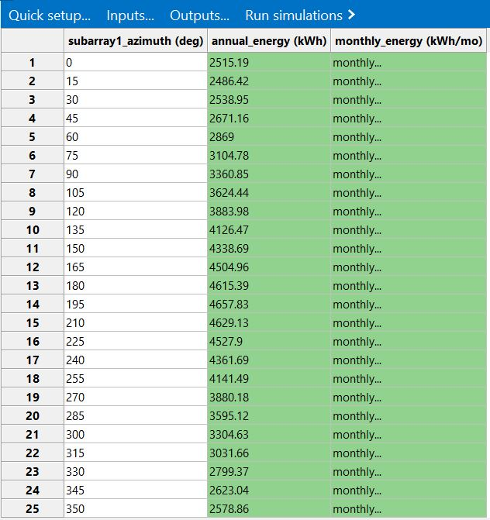
SIMULATION : AZIMUTHAL ANGLE
Parametric analysis on SAM :
Input Parameter : Azimuthal angle (0 to 350° instep of 15° ).
Output results :
Annual energy
Monthly energy
Locations :
Northern hemisphere (7 loc)
Equatorial region (6 loc)
Southern hemisphere (7 loc)
Extreme south and North(1 each)
7/17
Ritesh Kumar

Slide 8
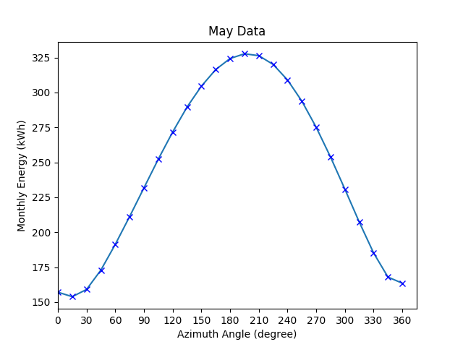
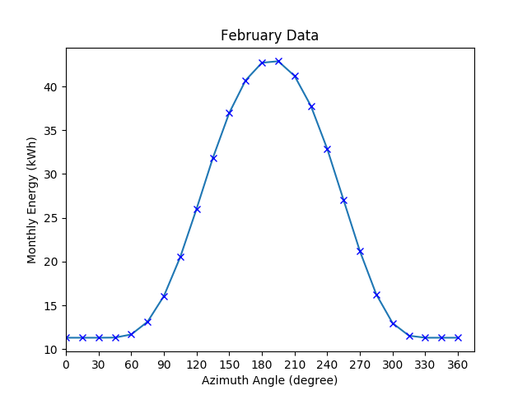
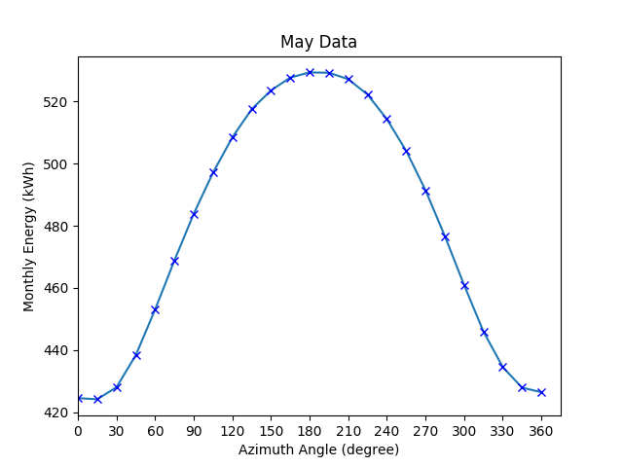
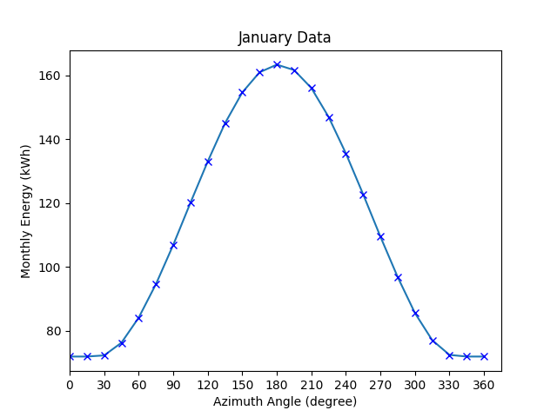
NORTHERN HEMISPHERE
Fig: Energy output vs azimuth angle in summer and winter months with tilt angle = latitude
Above : Greenland (at latitute 70°)
Below : Washington (at latitude = 46°)
Conclusion : Optimally module should be south facing
8/17

Slide 9
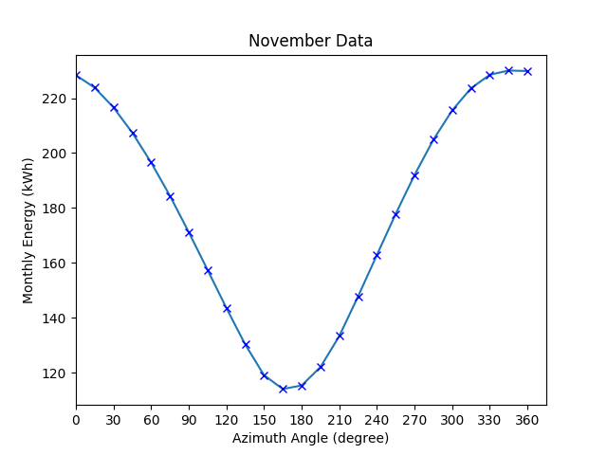
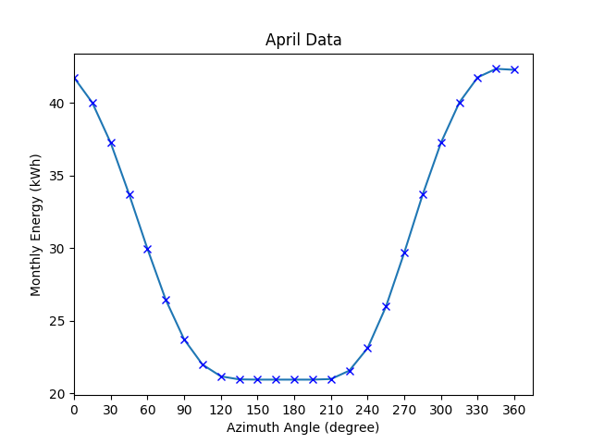
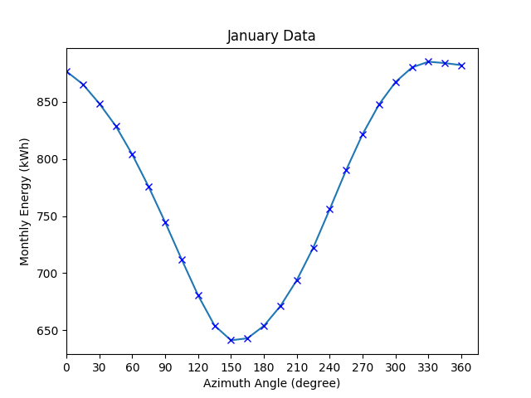
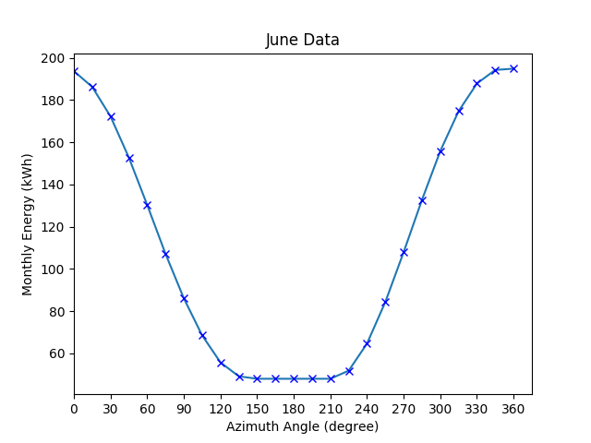
SOUTHERN HEMISPHERE
Fig: Energy output vs azimuth angle in summer and winter months with tilt angle = latitude
Above : Antartica (at latitute 63°)
Below : Argentina (at latitude 47°)
Conclusion : Optimally module should be north facing
9/17

Slide 10
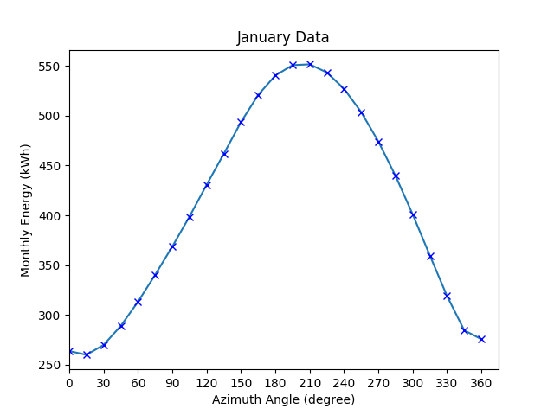
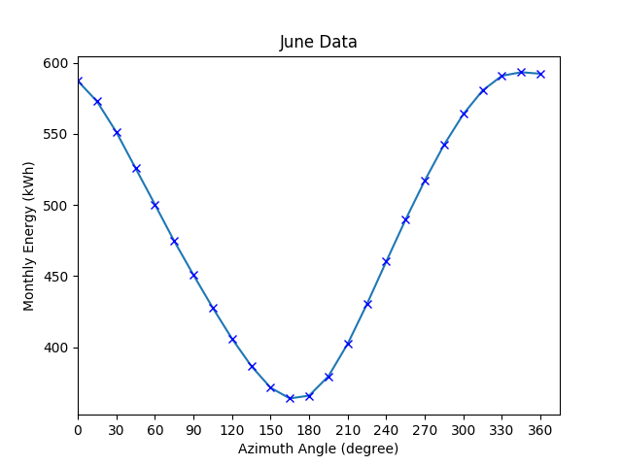
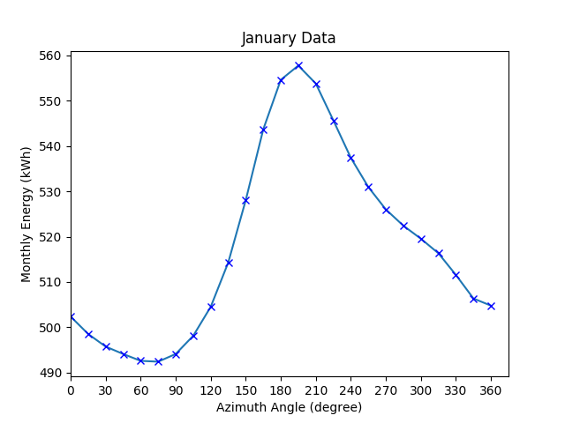
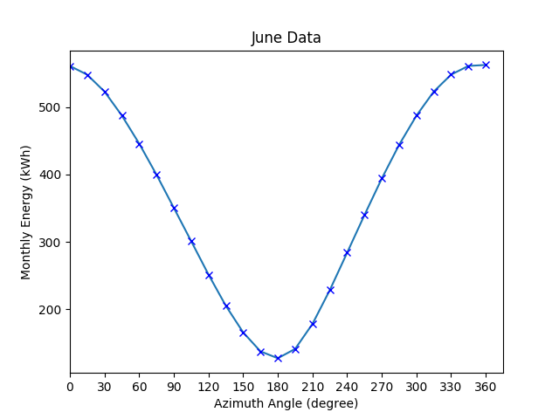
NEAR EQUATOR
Fig: Energy output vs azimuth angle in summer and winter months with tilt angle = latitude
Above : Chennai (at latitute 12°)
Below : Nam (at latitude -24°)
Conclusion : January - optimally facing south, June - optimally facing north
10/17

Slide 11
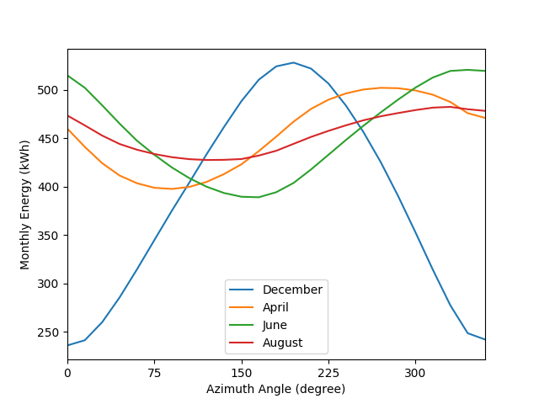
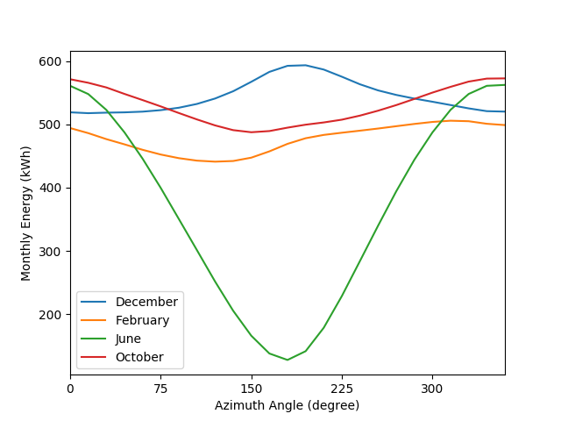
NEAR EQUATOR - CROSSOVER
Fig: Energy output vs azimuth angle - showing crossover months for Chennai (left) and Nam(right)
Conclusion: Crossover happens when sun path is directly above the location
11/17

Slide 12
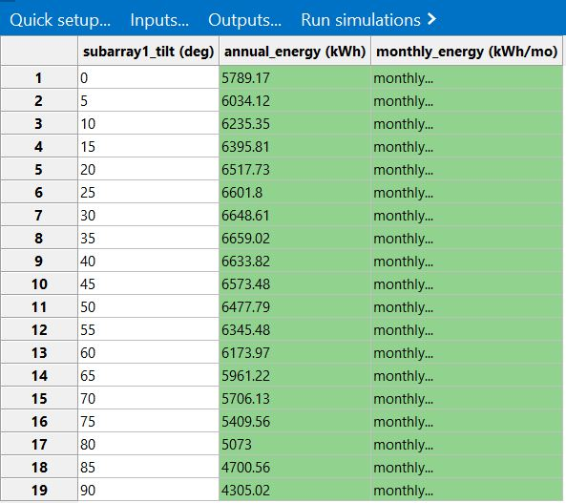
SIMULATION : TILT ANGLE
Parametric analysis on SAM :
Input Parameter : Tilt angle (0 to 90° in step of 5° ).
Output results :
Annual energy
Monthly energy
Locations :
Northern hemisphere (7 loc)
Equatorial region (6 loc)
Southern hemisphere (7 loc)
Extreme south and North(1 each)
12/17

Slide 13
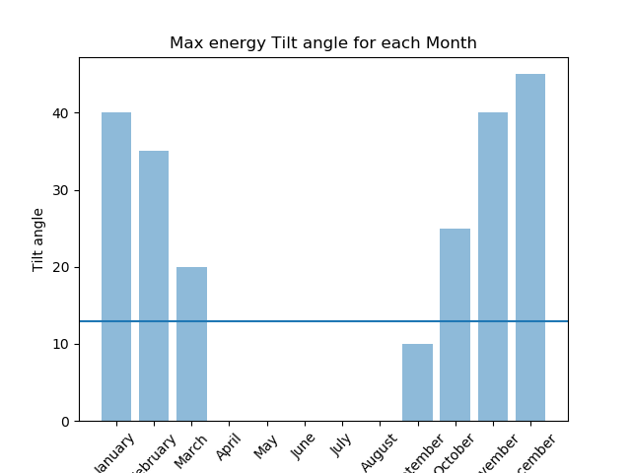
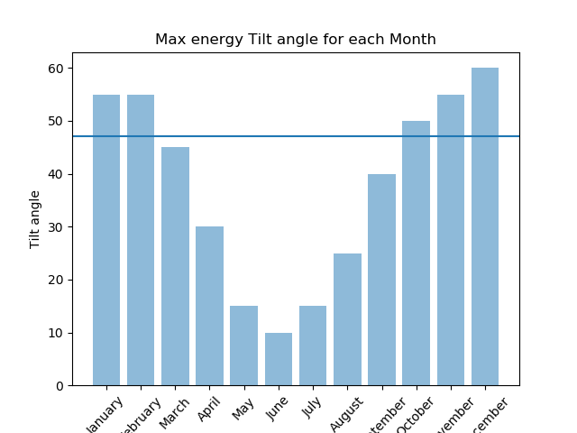
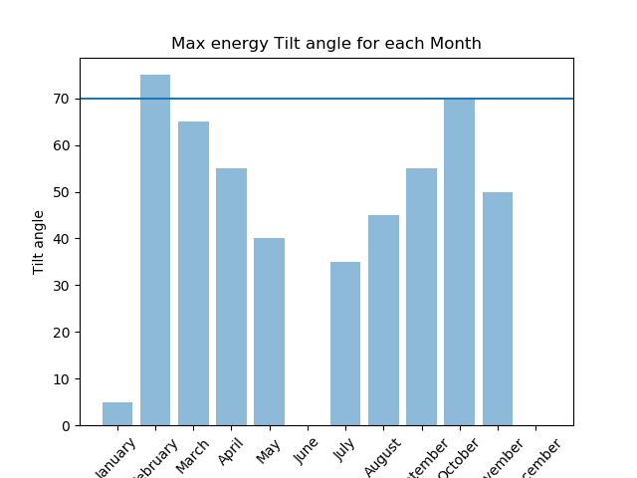
NORTHERN HEMISPHERE
Fig: Optimal tilt angle vs month (azimuth facing south)
Left: Chennai (12º), Center: Washington (47º), Left: Greenland (70º)
13/17
Saarvani Vempati

Slide 14
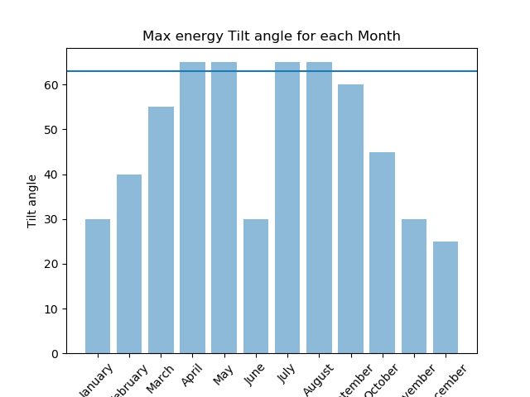
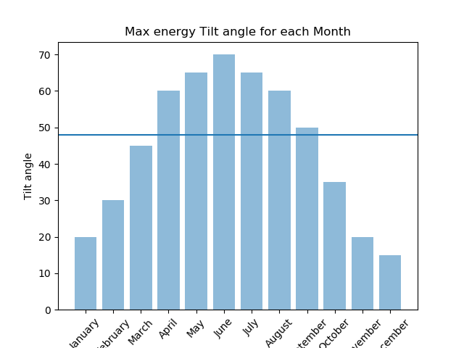
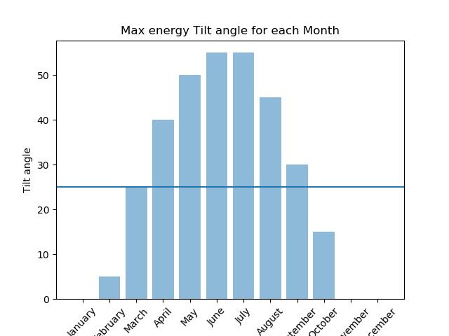
SOUTHERN HEMISPHERE
Fig: Optimal tilt angle vs month (azimuth facing south)
Left: Antartica(63º), Center: Argentina (47º), Left: Nam (-24º)
14/17
Saarvani Vempati

Slide 15
AXIS TRACKING
Proposal : Axis Tracking is more effective at lower latitudes. More variation in optimal tilt and azimuth angles can be seen at lower latitudes
Location | Fixed Axis (kWH) | Single Axis Tracking (kWH) | Dual Axis Tracking (kWH) | % increase -single axis tracking | % increase - single axis tracking
Washington (47º) | 4076 | 5395 | 5757 | 32.6 | 6.7
Blythe(33º) | 4818 | 6845 | 6995 | 42 | 2
Chennai(12º) | 4230 | 6276 | 7264 | 48 | 15.7
Uganda(0º) | 4131 | 6755 | 8647 | 49.5 | 28
15/17
Saarvani Vempati
Saarvani Vempati

Slide 16
CONCLUSION
Azimuthal angle for the panels should be facing north south (north in southern hemisphere and vice versa)
But in case of regions near equator, the result deviates between the summer and winter months.
Generally tilt = Latitude works, but we see that axis tracking helps a lot.
16/17
Saarvani Vempati

Slide 17
REFERENCES
Performance evaluation of photovoltaic modules at different tilt angles and orientations - H.M.S. Hussein * , G.E. Ahmad, H.H. El-Ghetany (2004)
Performance Comparison Between Fixed Panel, Single-axis and Dual-axis Sun Tracking Solar Panel System - Kamrul Islam Chowdhury, Md.Iftekhar-ul-Alam & Promit Shams Bakshi (2017)
17/17
Saarvani Vempati

