Slide 1
Version 2.4.3
biofilter.py
Version 2.4.4
biofilter/biofilter_modules/
biofilter/biofilter_modules/mixins/
database_management_mixin.py
input_source_mixin.py
biofilter.py
filter_annot_model_mixin.py
internal_query_build_mixin.py
input_data_parsers_mixin.py
paris_mixin.py
argparse_config.py
input_gene_mixin.py
logger_mixin.py
arg_utils.py
input_group_mixin.py
schema.py
input_locus_position_mixin.py
user_knowledge_input_mixin.py
biofilter_class.py
input_region_mixin.py
loki_data_retrieval_mixin.py
input_snp_mixin.py
user_knowledge_retrieval_mixin.py

Slide 2
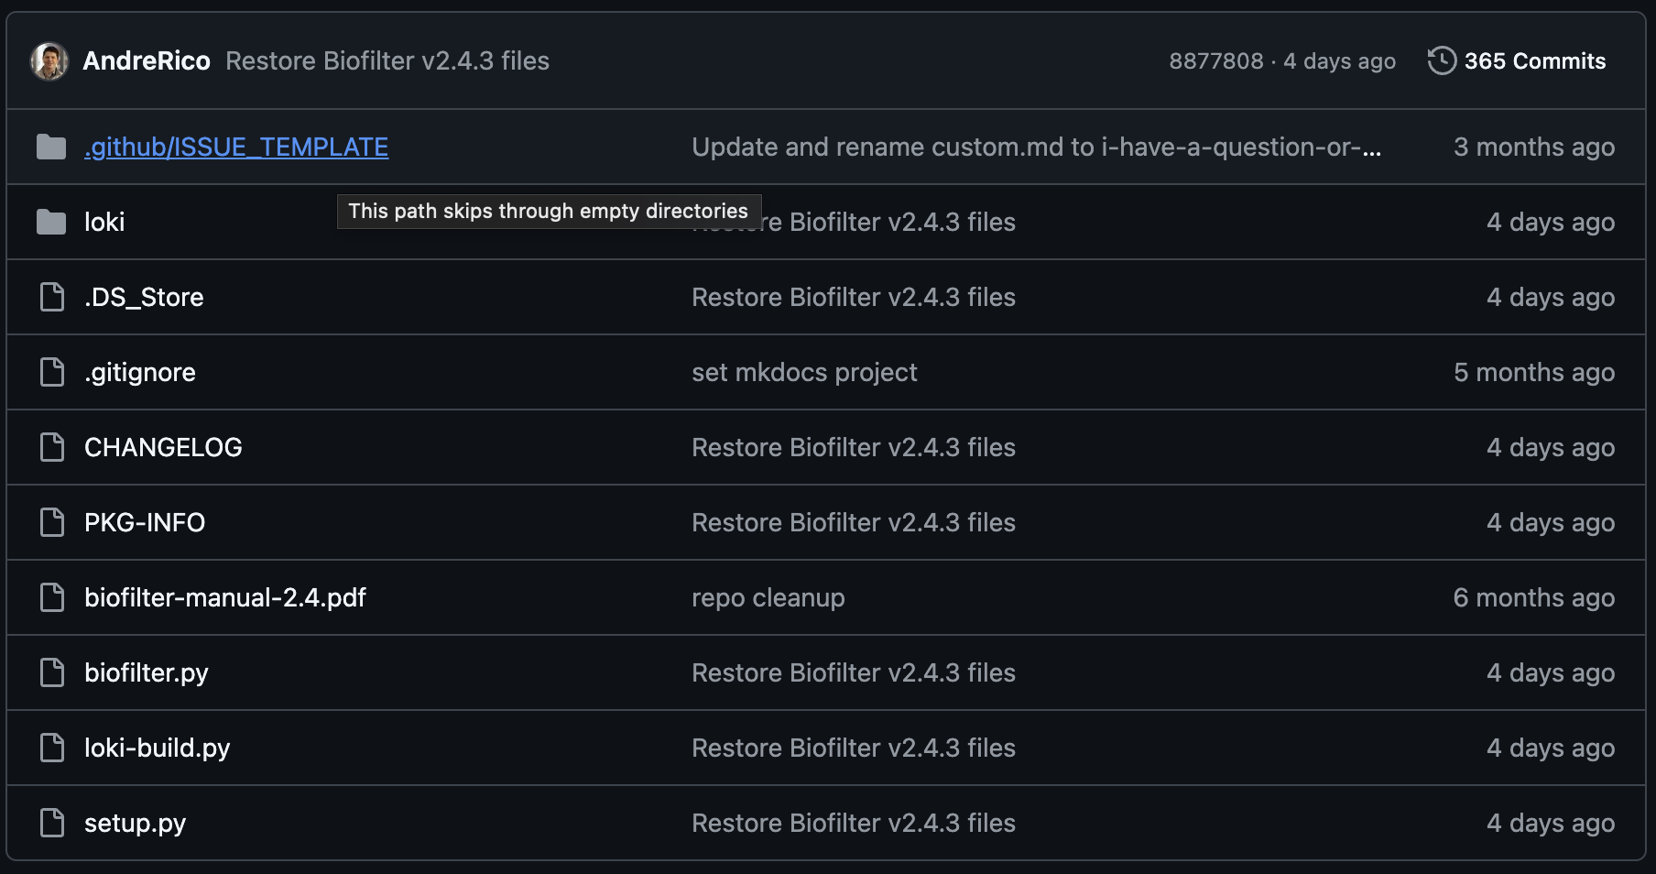
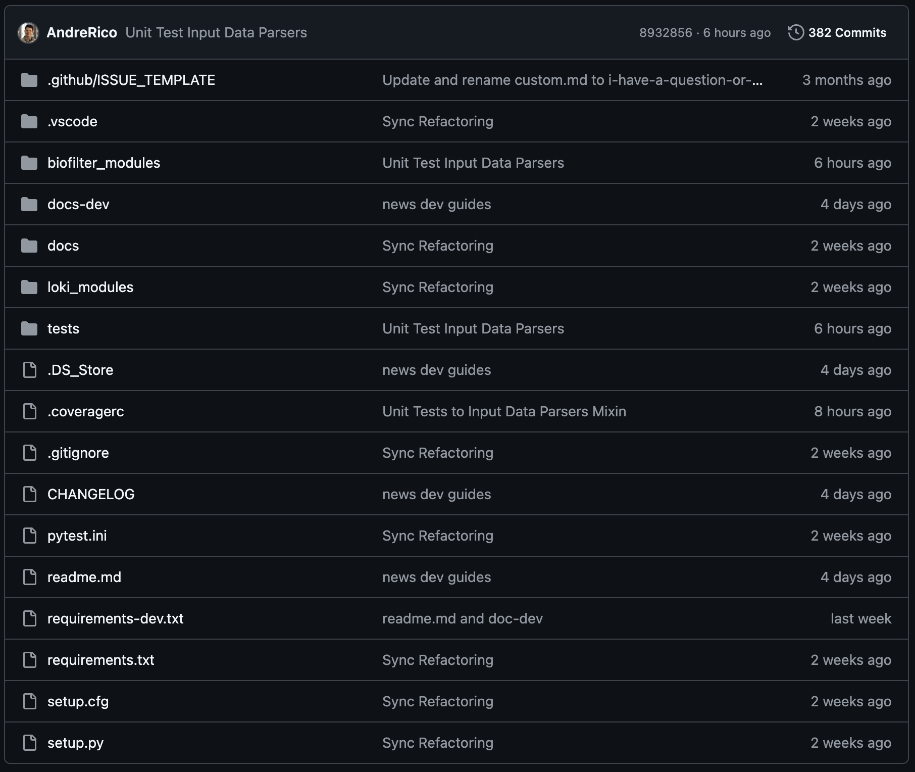
Version 2.4.3
Version 2.4.4

Slide 3
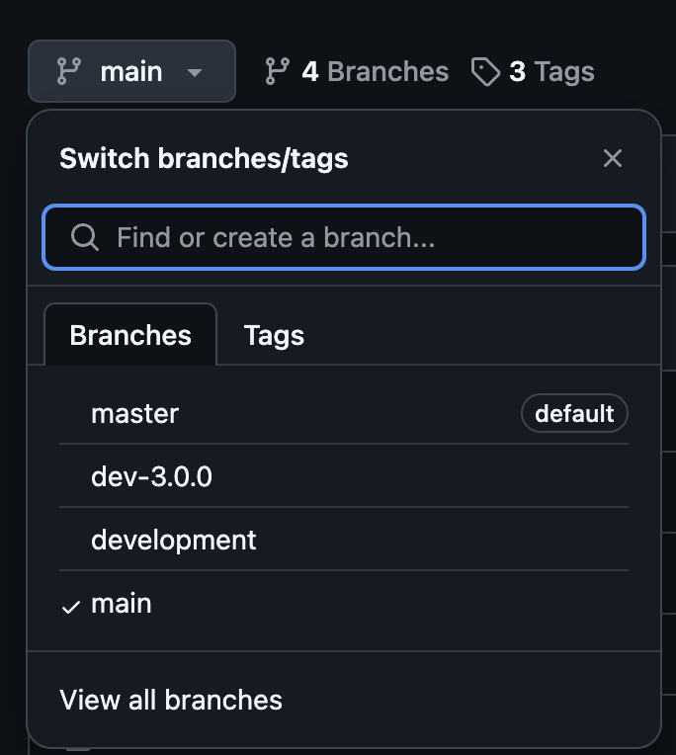

Slide 4
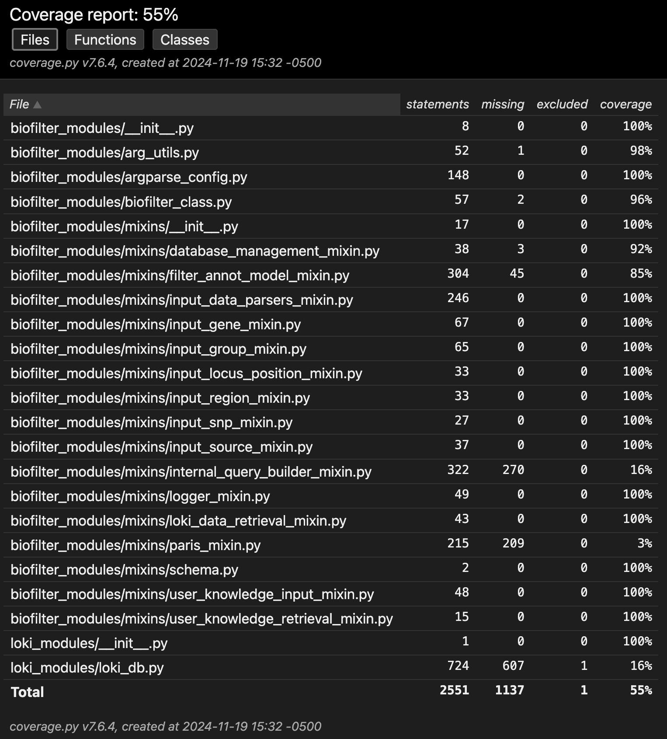

Slide 5
