Slide 1
Towards Virtual Reality Infinite Walking: Dynamic Saccadic Redirection
Published in: ACM Transactions on Graphics (Proceedings of SIGGRAPH) 2018
18721802 李琦
November 29th, 2018

Slide 2
CONTENTS
INTRUDUCTION
RELATED WORK
METHOD
EVALUATION
FUTURE WORK

Slide 3
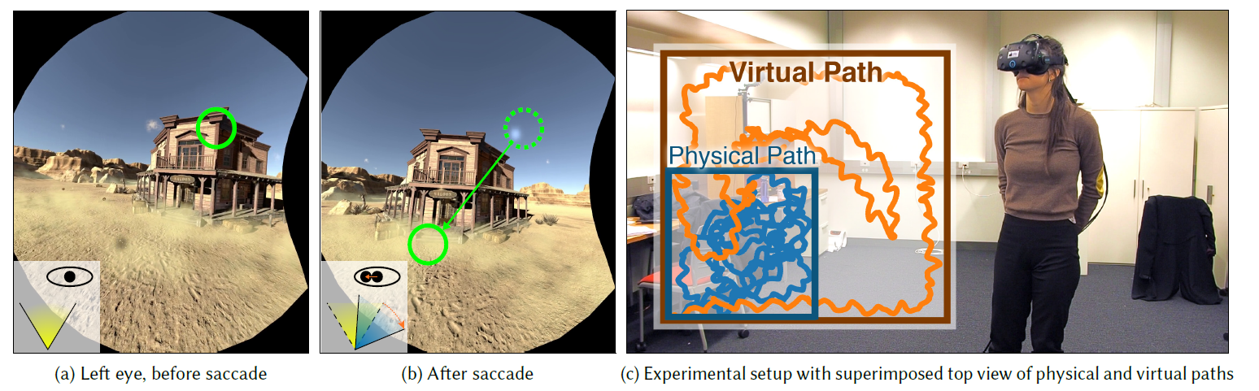
1. INTRUDUCTION
An end-to-end redirected walking system
A real-time path planning algorithm
subtle gaze direction (SGD) methods
Validation

Slide 4
2.RELATED WORK
Saccade: rapid eye movement that occurs when we change fixation points
(speed up to 900 ◦/sec long 20–200 ms )
Saccadic suppression: viewers are momentarily blind in a Saccade
Subtle Gaze Direction：uses image-space modulation to direct a viewer’s gaze to a specific target
Notes:
Suppression的范围大概在100ms。眼球捕捉，VR渲染的延迟大概在35ms.所以在supression期间进行重定向完全是可行的。

Slide 5
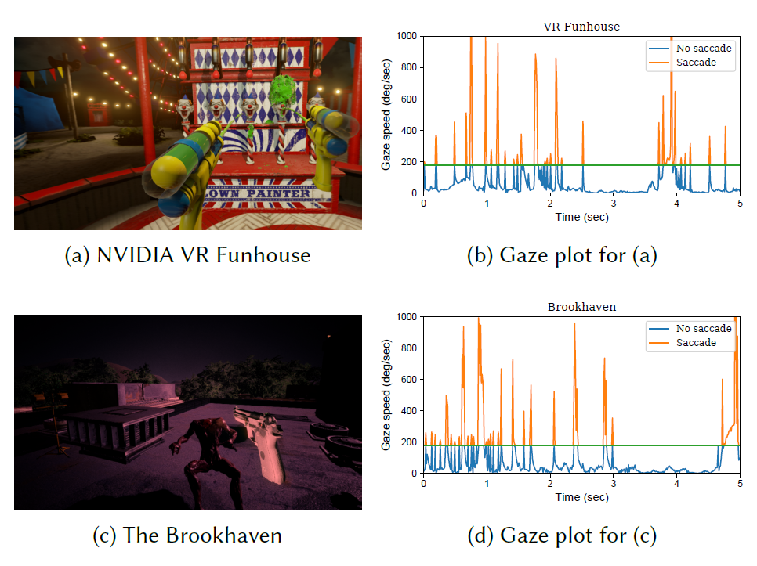
2.RELATED WORK
proportion of frames with redirection was approximately 11.40%
1.4◦/sec angular gains
15.16% for Brookhaven
1.9 ◦/sec angular gains
Notes:
本次实验，确定180°为扫视速度。12.6°/sec为察觉上限。(0.14◦ at 90 frames per second)

Slide 6
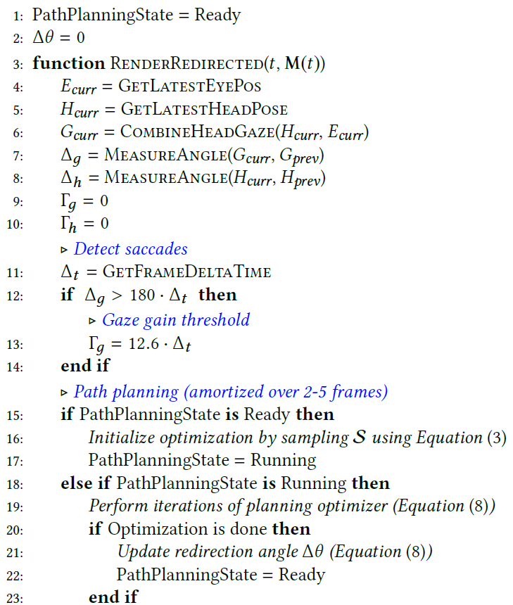
3.METHOD
Overview of approach
Notes:
首先检测扫视。然后调用dynamic path planning algorighm. 这个算法我们分摊2-5帧以保持实时性能。

Slide 7
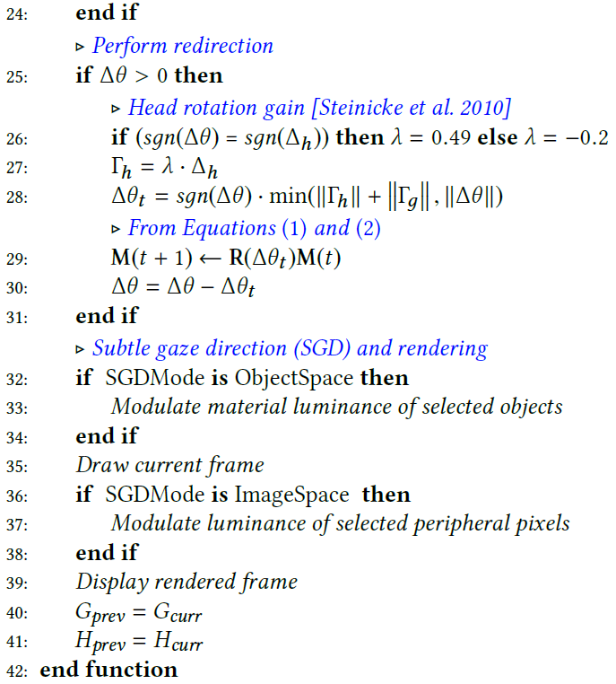
3.METHOD
Overview of approach
Notes:
首先检测扫视。然后调用dynamic path planning algorighm. 这个算法我们分摊2-5帧以保持实时性能。

Slide 8
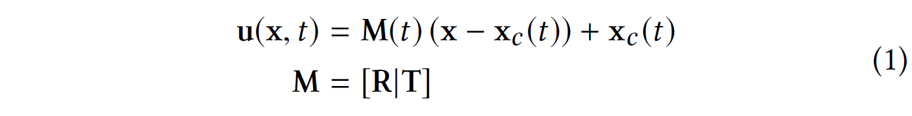
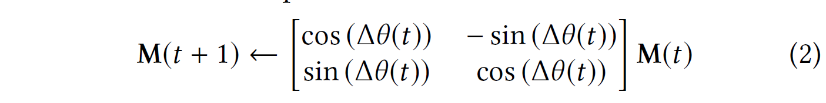
3.METHOD
using an affine transformation M between the virtual and physical spaces:

Slide 9
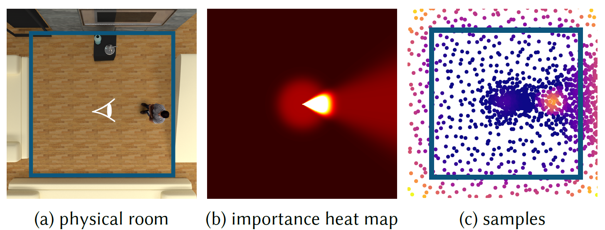
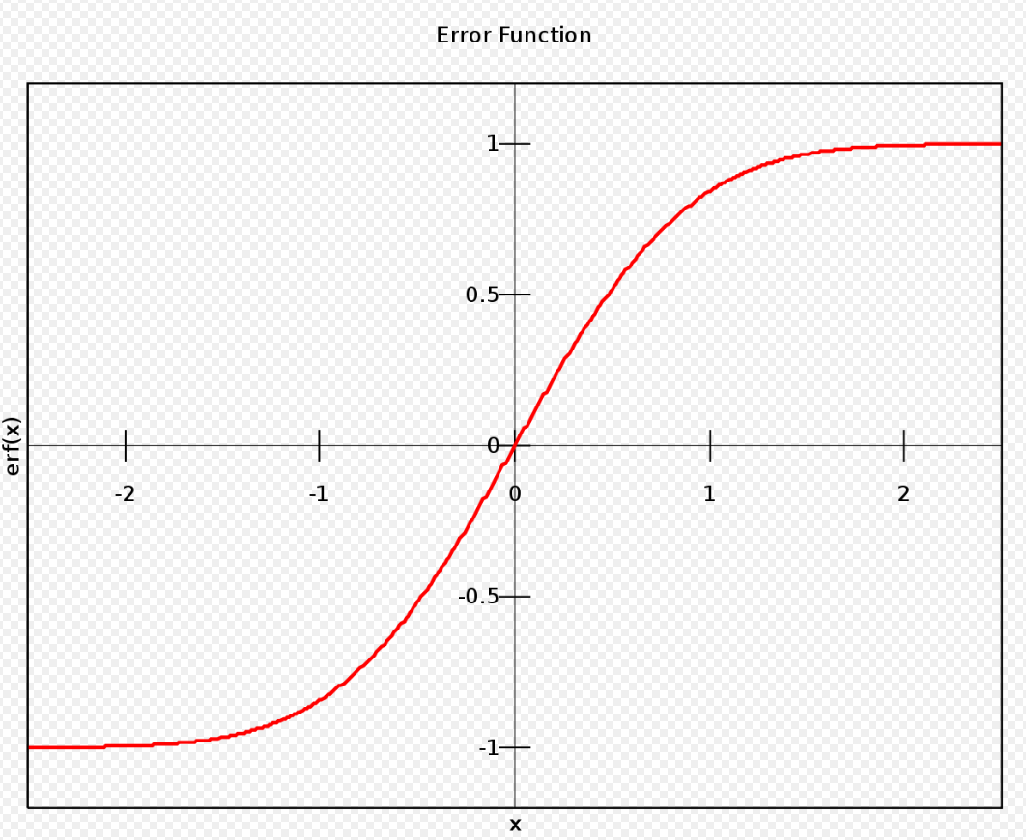
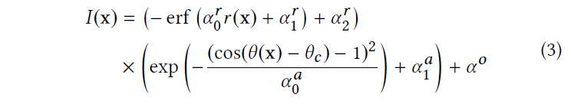

3.METHOD-Path Planning
Notes:
实时采样机制，强调近的，可见的，在摄像机视野里的区域。来预测可能性。
Θc是用户现在摄像机的方向 αri ∈{0,1,2}和αai ∈{0,1,2}都是适应房间大小的参数 αo是避免在不重要的地方零采样
本次实验aro=30 ar1 = -3 ar2 =1.15 aa0=0.01 aa1 =0.1 a0=0.01

Slide 10
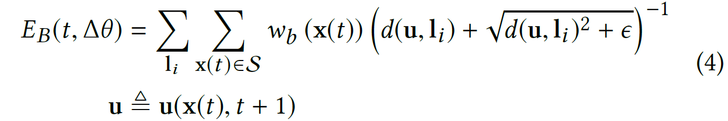
3.METHOD-Energy Terms
soft barrier function
Notes:
得到采样点集S之后，使用边界函数来避免碰撞。i是第i个边界d(u,l)是用户真实位置u和边界i的距离。
U(x,t+1)是等式1和2关于角度的函数.wb权衡了x的对于边界碰撞躲避的重要性。对于距离用户更近的点,wb应该越大，因为用户到的可能性更大。A0b是保证wb适应虚拟空间的大小。A1b是用来避免0权重，Xc是用户当前的位置。

Slide 11
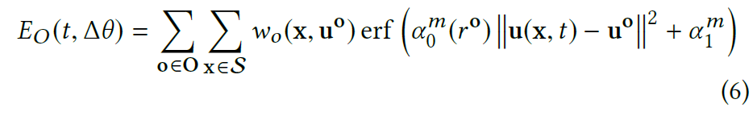
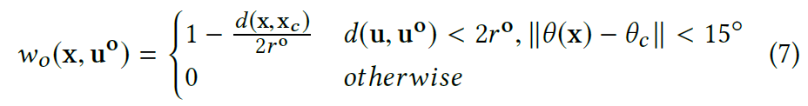
3.METHOD-Energy Terms
Obstacles function
Real-time Optimization and Redirection
Notes:
O是障碍物的集合，u0和r0是障碍物的位置和半径 a0和a1用来适应障碍物的大小和误差函数。本实验设置a0为-1/r0 a1是2。因为障碍物比边界要小。我我们只有在障碍物在用户附近的时候才考虑他。
arg min 就是使后面这个式子达到最小值时的变量的取值

Slide 12
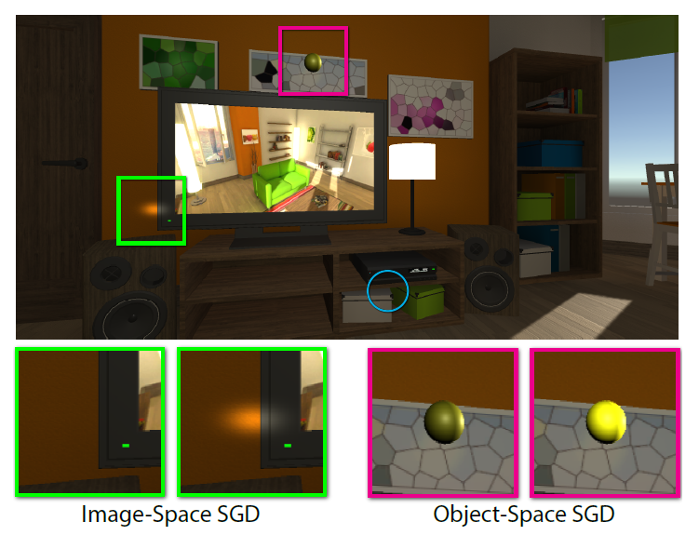
3.METHOD Subtle Gaze Direction for Saccades
Notes:
smooth Gaussian fall-off.

Slide 13
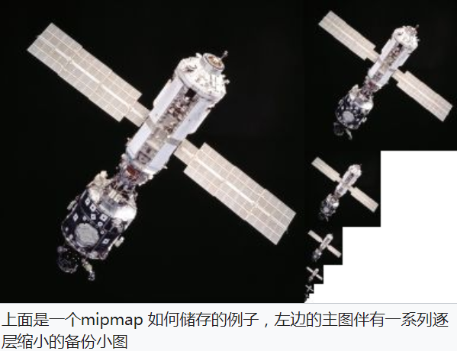
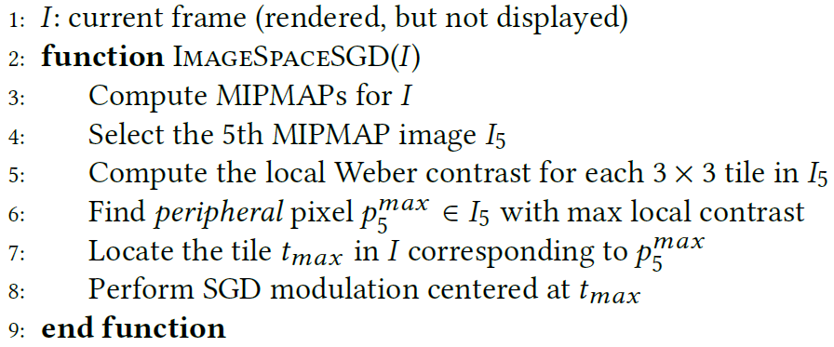
3.METHOD Subtle Gaze Direction for Saccades
Notes:
Mipmap中每一个层级的小图都是主图的一个特定比例的缩小细节的复制品。虽然在某些必要的视角，主图仍然会被使用，来渲染完整的细节。但是当贴图被缩小或者只需要从远距离观看时，mipmap就会转换到适当的层级。

Slide 14
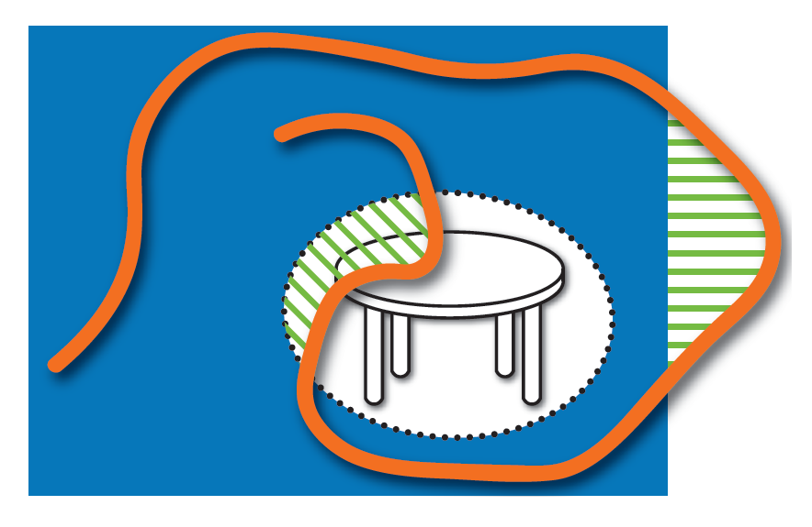
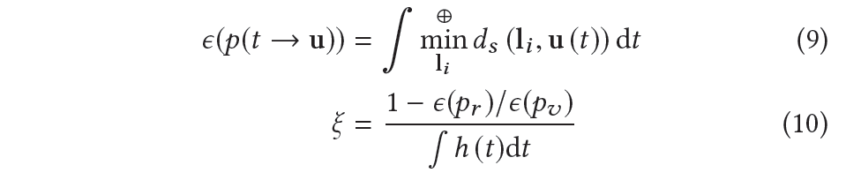
4.EVALUATION- saving ratio effectiveness of the redirected walk
Notes:
P是时间到物理位置的映射 Pv是没有重定向的路径，Pr是有重定向的路径。Min是找到外部或内部边界线段l与实际用户位置之间的非负符号距离ds
由于我们使用仅限头部增益的节省作为基线，

Slide 15
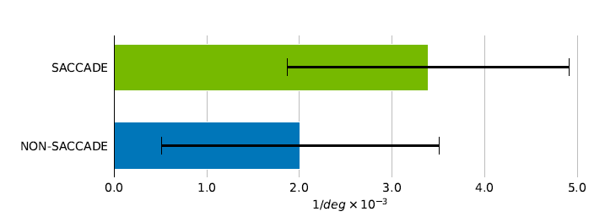
4.EVALUATION- saving ratio effectiveness of the redirected walk
The average saving ratio ξ was
2.01e −3 (SD = 1.95e −3) for NON-SACCADE
3.39e − 3 (SD = 1.98e − 3) for SACCADE
Notes:
P是时间到物理位置的映射 Pv是没有重定向的路径，Pr是有重定向的路径。Min是找到l（内外边界）和用户位置之间的最小非负距离

Slide 16
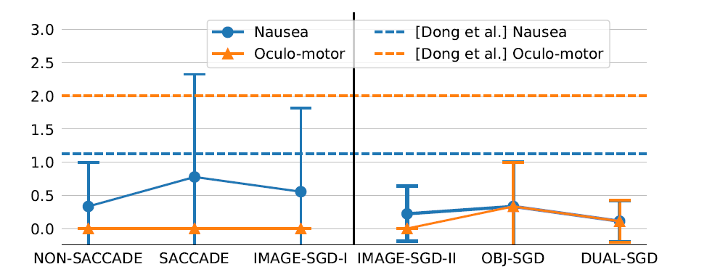
4.EVALUATION
redirected angle across all users was 163.82◦ for SACCADE
148.63◦ (SD = 22.99◦) for IMAGE-SGD-I
Nausea and oculomotor levels are reported below 2 by all users
Notes:
大多数人报告他们在不断移动的同时专注于任务对象检索,没有注意图像内容的变化

Slide 17
4.EVALUATION
145.13◦ (SD = 21.83◦) for IMAGE-SGD-II
156.78◦(SD = 23.41◦) for OBJ-SGD
167.48◦ (SD = 22.56◦) for DUAL-SGD.
Notes:
图像SGD效果比OBJ SGD效果要差。
但是如果具有与图像SGD类似的闪烁外观的任务对象可能触发更多的扫视。

Slide 18
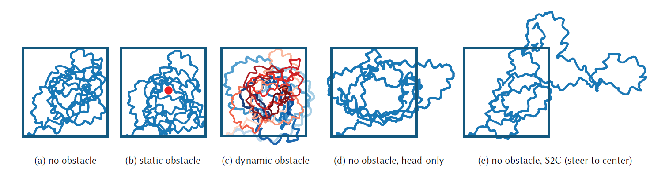
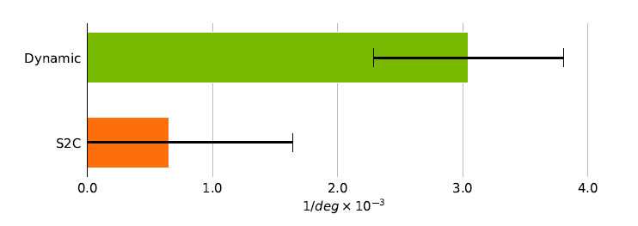
4.EVALUATION
With all 18 users, the average ξ was 3.06e−3 (SD = 1.52e−3) for the dynamic path planning condition
0.75e−3 (SD = 2.12e−3) for the corresponding simulated S2C
Notes:
Traditional redirection planning approaches such as S2C. handle convex-shaped laboratory spaces like rectangular rooms
highly likely to cause collisions

Slide 19
5.FUTURE WORK
robotics and artificial intelligence fields may be adapted to the redirection planning approach
plan to investigate whether translational gain can be incorporated into the optimization while maintaining real-time performance.
additional forms of distractors
Tuning the system for larger areas

Slide 20
THANKS

