Slide 1
Business Data Management Project
  Demand Forecasting for a Screen-Printing Company
  Riteesh TM (Roll No: 23f3002667)
  IITM BS Degree Program
  Business: Sri Meenakshi Screen Printing, Madurai
  Data: 500 Orders (2022–2025)

Slide 2
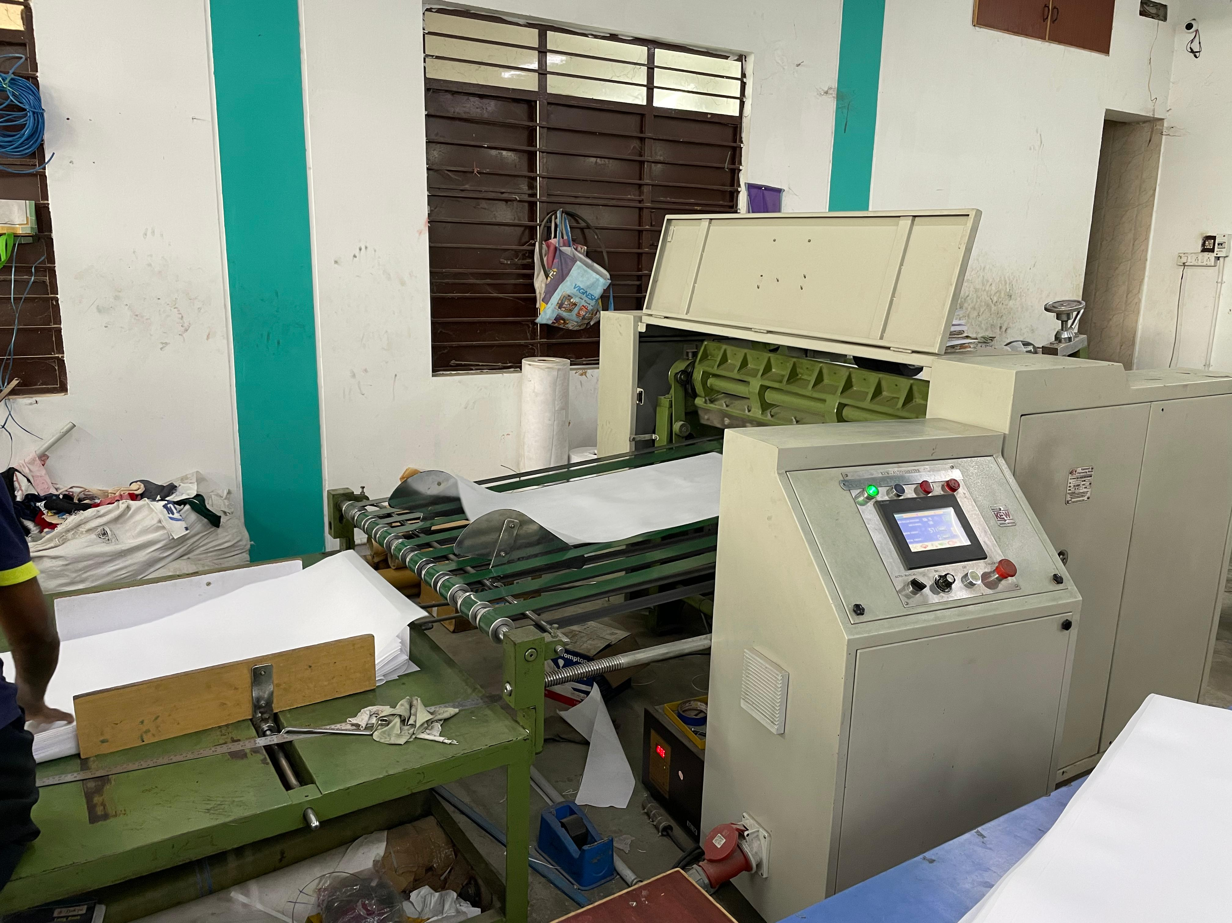
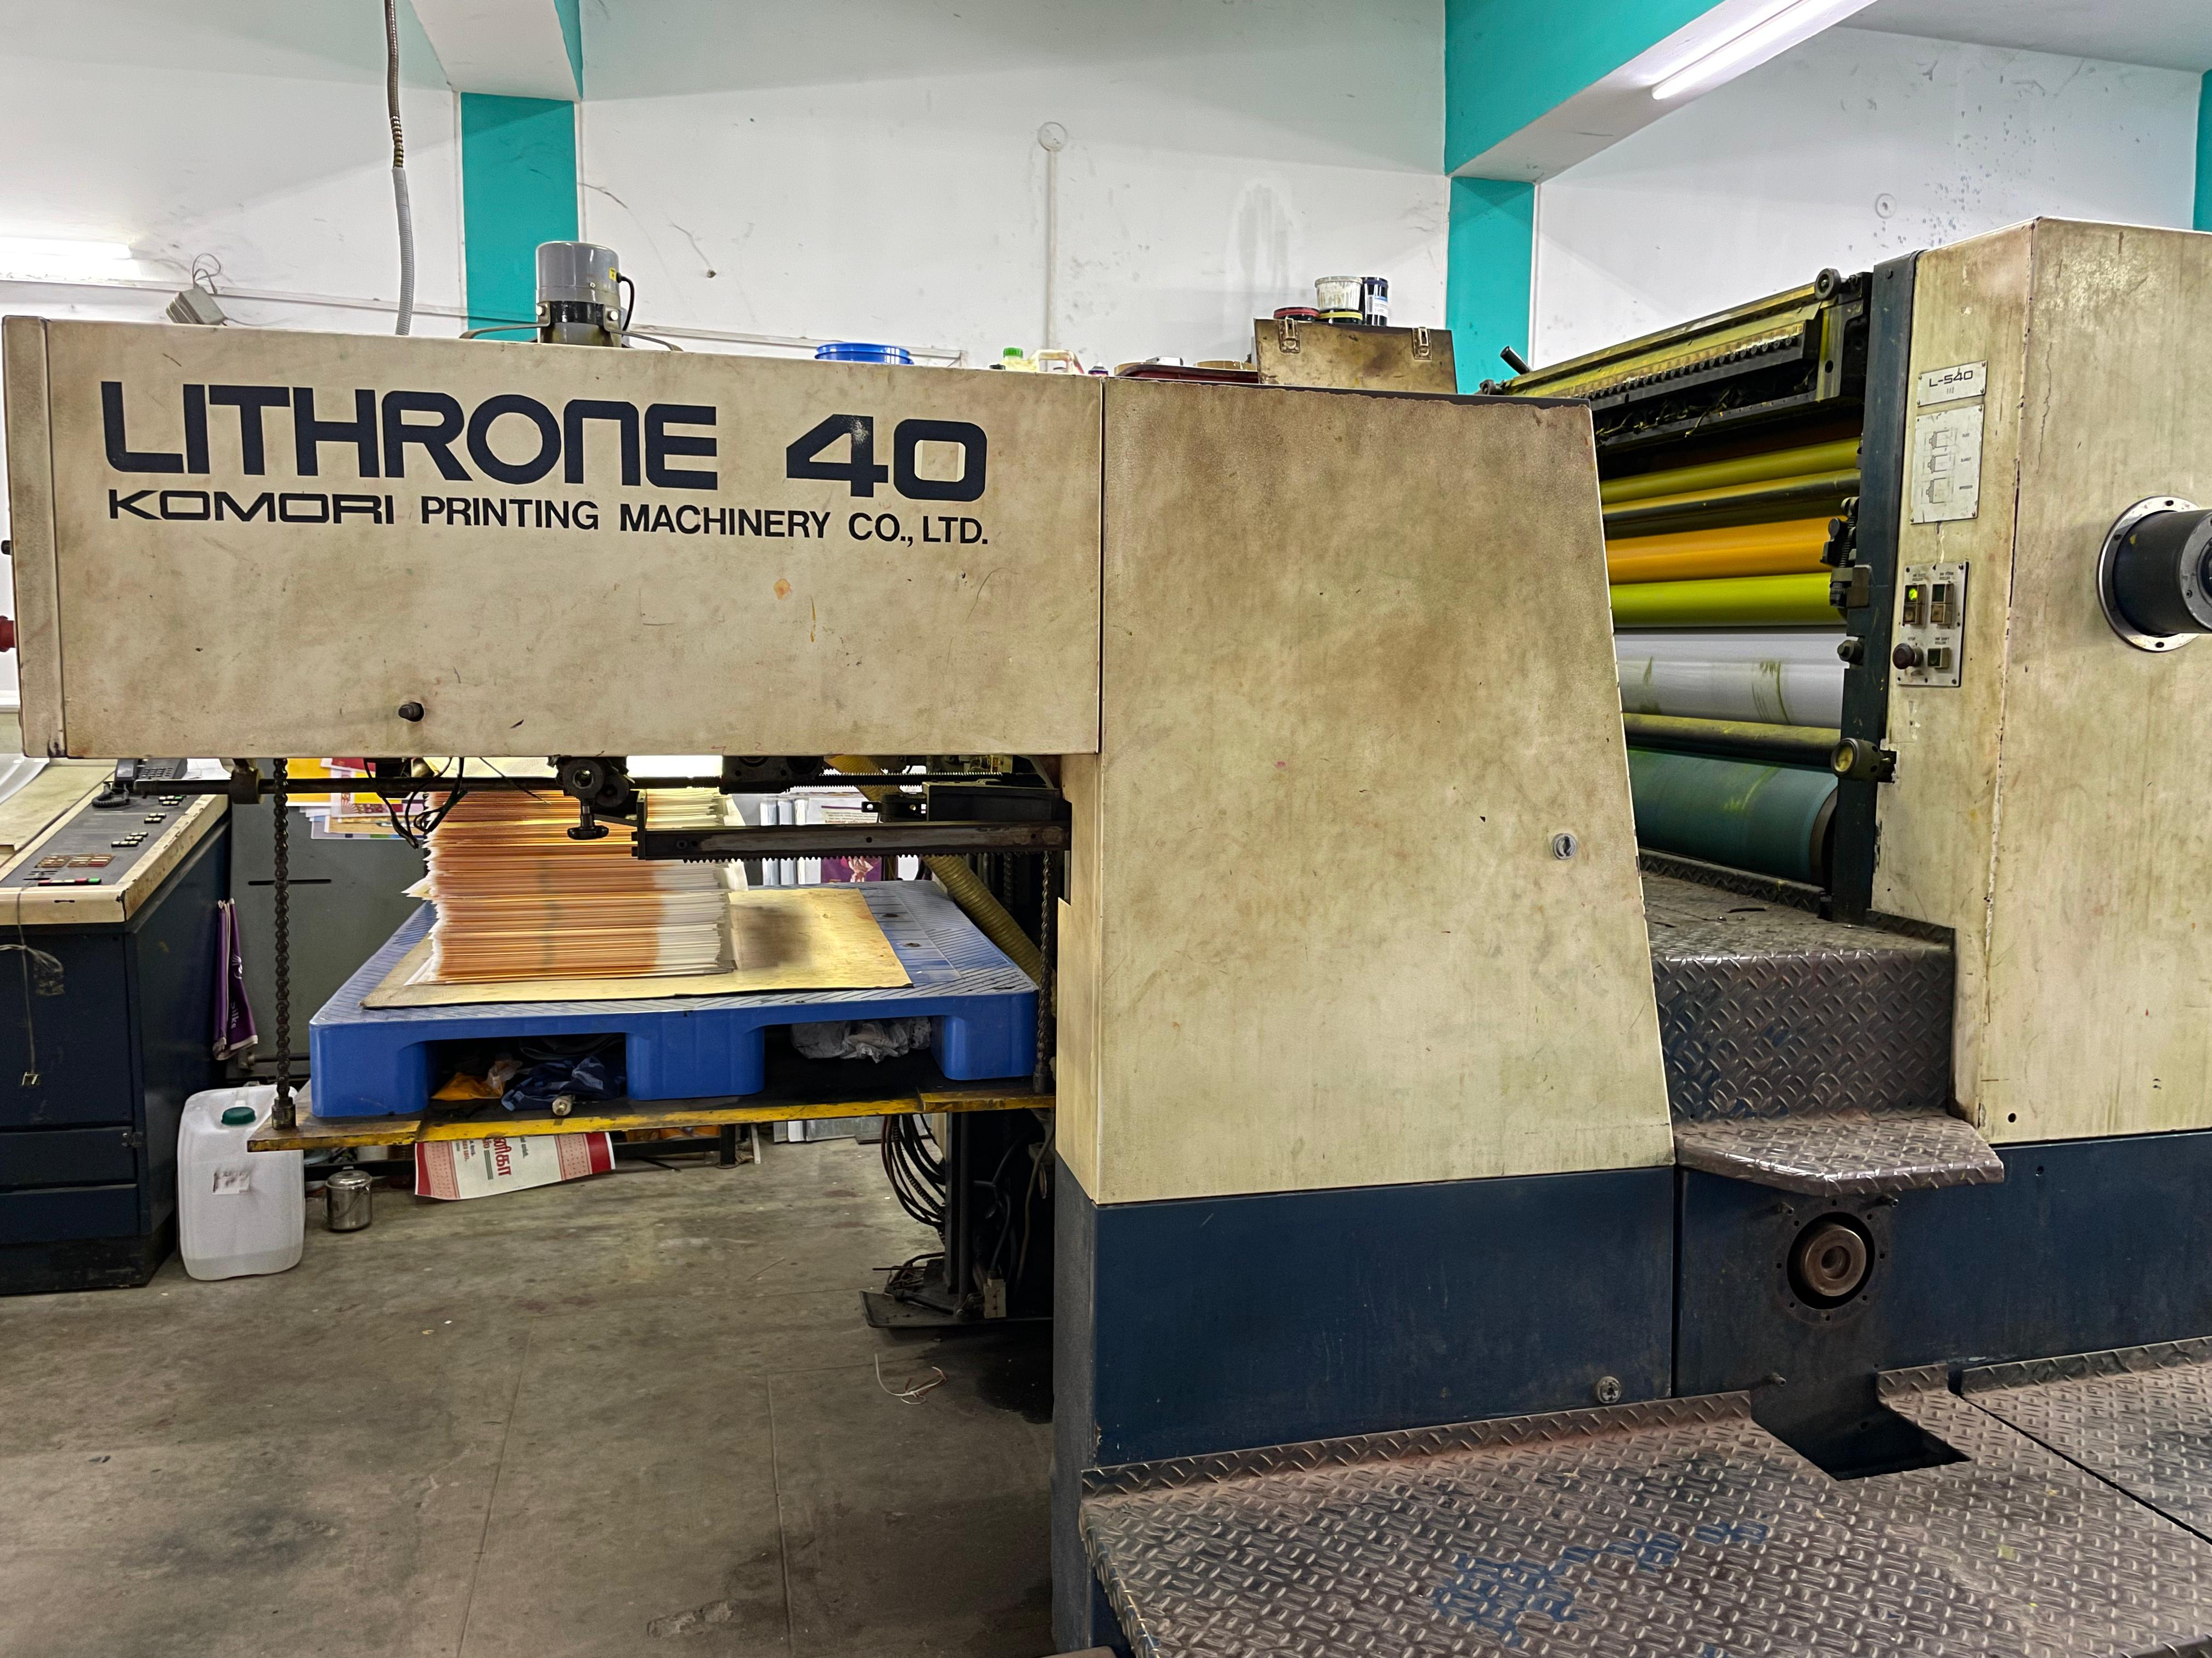
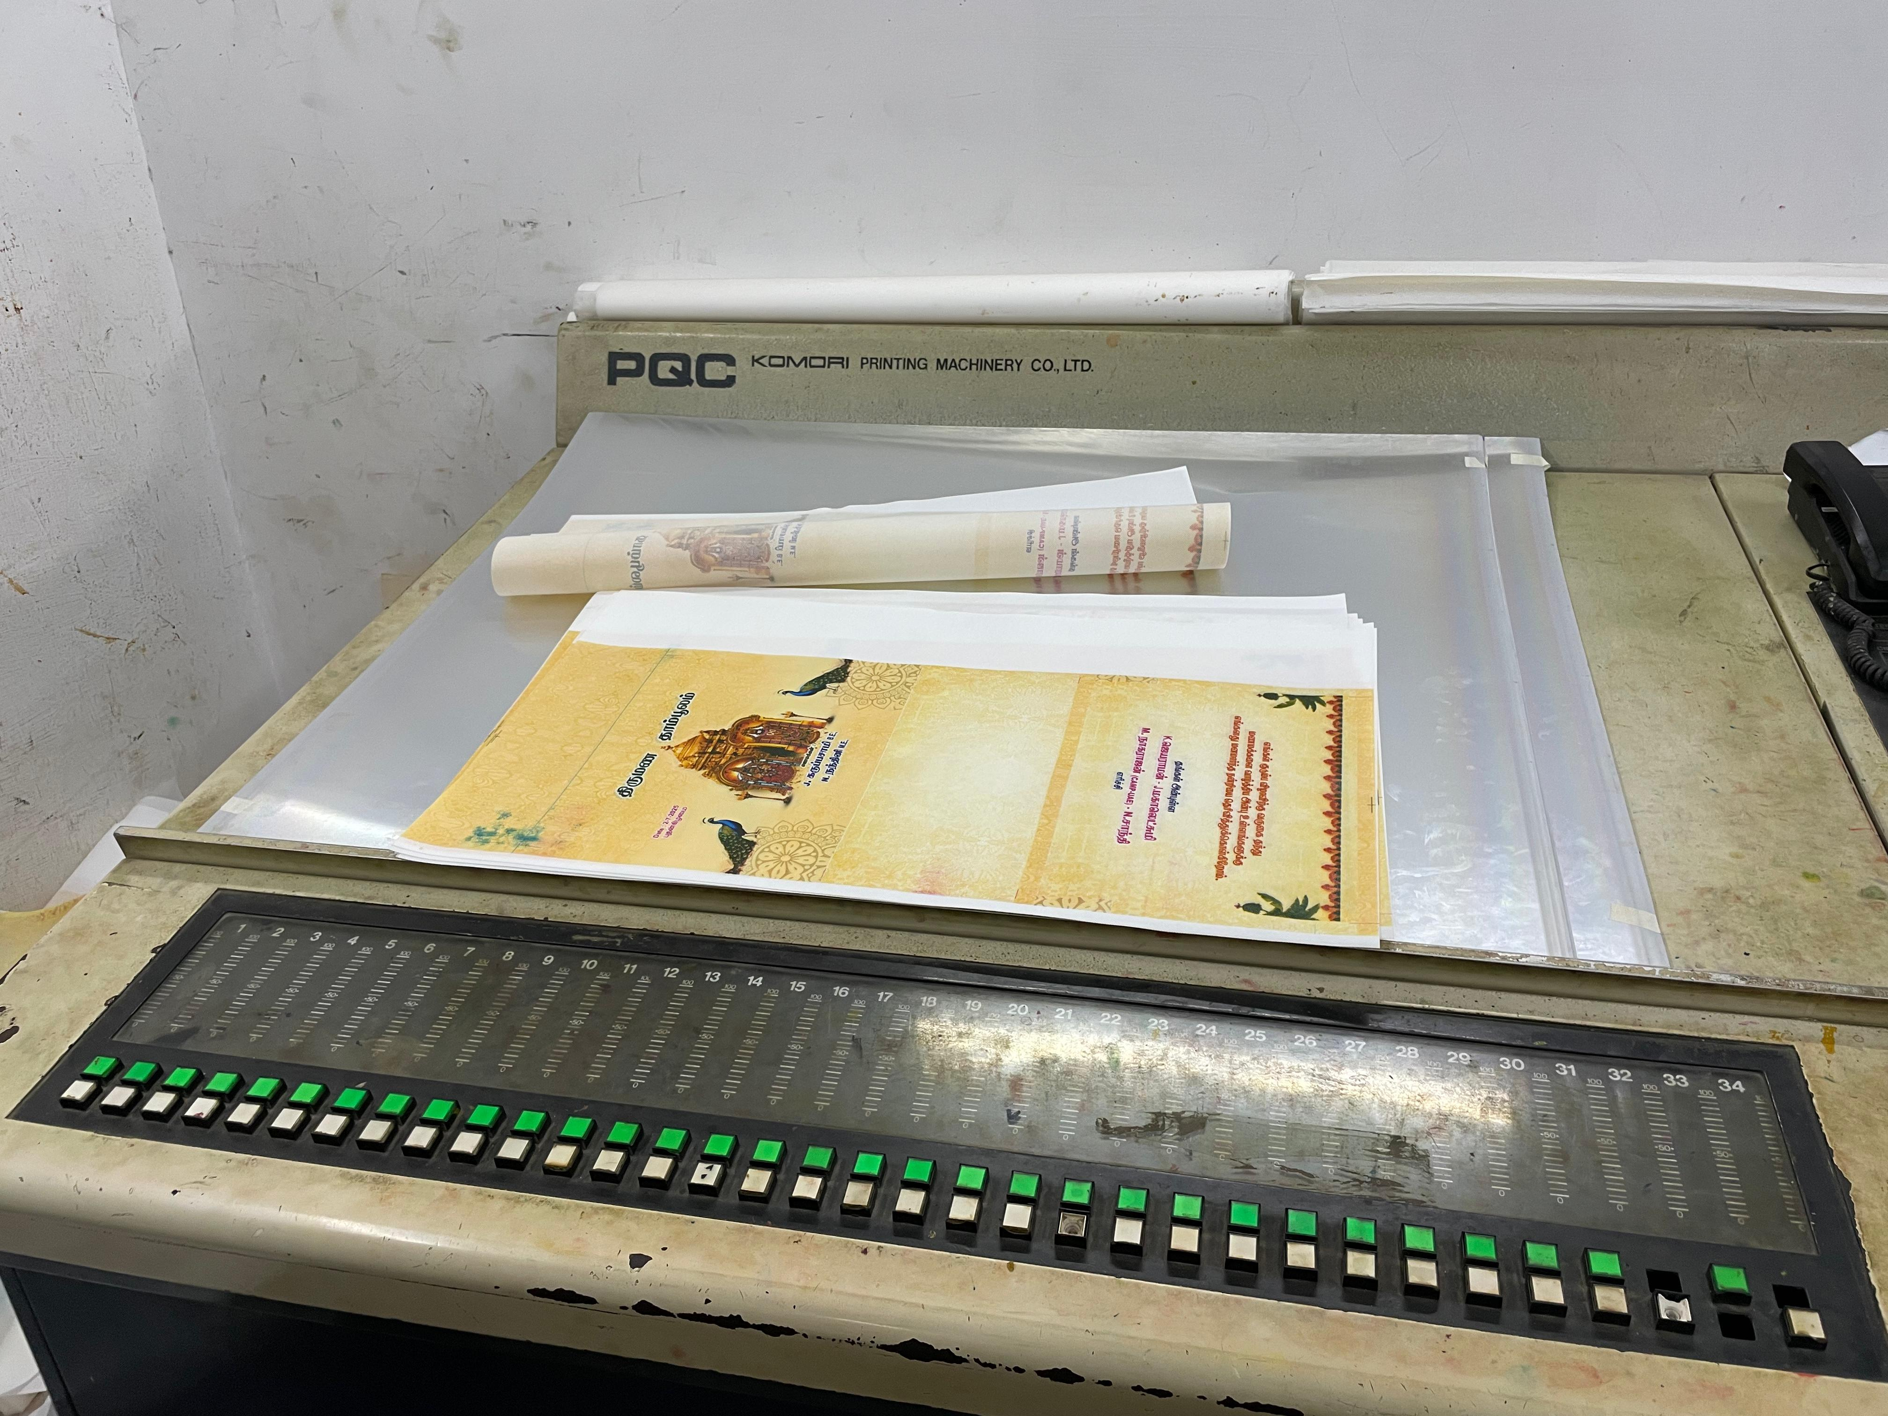
About the Business
Established in 2011, the business manufactures Thamboolam cloth bags in Madurai
Offers screen printing, offset printing, and ID card printing services
Caters to jewellery retailers, textile stores, and individual clients
Supported by a 10-member workforce, handling consistent, high-volume monthly orders

Slide 3
Problem Statements
Seasonal Demand Forecasting
The business faces fluctuations in monthly orders but lacks a systematic way to analyze trends or predict upcoming demand. This leads to inconsistent raw-material procurement and rush-time production.
High-Value Customer Identification
All customers are treated the same, and no segmentation is done to find which clients contribute the most to revenue. This reduces the ability to prioritize loyal, bulk-ordering clients.
Regional Demand Analysis
Orders come from multiple locations across Tamil Nadu, but the business does not analyze which regions generate higher or consistent demand. This limits targeted marketing and efficient delivery planning.

Slide 4
Dataset Overview
The dataset contains 500 verified customer orders collected between 2022 and 2025.
Each record includes transaction details, such as client type, location, bag specifications, printing requirements, and order quantity.
The data was originally maintained in Excel by the business and required cleaning due to inconsistent formats.
The final cleaned dataset consists of 14 well-defined fields, enabling reliable descriptive analysis, forecasting, and segmentation.

Slide 5
Data Cleaning Process
.
Standardized Date Formats (YYYY-MM-DD)
Purpose: Ensures consistent time-based analysis, monthly aggregation, and forecasting.
Normalized Categorical Fields
(Location, Client Type, Bag Colour, Bag Type)
Purpose: Removes variations like “madurai/Madurai” and enables accurate grouping.
Removed Duplicate & Invalid Records
Purpose: Prevents inflated counts and misleading statistics.
Validated Numerical Fields
(Number of Bags > 0)
Purpose: Ensures calculations such as mean, total demand, and segmentation are reliable.
Created Derived Fields (Order Month, Order Year, Month Index)
Purpose: Simplifies trend analysis, seasonal pattern detection, and regression modeling

Slide 6
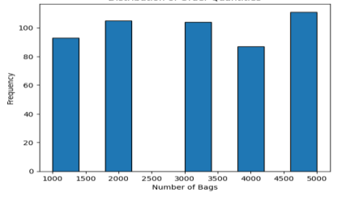
Descriptive Statistics
Descriptive Statistics for No of Bags
Mean : 3036 Median : 3000 Mode : 5000
std: ~1420 skew : ~0.012
Descriptive Statistics by Client Type
Descriptive Statistics for Regional Demand
Business clients have a slightly higher average order size compared to individual clients.
Both categories have a median of 3000 bags, showing balanced order patterns.
Variation (std dev) is moderate for both groups.
Skewness values are near zero → distributions are almost symmetric.
Madurai has the highest number of orders and the most consistent demand.
Coimbatore has the second highest average order size and stable order quantities.
Theni contributes the smallest share of orders but shows steady medium-sized demand.
All regions have similar average order sizes (~3000 bags), showing uniform pricing and demand behavior.
Notes:
Business clients place slightly larger orders on average (3124 bags) compared to individual clients (2948 bags), although both groups share the same median value of 3000 bags. The standard deviation is moderately high for both categories, showing some variability in order size, but overall the skewness values are close to zero, indicating a balanced mix of small and large orders across both client types.
Madurai contributes the majority of the orders, making it the primary demand center for the business. Coimbatore shows moderate demand with a slightly higher average order size, whereas Theni has the smallest number of orders but still maintains steady medium-volume purchases. Across all three regions, the average order size is fairly similar, indicating consistent customer behaviour and stable demand patterns.

Slide 7
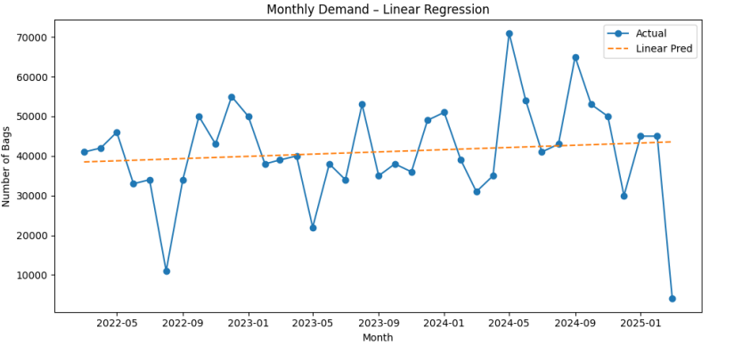
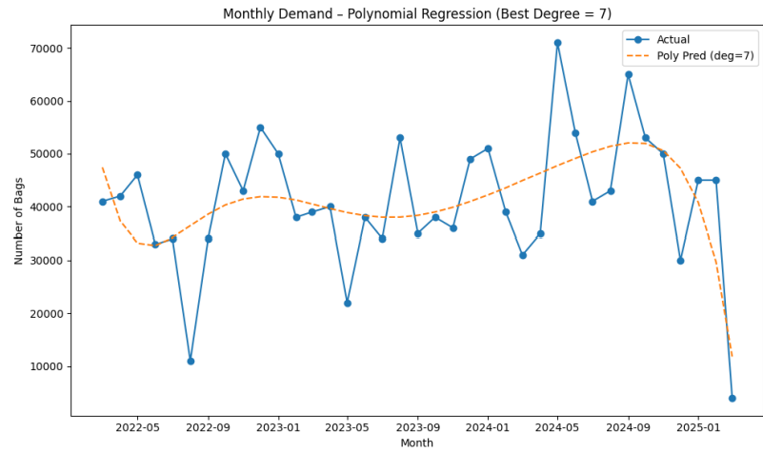
Demand Forecasting
Monthly total orders were aggregated from 2022–2025 to identify demand trends.
Monthly total orders were aggregated from 2022–2025 to identify demand trends.
A Linear Regression model was first applied but showed high error (MAPE = 50.40%), meaning it could not capture the fluctuations.
A Polynomial Regression (Degree = 7) model provided a much better fit, reducing MAPE to 23.01%.
The model effectively captured nonlinear patterns such as festival-driven spikes and event-based bulk orders.
Forecasting results help plan raw material procurement, labour allocation, and production scheduling more accurately.
Notes:
“I started by preparing a month-wise demand series from 2022 to 2025.
Linear Regression showed a general increasing trend but failed to follow the frequent spikes in demand. These spikes usually occur during festival seasons or when major clients place bulk orders. The model's MAPE was around 50%, which is too high for forecasting.
Next, I tested Polynomial Regression with degrees from 1 to 10. Higher degrees started overfitting, but Degree 7 gave the optimal balance. It reduced the MAPE to around 23%, meaning it captured the nonlinear behaviour effectively. This forecast can help the business in deciding raw material purchases, planning manpower, and allocating production effort ahead of high-demand months.”

Slide 8
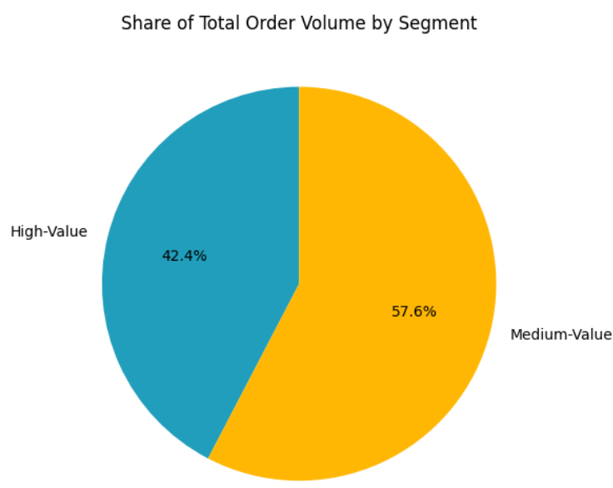
High-Value Customer Segmentation
Customers were grouped based on their total order quantity across 2022–2025.
Mean ± Standard Deviation method was used to classify customers into:
  High-Value: Total orders > (Mean + 1 SD)
  Medium-Value: Within (Mean ± 1 SD)
  Low-Value: < (Mean − 1 SD)
6 High-Value clients contribute 42.36% of total demand.
26 Medium-Value clients contribute the remaining 57.64%.
High-Value clients place frequent bulk orders and are critical to revenue stability.

Slide 9
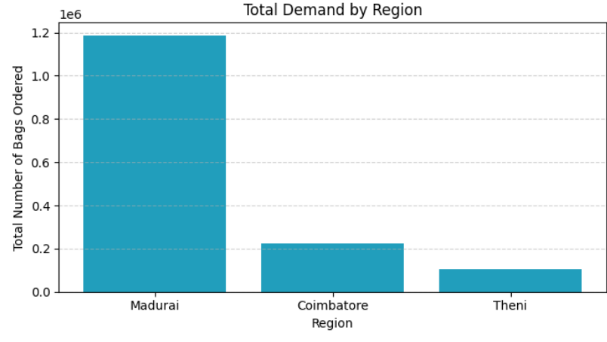
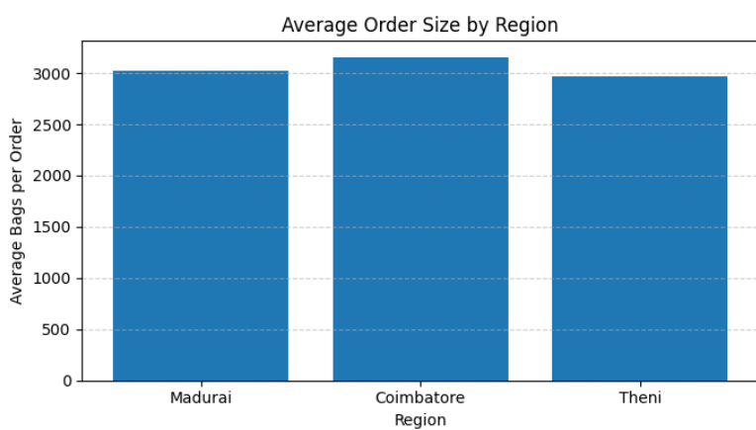
Regional Demand Analysis
Madurai has the highest number of orders (393) and contributes the largest share of total demand (≈78%).
Coimbatore, though smaller in order count (71), has the highest average order size (≈3155 bags), indicating strong bulk-order behaviour.
Theni has the lowest demand (36 orders) but maintains consistent medium-volume orders.
Average order size across regions is around 3000 bags, showing uniform pricing and stable customer demand.
Demand is concentrated in Madurai, while Coimbatore represents a high-value growth region because of larger order sizes.

Slide 10
Key Insights
Demand Insights
Demand follows a nonlinear pattern with clear fluctuations driven by festival seasons and bulk client orders.
Overall order distribution is stable, centered around 3000 bags with moderate variability.
Customer Insights
High-Value clients (only 6 customers) contribute 42% of total demand, showing a strong Pareto effect.
Medium-value clients offer significant growth potential if targeted properly.
Regional Insights
Madurai is the primary demand hub with the highest order frequency.
Coimbatore has the highest average order size, indicating strong bulk-order clients.
Theni contributes low volume but shows stable demand.

Slide 11
Recommendations
Operational & Production
Use polynomial forecasting to plan raw material procurement and labour scheduling ahead of peak months.
Maintain 10–15% safety stock to handle sudden demand spikes.
Customer Strategy
Prioritize High-Value clients with faster delivery, priority handling, and personalized service.
Develop targeted offers for Medium-Value clients to increase order frequency.
Regional Strategy
Strengthen logistics and capacity in Madurai (main market).
Expand marketing and partnerships in Coimbatore, where order sizes are highest.
Improve cost-effective distribution to Theni to increase order volume.

