Slide 1

Customer Shopping Behavior Analysis
A leading retail company aims to better understand its customers' shopping behavior to improve sales, customer satisfaction, and long-term loyalty. This comprehensive project analyzes a dataset of 3,900 purchases to uncover patterns across demographics, product categories, and sales channels.
The central question driving this analysis: "How can the company leverage consumer shopping data to identify trends, improve customer engagement, and optimize marketing strategies?"

Slide 2
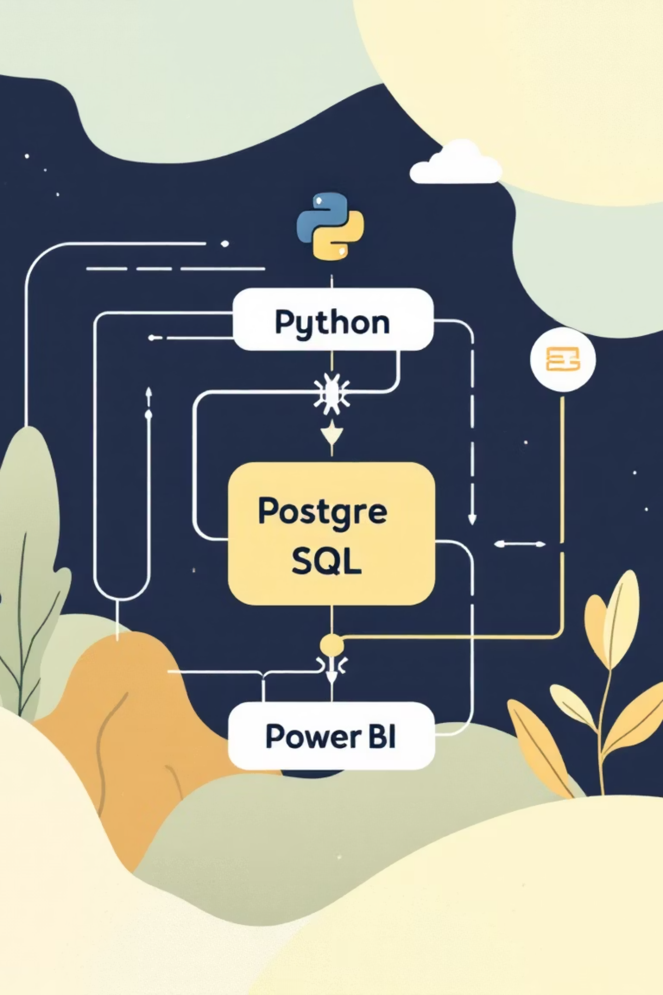

TECHNOLOGY STACK
Project Architecture & Deliverables
01
Data Preparation
Python-based cleaning and transformation using Pandas, NumPy, and SQLAlchemy to ensure data quality and consistency
02
Database Management
PostgreSQL implementation for storing structured data and executing complex analytical queries
03
Data Analysis
SQL-driven extraction of insights on customer segments, revenue patterns, and behavioral trends
04
Visualization
Power BI dashboard creation for interactive stakeholder engagement and decision-making

Slide 3
PYTHON
Data Preparation & Quality Assurance
Before diving into SQL analysis, we used Python (Pandas) to clean, validate, and structure the raw data. This ensured the insights generated later were accurate and consistent. The process involved loading 3,900 records across 18 columns from the customer_shopping_behavior.csv dataset.
Initial Exploration
Missing Data Strategy
Column Standardization
Ran df.info() and df.describe() to inspect data types, statistical distributions, and memory usage. Verified Age and Purchase Amount values fell within expected ranges.
Identified 37 missing values in Review Rating column. Performed median imputation by product category to preserve dataset integrity without losing valuable sales data.
Renamed all columns to snake_case format (e.g., item_purchased, purchase_amount) for PostgreSQL compatibility and easier code maintenance.
Feature Engineering
Database Integration
Created age_group column binning ages into Young Adult (<25), Adult (25-40), Middle-Aged (41-60), and Senior (>60)
Established connection to PostgreSQL using SQLAlchemy and psycopg2. Loaded the fully cleaned DataFrame directly into a SQL table named "customer", making it ready for complex querying and analysis.
Derived purchase_frequency_days metric to identify customer return patterns
Dropped redundant promo_code_used column after confirming it duplicated discount_applied information

Slide 4
SQL ANALYSIS
Revenue Analysis by Demographics
Gender-Based Revenue Distribution
$158K
Analysis of spending power reveals significant differences between male and female customers. Male customers generated $157,890 in total revenue, more than double the $75,191 contributed by female customers. This 68% vs 32% split suggests opportunities for targeted marketing strategies.
Male Revenue
68% of total
Key SQL Query Approach
$75K
Used GROUP BY aggregation to sum purchase amounts by gender, providing clear segmentation of revenue contribution across demographic groups.
Female Revenue
32% of total
Revenue by Age Group Analysis
Demographic segmentation reveals that Young Adults (under 25) lead revenue generation at $62,143, followed closely by Middle-aged customers at $59,197. Adults (25-40) and Seniors contribute $55,978 and $55,763 respectively, showing relatively balanced spending across age groups with a slight skew toward younger demographics.

Slide 5

Discount Strategy & High-Value Customer Behavior
Discount-Responsive Spenders
Top Discounted Products
Hats lead with 50% discount rate, followed by Sneakers and Coats at 49%, Sweaters at 48%, and Pants at 47%. These products rely heavily on promotional strategies.
Identified customers who used discounts but still spent above the average purchase amount of $59.76. This segment represents high-value customers responsive to promotions.
Strategic Opportunity
High-value customers still use discounts, suggesting targeted promotions could increase basket size further without sacrificing margin on full-price sales.
"Understanding which customers respond to discounts while maintaining high purchase values allows for precision marketing that maximizes both revenue and customer satisfaction."

Slide 6
PRODUCT PERFORMANCE
Product Ratings & Category Leaders
Top-Rated Products
Category Best Sellers
Customer satisfaction analysis reveals the highest-performing products based on average review ratings:
Window function analysis identified top 3 products within each category:
Accessories
Gloves - 3.86 Rating
Jewelry (171 orders)
Sandals - 3.84 Rating
Sunglasses (161 orders)
Belt (161 orders)
Boots - 3.82 Rating
Clothing
Hat - 3.80 Rating
Blouse (171 orders)
Pants (171 orders)
Skirt - 3.78 Rating
Shirt (169 orders)
Footwear
Sandals (160 orders)
Shoes (150 orders)
Sneakers (145 orders)

Slide 7


Shipping & Subscription Insights
Shipping Speed Impact
Subscription Status Analysis
Loyalty Correlation
Express shipping customers spend slightly more on average ($60.48) compared to Standard shipping ($58.46), suggesting a correlation between shipping preference and purchase value.
Only 1,053 customers (27%) are subscribers, generating $62,645 in revenue with $59.49 average spend. Non-subscribers represent 2,847 customers (73%) with $170,436 revenue and $59.87 average spend.
Among repeat buyers with more than 5 previous purchases, 2,518 are non-subscribers versus 958 subscribers, indicating significant untapped subscription potential.
Critical Finding: Repeat buyers show strong loyalty but low subscription adoption. This represents a prime opportunity for subscription upsells and retention programs targeting customers who already demonstrate purchasing consistency.

Slide 8



SEGMENTATION
Customer Lifecycle Segmentation
Segmentation based on previous purchase history reveals distinct customer groups with different engagement levels and potential value.
Returning Customers
701 customers with 2-10 purchases show growing engagement and conversion potential
Loyal Customers
3,116 customers with 10+ previous purchases represent the core base driving repeat revenue
New Customers
83 customers with only 1 purchase require nurturing to drive second purchase and retention
The overwhelming majority (80%) of customers fall into the "Loyal" segment, demonstrating strong retention. However, the small "New" customer base (2%) suggests opportunities to improve acquisition strategies and first-purchase conversion rates.

Slide 9
POWER BI
Interactive Dashboard Development
The Power BI dashboard provides an interactive view of the analysis, enabling stakeholders to explore data dynamically and make informed decisions.
Data Import
Loaded customer_shopping_behavior.csv via Get Data > Text/CSV in Power BI Desktop
Power Query Transformation
Validated data types, handled null values in Review Rating, created Age Group conditional column matching SQL analysis
DAX Measures
Built key measures for Total Customers, Average Purchase Amount, and Average Rating using DAX formulas
Visual Creation
Designed KPI cards, donut charts for subscription status, bar charts for revenue by category and age group
Interactive Filters
Added slicers for Gender, Category, and Shipping Type enabling dynamic data exploration
3.9K
$59.76
3.75
Total Customers
Avg Purchase
Avg Rating

Slide 10


INSIGHTS
Key Business Insights & Recommendations
1
2
Subscription Growth Opportunity
Demographic Focus
Only 27% of customers are subscribers, yet repeat buyers demonstrate strong loyalty. Target the 2,518 non-subscribed repeat buyers with subscription upsells and exclusive benefits to convert them into recurring revenue streams.
Young Adults and Middle-aged groups contribute the most revenue ($62,143 and $59,197 respectively). Tailor marketing campaigns and product offerings to these high-value demographic segments for maximum ROI.
3
4
Category Dominance
Strategic Discounting
Clothing is the dominant category with Jewelry, Pants, and Blouses as top sellers. Expand inventory depth in these high-performing categories while testing new products in underperforming segments.
High-value customers actively use discounts while maintaining above-average purchase amounts. Implement targeted promotions to increase basket size without eroding margins on full-price sales.
Project Author
Ritesh Brahmachari
Data Analyst specializing SQL, Python, and Power BI visualization

