Slide 1
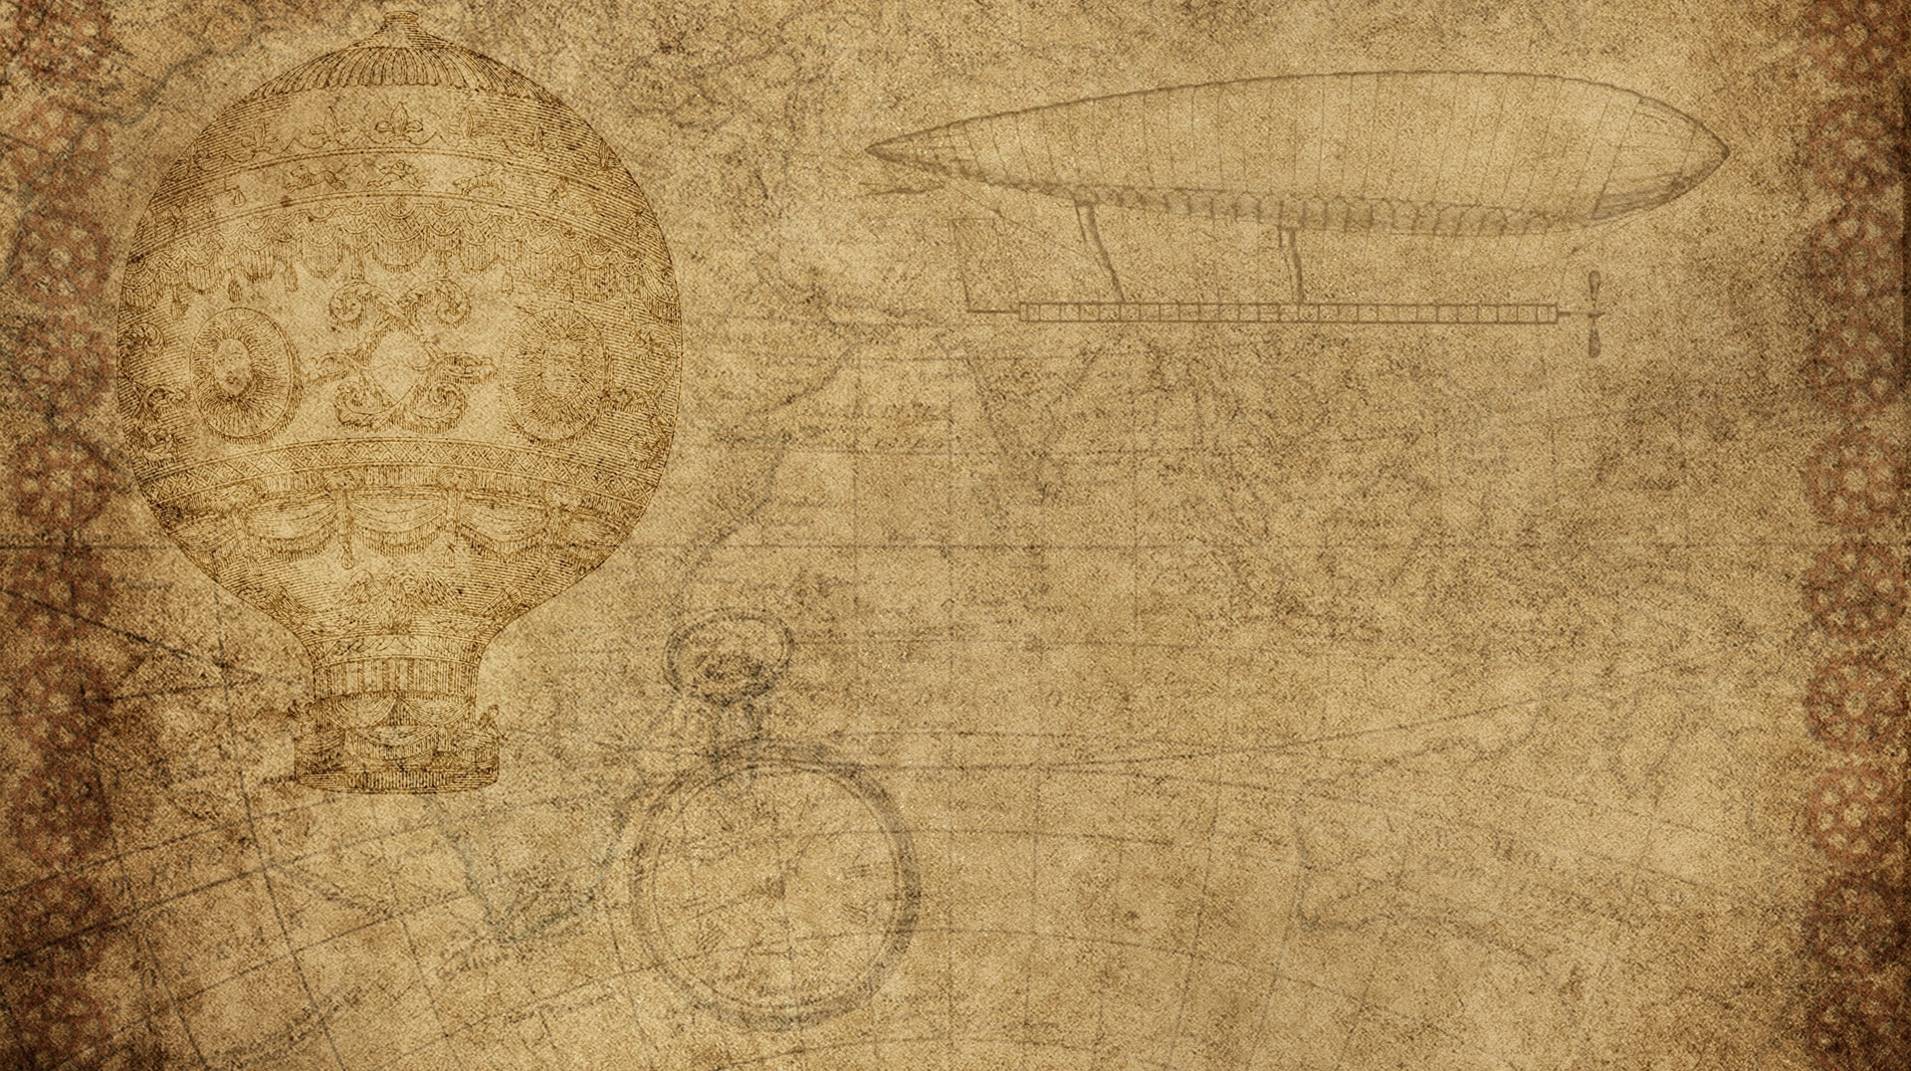

Auto-Ticket Vending machine
BY Ritesh Chaudhary
& priyanshu jha

Slide 2

Auto-Ticket Vending machine
Design Problems
Complex interface, confusing for first-time users
Not friendly for elderly and disabled people
Limited language options
Screen visibility issues in sunlight
Touchscreen hygiene concerns
No user assistance during errors
Technical reliability issues (payment failures, paper jams, etc.)

Slide 3
Auto-Ticket Vending machine
Suggested Design Improvements
Simplified icon-based interface with fewer steps
Multilanguage support
Voice-guided instructions and audio feedback
Adjustable screen height for wheelchair accessibility
High-contrast display
Contactless Interaction
Using antimicrobial screen coating

Slide 4


Invention design process
Identify a real-life problem
Research existing solutions and technologies
Generate multiple ideas and select the best one
Design and develop a prototype
Test the prototype and identify improvements
Finalize and implement the invention

Slide 5

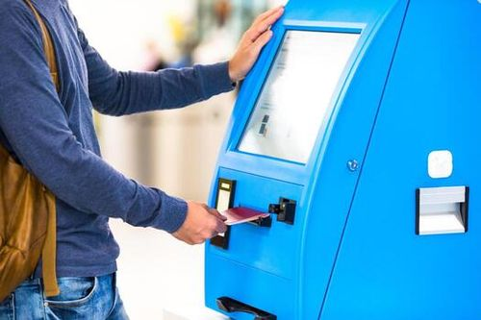
Who will use my invention ?
My invention will be used by:
Daily commuters and regular passengers
Occasional travelers and tourists
Elderly people and differently-abled users
Students and office-goers
Railway staff (indirectly, for workload reduction)

Slide 6
“This vending machine already exists in the market, so what is new?”
Ticket vending machines already exist in the market
Current machines are technology-focused, not user-focused
Limited language support and poor accessibility
Not user-friendly for elderly and disabled users
Hygiene issues due to touch-only interaction
My invention improves usability with:
Simple icon-based interface
Multilingual and voice guidance
Better accessibility and contactless interaction

Slide 7
THANK YOU !

