Slide 1
ATLIQ MEDIA · DATA ANALYSIS · 2026
The Night Tamil Nadu Rewrote Its Map
234
constituencies
analysed
2026 Tamil Nadu Assembly Election — A data-driven show pitch
for AtliQ Media leadership
Ritesh Das | Data Analyst

Slide 2
THE BIG PICTURE — 2026 IN 4 NUMBERS
108
163
16K
63
TVK seats won
Seats flipped
Avg winning margin
Won below 35%
Brand new party
first ever election
69.7% of all
234 constituencies
Votes — down from
23K in 2021
Constituencies with
fragmented mandate
Source: Election Commission of India — ECI Form-20 results data

Slide 3
STORY 1
The Great Flip
TOP SEAT TRANSITIONS
DMK → TVK
65
163 of 234 seats changed
their winning party.
AIADMK → TVK
26
INC → TVK
That is 69.7% of Tamil Nadu flipping in a single
election night. No party was safe.
11
DMK → AIADMK
22
AIADMK → DMK
15

Slide 4
WHERE DID EVERY SEAT GO? — 2021 → 2026
2021 Party | → 2026 | Seats
DMK | TVK | 65
AIADMK | TVK | 26
INC | TVK | 11
DMK | AIADMK | 22
AIADMK | DMK | 15
TVK absorbed seats from
every major party in its
very first election.

Slide 5
STORY 2 — THE GEOGRAPHIC SWEEP
Every region of Tamil Nadu shifted

Slide 6
STORY 2 — REGIONAL SPOTLIGHT
Chennai Metro: The Complete Takeover
2021
2026
29
29
→
DMK seats
TVK seats
out of 32 · 90.6% of the metro
DMK went from 29 seats to 2

Slide 7
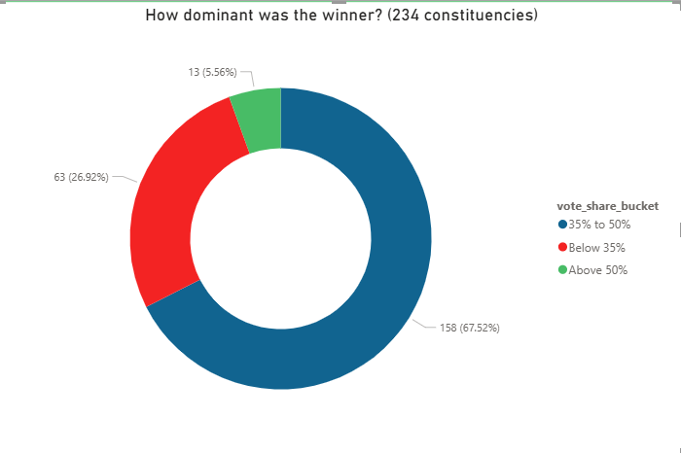
STORY 3 — THE FRAGMENTED MANDATE
Most winners did not get a majority
13
won above 50%
A true majority — only 5.6% of seats
158
won 35%–50%
Most common result — close but not majority
63
won below 35%
More voters chose someone else
Tiruppattur — won by exactly 1 vote out of 200,000+ cast

Slide 8
ADVANCED INSIGHTS — BEYOND THE HEADLINE NUMBERS
0%
BJP survival rate
52%
TVK win rate — SC seats
Lost all 4 seats it held in 2021.
Udhagamandalam gained — a different seat.
Higher than its 45% GEN seat rate.
Wave cut across reserved constituencies.
30%
DMK survival rate
100%
CPI — 100% survival
Retained only 40 of 133 seats.
Historic anti-incumbency collapse.
Only party that retained every seat.
Both seats held from 2021 to 2026.
Note: TVK was founded in 2024 and did not contest the 2021 election.

