Slide 1
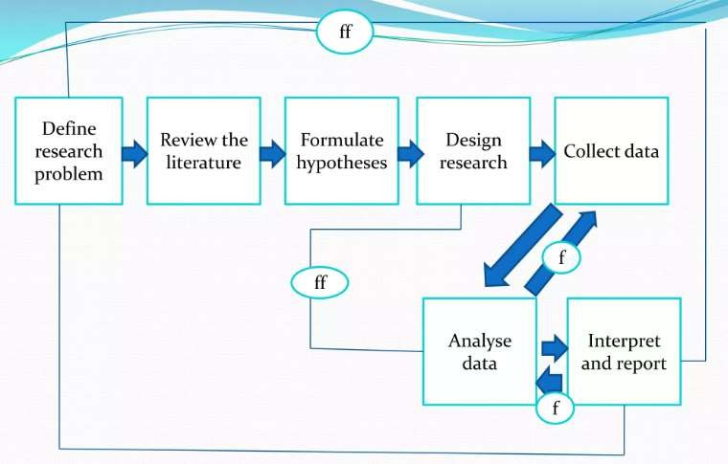
Research Process
Where f= feed back(helps In controlling the sub system)
ff= feed forward(serves the vital function of providing criteria for evaluation

Slide 2
Research Design
Definition
Purpose
Importance of a well-structured design
Types of Research Designs: Exploratory design, Descriptive design,
Experimental design, Quasi experimental design
Components of Research Design: Objectives Hypotheses,
Variables, Methods of data collection, Sampling design
Validity and Reliability: Internal validity, External validity, Construct validity, Reliability and consistency.

Slide 3
Definition
Once the research problem is clearly defined, the next step is to prepare a research design, which serves as the conceptual framework for conducting the study.
Definition :
According to C.R. Kothari, “A research design is the arrangement of conditions for collection and analysis of data in a manner that aims to combine relevance to the research purpose with economy in procedure”. It is
the conceptual structure within which research is conducted, it constitutes the blueprint for the collection, measurement, and analysis of data.
Ranjit Kumar describes research design as a plan that guides the researcher in the process of collecting, analyzing, and interpreting observations. It provides a systematic approach to answer research questions.
Donald R. Cooper and Pamela S. Schindler emphasize that a research design is a plan for selecting the sources and types of information used to answer the research question. It is a framework for specifying the relationships among the study's variables.
C. George Thomas highlights that a well-structured research design ensures that the evidence obtained enables the researcher to effectively address the research problem logically and as unambiguously as possible.

Slide 4
Deepak Chawla and Neena Sondhi note that research design involves the outline
of what the researcher will do from writing the hypotheses and their operational
i.mplications to the final analysis of data.
A research design is a comprehensive plan that specifies the methods and procedures for collecting and analyzing the needed information. It ensures that the study is methodologically sound and that the research questions are addressed appropriately

Slide 5
(i) What is the study about?
More explicitly, the design decisions happen to be in respect of:
Why is the study being made?
Where will the study be carried out?
What type of data is required?
Where can the required data be found?
What periods of time will the study include?
What will be the sample design?
What techniques of data collection will be used?
How will the data be analysed?
In what style will the report be prepared?

Slide 6
Research design can be split into the following parts:
the sampling design which deals with the method of selecting items to be observed for the given study
the observational design which relates to the conditions under which the
observations are to be made;
the statistical design which concerns with the question of how many items are to be observed and how the information and data gathered are to be analysed
the operational design which deals with the techniques by which the
procedures specified
In the sampling, statistical and observational designs can be carried out.

Slide 7
Important features of a research design are:
It is a plan that specifies the sources and types of
information relevant to the research problem.
It is a strategy specifying which approach will be used for
gathering and analysing the data.
It also includes the time and cost budgets since most studies are done under these two constraints.

Slide 8
Research design must, at least, contain
a clear statement of the research problem;
procedures and techniques to be used for gathering
information
the population to be studied;
methods to be used in processing and analysing data.

Slide 9
Research design in computer science
Problem Definition
A clear and precise statement of the research problem.
Definition of scope, limitations, and research questions.
Justification of the problem’s importance and relevance in computer science.
Literature Review and Theoretical Framework
Review of existing research, algorithms, models, and methodologies.
Identification of research gaps.
Explanation of theoretical foundations that guide the study.

Slide 10
3. Research Methodology
Selection of research type: Experimental, theoretical, empirical, or simulation-based
research.
Tools, techniques, and frameworks to be used (e.g., AI/ML models, data structures, cloud platforms).
Dataset and data collection methods (real-world datasets, synthetic data, or simulations).
Programming languages, libraries, and software environments to be used.
Experimental Design and Implementation
Algorithm or model development (if applicable).
Experimental setup, including hardware and software specifications.
Evaluation metrics (e.g., accuracy, precision, recall, computational efficiency).
Testing strategies, such as unit testing, stress testing, or validation techniques.
Dr. Manjiri B. Patwari

Slide 11
Population and Sampling (if applicable)
In machine learning and AI research, selection of datasets (e.g., benchmark datasets, real-world data).
In user studies (HCI, usability testing), defining the sample population and sampling methods.
Data Processing and Analysis
Preprocessing techniques (e.g., data cleaning, normalization, feature
engineering).
Methods for data analysis (e.g., statistical tests, visualization techniques, ML
models).
Performance evaluation metrics relevant to the study.

Slide 12
Validation and Verification
Comparison with baseline models or existing techniques.
Reproducibility of results using open-source code or datasets.
Error analysis and limitations of the approach.
Ethical Considerations
Privacy and security concerns (especially for sensitive datasets).
Bias and fairness issues in AI/ML-based research.
Compliance with ethical guidelines for computer science research.
Expected Outcomes and Contributions
Key findings and expected impact on the field of computer science.
Potential real-world applications of the research.
Future research directions and improvements.

Slide 13
Research Design Purpose
Provides a Structured Framework - Guides the entire research process
systematically.
Ensures Relevance – Aligns research activities with the research objectives. Minimizes Bias and Errors – Helps in collecting unbiased and accurate data. Enhances Validity and Reliability – Ensures credible and reproducible results. Facilitates Efficient Data Collection – Determines the best methods for gathering relevant data.
Defines Data Analysis Techniques – Helps in choosing appropriate tools and
techniques for analysis.
Optimizes Resources – Ensures research is cost-effective and time-efficient. Improves Decision-Making – Supports informed conclusions based on systematic findings.
Provides a Basis for Hypothesis Testing – Helps in verifying assumptions through
empirical evidence.
Ensures Ethical Research Practices – Promotes integrity and adherence to ethical
guidelines.

Slide 14
Importance of a well-structured design
Ensures Clarity of Research Objectives – A structured research design helps in
defining clear objectives and aligning the study accordingly (Kothari & Garg).
Provides a Systematic Framework – It offers a logical sequence for research
execution, ensuring coherence and consistency (Ranjit Kumar).
Reduces Bias and Errors – By carefully selecting methods and procedures, a well-planned design minimizes researcher bias and sampling errors (Cooper & Schindler).
Enhances Validity and Reliability – It ensures accurate measurement of variables, increasing the reliability and generalizability of results (C. George Thomas).

Slide 15
Efficient Use of Resources – Proper planning prevents wastage of time, effort,
and financial resources, making research more effective (Chawla & Sondhi).
Facilitates Appropriate Data Collection – It helps in selecting the best methods (surveys, experiments, observations) for collecting relevant data (Kothari & Garg).
Strengthens Data Analysis – A structured design aids in choosing suitable
analytical techniques, ensuring valid interpretations (Ranjit Kumar).
Supports Hypothesis Testing – It provides a basis for empirical validation of
hypotheses, improving the scientific rigor of the study (Cooper & Schindler).
Ensures Ethical Compliance – Following ethical guidelines in research design maintains integrity and credibility (C. George Thomas).
Improves Decision-Making – Well-structured research supports informed
conclusions and actionable insights (Chawla & Sondhi).

Slide 16
Types of Research Designs
Exploratory design
Descriptive design
Experimental design
Quasi experimental design

Slide 17
Exploratory Research Design
Exploratory Research studies are also termed as formulative research studies. And main purpose is formulating a problem for more precise investigation , developing the working hypothesis.
Exploratory research is conducted when the problem is not clearly defined, and there is a need to gather preliminary information. It helps in understanding concepts, generating hypotheses, and identifying new research directions.
Methods Used:
Literature reviews(The survey of concerning literature)
Experience survey
Analysis of ‘insight-stimulating’
Exploratory research is as an initial step in research methodology, particularly in qualitative studies. It is common in business and market research to identify customer preferences and market trends.

Slide 18
Objective: To explore the factors influencing people's decisions when selecting educational apps.
Ex:
Topic: How Do People Choose Mobile Apps for Learning?
Method:
Conduct informal interviews with students and professionals about their
preferred learning apps.
Observe user behavior by analyzing app store reviews to identify common
themes.
Conduct a small survey asking participants about the features they find
most useful in an educational app.
Why Exploratory?
The study does not test a hypothesis but gathers insights.
It helps identify trends, user preferences, and possible areas for deeper research.

Slide 19
Variable
Variables are measurable characteristics or attributes that change across individuals, groups, or conditions in a study.
Ex.
Independent Variable (IV): Study Time (in hours)
Dependent Variable (DV): Exam Score (out of 100)

Slide 20
Descriptive Research Design
Definition & Purpose:
Descriptive research aims to systematically describe a phenomenon, individual, or group without manipulating variables. It answers the "what," "when," "where," and "how" aspects of research but does not establish causation.
Methods Used Surveys Observational studies
Cross-sectional studies
Descriptive research is often used in social sciences, business research, and public health
studies.
Descriptive research focuses on gathering factual, accurate, and systematic data, making it essential for understanding population characteristics.
Used extensively in business research to analyze customer behavior and market trends.
It is used in economic studies for analyzing company performance, employee satisfaction, and industry patterns.

Slide 21
Topic: Study Habits of College Students
Objective: To describe the study habits of college students, such as study
duration, preferred environment, and use of digital tools.
Method:
Conduct a survey asking students how many hours they study daily,
where they study, and what resources they use.
Observe students in a library or study area to note behaviors like group
vs. solo study, use of laptops vs. books, etc.
Analyze existing data (e.g., library check-out records, app usage
statistics) to find trends in study habits.
Why Descriptive?
It describes student behaviors without manipulating variables.
The focus is on what is happening rather than why it happens.

Slide 22
Experimental Research Design
Definition & Purpose:
Experimental research is the most rigorous form of research design, used to establish cause and-effect relationships by manipulating independent variables and observing changes in dependent variables.
It involves randomization, control groups, and controlled settings.
Methods Used:
Laboratory experiments
Field experiments
Randomized Controlled Trials (RCTs)
Experimental research provides the highest level of accuracy and reliability in scientific
studies.
This design is suitable for hypothesis testing and is common in natural and social sciences. In business and consumer behavior research its very important because companies test new products and marketing strategies.
Used in engineering, medicine, and psychology, where variables must be tightly controlled
to ensure valid results.
Its important in economic and management research, where controlled experiments
help assess policy impacts.

Slide 23
Example
Topic: Does Music Improve Study Performance?
Objective: To determine if listening to music while studying improves test performance.
Method:
Participants: Select two groups of students.
Independent Variable: Background music while studying.
Dependent Variable: Test scores.
Procedure:
Group A (Experimental Group): Studies while listening to instrumental music.
Group B (Control Group): Studies in complete silence.
Both groups take the same test after a study session.
Analysis: Compare the average test scores of both groups.
Why Experimental?
The researcher controls the study environment.
There is random assignment to groups.
A cause-and-effect relationship is tested.

Slide 24
Quasi-Experimental Research Design
Definition & Purpose:
Quasi-experimental research is similar to experimental research but lacks random assignment
of participants into control and experimental groups.
It is used when randomization is not possible, such as in real-world settings like schools,
workplaces, or hospitals.
This design helps establish causality but with less control over external variables than true
experiments.
Methods Used:
Non-randomized control group studies
Time-series analysis
Matched-pair studies

Slide 25
Quasi-Experimental Research Design
Quasi-experimental research is useful when real-world constraints prevent true
experimental design.
It is widely used in social sciences and public policy research, especially in
studies involving education, healthcare, and community programs.
Used in business research, where randomization is impractical, such as in testing
new marketing campaigns or HR policies.
This design is common in medical and clinical research, where ethical concerns
prevent full randomization.
Used in economics and finance, where pre-existing data and observational
studies form the basis of analysis.

Slide 26
Ex:
Topic – “The Effect of Online Learning on Student Performance “
Objective: To determine whether online learning improves students' test
scores compared to traditional classroom learning.
Method:
Select two groups of students: one using online learning and the other using traditional classroom learning.
Ensure both groups have similar characteristics (e.g., same grade
level, similar past performance).
Compare test scores at the end of the semester.
Why Quasi-Experimental?
No random assignment (students are already in existing classes).
The study still compares two groups to measure cause-and-effect relationships.

Slide 27
Example showing the difference between both.
Experimental Design Example:
A university wants to test a new programming teaching
method.
They randomly divide students into two groups:
Group A (Experimental Group) learns with the new method.
Group B (Control Group) learns with the traditional method.
After a semester, their performance is compared.
Quasi-Experimental Design Example:
A study wants to compare coding skills between students from two different colleges (one using online classes and the other using offline classes).
Since students cannot be randomly assigned to a different
college, the study observes pre-existing groups.

Slide 28
Components of Research Design
Objectives
To Provide a Clear Research Framework – Establish a logical structure that defines the research problem, objectives, and methodology.
To Ensure Validity and Reliability – Minimize bias, enhance
accuracy, and ensure replicability of findings.
To Guide Data Collection and Analysis – Select appropriate
methods for data gathering, measurement, and interpretation.
To Align Research with Theory – Establish consistency between
research questions, hypotheses, and theoretical foundations.
To Facilitate Decision-Making – Support evidence-based
conclusions, especially in business and applied research.
To Support Different Research Approaches – Define strategies for
qualitative, quantitative, and mixed-methods research.
To Maintain Ethical Standards – Promote ethical considerations in
study design, data collection, and reporting.

Slide 29
Hypothesis
A hypothesis is a testable assumption that provides a focal point for research.
When a researcher observes known facts and takes up a problem for analysis, he first has to start somewhere and this point of start is hypothesis.
It helps in formulating research objectives, guiding data collection, and determining analytical methods. It shapes the research process by setting boundaries and focusing on relevant aspects of the problem.
In computer science, a hypothesis is a testable assumption or prediction about a system, algorithm, or dataset that can be verified through experiments or analysis.
It helps researchers define problems, guide investigations, and validate findings using data and computational methods

Slide 30
A hypothesis is a statement that predicts a relationship between variables. It is an educated guess that researchers test through experiments or observations.
Simple Example:
Hypothesis: Drinking more water improves concentration. Independent Variable: Amount of water consumed.
Dependent Variable: Level of concentration.
Test: Compare the concentration levels of two groups—one drinking plenty of water and another drinking very little.
If the group drinking more water performs better on concentration tests, the hypothesis is supported. If not, it may be rejected.

Slide 31
A working hypothesis
Is a tentative assumption proposed to guide research by helping to structure data collection and analysis.
It serves as a crucial element in most research studies, influencing the overall direction, methodology, and focus. Developing a well- defined hypothesis is essential as it helps narrow the scope, ensures clarity, and determines the types of data required.
Importance of a Working Hypothesis:
It prevents unnecessary exploration by keeping the research focused.
It provides a clear research direction and enhances logical reasoning. It helps determine the type of data and analytical techniques required.

Slide 32
Methods for Developing Hypotheses:
Discussions with Experts & Peers: Consulting knowledgeable individuals helps refine the research problem.
Examining Data & Records: Reviewing existing datasets may reveal
patterns or trends.
Reviewing Similar Studies: Analyzing previous research provides insight
into existing gaps.
Exploratory Investigation: Conducting initial field studies or interviews
helps in better understanding the issue.
Characteristics of an Effective Hypothesis:
It should be specific, clear, and testable.
It must be relevant to the research problem and capable of being
supported or refuted through data analysis.
It should be structured in a way that facilitates effective research
execution.

Slide 33
Situations Where Hypotheses May Not Be Required
In some exploratory or formulative research, hypotheses may not be necessary since the study aims at discovering patterns rather than testing assumptions.
However, in most research cases, formulating a hypothesis is a fundamental step in structuring a systematic inquiry.

Slide 34
Variable
Variables are measurable characteristics or attributes that change across individuals,
groups, or conditions in a study.
They are fundamental to research, influencing hypothesis formulation, data collection, and
analysis.
Variables involved in research can take different qualitative values. Ex. Weight, height, income, age
Independent Variable (IV) The Cause : The variable that is manipulated or
changed to observe its effect on the dependent variable.
Example:
The processor speed of a computer (e.g., 2.0 GHz, 3.0 GHz, 4.0 GHz).
Electric power is independent variable.
The number of hours a student studies.
Dependent Variable (DV) The Effect : The variable that is measured or observed as a result of changes in the independent variable.
Example:
The time taken to complete a software compilation. (Faster processors may reduce
compilation time.)
Light is dependent variable ( Independent Eletricity)
The marks a student scores in an exam.

Slide 35
Variable
Extraneous Variable (Uncontrolled Factors) : Any unwanted variable that may affect the outcome of an experiment but is not intentionally studied.
Example:
The amount of background applications running during the software compilation.
The student’s health on the exam day.
Moderating Variable(Influences the Relationship) : A variable that influences the strength or direction of the relationship between the independent and dependent variables. Example:
The efficiency of the cooling system. (A better cooling system may allow the processor to run at peak speed for longer.)
A student's motivation level.
Mediating Variable (Acts as a Link ): A variable that explains the relationship between
the independent and dependent variables.
Example:
The RAM size in a performance test. (A faster processor improves performance, but only if sufficient RAM is available.)
Quality of study materials.

Slide 36
Variable
Control Variable (Kept Constant ): A variable that is kept constant to ensure
The experiment's accuracy and prevent it from influencing the results.
Example:
The type of software used for the compilation test. (Ensures the processor speed
is the only changing factor.)
The difficulty level of the exam.
Continuous Variable (Numeric with Infinite Possibilities ): A variable that can take any numerical value within a range.
Example: The amount of RAM used (e.g., 4.5 GB, 8.2 GB, 16 GB)
Battery percentage of a laptop (e.g., 45%, 78%, 99%).
Categorical Variable (Distinct Groups ): A variable that consists of distinct
groups or Categories.
Example: Operating system type (Windows, macOS, Linux), Gender (Male/Female/Other), Programming language used (Python, Java, C++).

Slide 37
Importance in Research
It helps to define the research problem.
It helps to formulate hypotheses.
It helps to choose appropriate data collection and
analysis methods.
It ensures validity, reliability, and accuracy of research findings.
It is crucial for statistical testing and establishing relationships between factors.
It helps in designing a structured and meaningful research study.

Slide 38
Key Considerations in Research Design
Methods of data collection
Availability and expertise of researchers
Organization and justification of chosen methods
Time constraints
Financial resources available
A well-structured research design helps ensure reliable and valid results while optimizing available resources.

Slide 39
Data Collection
Data collection is the process of gathering information from various sources to analyze and make informed decisions. It is essential for research, business analysis, and system improvements.
Types of Data Collection
1. Primary Data Collection (First-hand Data) : Data collected directly from sources for a specific
purpose.
Methods:
Observation – Watching and recording behaviors (e.g., monitoring user activity on a website).
Surveys & Questionnaires – Asking questions to a target audience (e.g., collecting customer
feedback).
Interviews – Direct conversation with individuals to gather insights (e.g., interviewing software
developers).
Experiments – Conducting tests to observe cause-effect relationships (e.g., testing app performance
On different devices).
Focus Groups – Group discussions to gather opinions (e.g., discussing UI/UX design improvements).

Slide 40
Secondary Data Collection (Pre-existing Data) : Data collected by others and used for analysis.
Sources:
Books & Research Papers – Referring to published academic studies.
Government Reports – Using census or official data for analysis.
Company Records – Analyzing historical sales or user data.
Online Databases – Extracting data from repositories like IEEE,
Google Scholar, or GitHub logs.

Slide 41
Determining sample design
Sampling is the process of selecting a group of individuals from a population to
study them and characterize the population as a whole.
The population includes all members from a specified group, all possible outcomes or measurements that are of interest. The exact population will depend on the scope of the study.
The sample consists of some observations drawn from the population, so a part of a subset of the population. The sample is the group of elements who participated in the study.
Example : COVID-19 vaccine clinical trials.
A sample design is a pre-determined plan for selecting a sample from a given
population for study purposes.
Types of Sample Designs: Probability Sampling - Non-Probability Sampling
Other Sampling Techniques

Slide 42
Validity and Reliability : Internal validity, External Validity, Construct
validity, reliability and Consistency
Validity and Reliability are two crucial aspects of research methodology that ensure the
accuracy, consistency, and credibility of research findings.
A research study must be both valid and reliable to produce meaningful and generalizable
results.
Validity :
Validity refers to the extent to which a research instrument measures what it is intended to measure. It determines the accuracy and appropriateness of research conclusions. If a study lacks validity, the results may be misleading or irrelevant.
The measurement of physical properties like height, weight, length can be validated easily
as they can be measured using the devices available.
The measurement of abstract properties like attitude, morale, motivation is indirect and
needs proper

Slide 43
Two forms of Validity
Internal Validity
Internal validity focuses on whether the study accurately establishes a cause-and- effect relationship between variables. It ensures that the observed changes in the dependent variable are due to the independent variable and not influenced by extraneous factors
External Validity
External validity refers to the extent to which research findings can be generalized beyond the specific study context. It ensures that results apply to different populations, settings, and times.

Slide 44
Types of Validity
Content validity
Criterion-related validity
Construct validity.

Slide 45
1) Content validity :
It is the extent to which a measuring instrument provides adequate
coverage of the topic of study.
If the instrument contains a representative sample of the universe,
the content validity is good.
Its determination is primarily judgemental and intuitive. It can also be determined by using a panel of persons who shall judge how well the measuring instrument meets the standards , but there is no numerical way to express it.
The degree of content validity rest primarily on the knowledge, skill
and judgement of the instrument designer and/or judges.

Slide 46
Ex.
Concept:
Content validity checks whether a test covers all the important topics it is
supposed to measure.
Example:
An MCA professor creates an “Advanced Database Management ” exam to
assess students' knowledge.
If the test has content validity:
It includes questions on SQL, normalization, indexing, transactions, and security.
It covers all key topics from the syllabus.
If the test lacks content validity:
It only has SQL queries but ignores database design and security. Important topics from the syllabus are missing.

Slide 47
2) Criterion-related :
It is related to the ability to predict some outcome or estimate the existence of some current condition. This form of validity reflects the success of measures used for some empirical estimating purpose.
The concerned criterion must possess the following qualities:
Relevance: (A criterion is relevant if it is defined in terms we judge to be the
proper measure.
Freedom from bias: (Freedom from bias is attained when the criterion gives each
subject an equal opportunity to score well.)
Reliability: A reliable criterion is stable or reproducible.
Availability: The information specified by the criterion must be available. In fact, a Criterion-related validity is a broad term that actually refers to
(i) Predictive validity : It refers to the usefulness of a test in predicting some
future performance.
Concurrent validity : It refers to the usefulness of a test in closely relating
to other measures of known validity.
(ii)
Criterion-related validity is expressed as the coefficient of correlation between test scores and some measure of future performance or between test scores and scores on another measure of known validity.

Slide 48
Simplified Example of Criterion-Related Validity
Concept:
Criterion-related validity checks whether a test or measure accurately predicts or correlates
with real-world performance or an established standard (criterion).
Example:
A company develops an "Aptitude Test for Software Developers" to assess candidates before hiring.
If the test has criterion-related validity:
Candidates who score high on the test perform well in real coding jobs.
Their test results match their actual job performance.
If the test lacks criterion-related validity:
High scorers struggle with real coding tasks.
Low scorers perform better in actual projects than high scorers.

Slide 49
Construct validity :
Construct validity is the most complex and abstract type of validity. It checks whether a test truly measures the concept it is supposed to,
based on a strong theoretical foundation.
To determine construct validity, we compare the test results with other related theories or expected outcomes.
If the test scores show the expected relationships, we can say the test has construct validity.
In simple terms, if a measurement aligns with established theories
and behaves as predicted, it is considered valid.

Slide 50
Example
Concept:
Construct validity checks whether a test truly measures what it claims to measure based on a solid theory.
Example:
A professor develops a "Programming Skills Test" to assess MCA students' coding
abilities.
If the test has construct validity:
Students who study programming regularly score higher.
Students with prior coding experience perform better.
The test results correlate with real-world coding performance.
If the test lacks construct validity:
Students with strong coding skills score low.
Students who memorize theory (without coding practice) score high.
The test does not align with expected patterns.
This shows that construct validity ensures the test truly measures programming
skills and not just theoretical knowledge.

Slide 51
Reliability
A measuring instrument is considered reliable if it consistently produces the
same results.
While reliability contributes to validity, a reliable instrument is not necessarily
valid.
For example, a scale that consistently overweighs objects by five kilograms is reliable but does not provide an accurate measurement of weight. However, the reverse is always true— a valid instrument is inherently reliable.
Although reliability is not as crucial as validity, it is easier to assess. When an instrument meets the criteria for reliability, we can trust that temporary or situational factors are not affecting the results.

Slide 52
1) Stability
Reliability has 2 aspects
2) Equivalence
Stability refers to obtaining consistent results when measuring the same individual multiple times using the same instrument. The degree of stability is typically assessed by comparing repeated measurements. Equivalence, on the other hand, examines the potential errors introduced by different investigators or variations in the sample items. A common method to test equivalence is by comparing the observations of the same events made by two different investigators.
Reliability can be enhanced in the following ways:
Standardizing measurement conditions – Ensuring minimal external variations,
such as fatigue or boredom, helps improve stability.
Carefully designing measurement procedures – Providing clear and consistent instructions, employing well-trained and motivated researchers, and expanding the sample of items contribute to improved equivalence.

Slide 53
Test of Practicality
The practicality of a measuring instrument is evaluated based on three key factors: economy, convenience, and interpretability. From an operational perspective, a measuring instrument should be practical, meaning it must be cost-effective, easy to use, and capable of producing meaningful results.
Economy: There is often a trade-off between an ideal research project and budget constraints. The length of the measuring instrument is a primary area where financial limitations are felt. While including more items enhances reliability, practical considerations—such as reducing interview or observation time—necessitate selecting only a few key items. Similarly, economic factors can influence the choice of data collection methods.
Convenience: The instrument should be easy to administer, which requires careful attention to its layout. For example, a well-structured questionnaire with clear instructions and illustrative examples is more effective and user-friendly than one lacking these elements.

Slide 54
Interpretability:
This is particularly important when individuals other than the test designers need to analyze
the results.
To ensure clarity, the instrument should include:
Detailed instructions for administering the test
Scoring guidelines
Evidence of reliability
Guidance on using the test and interpreting results
A well-designed measuring instrument that balances these aspects enhances both usability and effectiveness.

Slide 55
Determining sample design
Sampling is the process of selecting a group of individuals from a population to
study them and characterize the population as a whole.
The population includes all members from a specified group, all possible outcomes or measurements that are of interest. The exact population will depend on the scope of the study.
The sample consists of some observations drawn from the population, so a part of a subset of the population. The sample is the group of elements who participated in the study.
Example : COVID-19 vaccine clinical trials.
A sample design is a pre-determined plan for selecting a sample from a given
population for study purposes.
Types of Sample Designs: Probability Sampling - Non-Probability Sampling
Other Sampling Techniques

Slide 56
Probability sampling methods
Probability sampling involves random selection, allows to make strong statistical inferences about the whole group.
Probability sampling means that every member of the population has a chance of being selected. It is mainly used in quantitative research. To produce results that are representative of the whole population, probability sampling techniques are the most valid choice.
There are four main types of probability sample.
Simple random Sampling
Systematic Sampling
Stratified Sampling
Cluster Sampling

Slide 57
1. Simple random sampling
In a simple random sample, every member of the population has an equal chance of being selected. Here sampling frame should include the whole population.
To conduct this type of sampling, tools like random number generators or other techniques that are based entirely on chance are used.

Slide 58
2. Systematic sampling
Systematic sampling is similar to simple random sampling, but it is slightly easier to conduct. Every member of the population is listed with a number, but instead of randomly generating numbers, individuals are chosen at regular intervals.
Steps in selecting a systematic random sample:
Calculate the sampling interval (the number of observations in the population divided by the number of observations needed for the sample)
Select a random start between 1 and sampling interval
Repeatedly add sampling interval to select subsequent households

Slide 59
3. Stratified sampling
Stratified sampling involves dividing the population into subpopulations that may differ in important ways. It allows to draw more precise conclusions by ensuring that every subgroup is properly represented in the sample.
Here the population is divided into subgroups (called strata) based on the relevant characteristic (e.g., gender identity, age range, job, income bracket, job , role). Based on the overall proportions of the population, it is calculated how many people should be sampled from each subgroup. Then random or systematic sampling is used to select a sample from each subgroup.

Slide 60
4. Cluster sampling
Cluster sampling also involves dividing the population into subgroups, but each subgroup should have similar characteristics to the whole sample. Here entire subgroups is randomly selected.
This is called multistage sampling.
This method is good for dealing with large and dispersed populations, but there is more risk of error in the sample, as there could be substantial differences between clusters. It’s difficult to guarantee that the sampled clusters are really representative of the whole population.

Slide 61
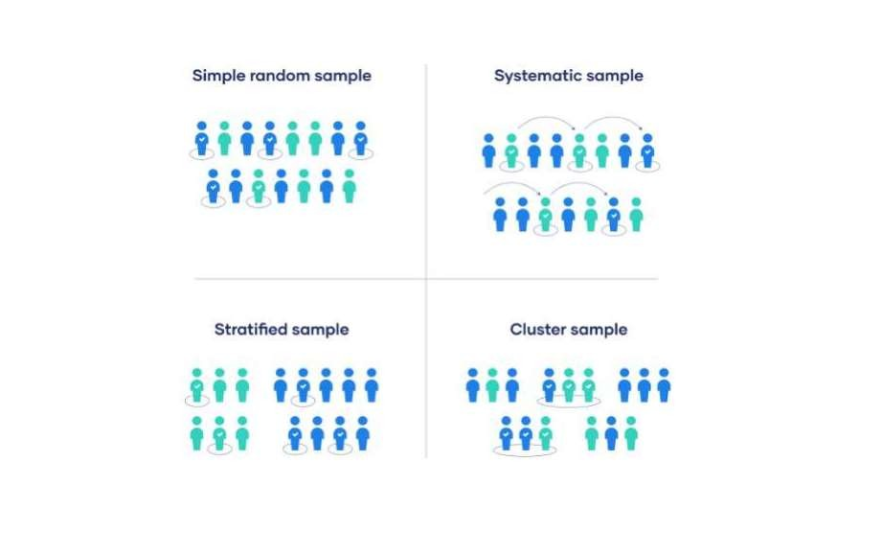

Slide 62
Non-probability sampling
In a non-probability sample, individuals are selected based on non-random criteria, and not every individual has a chance of being included.
Non-probability sampling techniques are often used in exploratory and qualitative research.
Types of non-probability sampling are
Convenience sampling
Voluntary response sampling
Purposive sampling
Snowball sampling

Slide 63
1. Convenience sampling
A convenience sample simply includes the individuals who happen to be most accessible to the researcher.
This is an easy and inexpensive way to gather initial data, but there is no way to tell if the sample is representative of the
population, so it can’t produce generalizable results.
For example, if MCA students are conducting a study on the average consumption of Sandwich in the cafeteria each week, they could call their classmates and ask how many slices they consume during the week.

Slide 64
2. Voluntary response sampling
Similar to a convenience sample, a voluntary response sample is mainly based on ease of access.
Instead of the researcher choosing participants and directly contacting them, people volunteer themselves (e.g. by responding to a public online survey).

Slide 65
3. Purposive sampling
It is also known as judgment sampling. It involves the researcher using their expertise to select a sample that is most useful to the purposes of the research.
It is often used in qualitative research, where the researcher wants to gain detailed knowledge about a specific phenomenon rather than make statistical inferences, or where the population is very small and specific.

Slide 66
4. Snowball sampling
If the population is hard to access, snowball sampling can be used to recruit participants via other participants.
The number of people you have access to “snowballs” as you get in contact with more people.
The downside here is also representativeness, as you have no way of knowing how representative your sample is due to the reliance on participants recruiting others. This can lead to sampling bias.
Example: Student Network

Slide 67
5. Quota Sampling
Quota sampling is a non probability sampling technique that relies on the non-random selection of a predetermined number or proportion of units. This is called a quota.
You first divide the population into mutually exclusive subgroups (called strata) and then recruit sample units until you reach your quota. These units share specific characteristics, determined by you prior to forming your strata.

Slide 68
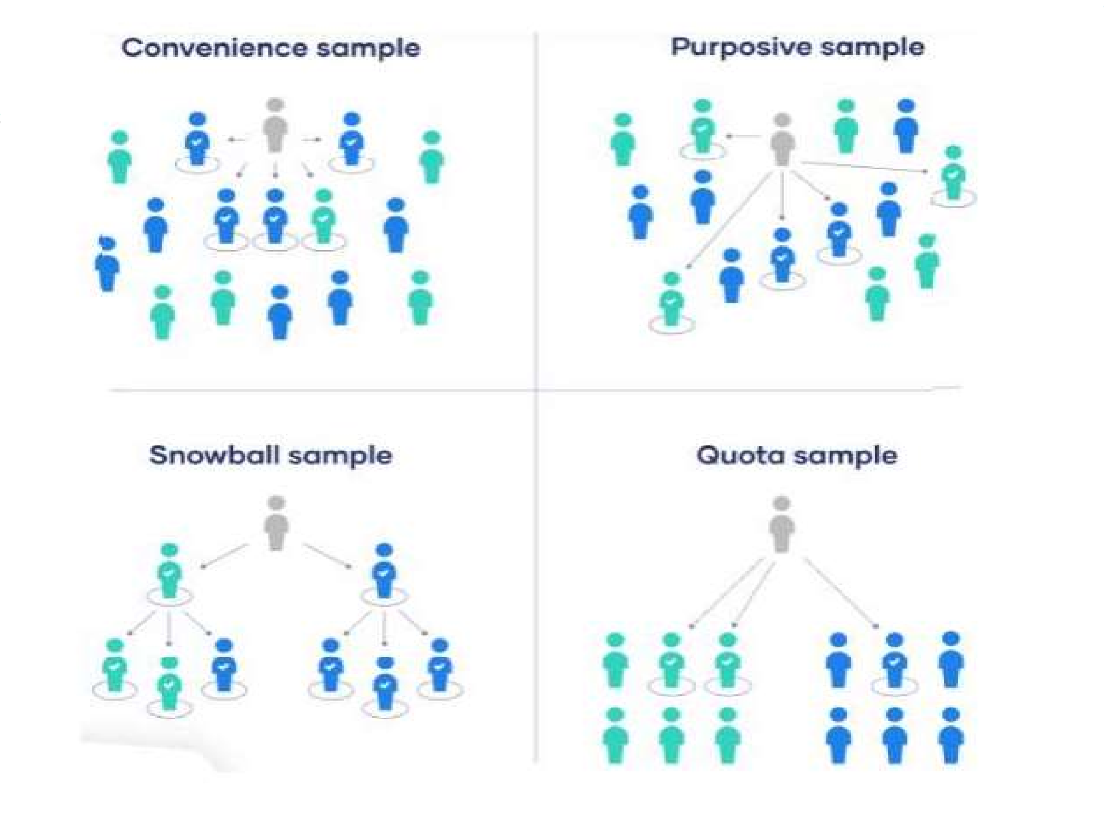




Slide 69


Research Questions
Definition: Research questions are specific queries that guide the entire research process. These questions define what the study aims to answer and focus the investigation on the key aspects of the problem.
Formulating Research Questions:
Link to Research Problem: The research questions should directly
stem from the identified problem.
Specific and Clear: Questions must be precise, avoid ambiguity, and
clearly specify what is being studied.
Feasibility: The questions should be answerable using the available research methods and resources.
Aligned with Objectives: The questions should align with the overall research objectives and the type of data that needs to be collected.

Slide 70
Characteristics of Effective Research Questions:
Focused: They should focus on specific aspects of the research
problem.
Operationalizable: The questions should be capable of being tested or
explored through data collection and analysis.
Clear: They must be straightforward and easily understandable.
Types of Research Questions:
Descriptive: Aimed at describing a phenomenon (e.g., “What is the
effect of X on Y?”).
Explanatory: Focused on explaining relationships or causes (e.g., “Why does X lead to Y?”).
Exploratory: Used when little is known about the topic, aiming to
explore new areas (e.g., “What are the challenges faced by X?”).

