Slide 1

Vehicle Damage
Detection System
Deep Learning | CNN | VGG16 Transfer Learning
TensorFlow · Keras · Streamlit · OpenCV · Python
CNN Deep Learning Project

Slide 2






Table of Contents
What this presentation covers
01
02
Project Overview
Tools & Technologies
Objective, dataset & problem statement
TensorFlow, Keras, OpenCV, Streamlit
03
04
Dataset & Training
Model Architecture
18,992 images, VGG16 fine-tuning
VGG16 transfer learning pipeline
05
06
Streamlit App Demo
Results & Conclusion
Live predictions — damaged vs undamaged
Performance metrics & key takeaways
2 / 10

Slide 3
Project Overview
Objective, dataset & problem statement
PROBLEM STATEMENT
DATASET
Custom Car Image Dataset
Predicting Vehicle Damage
18,992 total images | Undamaged & Damaged categories
Vehicle accidents and insurance claims require fast, accurate damage assessment. Manual inspection is time-consuming and prone to human error.
This project builds a binary image classification model using CNN (VGG16 transfer learning) to automatically detect whether a vehicle is damaged or undamaged — enabling rapid, scalable, AI-powered assessment.
18,992
15,000
Total Images
Train Split
3,992
224 × 224
Test Split
Image Size
Binary Classification | Damaged vs Undamaged
3 / 10

Slide 4


Tools & Technologies
Python ecosystem powering this project
TensorFlow / Keras
VGG16
OpenCV (cv2)
Deep learning framework
for model training
Pre-trained CNN model
for transfer learning
Image reading & BGR
preprocessing
NumPy
Streamlit
Scikit-learn
Array operations &
image normalization
Web app deployment
& real-time UI
Metrics: confusion matrix,
classification report
4 / 10

Slide 5


Dataset & Training
Data preparation, class structure, and model training setup
CLASS STRUCTURE
PREPROCESSING PIPELINE
1
Load Images via os.listdir()
Iterate Undamaged & Damaged folders, assign labels 0 and 1
Class 0
Class 1
2
Read with cv2.imread()
Undamaged
Damaged
Images loaded in BGR format (OpenCV default)
3
Resize to 224 × 224
Uniform input shape required by VGG16
TRAINING CONFIGURATION
4
Shuffle & Split
Optimizer:
Adam
15,000 train / 3,992 test (random shuffle applied)
Loss Function:
Sparse Categorical Crossentropy
Normalize: divide by 255
5
Epochs:
5
Scale pixel values to [0, 1] range for training
Batch Size:
64
6
BGR → RGB in App
Validation Split:
20%
App reverses channel order to match training preprocessing
5 / 10

Slide 6
Model Architecture
VGG16 Transfer Learning — frozen base + custom classification head
INPUT
VGG16 BASE
FLATTEN
DENSE 256
OUTPUT
224×224×3
13 Conv Layers
(Frozen weights)
7×7×512 →
25,088 units
ReLU activation
Dropout 0.5
Dense 2
Softmax
WHY VGG16?
CUSTOM HEAD LAYERS
Pre-trained on ImageNet (1.2M images, 1000 classes)
vgg_base.output
7 × 7 × 512 feature maps from VGG16
Powerful feature extractor for visual patterns
Flatten()
Converts 3D output → 25,088 flat vector
Transfer learning = fast convergence with small datasets
Dense(256, relu)
Frozen base layers → only custom head is trainable
Fully connected layer — learns combinations
Dropout(0.5)
Achieves high accuracy with significantly less compute
Regularization — prevents overfitting
Dense(2, softmax)
Output: [P(Undamaged), P(Damaged)]
6 / 10

Slide 7
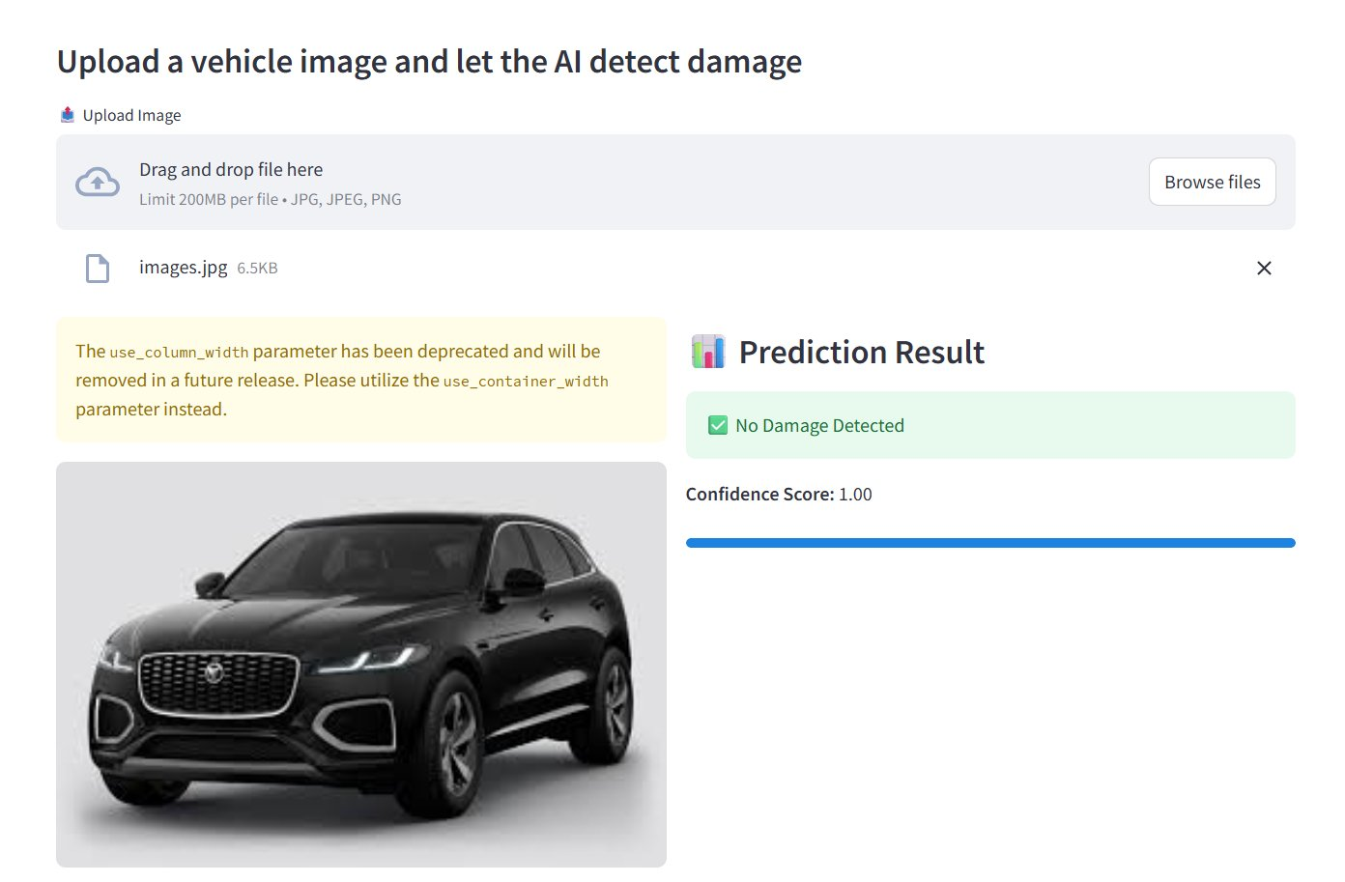
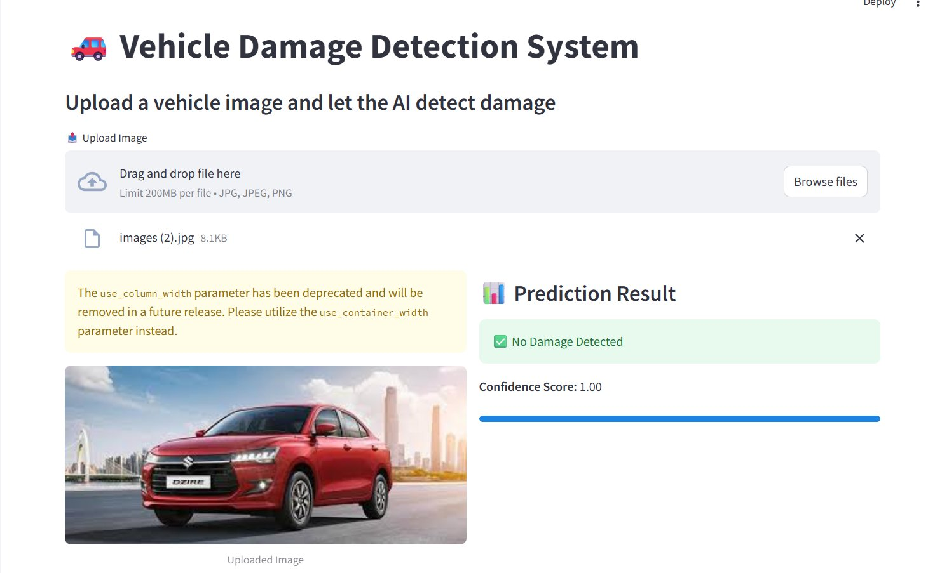
Streamlit App — Demo
Live deployment — undamaged vehicle predictions
Jaguar SUV — No Damage (Confidence: 1.00)
Suzuki Dzire — No Damage (Confidence: 1.00)
✅ No Damage Detected — Model correctly classifies intact vehicles
7 / 10

Slide 8
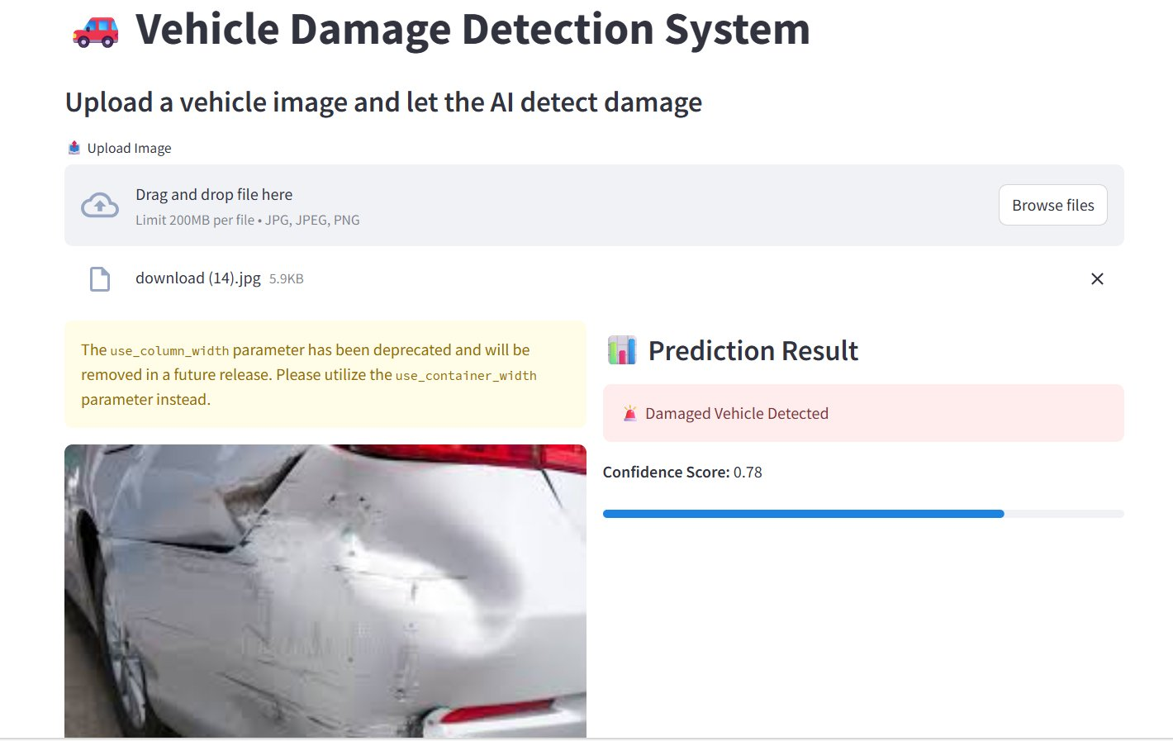
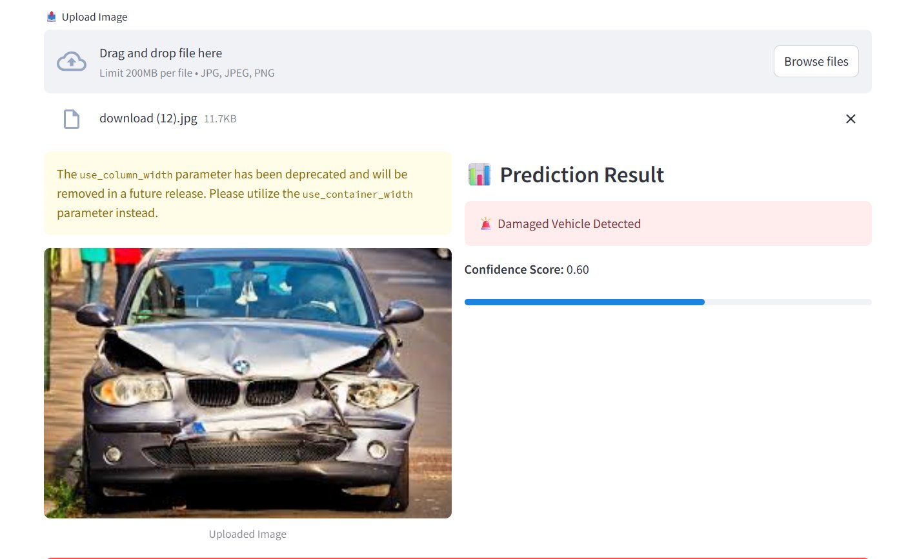
Streamlit App — Demo
Live deployment — damaged vehicle predictions
Side Dent — Damaged Detected (Confidence: 0.78)
Front Crash (BMW) — Damaged Detected (Confidence: 0.60)
🚨 Damaged Vehicle Detected — Model flags crash and dent damage
8 / 10

Slide 9
Streamlit App Features
Key capabilities of the deployed web application
Image Upload
Cached Model Loading
Confidence Score
Supports JPG, JPEG, PNG formats up to 200MB via drag & drop or browse
@st.cache_resource ensures the VGG16 model loads once — fast repeated inference
Shows numerical confidence (0-1) with a visual progress bar for transparency
Confidence Threshold
Clear Result Display
BGR Preprocessing
Adjustable slider in sidebar — set minimum confidence for a valid prediction
Green success for 'No Damage', red error for 'Damaged Vehicle Detected'
App reverses RGB→BGR to match cv2.imread() training, ensuring accurate results
9 / 10

Slide 10

Results & Conclusion
~97%
2-class
VGG16
18,992
Training Accuracy
Classification Output
Architecture Used
Training Images
VGG16 transfer learning dramatically accelerates training with pre-learned visual features
BGR→RGB channel consistency between cv2 training and PIL inference is critical for accuracy
Confidence threshold slider provides explainability and control in real-world deployment
Practical use cases: insurance claim automation, fleet management, dealership inspection
CNN Deep Learning Project | TensorFlow · Keras · Streamlit
10 / 10

