Slide 1
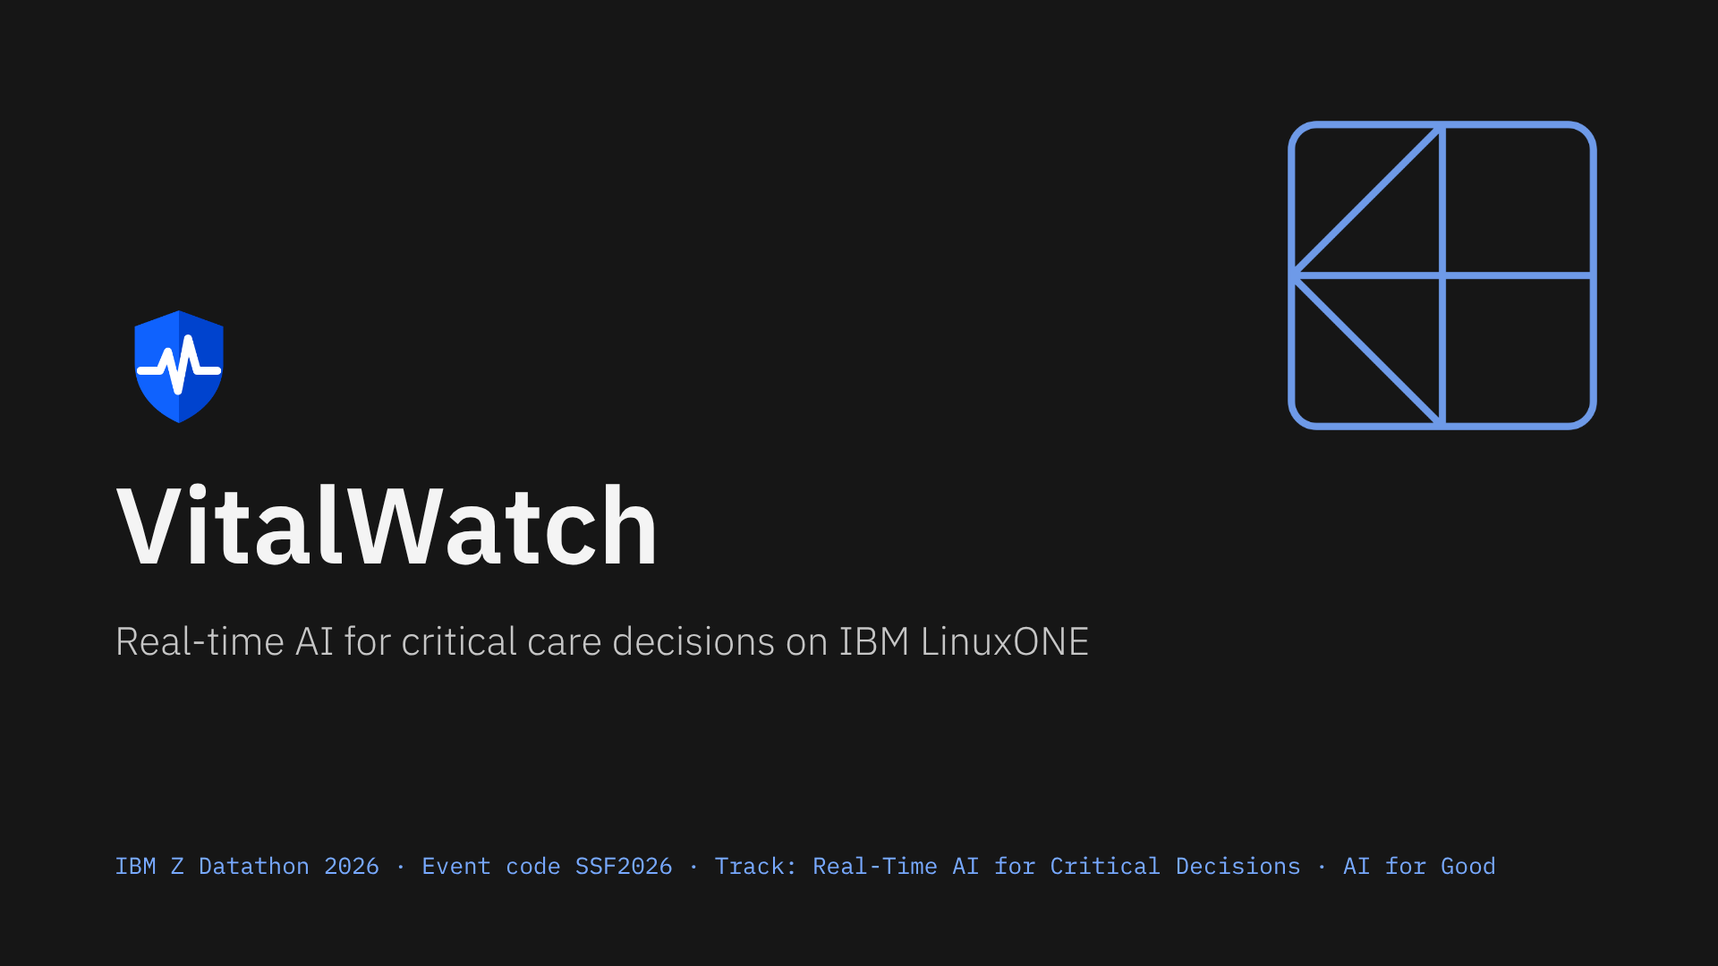
Notes:
VitalWatch analyses streaming ICU data in real time, identifies patients at risk of sepsis hours before onset, and supports the nurse’s critical decision with an explained, audited alert. Everything runs on IBM LinuxONE, so patient data never leaves the system.

Slide 2
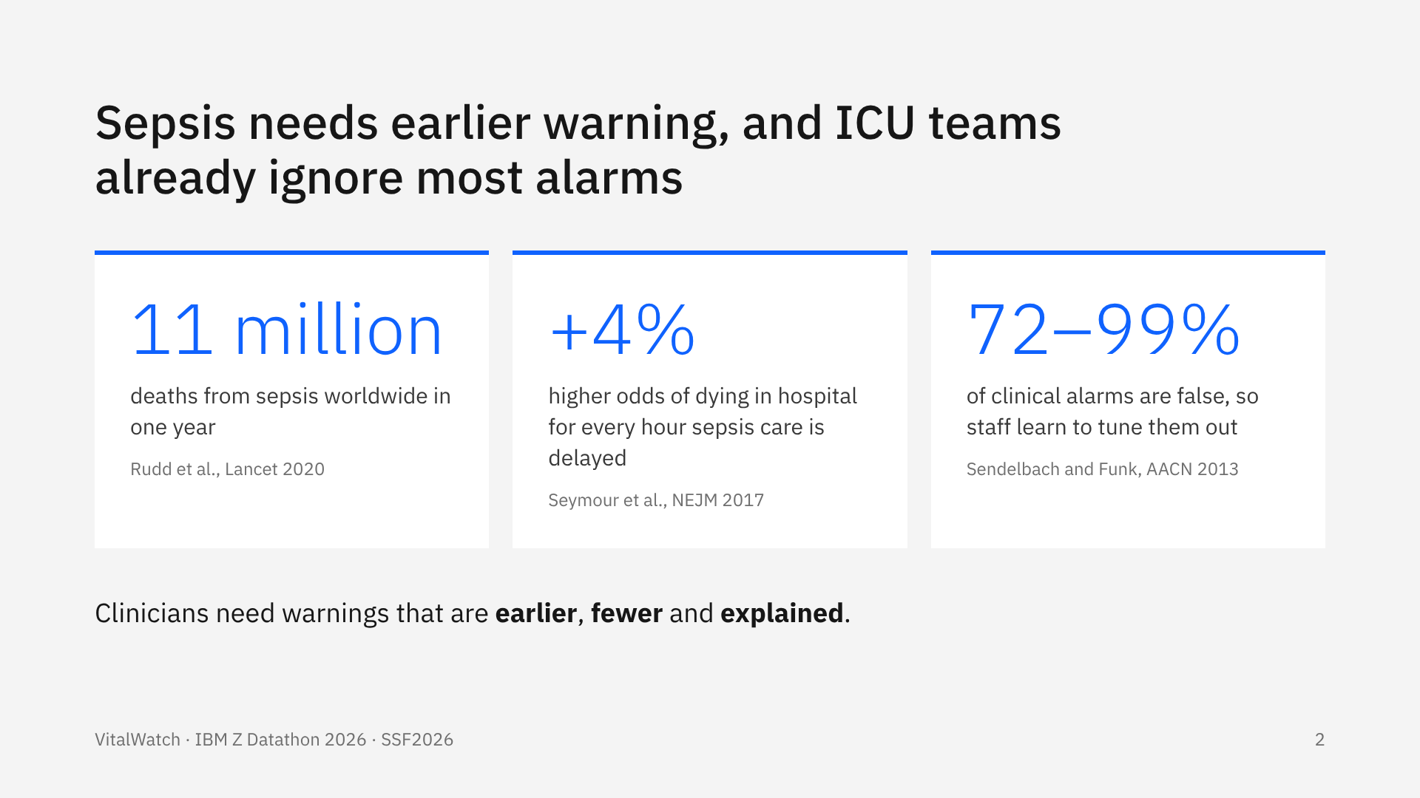
Notes:
Sepsis is one of the most common causes of death in hospitals. Every hour of delay matters: in New York State data, each hour before the sepsis bundle was completed raised the odds of in-hospital death by about 4%. At the same time, most ICU alarms are false, so alarm fatigue makes even good alerts easy to miss. A useful system must be earlier, quieter and explain itself.

Slide 3
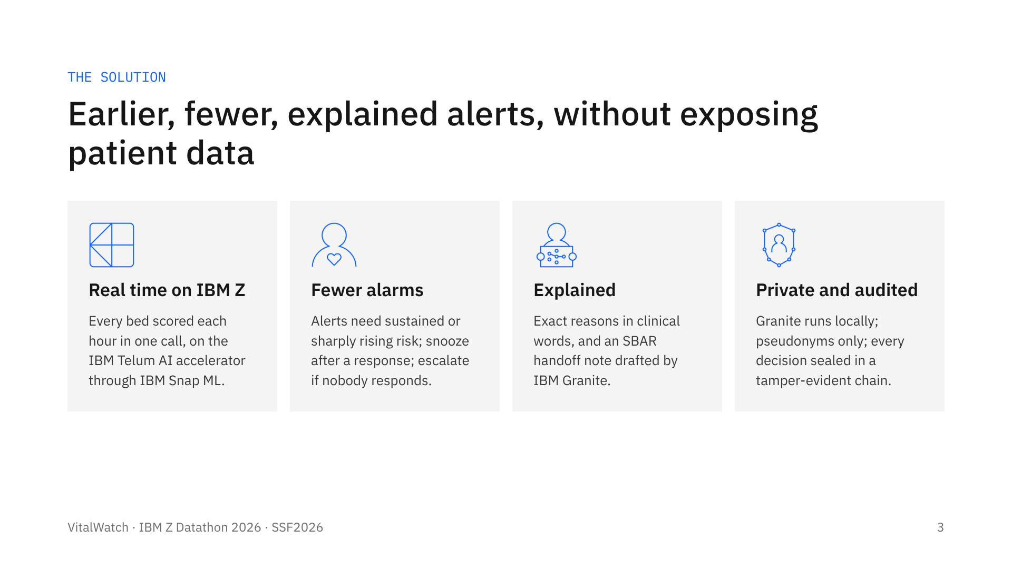
Notes:
VitalWatch fits the Real-Time AI for Critical Decisions track: it analyses information in real time, identifies risk, and supports an important decision. Four pillars: real-time scoring on IBM Z, an alert policy designed against alarm fatigue, explanations a nurse can act on, and privacy plus auditability by design.

Slide 4
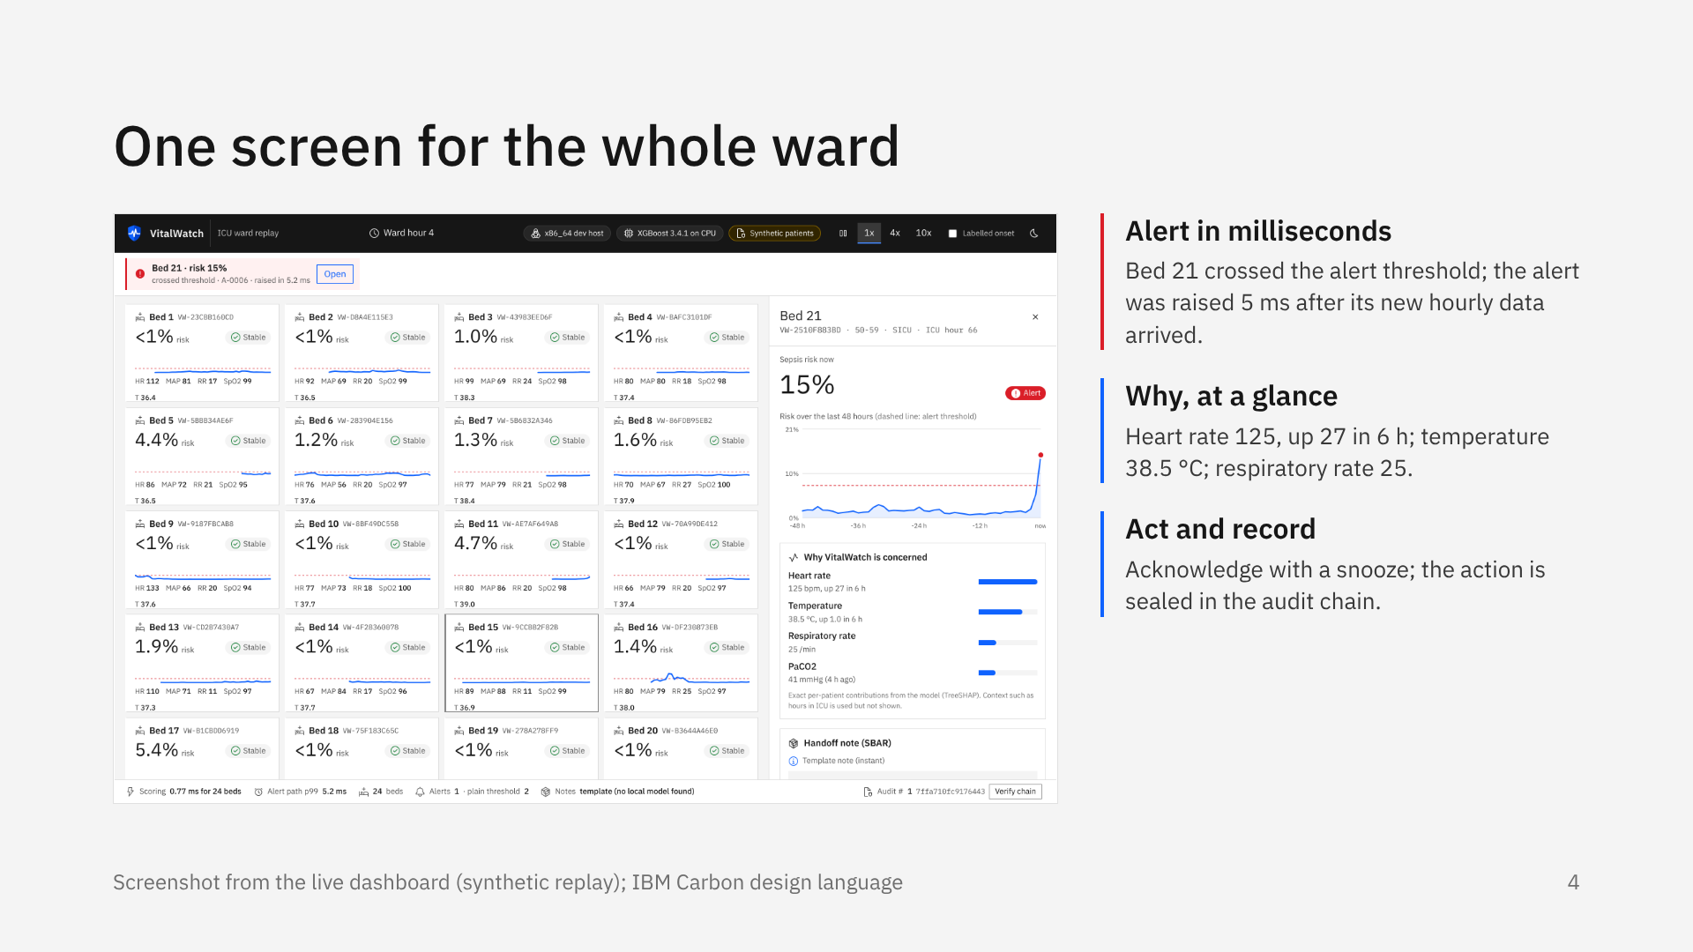
Notes:
This is the live dashboard. Twenty-four beds are replayed hour by hour from held-out patients. Each tile shows the risk, its 48-hour trend against the alert threshold, and the latest vitals. When bed 21 crossed the threshold, the alert arrived in about five milliseconds with its reasons. The nurse opens the bed, reads why, sees the handoff note, and acknowledges. That action goes into the audit chain.

Slide 5
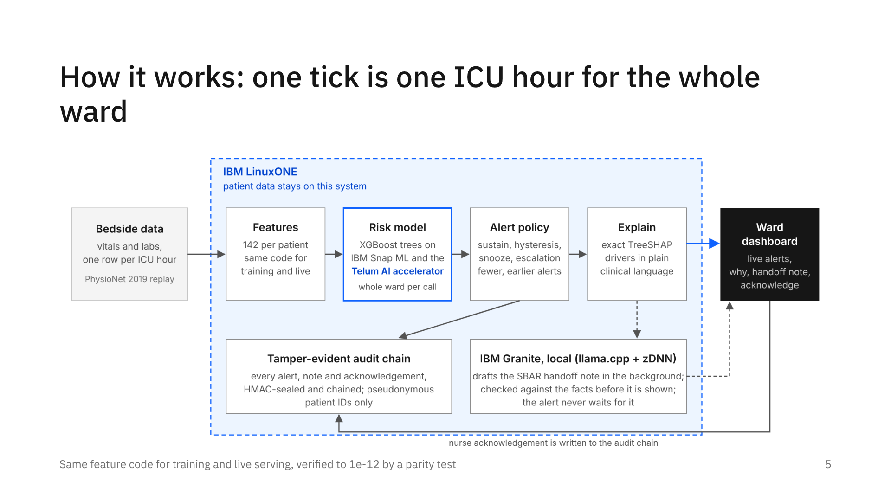
Notes:
Each hour, every bed’s new vitals and labs become 142 trend features. One batched call scores the whole ward with IBM Snap ML, which runs the same XGBoost trees on the Telum on-chip accelerator. A state machine decides whether to alert. New alerts get exact TreeSHAP reasons in one more batched call. IBM Granite drafts the handoff note in a separate thread, so the alert never waits for it. Every event is sealed into the audit chain, and the dashboard receives it over server-sent events.

Slide 6
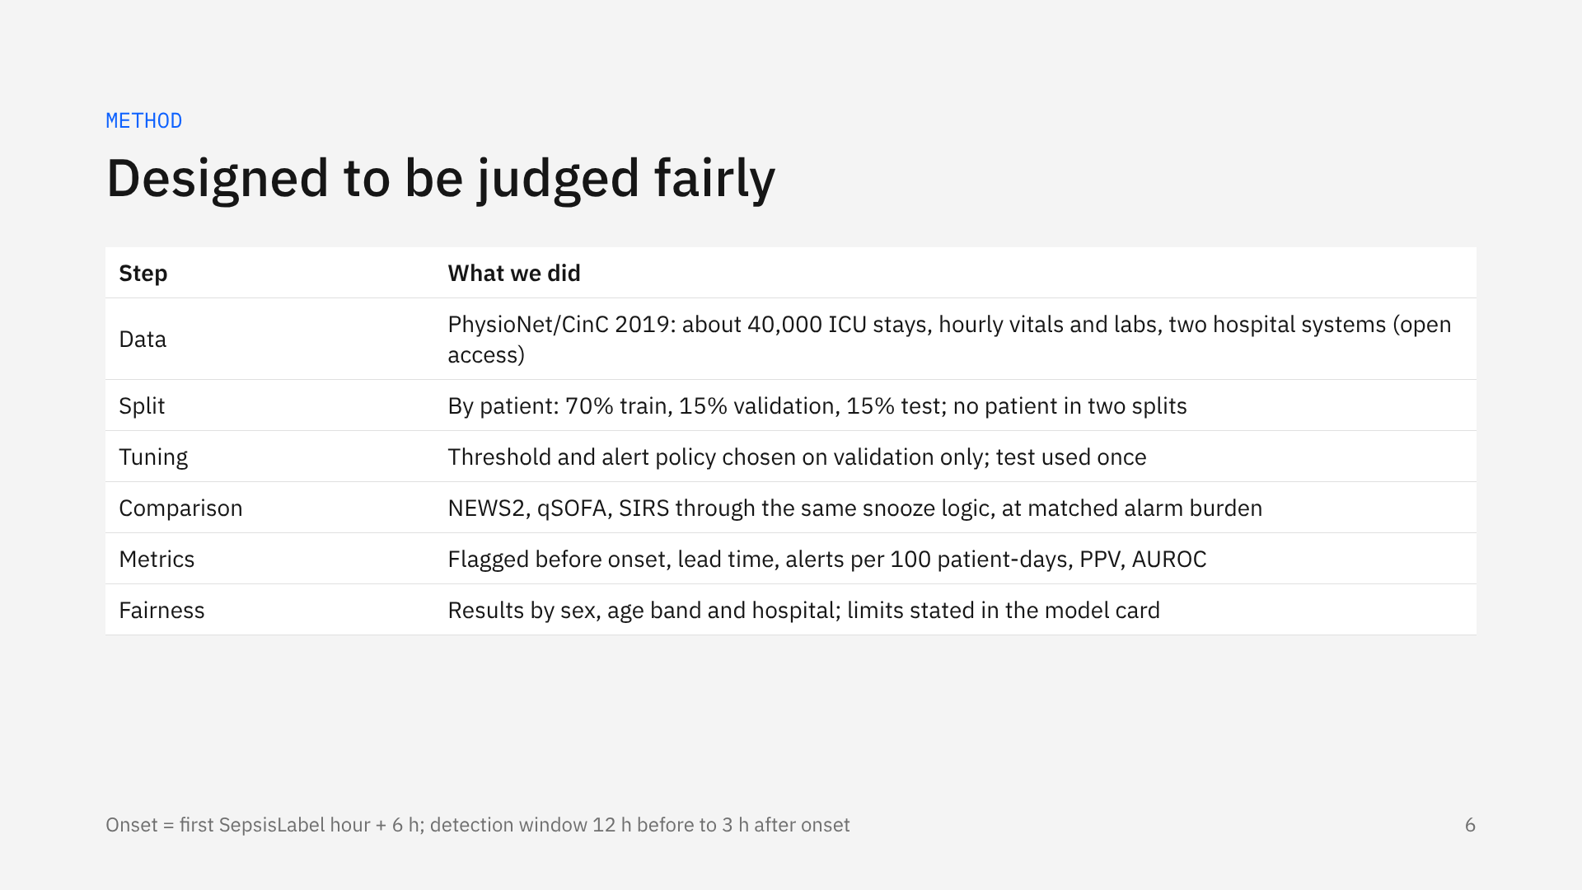
Notes:
We avoided the usual traps. Splits are by patient. Every setting is chosen on validation patients, and the test set is touched once. The bedside scores run through exactly the same snooze logic, and we compare at the same number of alarms, because sensitivity alone is meaningless if you alarm all the time. We also report results by sex, age and hospital.

Slide 7
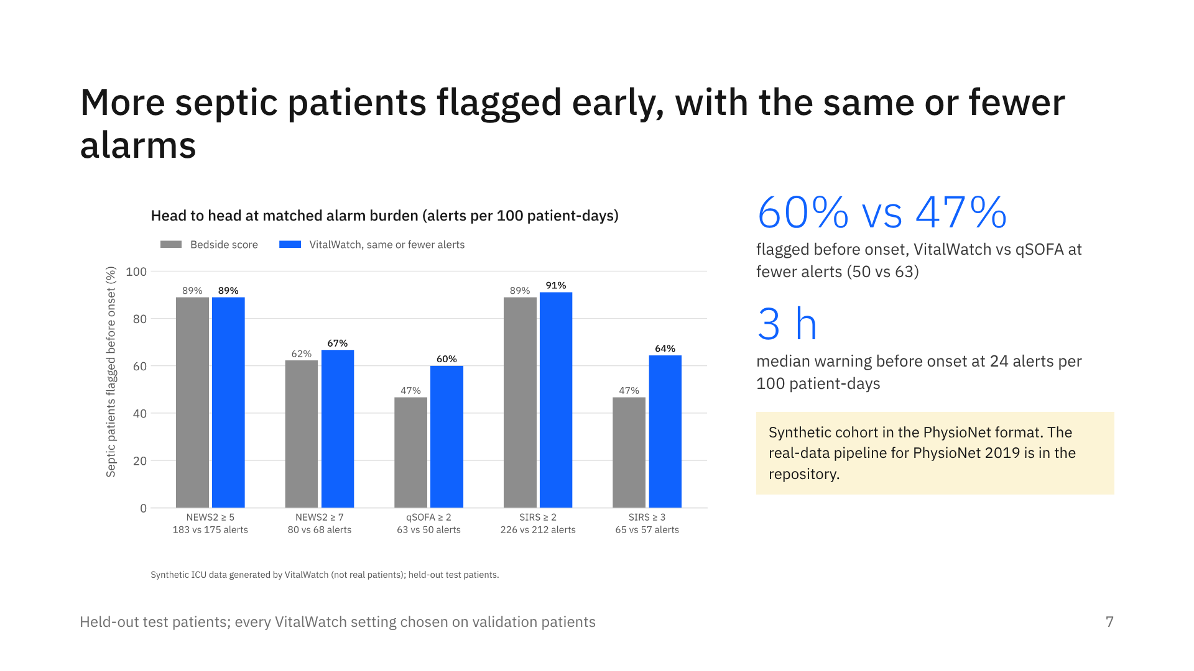
Notes:
At every bedside-score operating point, VitalWatch flags as many or more septic patients before onset while raising the same or fewer alerts. Be explicit when presenting: these numbers are from the synthetic development cohort in the PhysioNet file format. The script that runs the same evaluation on the real PhysioNet 2019 data is included.

Slide 8
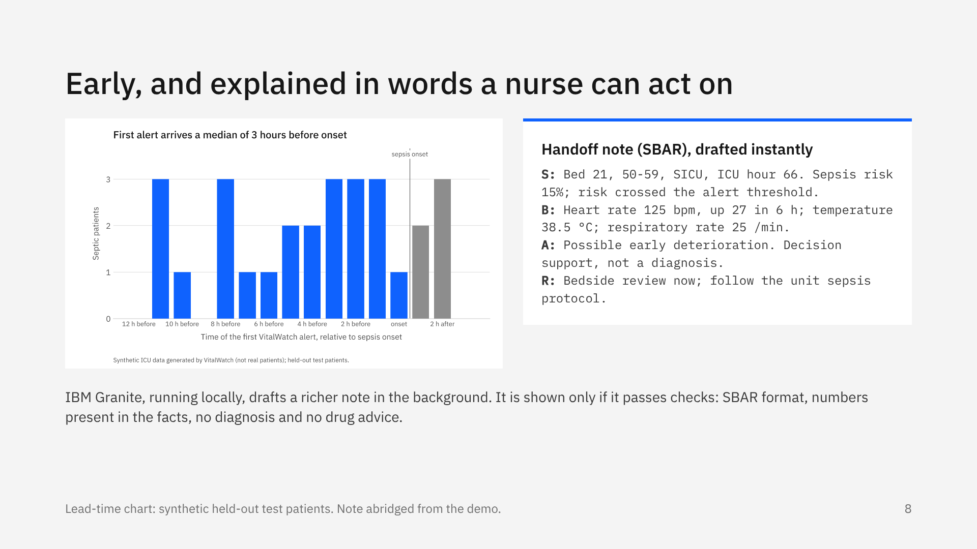
Notes:
Most first alerts arrive several hours before the labelled onset. Each alert explains itself with exact TreeSHAP contributions, written as clinical facts, and comes with a handoff note in SBAR form. The template note is instant. Granite’s richer draft streams in a few seconds later and is checked against the facts first: if it invents a number, mentions a diagnosis or suggests a drug, it is rejected and logged.

Slide 9
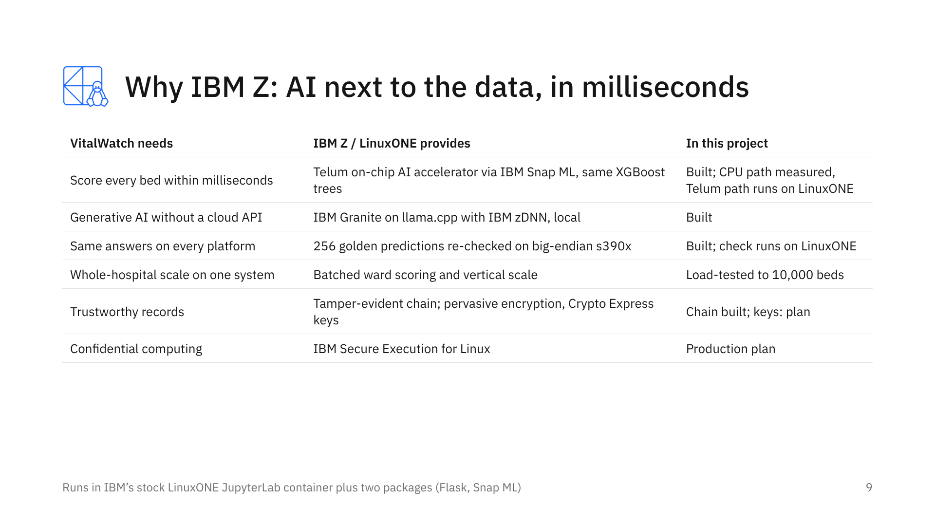
Notes:
IBM Z is the right home for this because the decision has to happen next to the clinical data, in real time, without sending patient data anywhere. Snap ML runs our exact XGBoost trees on the Telum accelerator, Granite runs on the same system, and the artifacts are verified on big-endian IBM Z. The last two rows are the production path, stated honestly as plans.

Slide 10
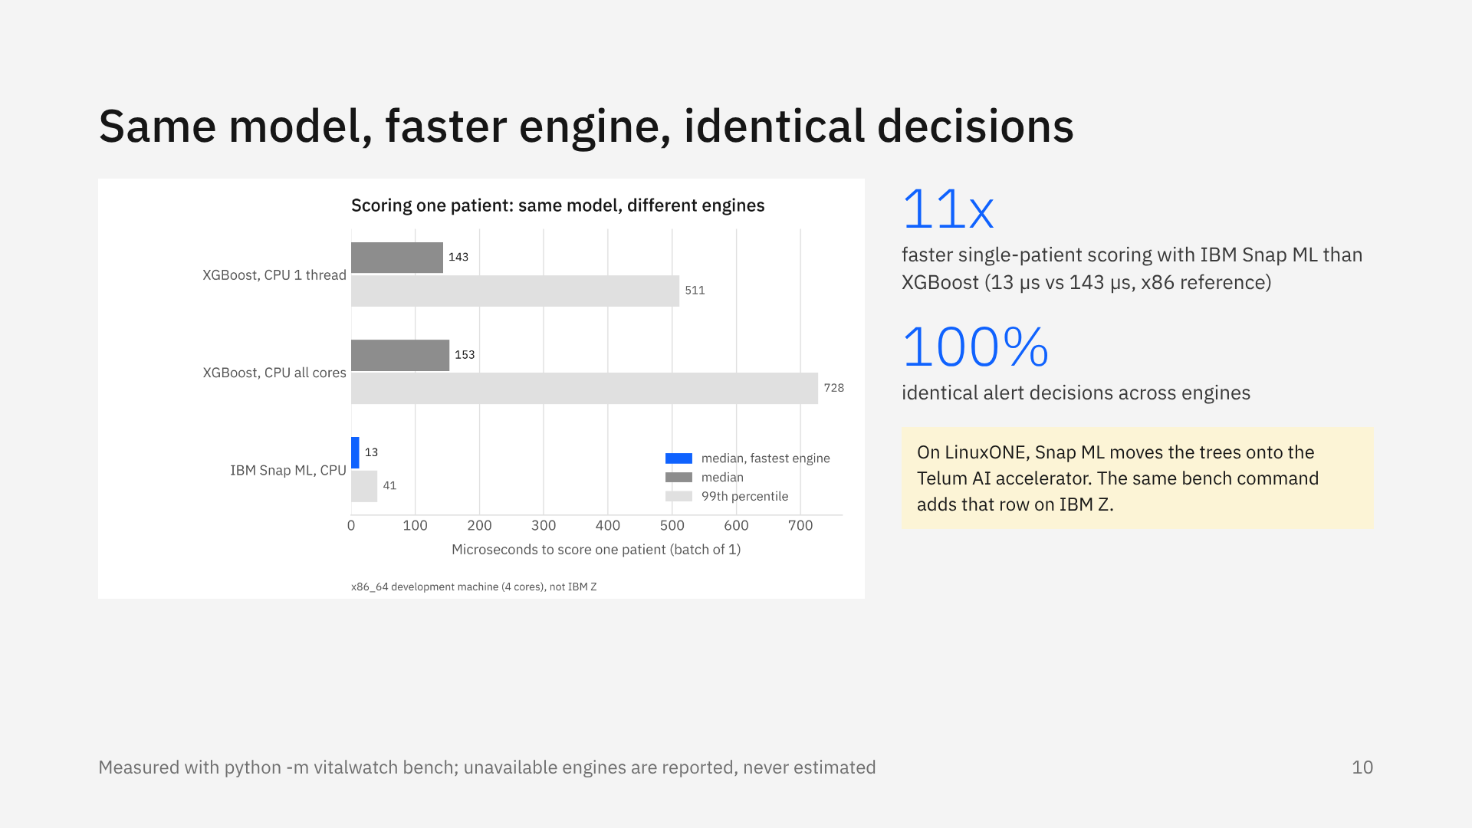
Notes:
The benchmark runs the identical model through every engine available on the machine, each in its own process. On the development machine, Snap ML already scores one patient about eleven times faster than XGBoost, with exactly the same alert decisions. On LinuxONE the same command adds the Telum accelerator arm; we never estimate numbers we have not measured.

Slide 11
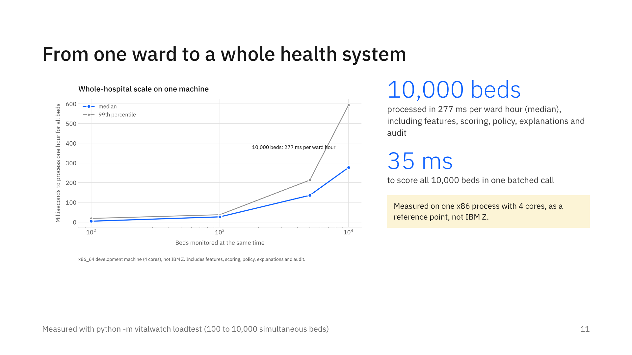
Notes:
Because every bed is scored in one batched call per hour, the system scales to a whole hospital network on a single machine. Even on a single x86 process, ten thousand beds take under three tenths of a second per hour, and scoring is only 35 milliseconds of that. On IBM Z the headroom is far larger, and readings every minute instead of every hour become realistic.

Slide 12
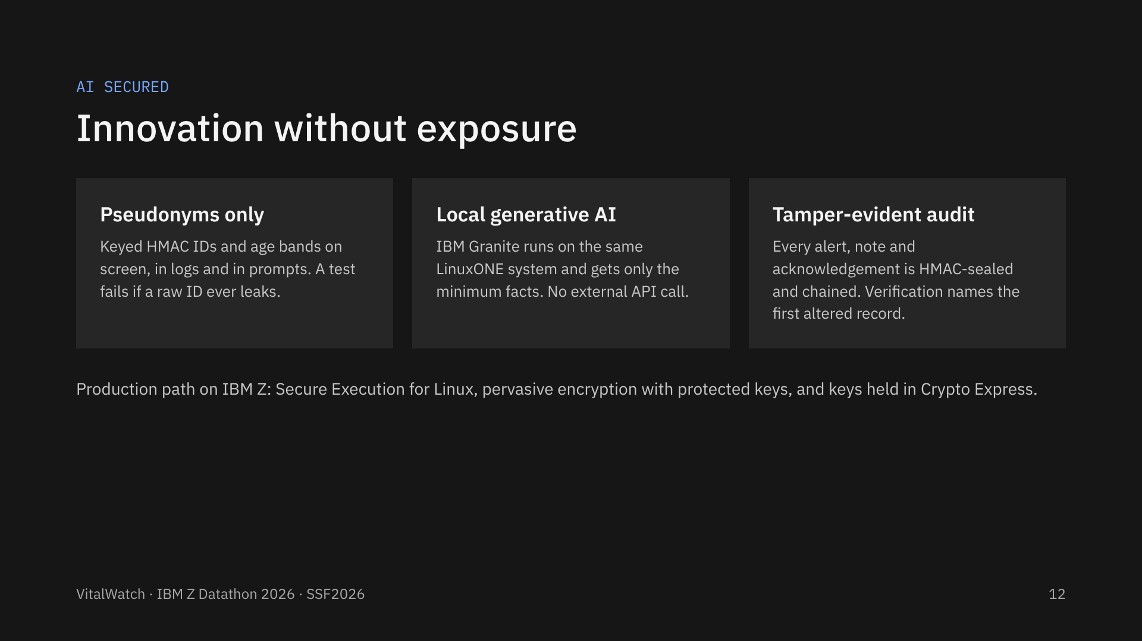
Notes:
This is the AI Secured side of the project. Patient identity never reaches the screen, the log or the language model. Granite runs locally, so there is no cloud call. Every decision is sealed into a hash chain; in the demo we edit one record in a copy of the log, and verification points straight at it. For production, IBM Z adds confidential computing and hardware-protected keys.

Slide 13
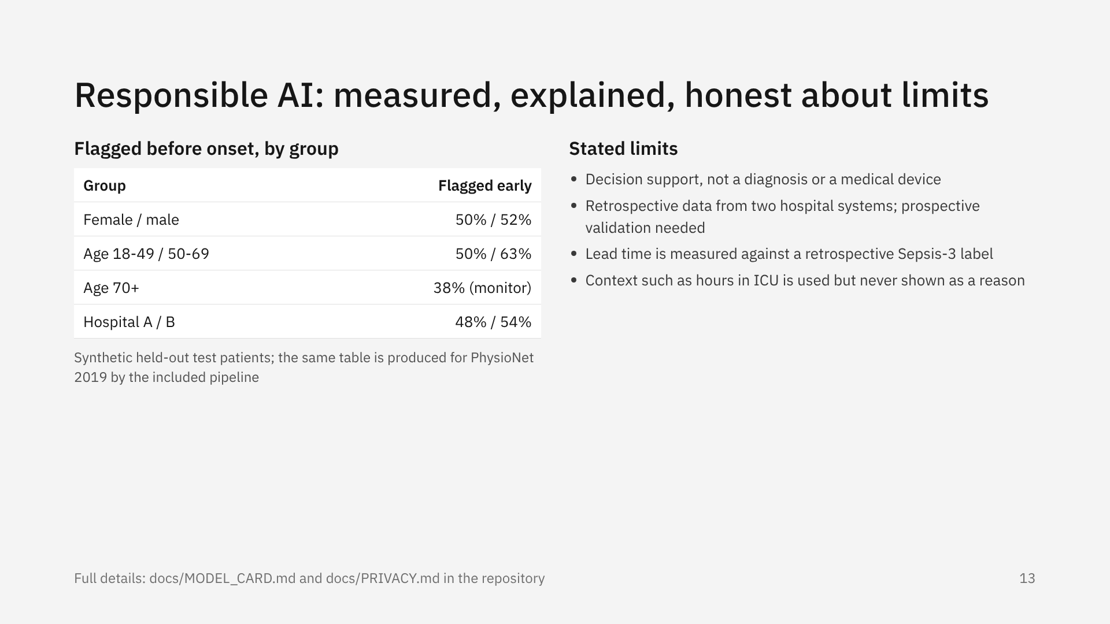
Notes:
We report performance by sex, age band and hospital. On the development data the oldest patients were flagged early less often, so the model card names that gap and the mitigation: recalibrate per group or lower the threshold for that group, after re-checking on PhysioNet. We are explicit that this is decision support, evaluated retrospectively.

Slide 14
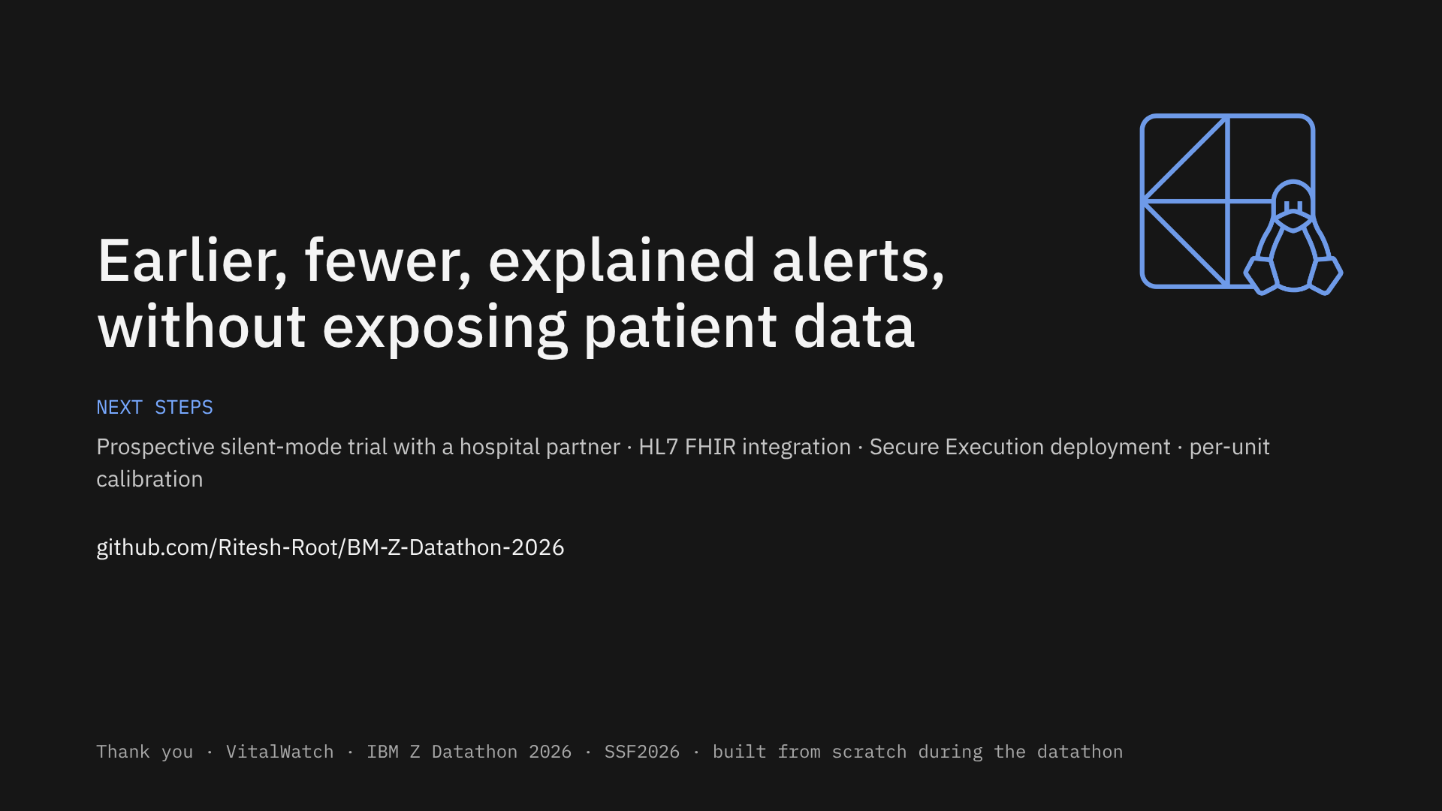
Notes:
To close: VitalWatch delivers earlier, fewer and explained alerts on IBM LinuxONE without exposing patient data. Next we would run it silently alongside clinicians in a partner hospital, connect it through HL7 FHIR, and deploy it in IBM Secure Execution. Thank you.

