Slide 1
Docker

Slide 2
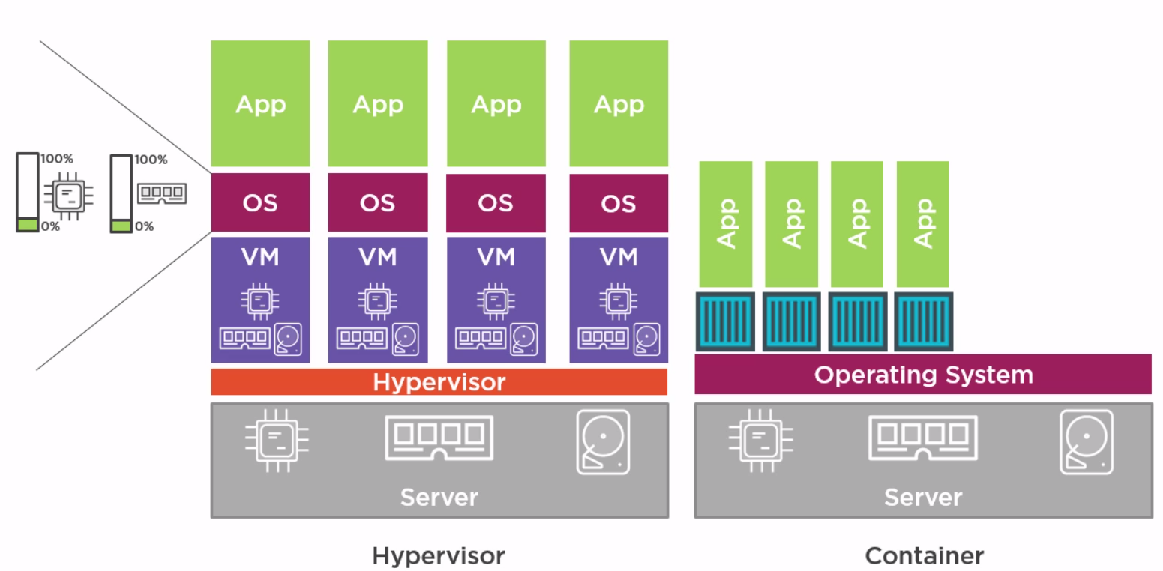
VMWare vs Container Architecture -

Slide 3
Installation on ec2 -
To install docker on EC2 -
-> Update the packages on your instance [ec2-user ~]$ sudo yum update -y
-> Install Docker [ec2-user ~]$ sudo yum install docker -y
-> Start the Docker Service [ec2-user ~]$ sudo service docker start

Slide 4
Kernel Utilities used by docker -
1. Kernel Namespaces -
The namespace service helps in creating different independent environments for the containers. Like different pid numbers, networking, file system mounts, user namespaces etc.
2. Control groups (CGroups)-
This contains the limits like how much CPU, memory is allocated to a container. You can change the Cgroup limits however you want.
3. Capabilities-
Breaks the root privileges into smaller groups, and these can be used to assign to a specific user. Privileges for users/process.

Slide 5
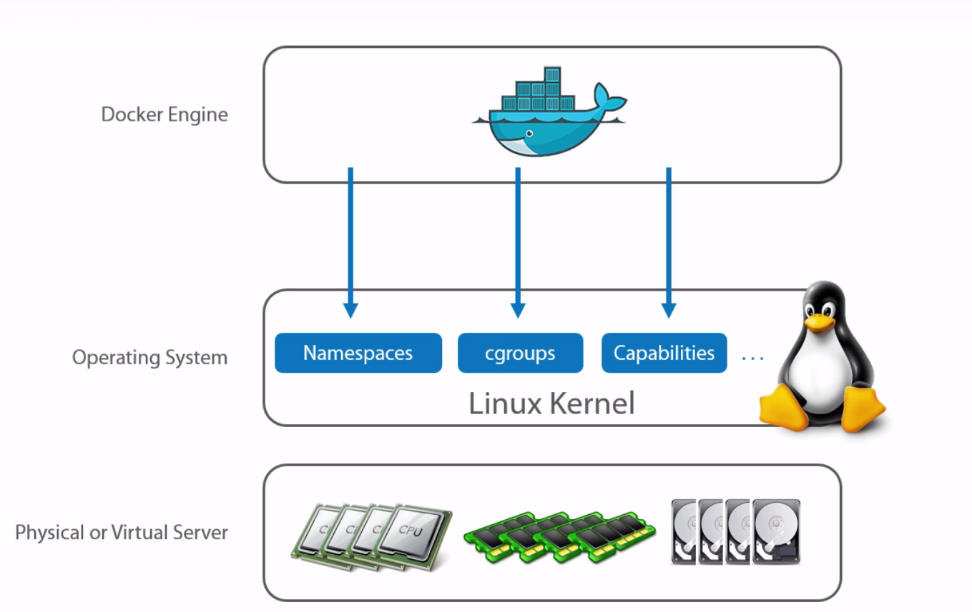
Docker installation installs Docker client and Docker Daemon.
Client calls daemon, daemon call the actual docker hub registries.
Docker engine means Docker client + docker daemon.

Slide 6
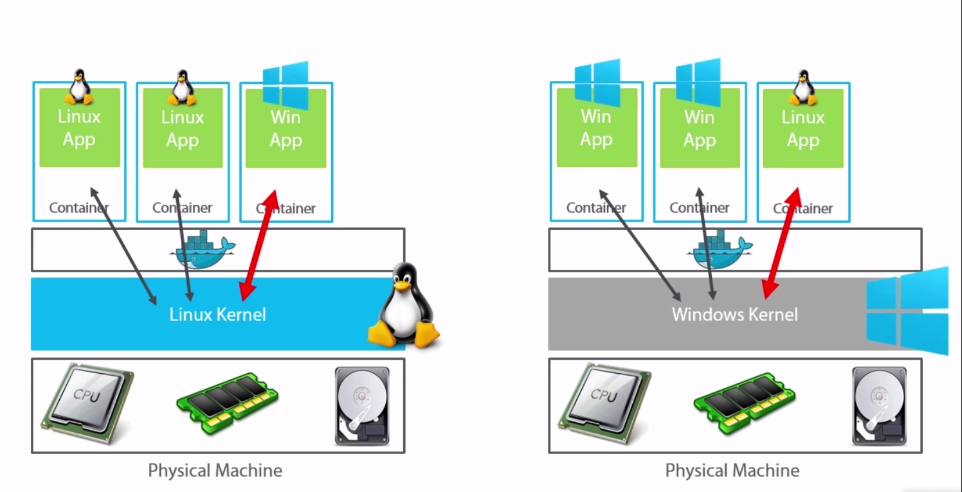
Docker on vivid platforms -
If you want to run a windows application on the container then the OS should in windows, as the container uses the windows Kernel. In the same way to run a Linux application we should be using a Linux OS

Slide 7
Docker Images
Images are nothing but a configuration file that we down from the docker hub.
If you run the Images using the docker commands you can spin up a container.

Slide 8
Images related commands
docker run –it fedora /bin/bash -→ run does two things first, get the fedora image from docker hub if it is not present locally, second this this spins up the container. –it means this give you a interactive terminal to the container that will be spinned up after executing this command, /bin/bash is the pid1 process that will be running in the container.
docker images -→ gives you the list of images on the box.
docker images <image_name> -> list of images related to this image_name.

Slide 9
docker pull <image_name> -→ pull the image from docker hub and download it locally without spinning up the container.
docker start <image_name> -> starts the container with the image_name mentioned, this searches for the image locally only.
docker pull + docker start = docker run
docker images --tree -→ give the images tree.
docker history <image_id> -> gives you the list of commands that ran to build the image, and the image layers within the specified image.

Slide 10
Docker Container
When a Image is executed using the docker commands we get a container.
Container is nothing but a virtual machine.
All container belonging to the same docker host can communicate with each other by default, however you can override this behavior by adding the following line in the /etc/default/docker file :–
DOCKER_OPTS=--icc=false (restart docker(daemon) to get this into effect)
Here icc means inter container communication, by default this is true.

Slide 11
You can run multiple process on a container, but remember this containers are meant for running only one process.
Reason – as in general unix/linux boxes init is pid1, whoch manages all the process on that box, but containers don’t have init in them. The process which you run is the pid1 for the container.
So if you run two processes on the container, any one of them will be pid1, if that processes dies, it automatically kills the other process also which is not a desired result.

Slide 12
Container related commands –
docker ps -→ gives you the containers that are running on the docker host.
docker ps –a → give you all the containers running and stopped on the docker host.
docker attach <container_id> -→ attachs us to the pid1 of the container.(works only for containers that are running.)
To come out of the containers without stopping them -→ ctrl+p+q
docker start <image_name> -> starts the container with the image_name mentioned, this searches for the image locally only.

Slide 13
docker stop <containerid/name> → to stop a container from the docker host. → every container gets a random funky name.
docker restart <containerid/name> → to restart a container from the docker host.
/var/lib/docker/containers -> on the docker host has all the containers in there.
docker rm <conatinerid/name> -> to remove a container, of course you can’t delete a running container.
docker top <containerid> -> gives the list of process running in the container.
docker logs <containerid> -> gives the container logs.
docker inspect <container_id> -> a very detailed json information related to the container.

Slide 14
This inspect gets the json from /var/lib/docker/containers/<container_id> → config.json & hostconfig.json.
ssh to a container –
One way -> docker-enter <container_id>
Second wat -> docker exec –it <containerid> /bin/bash (recommend way)

Slide 15
Docker related commands-
docker info -> gives you the info of the number of containers & images on the box, and also other like execution driver, storage driver etc.

Slide 16
DOCKERFILE & Commands related to this –
Docker file consists of a set of instructions that build a image.
Step 1 – Create a docker file -> vim Dockerfile → the case is important here.
Example of a docker file –
FROM ubuntu:15.04
MAINTAINER xxx@gmail.com → this can be any were in the file
RUN apt-get update → RUN command comes @ container build time.
RUN apt-get install –y ngnix

Slide 17
CMD [“echo”,”Hello world”] → CMD command comes at the container run time. This is the command that runs after the container is spined up. Echo is the command, Hello world is the argument.
then once the file is written save it –
Now we need to build the image file using this docker file we just wrote – docker build -t helloworld:1.0 Dockerfile
-t -> tagging helloworld is the image name 1.0 is the image version. All the image names must be small cases.
each line in the Dockerfile is a image layer within the image we build. So to decrease the image layers with in the image, compress the docker file by reducing the number of lines, keep all the RUN commands in a single line using &&.

Slide 18
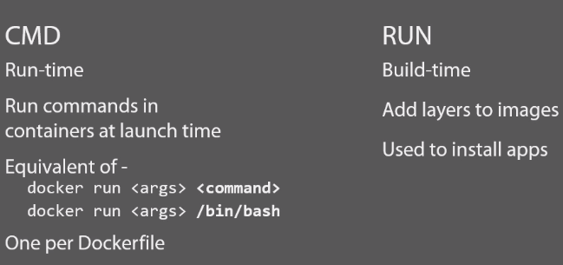
CMD Instruction

Slide 19
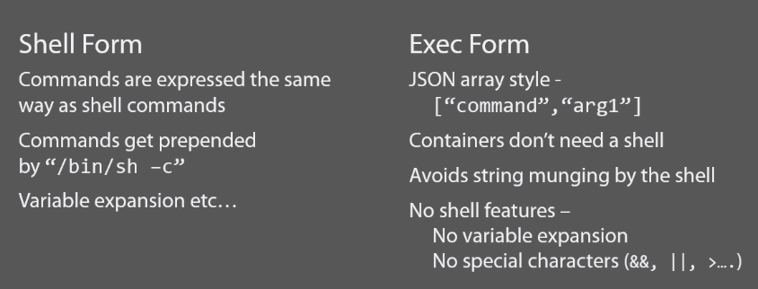
CMD Instruction

Slide 20
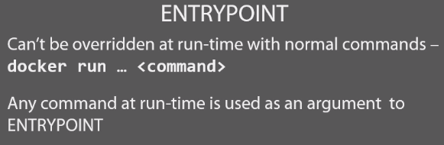
ENTRYPOINT -
Ofcourse, CMD is used to run your app inside the container, but ENTRYPOINT is better/recommended way.
There can be multiple ENTRYPOINTS in a Dockerfile, only the last one will come into play and the others are ignored.

Slide 21
ENV instruction -
ENV var=value
Is used to set the environment variables in the container.

Slide 22
Volumes -
docker run –v /pathondockerhost <image_name>
So –v is the tag used to tell the docker that to store the volume on docker host at the specified path along with the volume in the container.
So if you want to link the new container to the volume of other container –
docker run --volumes-from=<previouscontainername> <image_name>
Suppose you want a data directory from docker host to be mounted on data directory of the container –
docker run –v /data:/data <image_name>

Slide 23
Build cache
Docker store the builds cache.
So when you build the file again with the same dockerfile, the build is done quickly as the build cache is stored.

Slide 24
Docker hub -
Remember these two terminologies –
Registry – is nothing but that contains a set of repositories in it.
Repository – is nothing but that has the actual score code/image.

Slide 25
Committing the image to docker hub -
First build your image.
Then tag the image– docker tag <imageid> <reponame>:<versionnumber>
Repo name example – ritesh/helloworld
Version number example – 1.0
Secondly push the image – docker push <reponame>:<versionnumber>
That’s it the image is now committed to dockerhub.

Slide 26
Private registry –
Build a private registry :-
docker run –d –p 5000:5000 registry -→ spins a registry –p means private –d means detached, port 5000 on docker host is mapped to port 5000 on the container.
You can access this by :- docker_hostip:5000
Using a private registry –
Commit to a private registry –
docker tag <imageid> docker_hostip:5000/<reponame>
docker push docker_hostip:5000/<reponame>

Slide 27
Pulling a image from private registry –
docker run –d docker_hostip:5000/<reponame>:<versionno>

Slide 28
Docker networking -
ip a → Gives you the ethernet port details on the box.
When you execute the above command you get all the ethernet port details along side with that you also get the docker0 bridge details.
Docker0 bridge is a virtual ethernet bridge/port that connect from the host tp the eth0 on the container spinned from that host.
To check the docker0 bridge connection, you need to have bridge-utils package installed on the host box –
yum install –y bridge-utils
brctl show docker0 → To see the docker0 connetions.

Slide 29
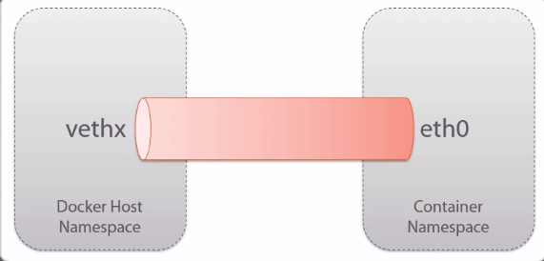
When the docker daemon is started it assigns the docker0 some range of ip’s from which docker0 assigns them to the containers.

Slide 30
Networking configuration Files-
They are in → /var/lib/docker/containers/<container64bitid> → hosts and resolv.conf files are the network related files.
To see these conf files of docker host go to /etc/resolv.conf and hosts file.
If you want to specify the dns name while spinning up a container –
docker run –dns=8.8.4.4 <image_name>

Slide 31
Networking ports
So we need to expose on port from the container to a port on the docker host, so that when we access the docker host ip on that port we can access the container in their.
For this you can just add this line in the Dockerfile –
EXPOSE 80 -→ exposes port 80 of the container to the random docker host port.
Or just while spinning the container you can give something like this-
docker run –d –p 5001:80 <image_name> --→ port 5001 on docker host is mapped to port 80 on the container.

Slide 32
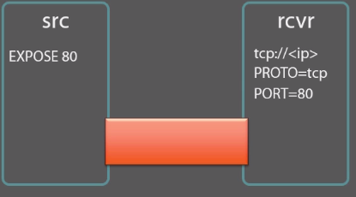
To view the ports –
docker port <container_name>
Linking containers –

Slide 33
Spin up the first container :-
docker run –name=src –d <image_name>
Spin the second one using the link option : –
docker run - - name=recr –link=src:<alias_name> -it <image_name>
Now the src container doesn’t know any thing about recr container, but recr container knows the details about src container, to check this go to the recr container can type – env |grep ALI.

Slide 34
Trouble Shooting
#Troubleshooting docker daemon logging - debug info error fatal
command - docker -d -l debug & (-d is to start demon nd -l is to specify the loglevel) other way is to edit the /etc/default/docker file and add the following line- DOCKER_OPTS="--log-level=fatal" always retsrat the docker demon to see the changed loglevel in effect. So what ever docker command you enter, observe the o/p as the loglevel effects the docker command o/p, hence daemon logging.

Slide 35
#Container Logging - docker logs <container_name> ---> to see the logs docker logs -f <c
#NetworkTroubleshooting - so there will be time where docker will be using IP's that are already in use. So there will be times where we will be mentioning docker the range of Ip's to be assigned. ip a ---> gives you the list of interfaces. ip link del docker0 ---> deletes the docker0 interface. after deleting the docker0, edit the docker config file by adding this line- DOCKER_OPTS=--bip=150.0.1/24 (bip-bridge IP) So now restart docker service, and check the docker0 bridge ip range by using this command - 'ip a'---> this ip will be in the range mentioned in the docker config file. Any container is spinned by this docker host will be getting this 150 range IP, and also please remember that if a container is restarted we get a new IP for the container.ontainer_name> ---> live logs

Slide 36
#Iptables Firewall- As default Docker allows all the containers on the same host to communicate with each other. --icc & --iptables have a default value of true. --icc is intercontainercommunications this guy decides if containers communicate with each other. to see iptables command - iptables -L -v to set icc value - in the /etc/default/docker file add DOCKER_OPTS=--icc=false restart docker (deamon). check the iptables were you can see a drop rule. --iptables :- this is by true. this option tells if docker can edit the iptables or not. By default docker can edit the iptables. line to add DOCKER_OPTS=--iptables=false to give two otions at a time :- DOCKER_OPTS="--icc=true --iptables=false”

Slide 37
Storage and execution drivers
Storage driver used by docker –aufs.
AUFS is a union filesystem, which means that it layers multiple directories on a single Linux host and presents them as a single directory. These directories are called branches in AUFS terminology, and layers in Docker terminology. The unification process is referred to a a union mount.
Execution driver used by docker is – lib container(Docker INC developed this recommended one) and LXC(this is a third party one not so recommended)

