Slide 1
Docker

Slide 2
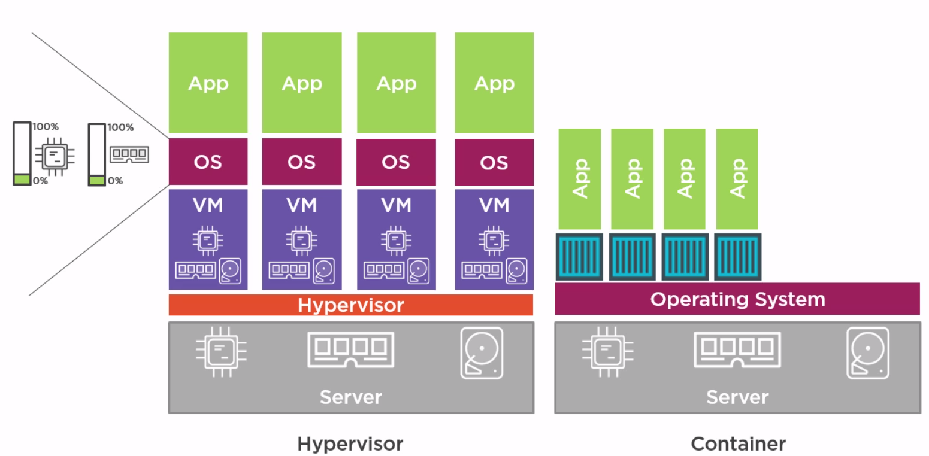
VMWare vs Container Architecture -

Slide 3
Installation on ec2 -
To install docker on EC2 -
-> Update the packages on your instance [ec2-user ~]$ sudo yum update -y
-> Install Docker [ec2-user ~]$ sudo yum install docker -y
-> Start the Docker Service [ec2-user ~]$ sudo service docker start

Slide 4
Kernel Utilities used by docker -
1. Kernel Namespaces -
The namespace service helps in creating different independent environments for the containers. Like different pid numbers, networking, file system mounts, user namespaces etc.
2. Control groups (CGroups)-
This contains the limits like how much CPU, memory is allocated to a container. You can change the Cgroup limits however you want.
3. Capabilities-
Breaks the root privileges into smaller groups, and these can be used to assign to a specific user. Privileges for users/process.

Slide 5
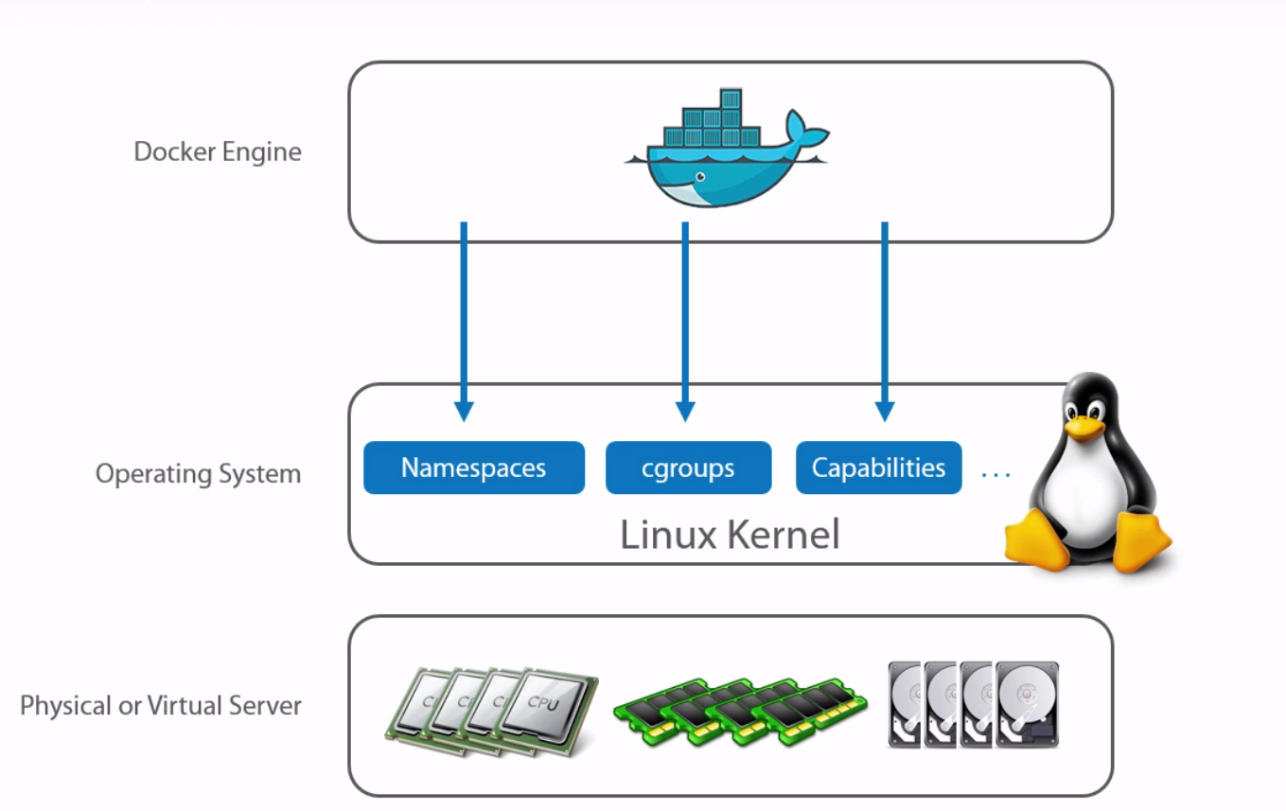
Docker installation installs Docker client and Docker Daemon.
Client calls daemon, daemon call the actual docker hub registries.
Docker engine means Docker client + docker daemon.

Slide 6
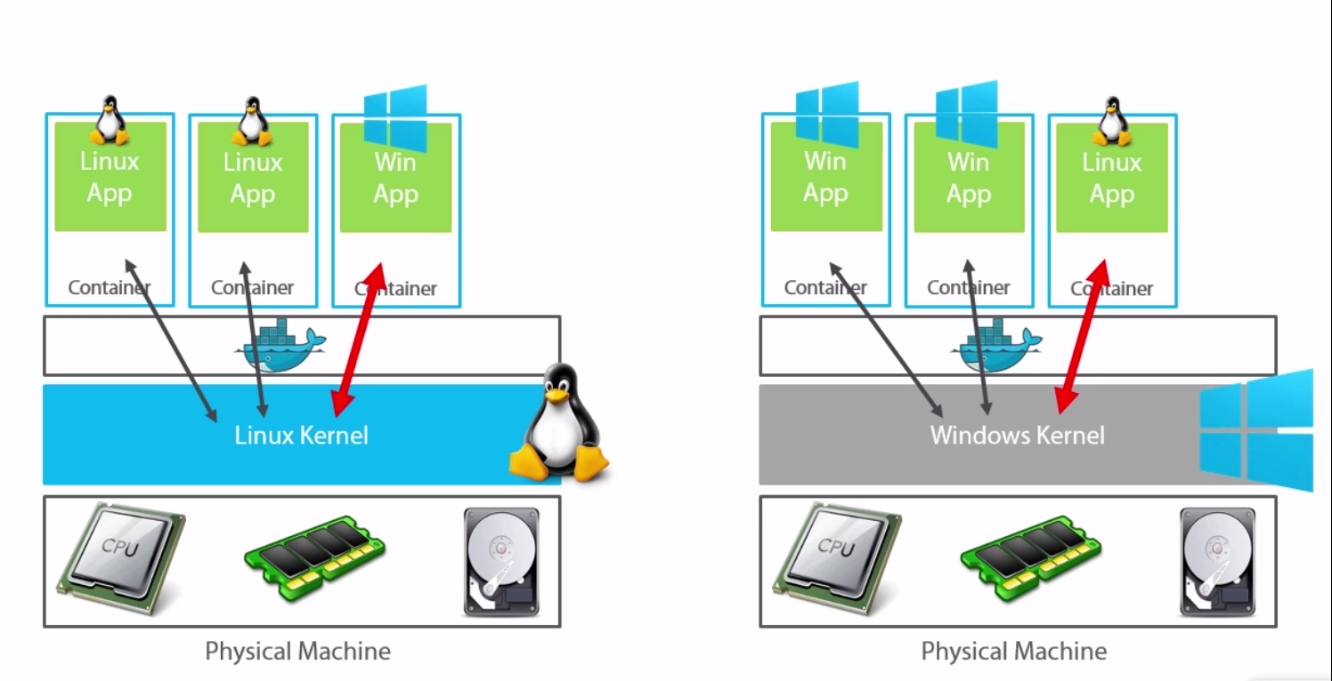
Docker on vivid platforms -
If you want to run a windows application on the container then the OS should in windows, as the container uses the windows Kernel. In the same way to run a Linux application we should be using a Linux OS

Slide 7
Docker Images
Images are nothing but a configuration file that we down from the docker hub.
If you run the Images using the docker commands you can spin up a container.

Slide 8
Images related commands
docker run –it fedora /bin/bash -→ run does two things first, get the fedora image from docker hub if it is not present locally, second this this spins up the container. –it means this give you a interactive terminal to the container that will be spinned up after executing this command, /bin/bash is the pid1 process that will be running in the container.
docker images -→ gives you the list of images on the box.
docker images <image_name> -> list of images related to this image_name.

Slide 9
docker pull <image_name> -→ pull the image from docker hub and download it locally without spinning up the container.
docker start <image_name> -> starts the container with the image_name mentioned, this searches for the image locally only.
docker pull + docker start = docker run
docker images --tree -→ give the images tree.
docker history <image_id> -> gives you the list of commands that ran to build the image, and the image layers within the specified image.

Slide 10
Docker Container
When a Image is executed using the docker commands we get a container.
Container is nothing but a virtual machine.
All container belonging to the same docker host can communicate with each other by default, howerver you can override this behavior by adding the following line in the /etc/default/docker file :–
DOCKER_OPTS=--icc=false (restart docker(daemon) to get this into effect)
Here icc means inter container communication, by default this is true.

Slide 11
You can run multiple process on a container, but remember this containers are meant for running only one process.
Reason – as in general unix/linux boxes init is pid1, whoch manages all the process on that box, but containers don’t have init in them. The process which you run is the pid1 for the container.
So if you run two processes on the container, any one of them will be pid1, if that processes dies, it automatically kills the other process also which is not a desired result.

Slide 12
Container related commands –
docker ps -→ gives you the containers that are running on the docker host.
docker ps –a → give you all the containers running and stopped on the docker host.
docker attach <container_id> -→ attachs us to the pid1 of the container.(works only for containers that are running.)
To come out of the containers without stopping them -→ ctrl+p+q
docker start <image_name> -> starts the container with the image_name mentioned, this searches for the image locally only.

Slide 13
docker stop <containerid/name> → to stop a container from the docker host. → every container gets a random funky name.
docker restart <containerid/name> → to restart a container from the docker host.
/var/lib/docker/containers -> on the docker host has all the containers in there.
docker rm <conatinerid/name> -> to remove a container, of course you can’t delete a running container.
docker top <containerid> -> gives the list of process running in the container.
docker logs <containerid> -> gives the container logs.
docker inspect <container_id> -> a very detailed json information related to the container.

Slide 14
This inspect gets the json from /var/lib/docker/containers/<container_id> → config.json & hostconfig.json.
ssh to a container –
One way -> docker-enter <container_id>
Second wat -> docker exec –it <containerid> /bin/bash (recommend way)

Slide 15
Docker related commands-
docker info -> gives you the info of the number of containers & images on the box, and also other like execution driver, storage driver etc.

Slide 16
DOCKERFILE & Commands related to this –
Docker file consists of a set of instructions that build a image.
Step 1 – Create a docker file -> vim Dockerfile → the case is important here.
Example of a docker file –
FROM ubuntu:15.04
MAINTAINER xxx@gmail.com → this can be any were in the file
RUN apt-get update → RUN command comes @ container build time.
RUN apt-get install –y ngnix

Slide 17
CMD [“echo”,”Hello world”] → CMD command comes at the container run time. This is the command that runs after the container is spined up. Echo is the command, Hello world is the argument.
then once the file is written save it –
Now we need to build the image file using this docker file we just wrote – docker build -t helloworld:1.0 Dockerfile
-t -> tagging helloworld is the image name 1.0 is the image version. All the image names must be small cases.
each line in the Dockerfile is a image layer within the image we build. So to decrease the image layers with in the image, compress the docker file by reducing the number of line, keep all the RUN commands in a single line using &&.

Slide 18
Docker hub -
Remember these two terminologies –
Registry – is nothing but that contains a set of repositories in it.
Repository – is nothing but that has the actual score code/image.

Slide 19
Committing the image to docker hub -
First build your image.
Then tag the image– docker tag <imageid> <reponame>:<versionnumber>
Repo name example – ritesh/helloworld
Version number example – 1.0
Secondly push the image – docker push <reponame>:<versionnumber>
That’s it the image is now committed to dockerhub.

Slide 20
Private registry –
Build a private registry :-
docker run –d –p 5000:5000 registry -→ spins a registry –p means private –d means detached, port 5000 on docker host is mapped to port 5000 on the container.
You can access this by :- docker_hostip:5000
Using a private registry –
Commit to a private registry –
docker tag <imageid> docker_hostip:5000/<reponame>
docker push docker_hostip:5000/<reponame>

Slide 21
Pulling a image from private registry –
docker run –d docker_hostip:5000/<reponame>:<versionno>

Slide 22
Docker networking -

