Slide 1
Docker

Slide 2
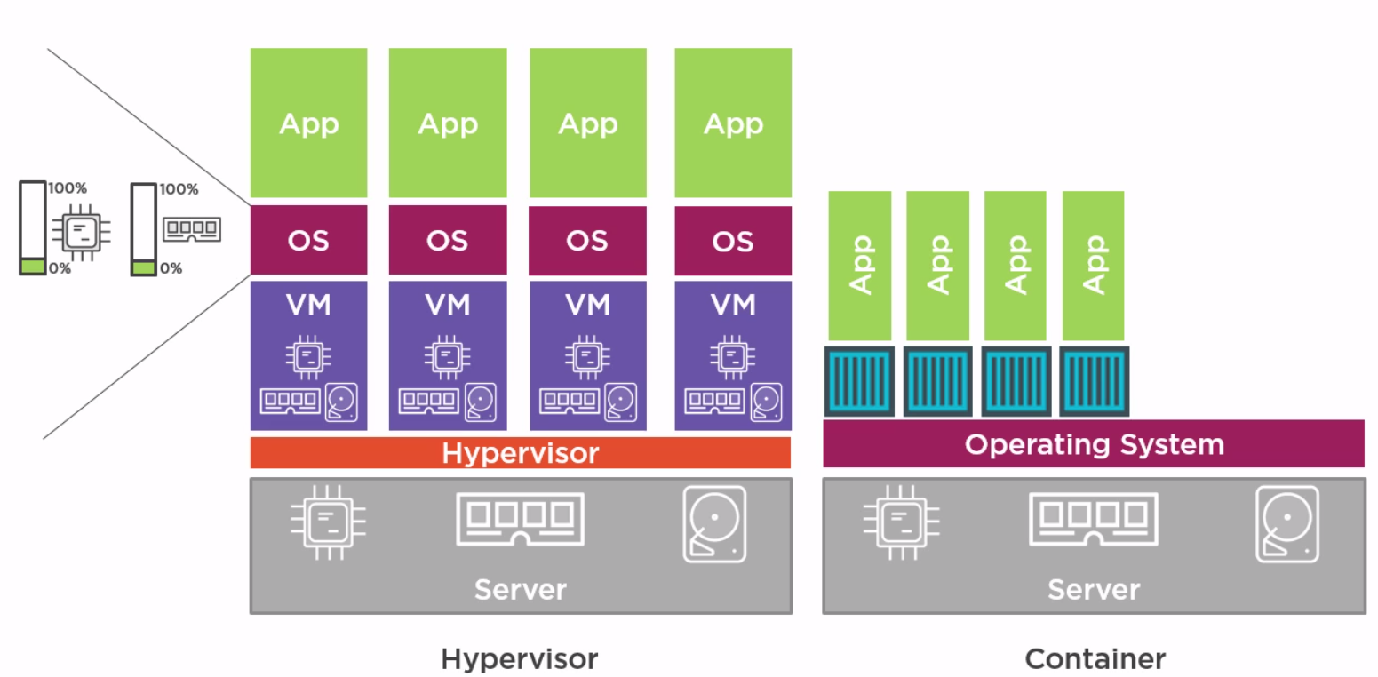
VMWare vs Container Architecture -

Slide 3
Installation on ec2 -
To install docker on EC2 -
-> Update the packages on your instance [ec2-user ~]$ sudo yum update -y
-> Install Docker [ec2-user ~]$ sudo yum install docker -y
-> Start the Docker Service [ec2-user ~]$ sudo service docker start

Slide 4
Kernel Utilities used by docker -
1. Kernel Namespaces -
The namespace service helps in creating different independent environments for the containers. Like different pid numbers, networking, file system mounts, user namespaces etc.
2. Control groups (CGroups)-
This contains the limits like how much CPU, memory is allocated to a container. You can change the Cgroup limits however you want.
3. Capabilities-
Breaks the root privileges into smaller groups, and these can be used to assign to a specific user. Privileges for users/process.

Slide 5
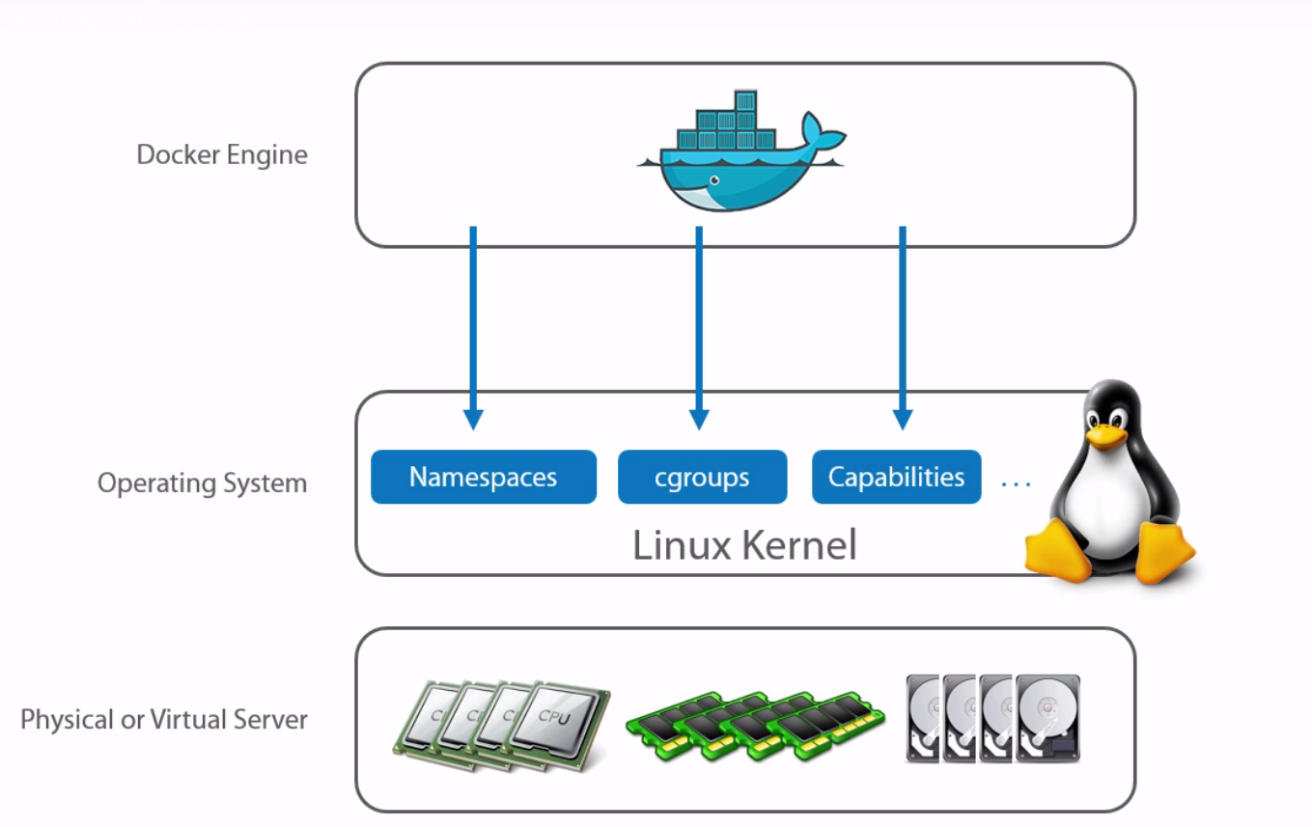
Docker installation installs Docker client and Docker Daemon.
Client calls daemon, daemon call the actual docker hub registries.
Docker engine means Docker client + docker daemon.

Slide 6
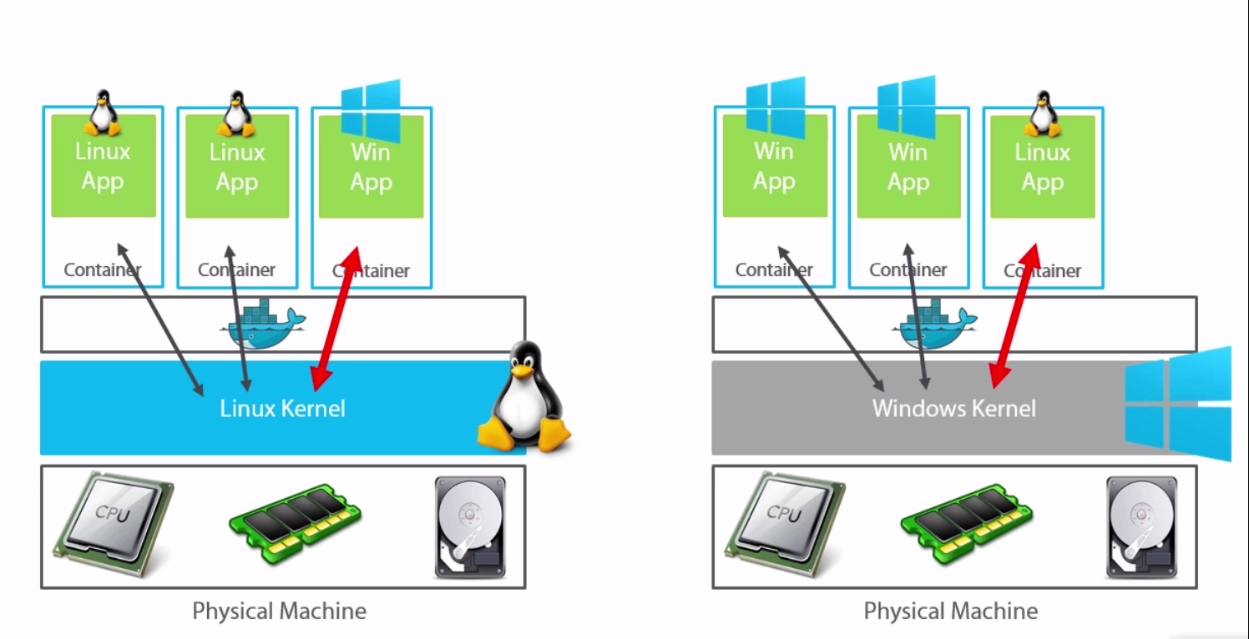
Docker on vivid platforms -
If you want to run a windows application on the container then the OS should in windows, as the container uses the windows Kernel. In the same way to run a Linux application we should be using a Linux OS

