Slide 1
HACKATHON : MODEL BASED AUTOMATION
Team Name : Anonymous (MBA03)
Ritesh Sinha
Alen Joe Antony
Sachin Naik
Prakruthi Dhanya

Slide 2
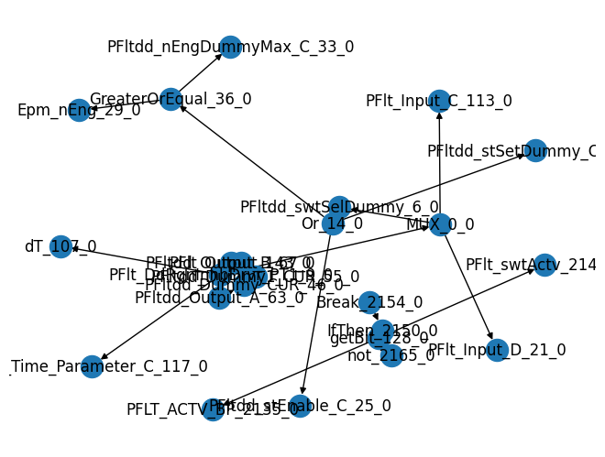
ARCHITECTURE
NetworkX
Test case automation
Output representation is done by using MDA tool.

Slide 3
Graph based approach
Loop based approach
Pros:
Generic approach
Faster execution
Modular implementation of ASCET functions
Better testcase coverage
Better data visualization
Generic output formats
Scalable for larger FCs
Better readability and maintainability
Intermediate values are recorded / visualized
Cons:
Testcase generation takes time for large no. of inputs
Pros:
Simpler logic
Better testcase coverage
Better data visualization
Generic output formats
Cons:
Increased time complexity
Increased code complexity (less scalable)
Possibility of code repetition
Readability and maintainability
Circular dependencies can cause issues
Intermediate values not recorded
Testcase generation takes time for large no. of inputs

Slide 4
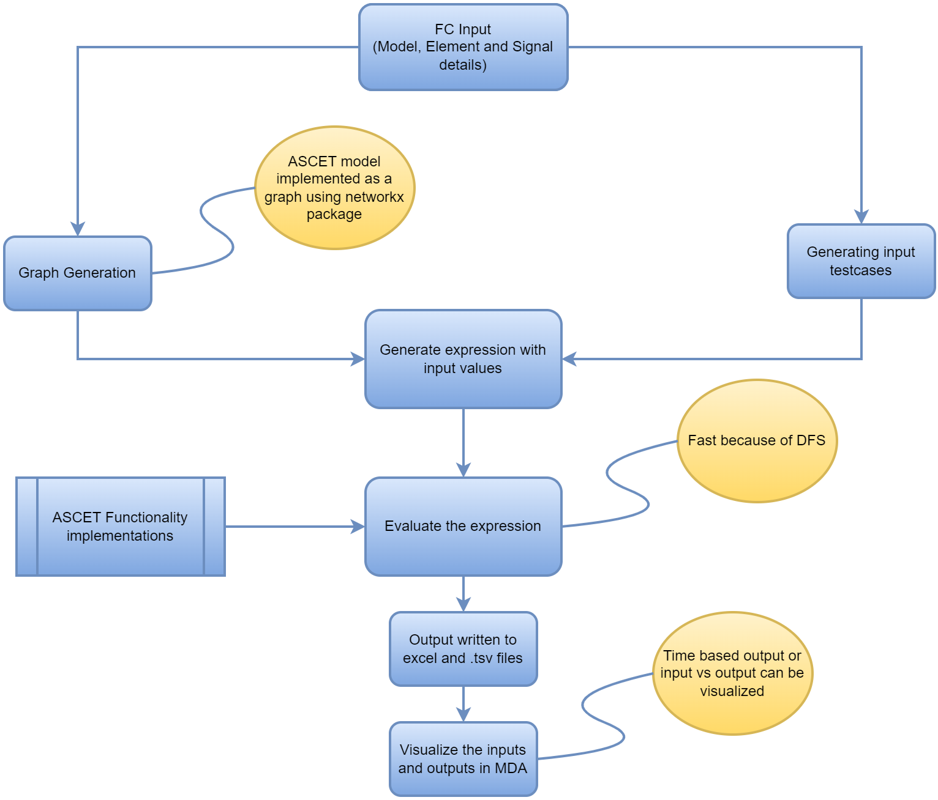
WORKFLOW

Slide 5
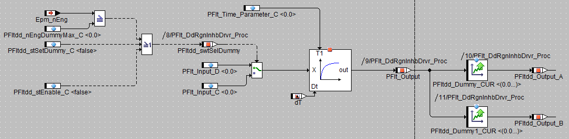
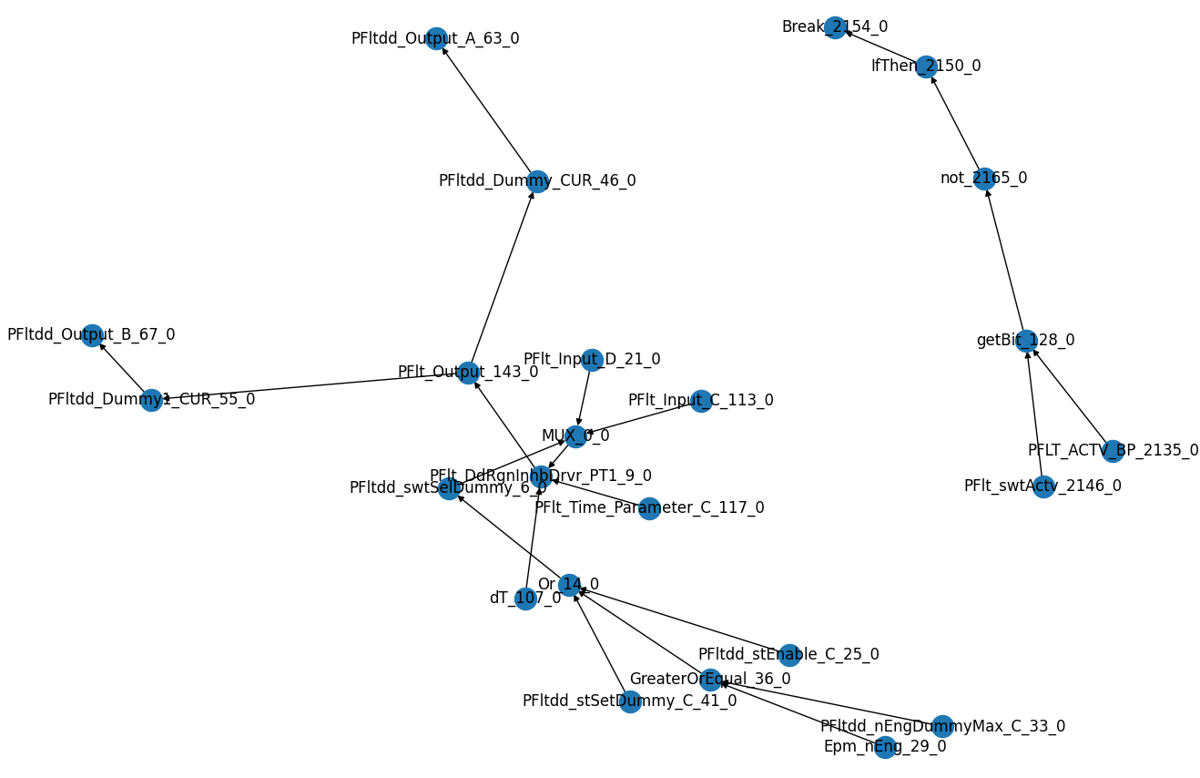
Modelling
Graph based representation of ASCET model for PFlt_DdRgnInhbDrvr_1.0.0

Slide 6
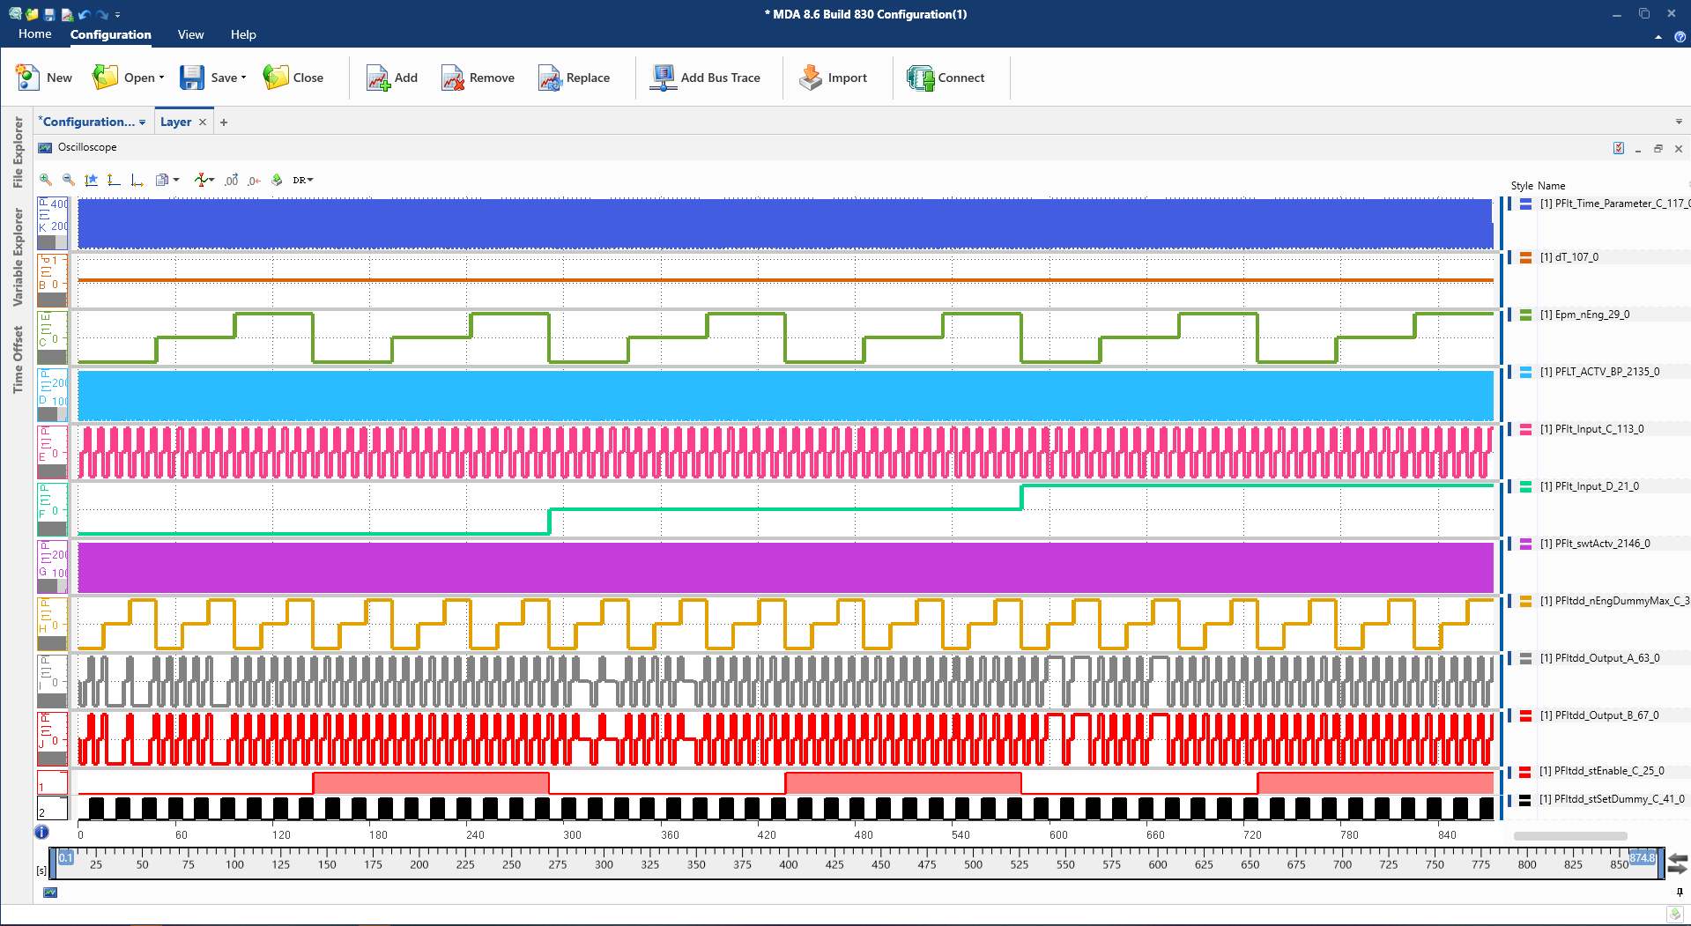
Input Output Visualization

Slide 7
DEMO

Slide 8

BOTTLENECK
Time
ASCET functionality implementation
Time
Test automation

