Slide 1
Library Orientation Programme
By
Librarian
IGNOU REGIONAL CENTRE
LIBRARY, 38 DELHI 3 NARAINA

Slide 2
What is Library Orientation ?
Library orientation is an educational program designed to introduce new users to a library’s resources, services, policies, and layout, enabling them to navigate and utilize the library effectively.
Library orientation, also known as user orientation, is a structured process aimed at familiarizing individuals—typically new students, researchers, or library patrons—with the library’s offerings and environment. It goes beyond showing the physical layout; it includes instruction on catalog systems, borrowing policies, research tools, digital resources, and the library’s broader mission as a hub of knowledge. The ultimate goal is to empower users to access information efficiently, develop information literacy skills, and support academic, professional, and personal learning.
Library & Information Science Education Network

Slide 3
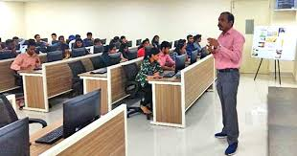
Library Orientation Session
A library orientation session is an educational program designed to familiarize new users with library resources, services, policies, and research tools, empowering them to navigate and utilize the library effectively.
Library orientation sessions aim to introduce participants to the library’s physical layout, catalog systems, digital databases, borrowing policies, and additional services such as reference assistance, interlibrary loans, and technology support. These sessions are essential for developing information literacy skills, enabling users to evaluate sources, cite materials correctly, and manage research efficiently.

Slide 4
Library Collection
Library has 9245 books
S. No. | Documents | Total No. Of Volumes
1 | Books (Print) | 9245
2 | Journals | 109
3 | Bound Journals (Print) | 150
4 | Magazines | 11
5 | newspaper | 4

