Slide 1


BUSINESS DATA
MANAGEMENT
CAPSTONE PROJECT
Improving Production and Quality Control in Injection Moulding through Operational Optimization
Name: Ritesh Sharma
Roll No: 24f1001677
Course Stage: Diploma Level
Email: 24f1001677@ds.study.iitm.ac.in

Slide 2
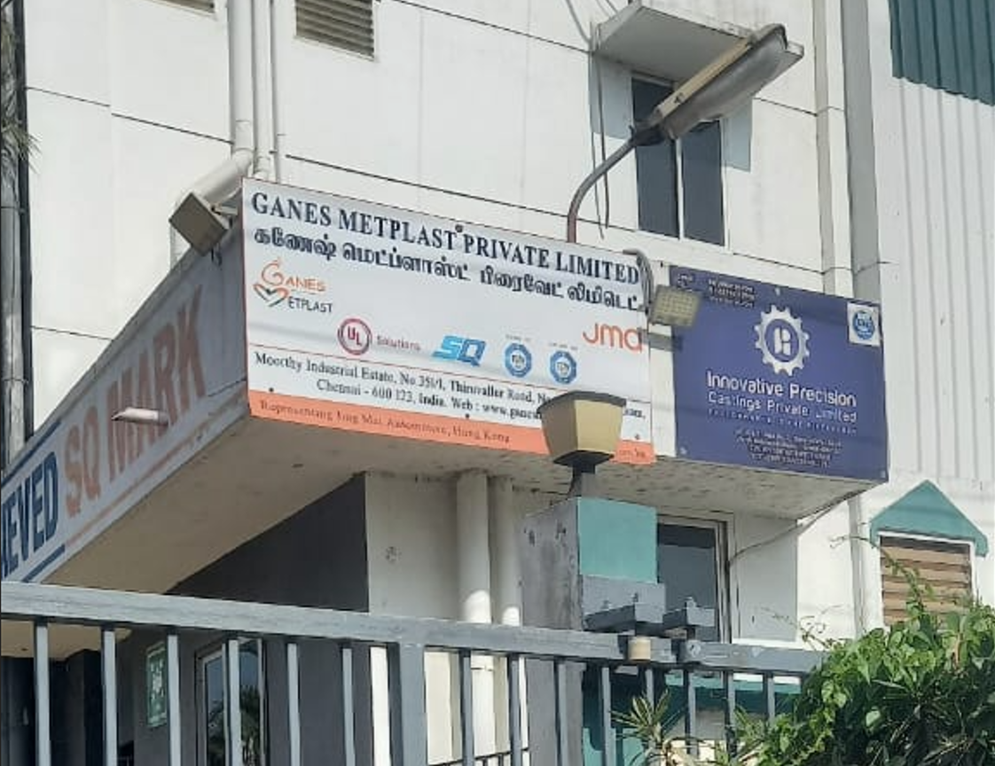
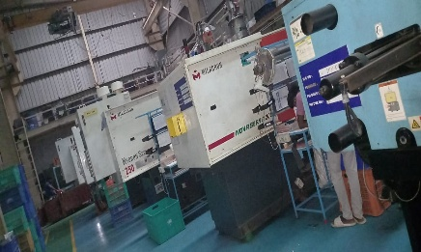
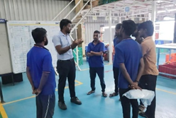
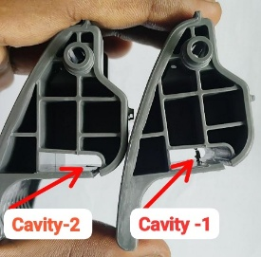
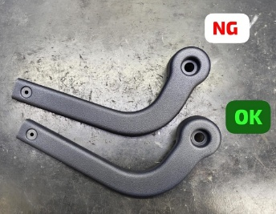
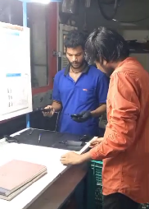
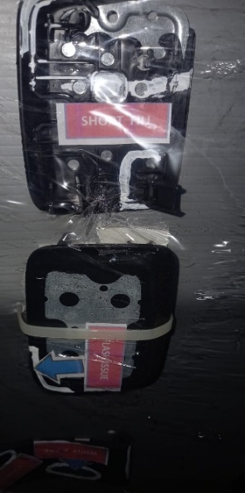
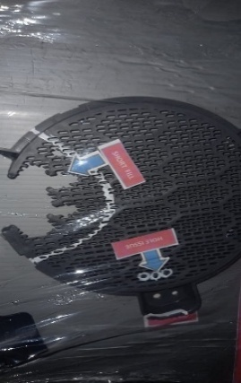
ORGANIZATION BACKGROUND
Organization: Ganes Metplast Pvt. Ltd.
Business: Manufacturer of plastic components for Automotive, Electrical, and Consumer Goods industries.
Operations: Uses 80T–350 T injection molding machines for end-to-end production.
Specific Problem: High rework/rejection rates, frequent machine downtimes, and inefficient inventory planning affecting production targets.
i). Photograph of the firm’s main entrance gate
ii). 80T-350T Machines
iii). Discussion Panel by workers
iv). Product defects
v). Inspection Units
Page 2

Slide 3

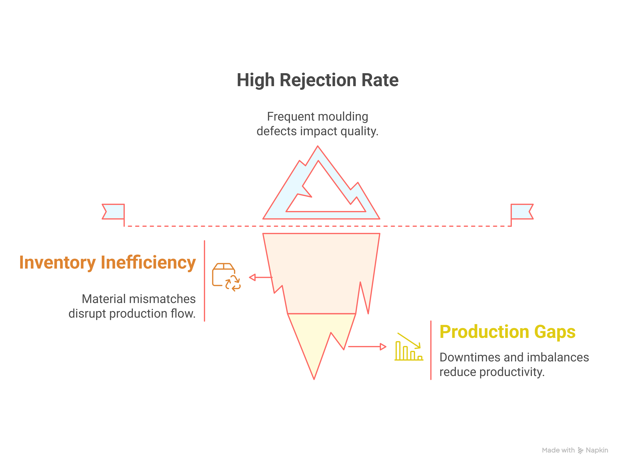
PROBLEM STATEMENTS
Page 3

Slide 4
DATA CLEANING
METHOD OF ANALYSIS
Rejection & Lumps: Tracked rejection % (Rt) & lump weights (Lt) to capture explicit & hidden losses.
Correlation Analysis: Applied Pearson’s r to find relationships between rejection, lumps, downtime.
Downtime Trend & RCA: Categorized total downtime (Dt), identified high-impact causes using trend & root cause analysis.
Pareto Analysis: Used 80/20 rule to pinpoint vital few downtime drivers for prioritization.
OEE Analysis: Calculated Availability, Performance, and Quality to assess machine-wise effectiveness.
Inventory Analysis: Performed 12-month trend study on opening stock, RM+RG, shortages, to uncover planning gaps.
Visualized results with Excel charts, pivot tables, and Python (Matplotlib, Seaborn) plots.
Collected 12 months of production, rejection, downtime, and inventory data (June 2024–May 2025).
Managed 13+ Excel datasets covering OEE, daily logs, downtime, parts stock, material details.
Handled missing values, duplicates, password-protected sheets, and formatting misalignments.
Used Excel for manual fixes, summaries, and early checks.
Applied Python (Pandas) for merging, filtering, reshaping, and final clean datasets.
Created 11+ custom summary sheets for ready analysis.
Page 4

Slide 5
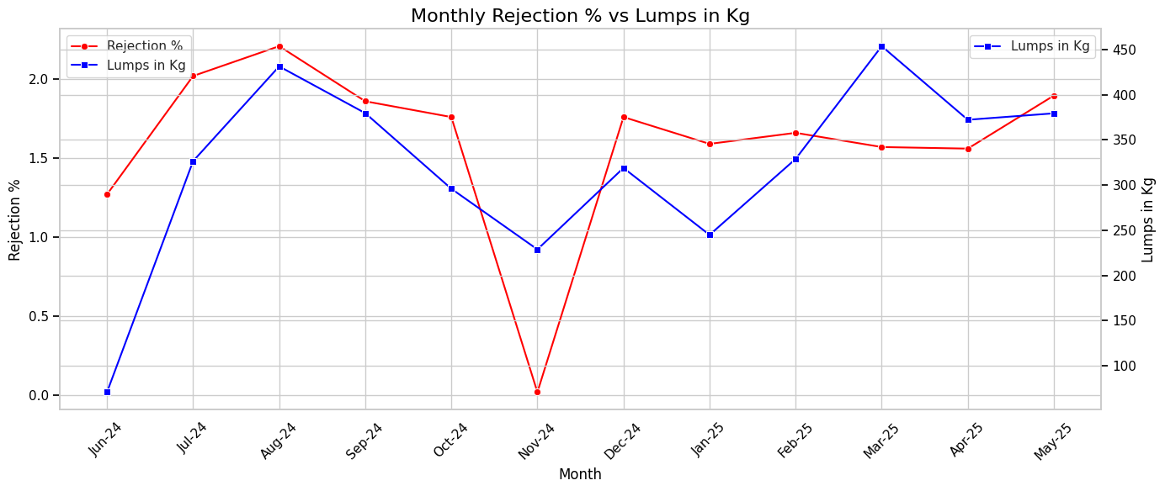
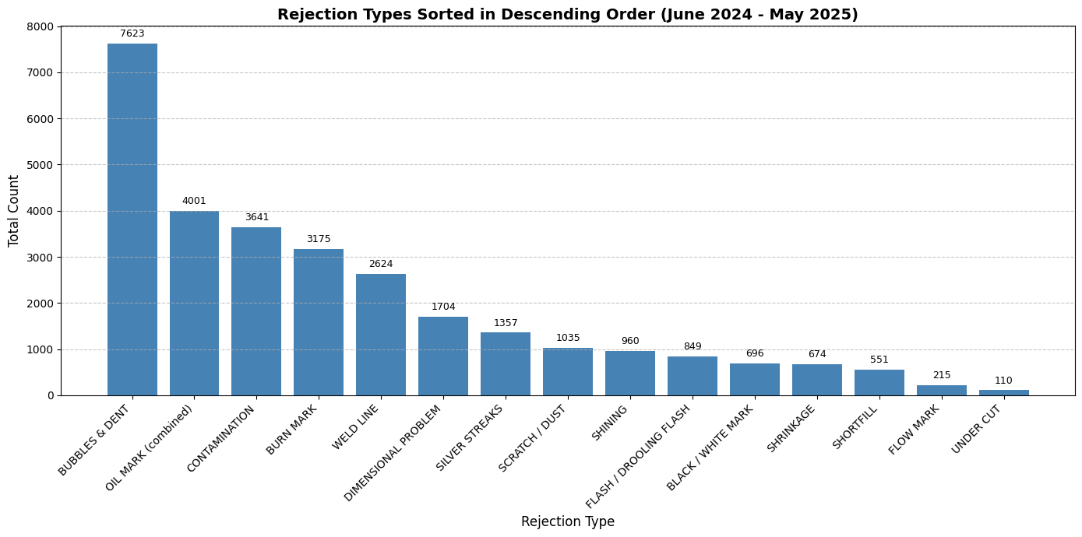
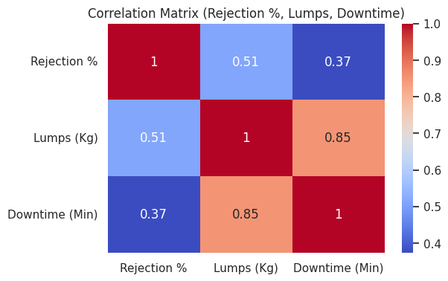
RESULTS AND FINDINGS
Operational Insights from Rejection Rates and Scrap Analysis
Fig 1: Analysis of Monthly rejections % and Lumps in Kg
Fig 3: Rejection types analysis over 12 months (June-24 to May-25)
OVERALL INSIGHTS
Created monthly trend charts for Rejection % and Lump weight (June 2024–May 2025).
Compared trends to identify hidden material waste and quality issues.
Noted peaks in August & March; stable period in Dec–Feb; anomaly in November.
Used correlation matrix to link Rejection %, Lumps, and Downtime.
Found strong Downtime–Lumps link (r = 0.85); moderate Rejection–Lumps link.
Confirmed downtime causes hidden waste; rejection mainly driven by quality factors.
Analyzed defect types (Bubbles, Oil Marks, Burn Marks) to find main causes.
Combined findings to design targeted actions for improving quality, waste control, and uptime.
Fig 2: Correlation Analysis Between Rejection, lumps and downtime
Page 5

Slide 6

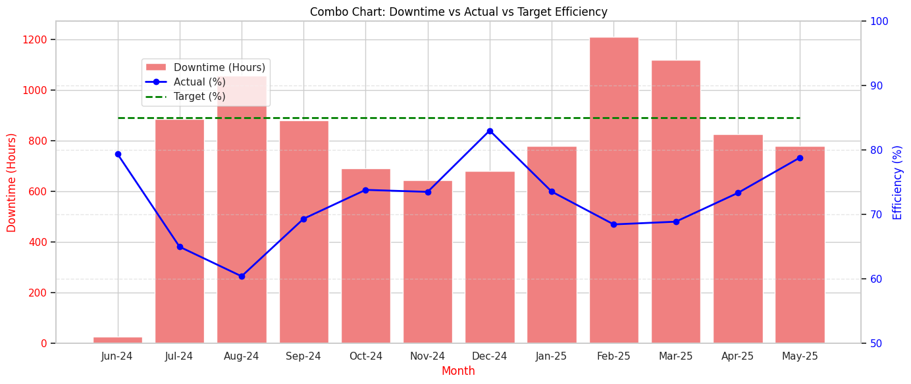
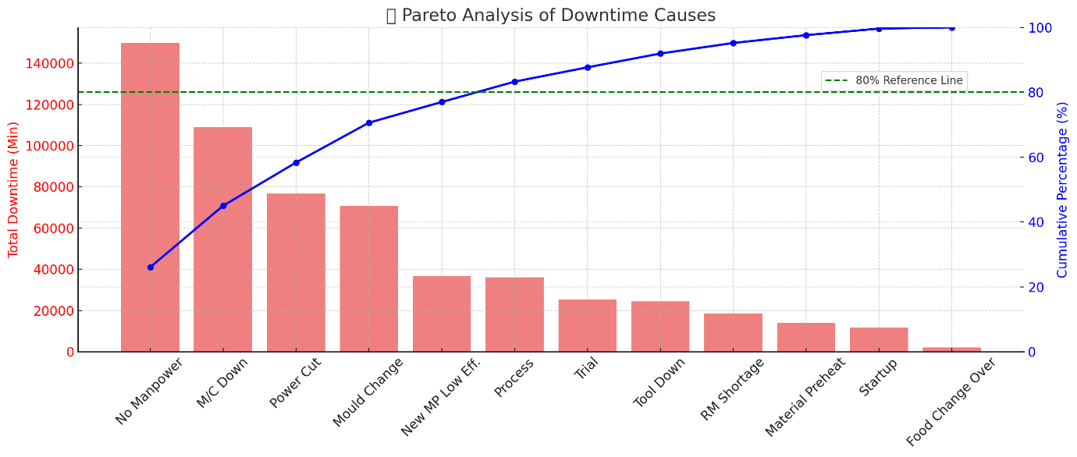
RESULTS AND FINDINGS
Performance Gap Analysis Between Targeted and Actual Output
Fig 4: Downtime Analysis over 12 months June 2024-May-2025
Fig 5: Analysis of Downtime with Actual vs Target
OVERALL INSIGHTS
Tracked downtime monthly to spot seasonal and operational spikes.
Identified summer (June–Aug) and fiscal-end (Dec–Feb) peaks.
Linked spikes to heat, maintenance delays, and manpower gaps.
Mapped downtime impact on actual vs target output.
Found chronic 40,000+ min/month losses; Feb peak: 72,719 mins.
“No Manpower” was the top reason (~155,000 mins lost).
Highlighted machine breakdowns, power cuts, and changeovers.
Used Pareto to confirm top 5 causes = 80% of total downtime.
Exposed gaps in shift planning, training, and maintenance.
Fig 6: Pareto Analysis to perform major downtime reasons
Page 6

Slide 7
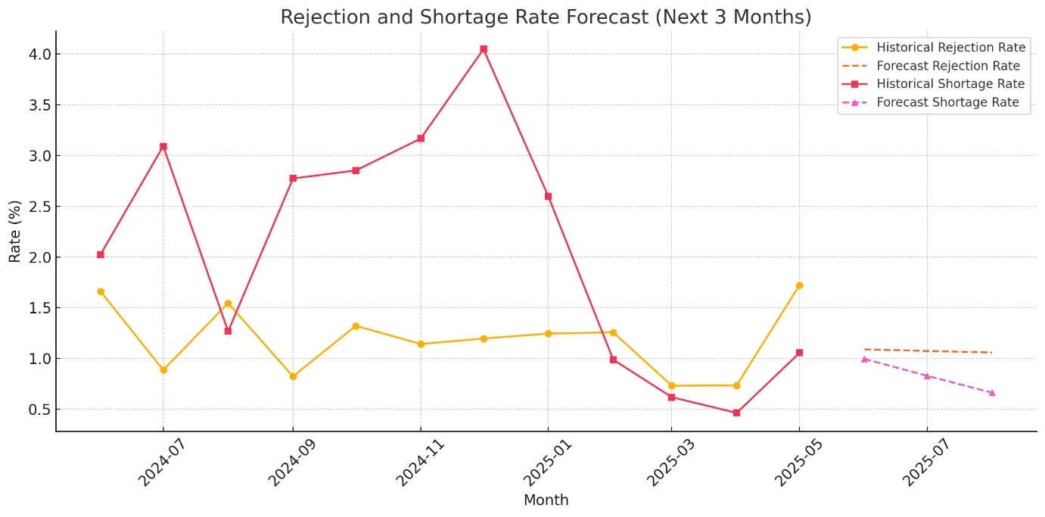
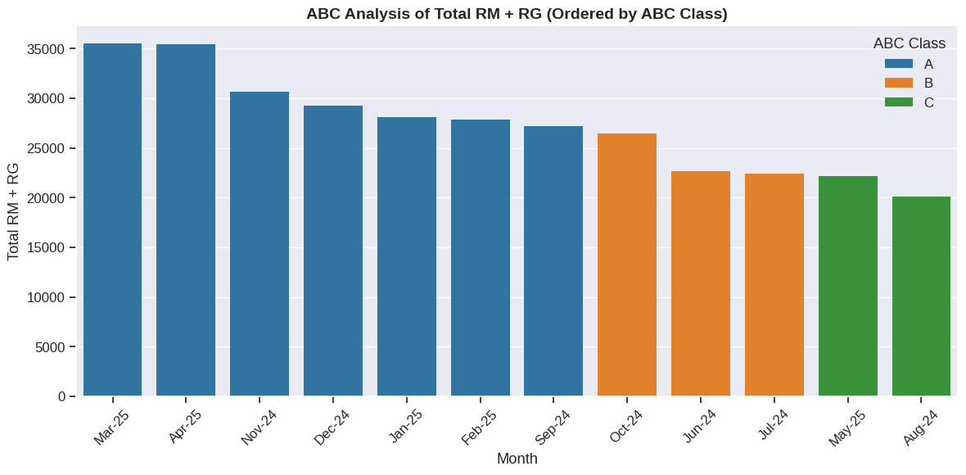
RESULTS AND FINDINGS
Inventory Analysis over 12 Months June-25 to May -25
Fig 7: Balance trend analysis over the months
Fig 8: Rejection and Shortage Forecast
OVERALL INSIGHTS
Balance shows unstable planning with big swings.
June–Aug 2024: Excess stock peaked (+940).
Sept–Oct: Sharp drop to -1384 — poor forecasting.
Caused delays, costly fixes, and flow issues.
Nov–Jan: Slow manual recovery, no strategic fix.
Feb onwards: Stable but surplus risk if demand stays low.
Forecast: Rejection trend rising (June–Aug 2025) — more waste risk.
Shortages stay unstable — poor raw material sync.
ABC: March, April, Nov = high Class A; May, July, Aug = Class C.
Confirms uneven demand — need proactive, data-driven control.
Fig 9: ABC Analysis on total RM+ RG monthly
Page 7

Slide 8
INTERPRETATION OF RESULTS
RECOMMENDATION
Systemic inefficiencies exist in rejection handling, downtime management, machine utilization, and inventory control.
Rejection percentages hide true material loss.
There is a strong correlation (r = 0.85) between downtime and lump generation.
Machine utilization is imbalanced.
Inventory levels fluctuate between surplus and shortages.
These interlinked inefficiencies in people, processes, and planning threaten scalability and profitability if not strategically addressed.
Short Time Recommendations
Shift-Wise Rejection Audits
Manpower Planning Revamp
SMED on High downtime machines
(Single Machines Exchange Dies)
Long Time Recommendations
Downtime Analytics Dashboard
Preventive Maintenance and Condition Monitoring
Inventory Planning with predictive Models
.
Page 8

Slide 9





CONCLUSIONS
FUTURE SCOPE
Acting on these recommendations will improve production stability, quality, and cost efficiency.
Short term: Better rejection tracking and manpower stabilization will restore baseline performance.
Long term: Digital tools and predictive strategies will enable proactive control of downtime, inventory, and machine allocation.
Operations will shift from reactive to resilient.
Overall impact: Higher profitability, stronger customer trust, and readiness for growth without added inefficiencies.
Advanced Predictive Analytics
Industry 4.0 Automation
Scalable Digital Dashboards
Lean Manufacturing Culture
Collaborative Supply Chain Planning
Page 9

Slide 10
THANK YOU

