Slide 1
Kaggle data challenge for dog breed identification
Presentation created by: Gudipati, Shahsnak
Kokad, Saurabh
Muley, Jaideep
Vangapalli, Ritesh Kumar

Slide 2
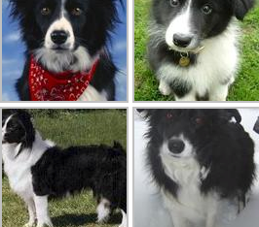
Introduction
Kaggle has a Dog Breed identification competition
The data has unique images of dogs with 120 different breeds
Every image has a unique id

Slide 3
Project Goal
The goal of this project is to create a classifier which is capable of determining a dog's breed from the available image

Slide 4
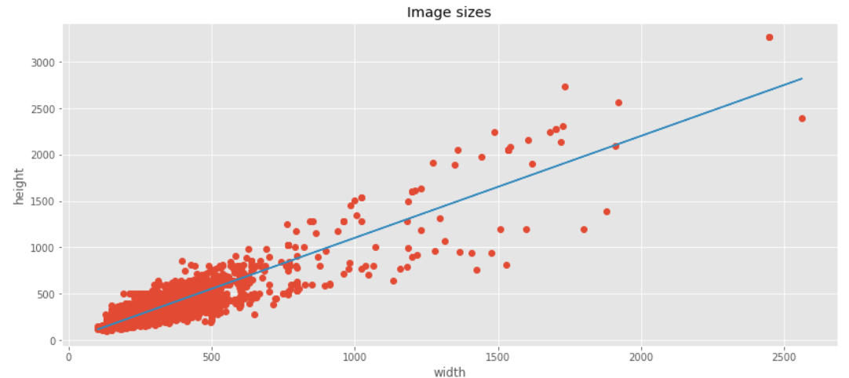
Images Size Distribution

Slide 5
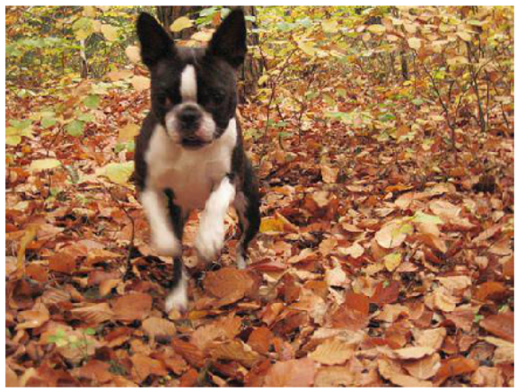
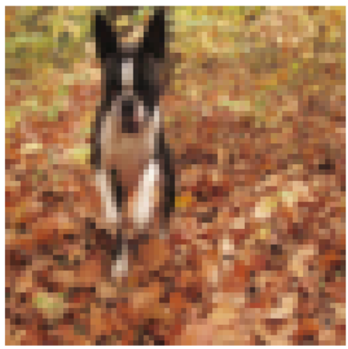
Resizing the image without losing its features
Original Picture
After Resizing

Slide 6
Model Approach
Pretrained the model by scraping the data from ImageNet
The data was divided into training and validation.
Pretrained Neural Network VGG-16 was used to classify the dog breeds

Slide 7
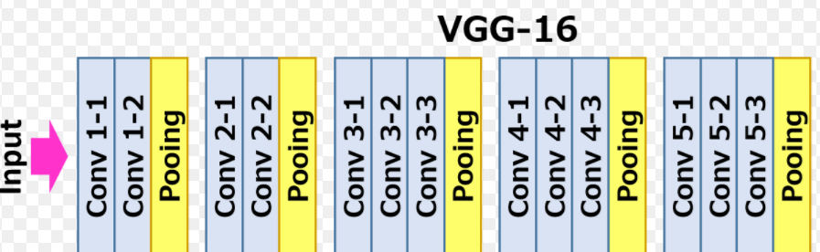

Layers used in the model
D
E
N
S
E
1
D​
E​
N​
S​
E​
2​
D
R
O
P
1
DENS
E
3
DE
N
S
E
4

Slide 8
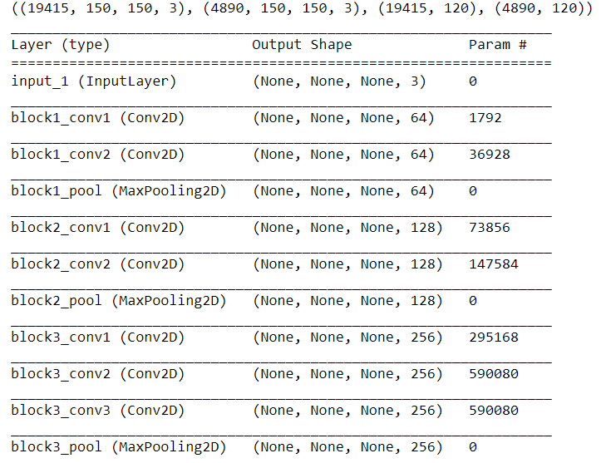
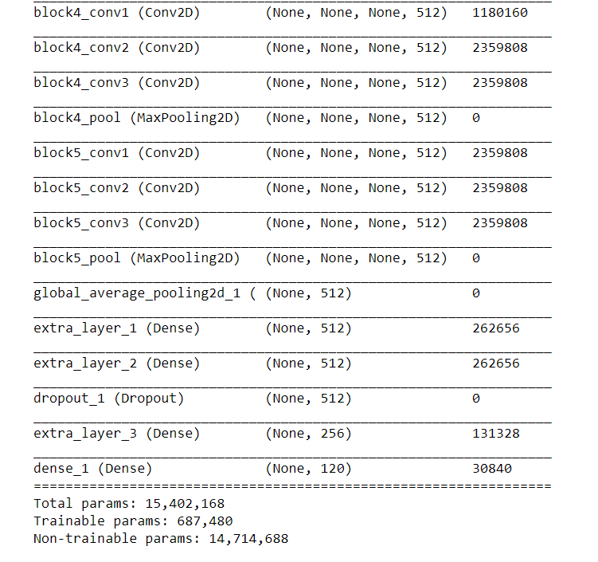
Summary of the layers

Slide 9
Model Statistics
Number of epochs = 2
Input size (pixels) = 150
Number of classes = 120
Number of layers = 21
Size of the Sample = 30,087
Training Accuracy = 37%
Validation Accuracy = 28%

Slide 10
Future scope
In future, We will try to increase Testing accuracy by:
Adding the more layers to the trained neural network
Using different possible pretrained models
Increasing input size

