Slide 1
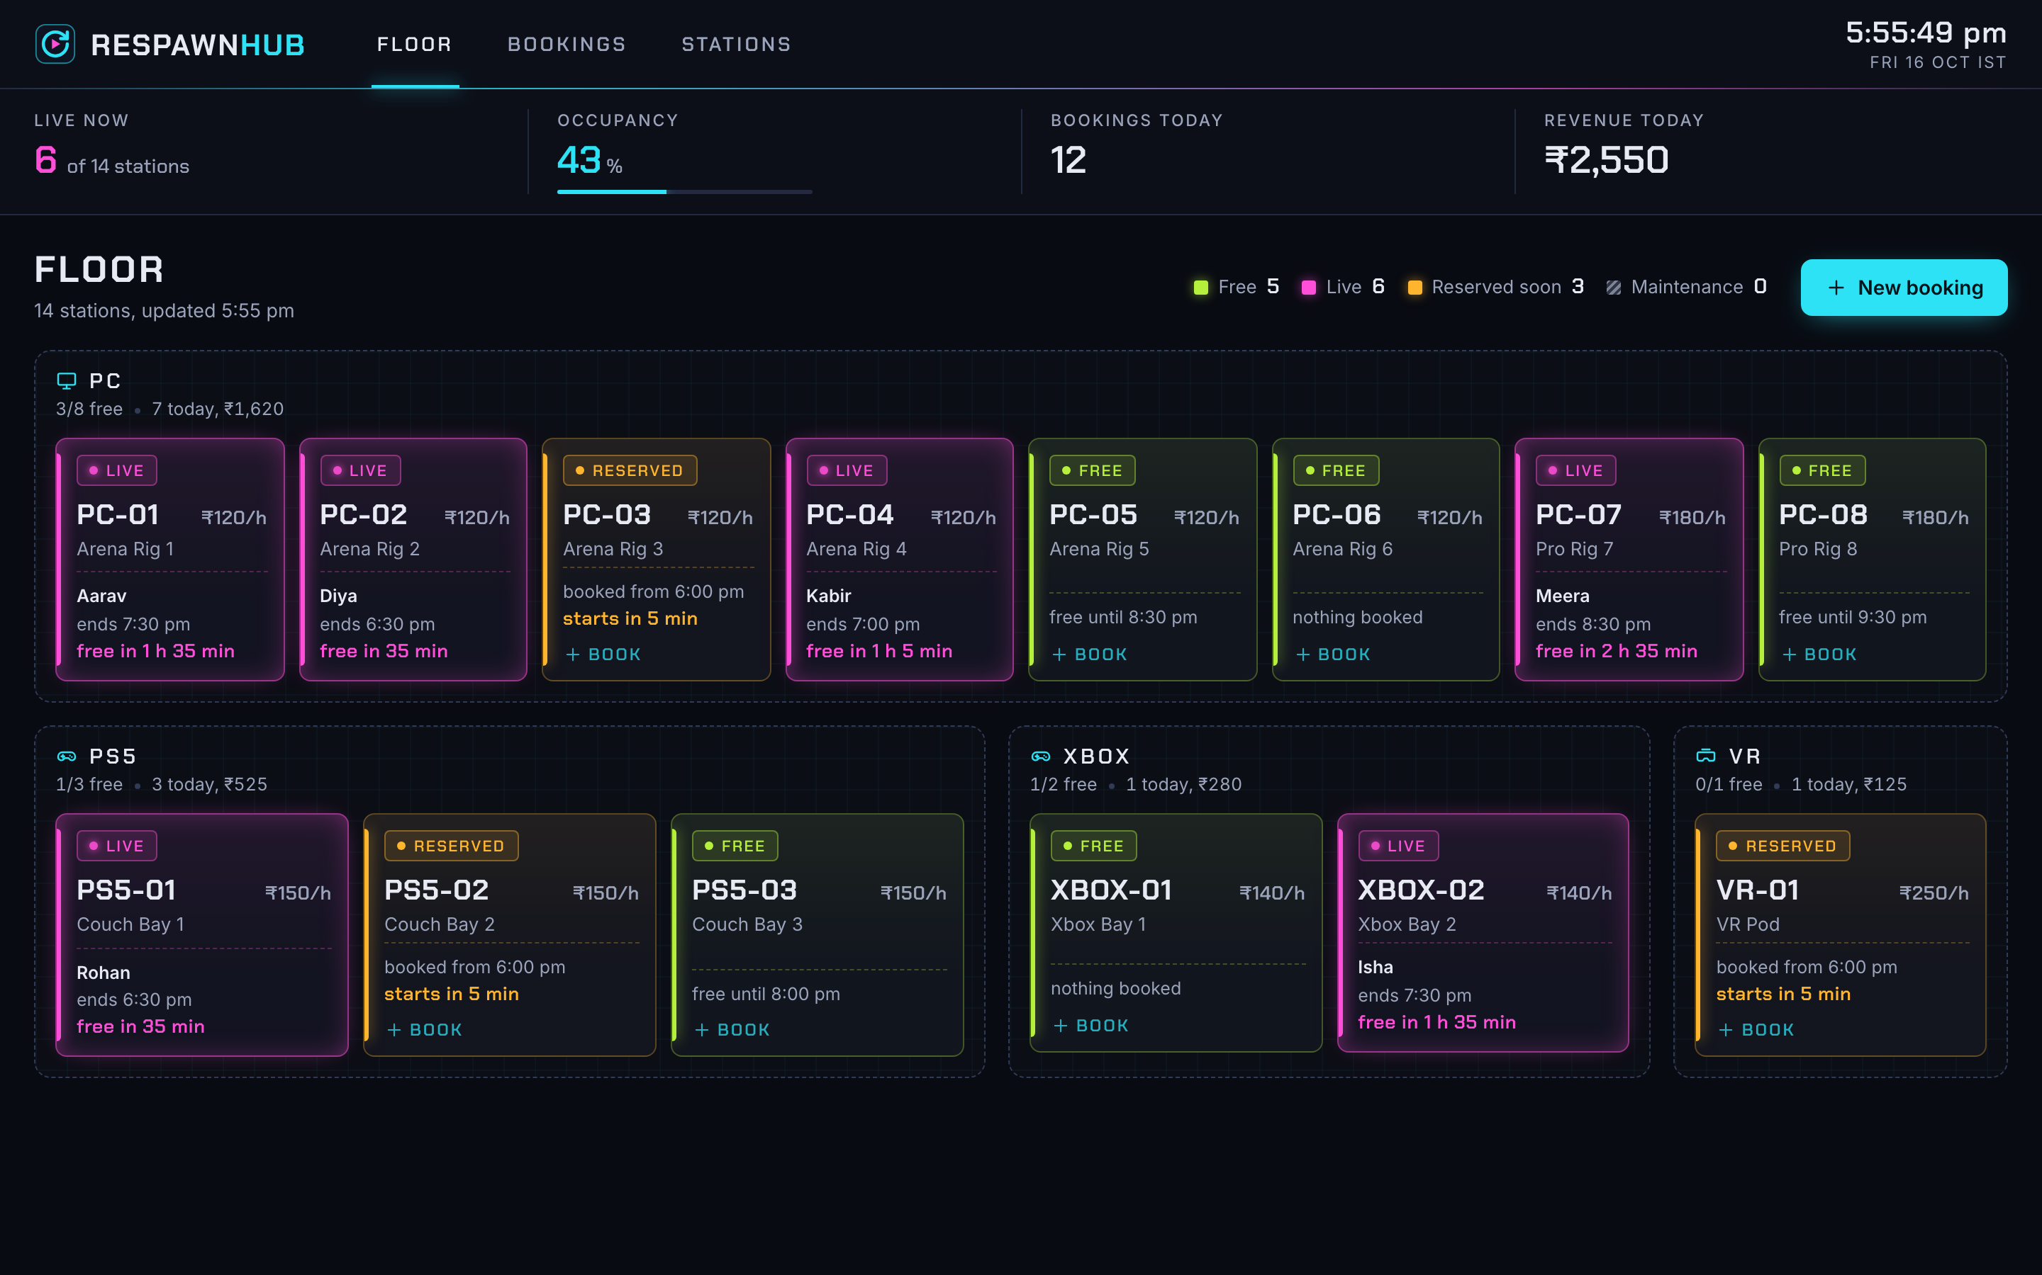
RespawnHub
Live floor and bookings for a gaming cafe, built and shipped like a real product
Ritesh Prajapati
github.com/Ritesh381/respawnhub
Notes:
RespawnHub is a booking app for a gaming cafe. In this talk: what it does, and how a change goes from my laptop to a cluster on AWS, tested, scanned, deployed and monitored.

Slide 2
The problem at a gaming cafe
2x
?
₹
Double bookings
Nobody knows what is free
No numbers
Two players turn up for the same PC at 7 pm, and someone goes home unhappy.
Staff walk the floor or flip through a notebook to find a free console.
How busy were we today? What did we earn? Nobody can say until closing.
RespawnHub puts the whole floor on one screen and refuses a booking that clashes.

Slide 3
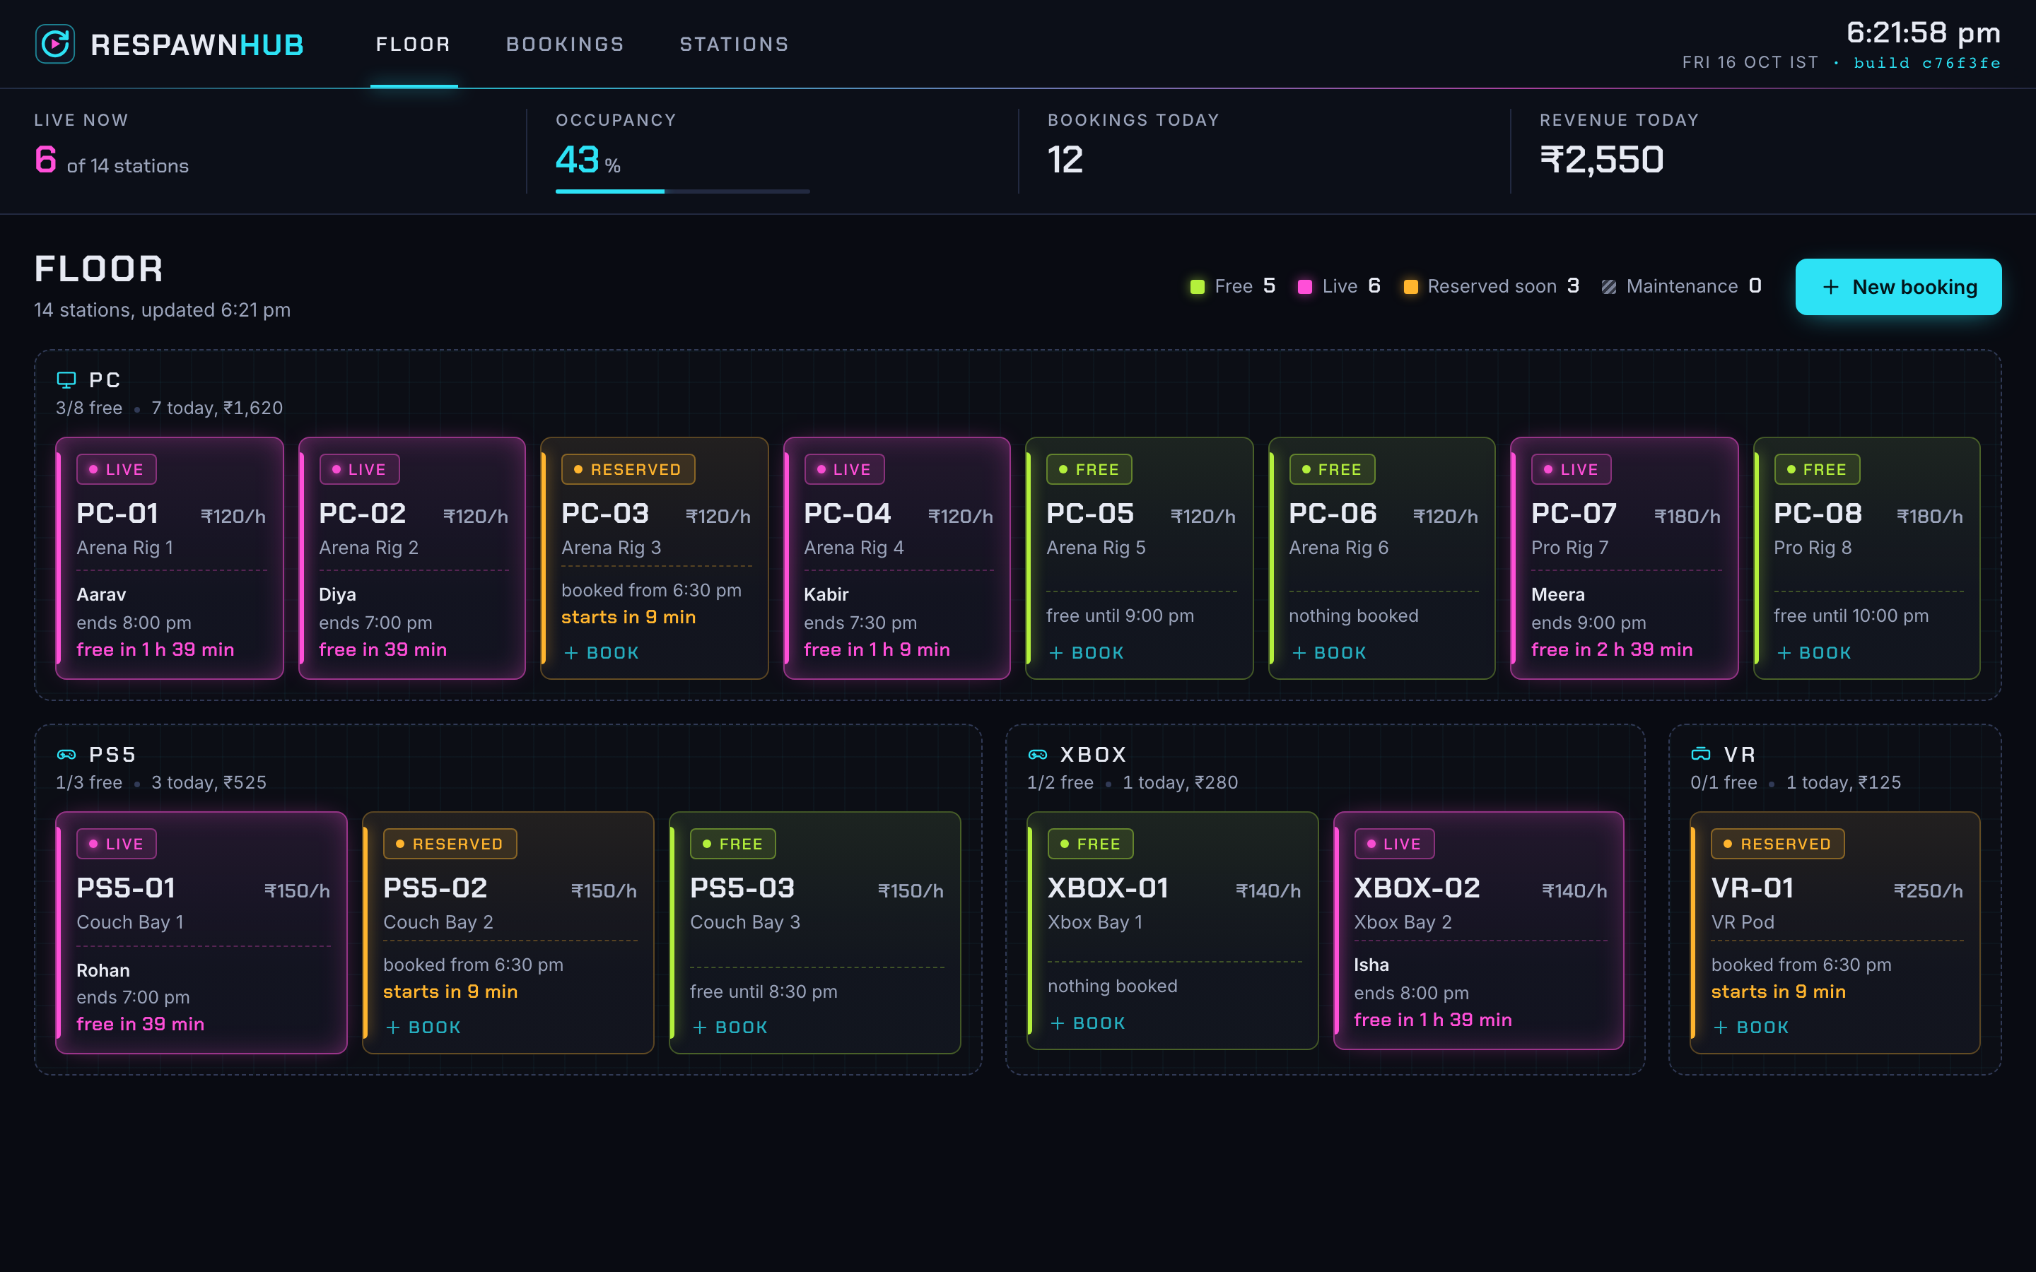
What staff see
Live floor
Every PC, PS5, Xbox and the VR pod, coloured free, live, reserved soon or under maintenance.
Safe bookings
30 minute slots. A booking that overlaps another on the same station is refused.
Today's numbers
Who is playing now, occupancy, bookings and revenue for the day.
Works on a phone too, so staff can check the floor while walking around.

Slide 4
How it is built
Browser
React app
FastAPI
PostgreSQL
Staff open the app on a laptop or phone
The screens. Served by nginx as plain files
The rules: prices, overlaps, live status
Stations and bookings, kept safe on disk
Why these: React and FastAPI are quick to build with and FastAPI writes the API docs itself. PostgreSQL can lock a station while it checks for a clash, so two staff booking at the same moment cannot both win.

Slide 5
From a commit to the cafe floor
Commit
Test
Package
Scan
Store
Deploy
Watch
I push a change to GitHub
47 automatic checks run
Two Docker images are built
Trivy looks for known holes
Images go to GHCR, named by commit
Argo CD updates the cluster
Prometheus and Grafana
One rule holds it together: if a test or the security scan fails, nothing after it runs. A broken change never becomes an image, and an image never reaches the cafe without passing both.

Slide 6
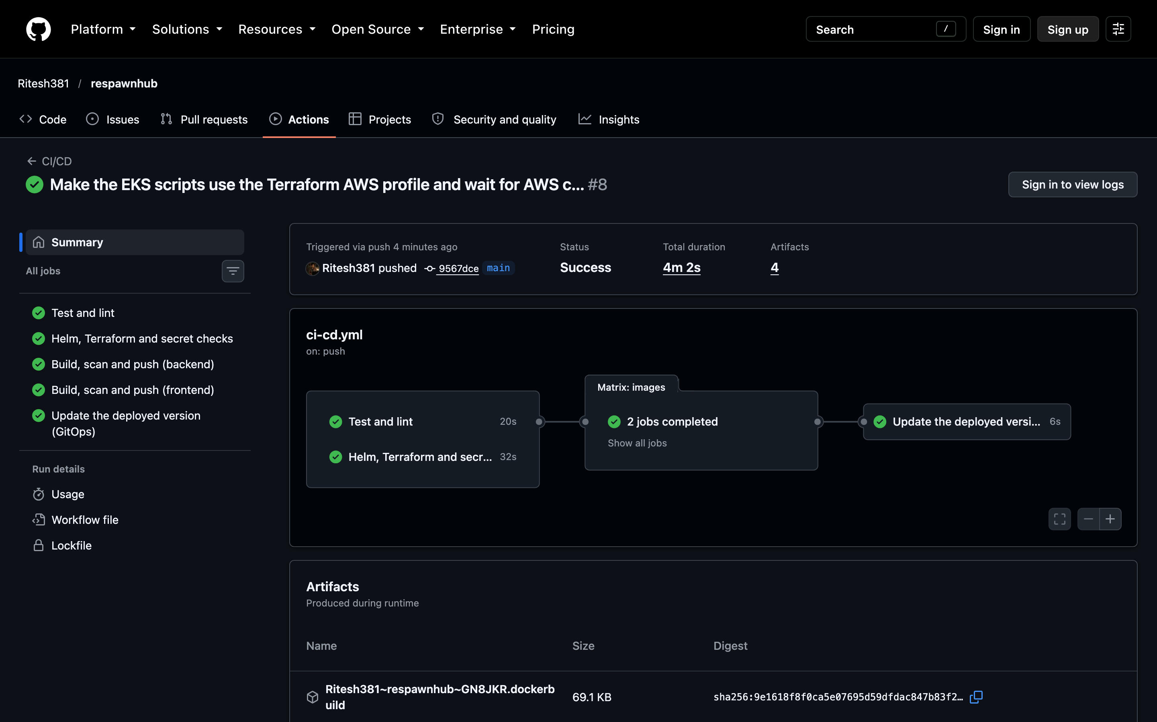
Every push is tested and scanned
47
automatic tests pass on every push
43 → 0
serious security problems in the web server image, fixed by updating its packages
~4 min
from push to new images in the registry
Each image is named after the commit that made it, so any running copy can be traced back to the exact code.

Slide 7
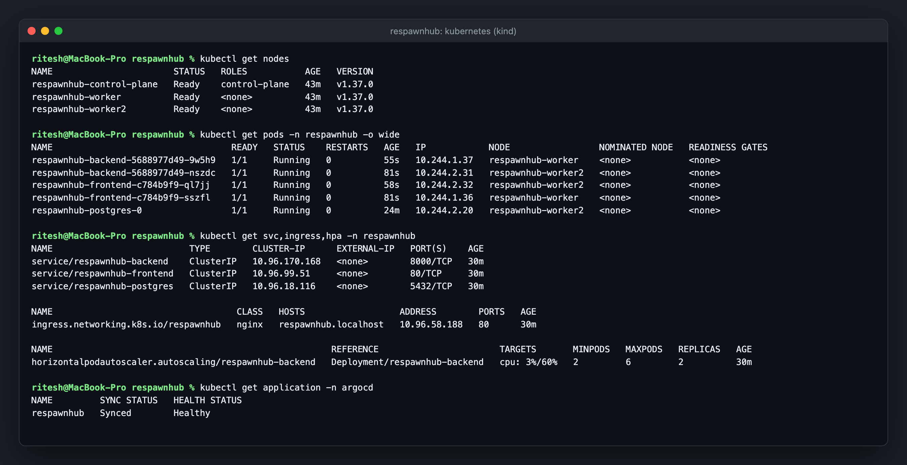
Running on Kubernetes
Two of everything
Two copies of the app and the web front end, so one can fail without anyone noticing.
Heals itself
A crashed copy is replaced automatically.
One front door
An Ingress sends / to the screens and /api to the backend.
Data survives
Postgres keeps its data on a volume, not inside the container.

Slide 8
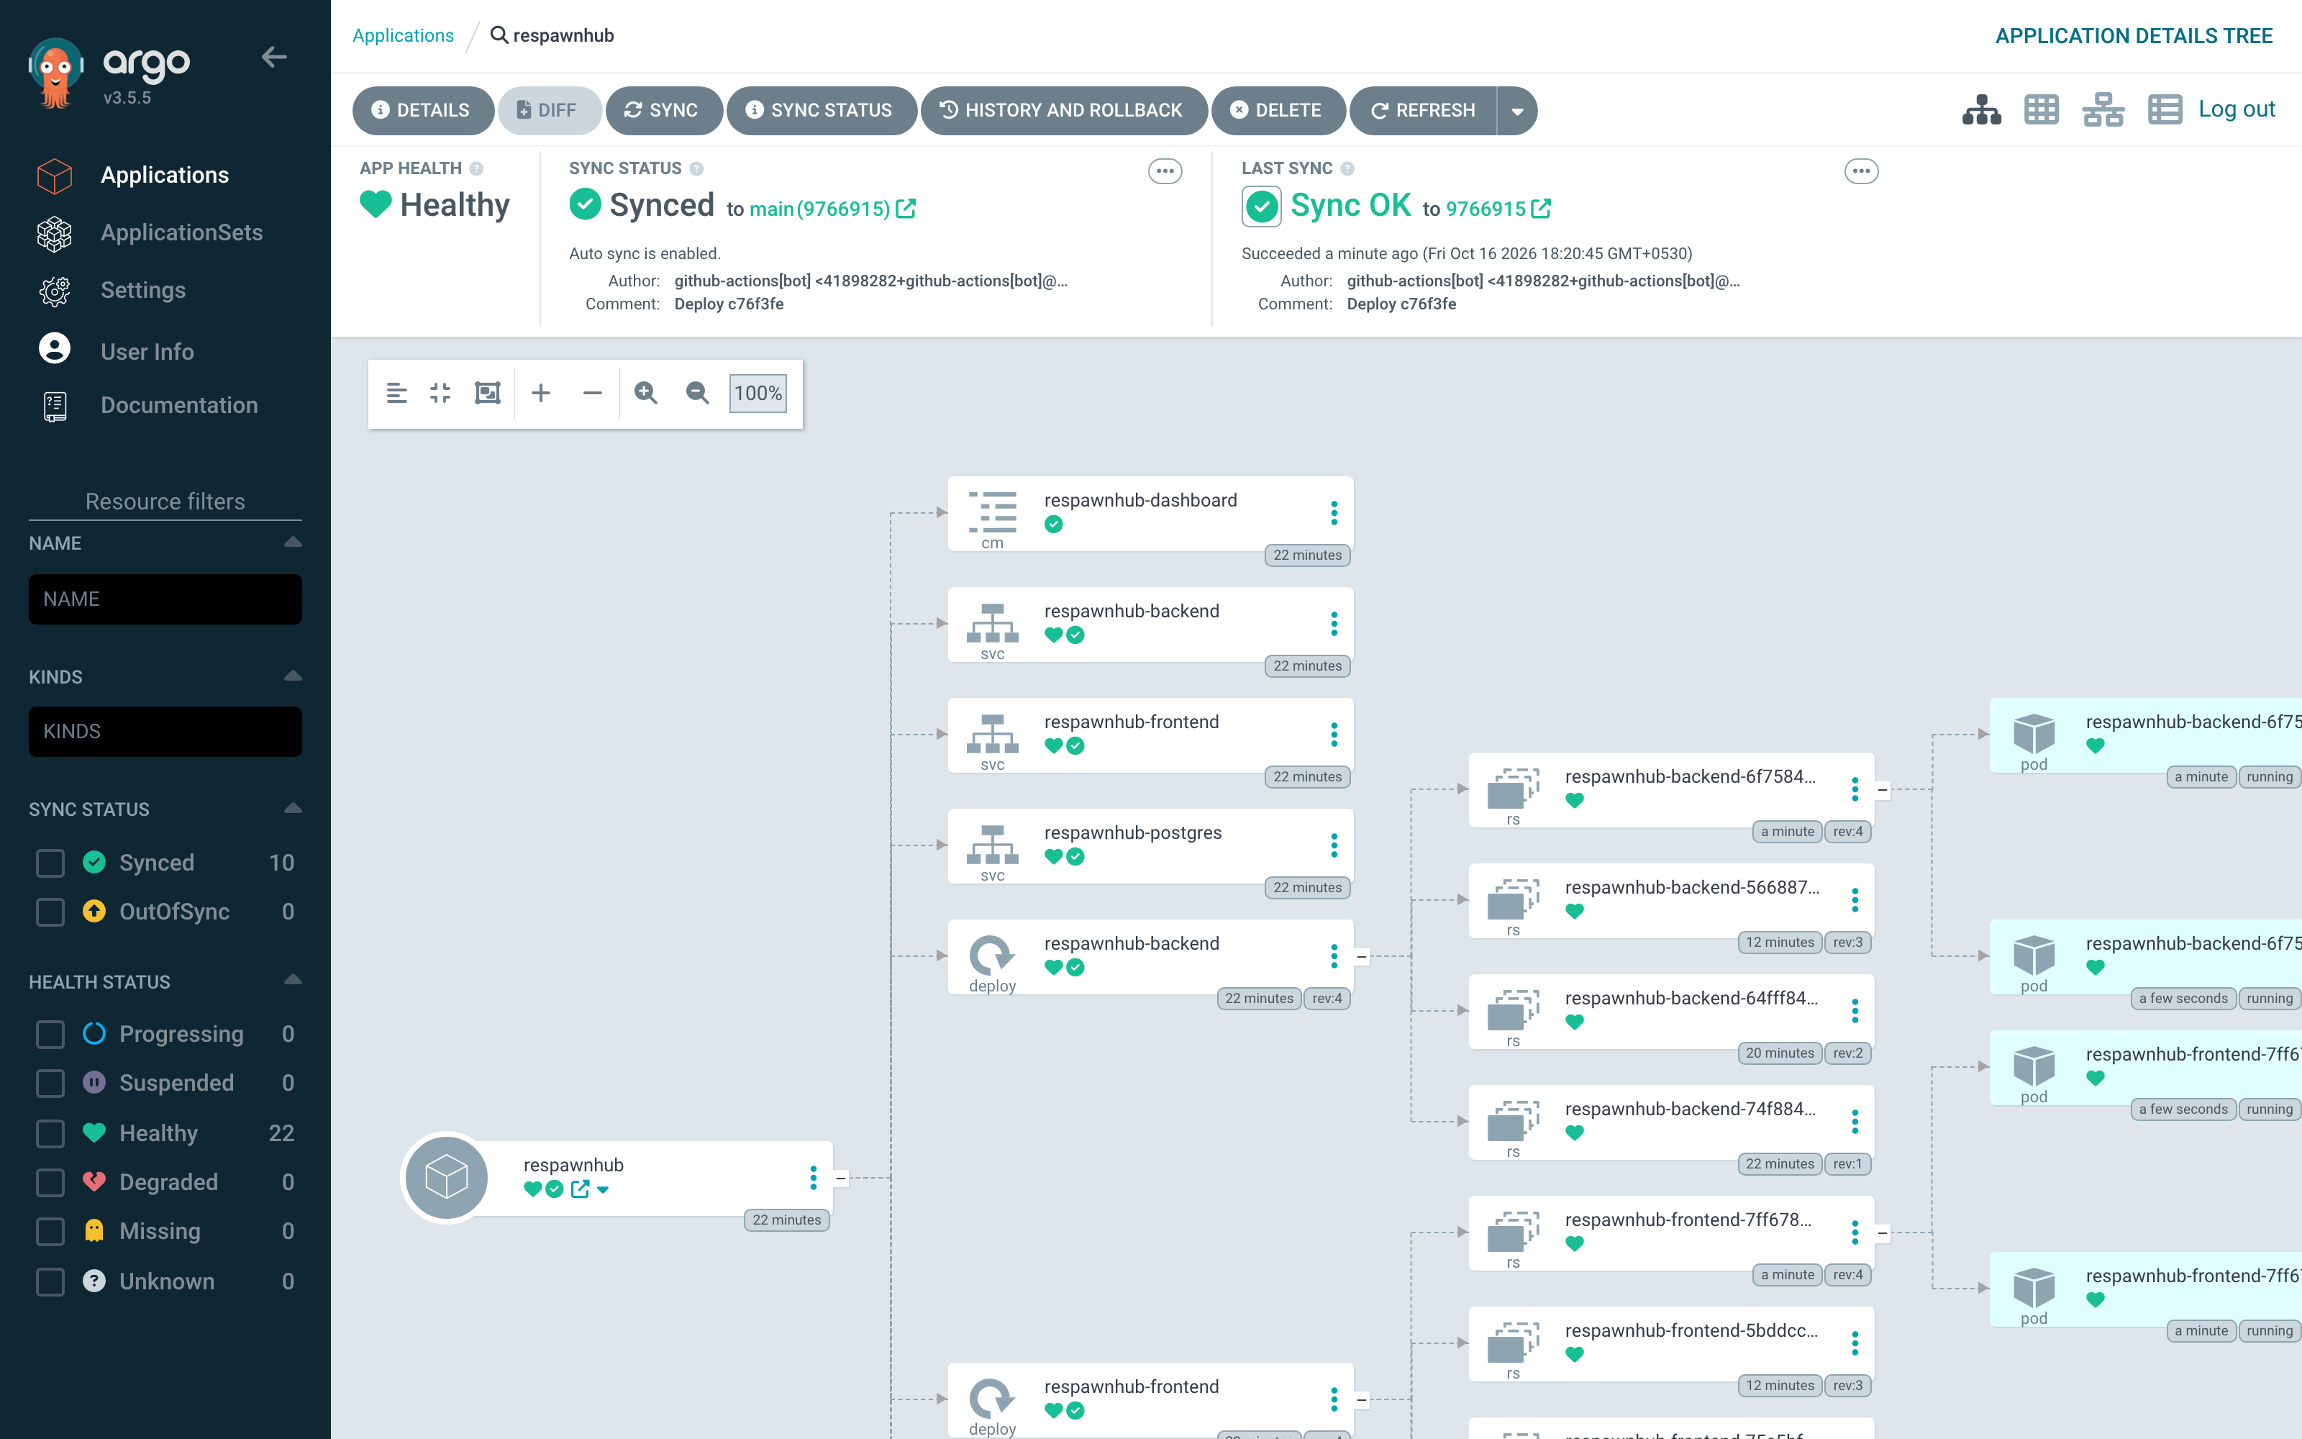
Git decides what runs
1
I commit "Show the running build in the top bar"
2
The pipeline tests, scans and pushes images c76f3fe
3
It commits "Deploy c76f3fe" to the Helm values
4
Argo CD sees Git changed and rolls the pods
5
The app now says build c76f3fe in its top bar
Nobody runs kubectl to deploy. Changes made by hand in the cluster are put back to what Git says.

Slide 9
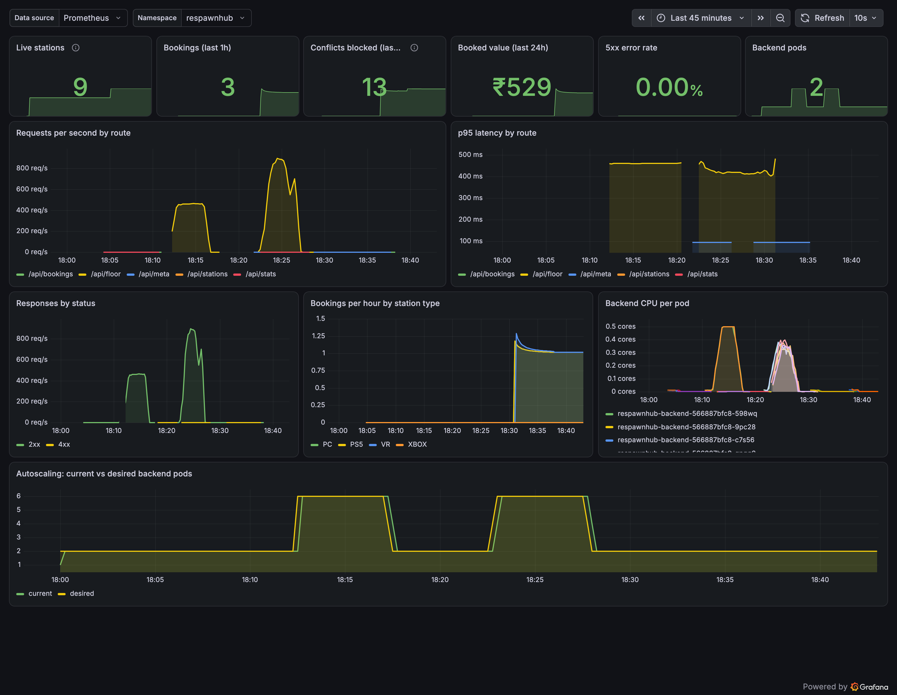
Ready for a Friday night rush
2 → 6
backend copies added automatically when CPU passed 60%
~900
requests a second at the peak of the load test
0.00%
server errors during the test
Grafana shows traffic, speed, errors, bookings and the autoscaler in one place.

Slide 10
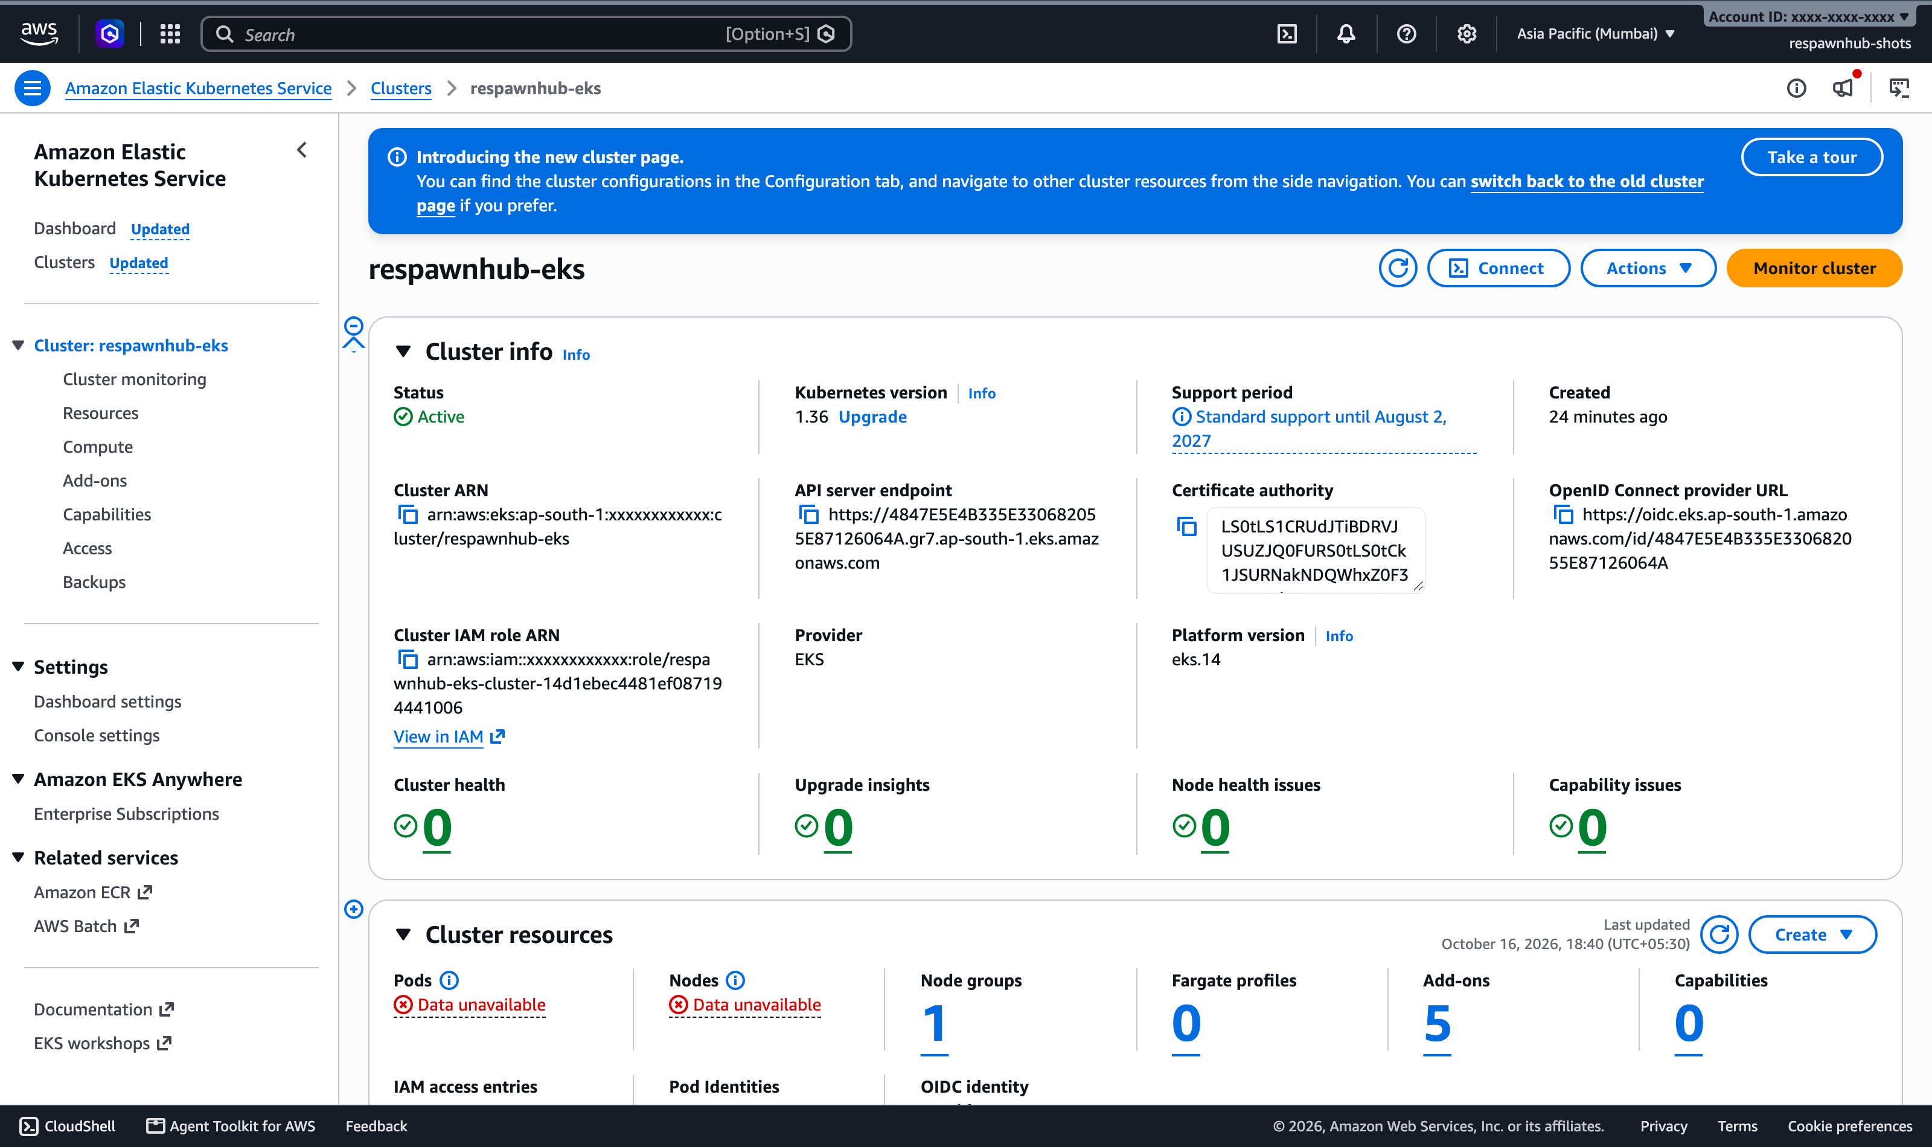
On AWS, built from code
Network
A private network across two data centres in Mumbai, with public and private subnets
Cluster
Amazon EKS with two worker machines
Same app
The same Helm chart and Argo CD setup as on my laptop
Clean up
terraform destroy removes all of it, so nothing keeps costing money
55 AWS resources from one terraform apply. The app ran there behind an AWS load balancer, then everything was destroyed.

Slide 11
When things break
Pod never starts
Service sends traffic nowhere
Pod keeps restarting
ImagePullBackOff
No endpoints
CrashLoopBackOff
Cause Deployment asked for an image tag that was never built.
Cause Its selector looked for "api" pods; ours are labelled "backend".
Cause Logs said the database password was wrong.
Fix Point it at a real commit tag.
Fix Fix the selector.
Fix Use the right Secret.
Each one was broken on purpose and fixed with kubectl get, describe and logs. The steps are in troubleshooting/RUNBOOK.md.

Slide 12
Why Kubernetes and not something simpler
 | Docker Compose on one server | AWS ECS | Kubernetes (kind and EKS)
Replaces crashed copies | Same server only | Yes | Yes
Adds copies under load | No | Yes | Yes
Same setup on laptop and cloud | Laptop only | No | Yes
Deploys from Git (GitOps) | No | With extra tools | Yes
Simple to start with | Yes | Medium | Harder
Compose is still what I use on my laptop. Kubernetes wins once the app has to stay up, grow and be deployed the same way everywhere.

Slide 13
What went wrong and what I changed
Database restarted on every deploy
Load test only reached two copies
A label that changes with each version was on the Postgres pods. Moved it off.
Kept-open connections stuck to the first pods. New connection per request fixed it.
First booking never showed in Grafana
Health check that never passed
Counters appeared only after the first booking. They now start at zero.
"localhost" meant IPv6 inside the container while nginx listened on IPv4.
43 security problems in a base image
Backend crashed on first start
The official nginx image had old packages. The Dockerfile now updates them.
It started before Postgres was ready. Compose now waits for a health check.

Slide 14
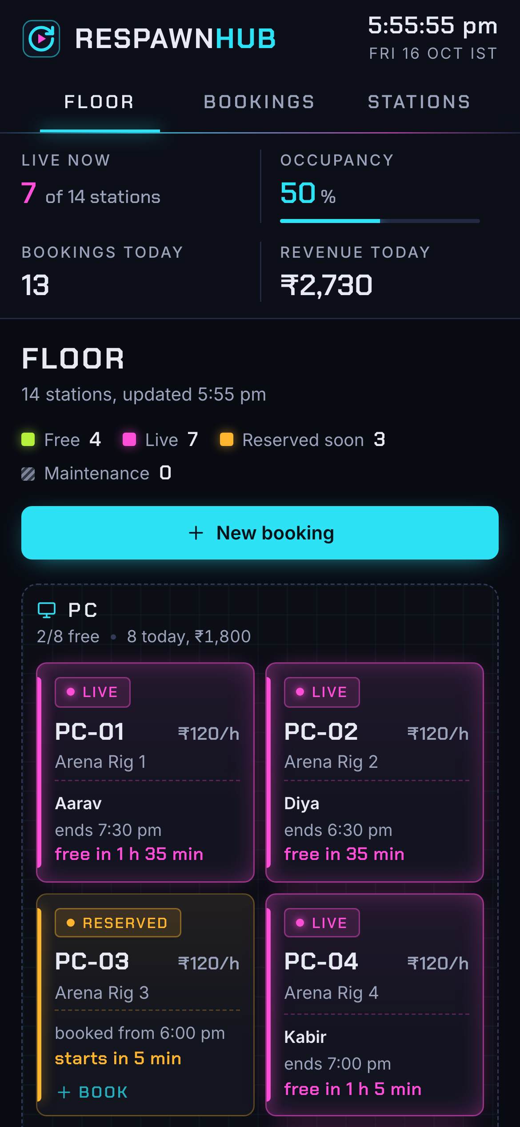
Live demo
Change the code, push, and watch the pipeline, Argo CD and the floor screen pick it up.
github.com/Ritesh381/respawnhub

