Slide 1
Kraken 2 Tutorial
Group Member: Ritesh Chidambaram, Yupei Yang
Instructor: Dr. Gail Rosen

Slide 2
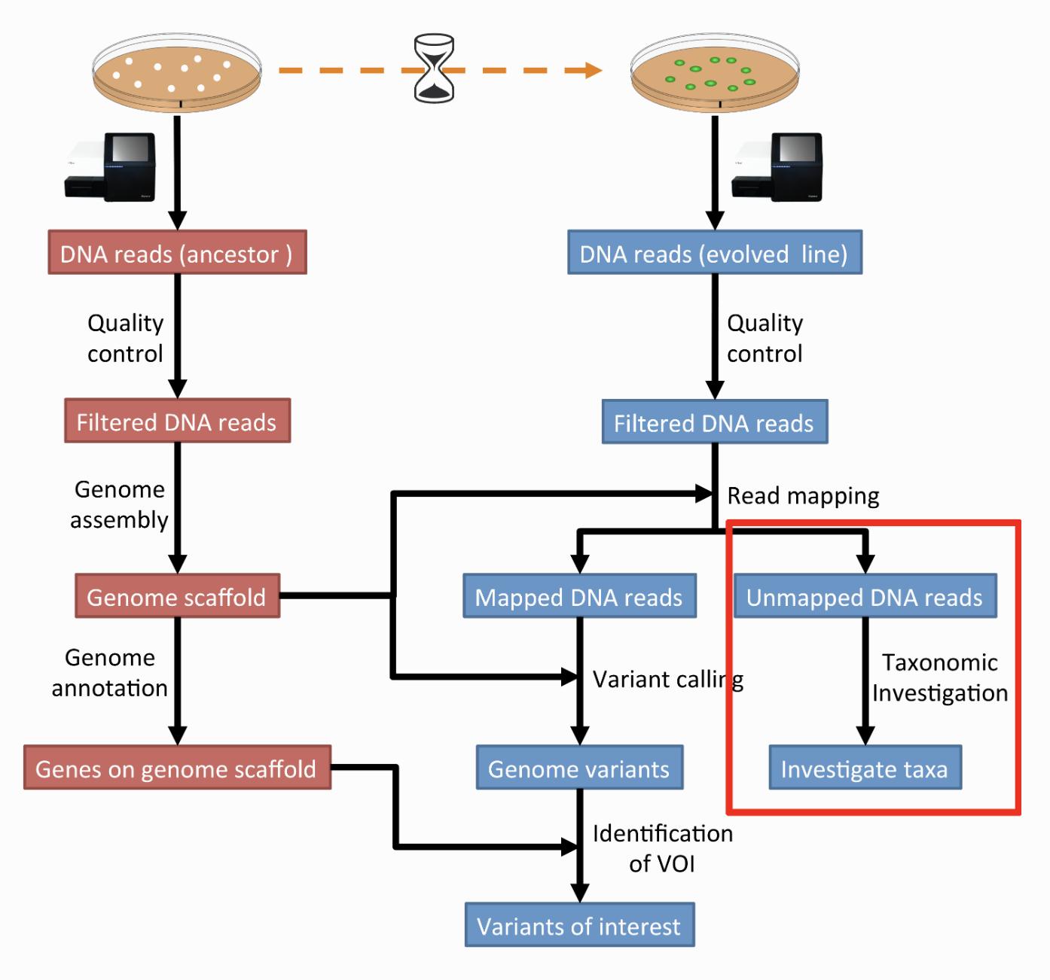
Overview
Kraken 2: Sequence Classification Tool
Assigning taxonomic labels to metagenomic DNA sequences
Notes:
Kraken 2: Sequence Classification Tool
Assigning taxonomic labels to metagenomic DNA sequences

Slide 3
Overview: K-mer to Lowest Common Ancestor (LCA) Database
Database:
contains records consisting of a k-mer and the LCA of all organisms whose genomes contain that k-mer
allows a quick lookup of the most specific node in the taxonomic tree that is associated with a given k-mer
Notes:
At the core of Kraken is a database that contains records consisting of a k-mer and the LCA of all organisms whose genomes contain that k-mer. This database, built using a user-specified library of genomes, allows a quick lookup of the most specific node in the taxonomic tree that is associated with a given k-mer. Sequences are classified by querying the database for each k-mer in a sequence, and then using the resulting set of LCA taxa to determine an appropriate label for the sequence (Figure 1 and Materials and methods). Sequences that have no k-mers in the database are left unclassified by Kraken. By default, Kraken builds the database with k = 31, but this value is user-modifiable.

Slide 4
Overview: Step
Sequences are classified by querying the database for each k-mer in a sequence
Using the resulting set of LCA taxa to determine an appropriate label for the sequence

Slide 5
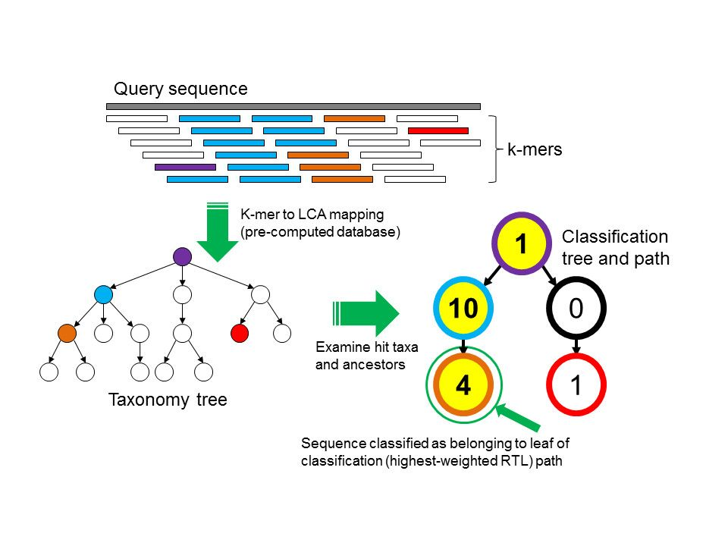
Sequence classification algorithm
Goal: To classify a DNA sequence S
Algorithm:
Collect all k-mers within that sequence into a set K(S)
Map each k-mer in K(S) to the LCA taxon of all genomes that contain that k-mer (Taxonomy Tree)
Notes:
Goal: To classify a DNA sequence S
Algorithm:
Collect all k-mers within that sequence into a set K(S)
Map each k-mer in K(S) to the LCA(Last Common Ancestor) taxon of all genomes that contain that k-mer (Taxonomy Tree)

Slide 6
Sequence classification algorithm (cont.)
Algorithm:
3. Using LCA taxa and their ancestors in the taxonomy tree form Classification Tree
each node has a weight = the number of k-mers in K(S) that mapped to the taxon associated with that node
each root-to-leaf (RTL) path is scored = the sum of all node weights along the path.
Notes:
Algorithm:
3. Using LCA taxa and their ancestors in the taxonomy tree form Classification Tree
each node has a weight = the number of k-mers in K(S) that mapped to the taxon associated with that node
each root-to-leaf (RTL) path is scored = the sum of all node weights along the path.

Slide 7
Sequence classification algorithm (cont.)
Algorithm:
4. Find the maximum scoring RTL path.(Classification Path)
=> nodes highlighted in yellow
5. The leaf of this classification path is the classification used for the query sequence
=> the orange, leftmost leaf in the classification tree
Notes:
Algorithm:
4. Find the maximum scoring RTL path.(Classification Path)
S is assigned the label corresponding to its leaf (if there are multiple maximally scoring paths, the LCA of all those paths’ leaves is selected)

Slide 8
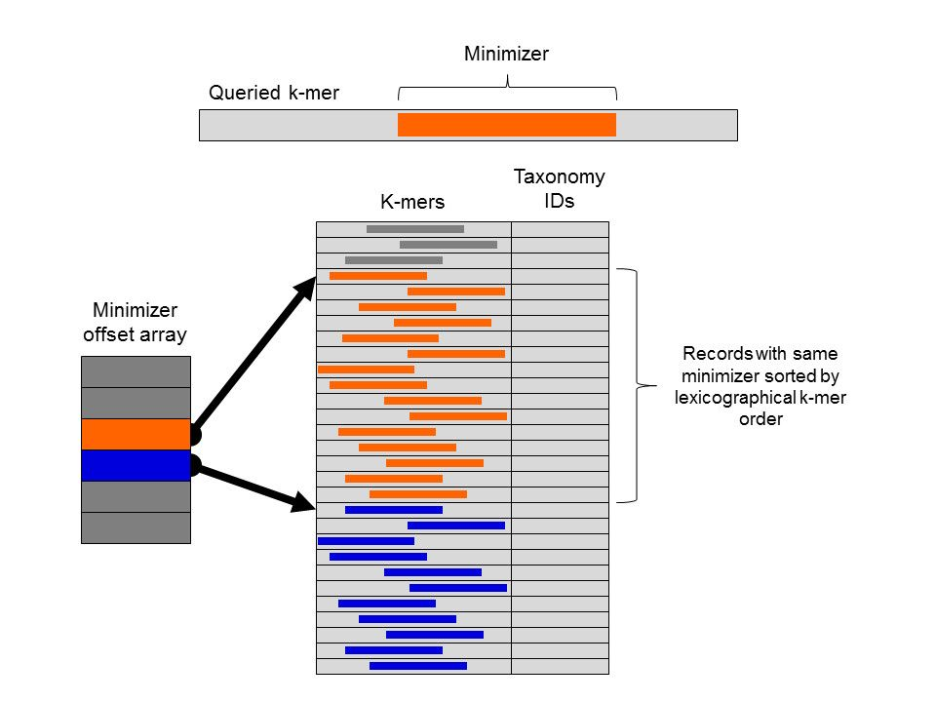
Kraken 2 Database Structure
Each queried k-mer has a specific substring that is its minimizer
examining the minimizer offset array for the start positions of records with the k-mer’s minimizer (orange) and the next possible minimizer (blue)
records are sorted by lexicographical ordering of their k-mers
Notes:
Efficient implementation of Kraken’s classification algorithm requires that the mapping of k-mers to taxa is performed by querying a pre-computed database. Kraken creates this database structure to improve the speed of searching
Each k-mer to be queried against the database has a specific substring that is its minimizer. To search for a k-mer in the database, the positions in the database that contain k-mers with the same minimizer are examined. These positions are quickly found by examining the minimizer offset array for the start positions of records with the k-mer’s minimizer (orange) and the next possible minimizer (blue). Within a range of records associated with a given minimizer, records are sorted by lexicographical ordering of their k-mers, allowing a query to be completed by using a binary search over this range.
Each queried k-mer has a specific substring that is its minimizer
examining the minimizer offset array for the start positions of records with the k-mer’s minimizer (orange) and the next possible minimizer (blue)
records are sorted by lexicographical ordering of their k-mers

Slide 9
Kraken 2 Installation
Clone the Kraken 2 in your own directory:
git clone https://github.com/DerrickWood/kraken2
Go to the directory you cloned Kraken2, export the path and install:
cd kraken2
export KRAKEN_DIR=${HOME}/kraken2
PATH=$PATH:</path/to/kraken2 folder>
./install_kraken.sh ${KRAKEN_DIR}

Slide 10
Download the Kraken 2 Database
Downloading the pre-build “minikraken” database from the Kraken2 website that can be used to assign the taxonomic labels to sequences
wget ftp://ftp.ccb.jhu.edu/pub/data/kraken2_dbs/minikraken2_v2_8GB_201904_UPDATE.tgz
Extract the archive content
tar -xvzf minikraken2_v2_8GB.tgz
Notes:
if the website doesn’t work
wget ftp://ftp.ccb.jhu.edu/pub/data/kraken2_dbs/minikraken2_v2_8GB_201904_UPDATE.tgz

Slide 11
Download the Datasets need to be classified
Download or Create a dataset need to be classified
wget http://compbio.massey.ac.nz/data/203341/trimmed.tar.gz
Extract the archive content
tar -xvzf trimmed.tar.gz

Slide 12
Using Kraken 2
To classify a set of sequences use the command : kraken2 --db $dbname seqs.fa
Options provided by Kraken2 :
Multithreading - Usage : --threads num
Quick Operation - Stops classification after first database hit instead of searching all l-mers in a sequence. Usage: --quick
Sequence filtering - Classified and unclassified data can be sent to a file for processing. Usage : --classified-out /--unclassified-out
Output redirection - Redirecting the output to a file. Usage: --output <filename>
FASTQ input - Specify the fastq option if input file is in FASTQ format. Usage: --fastq-input
Compressed input - Kraken can also handle compressed file formats. Usage: --gzip-compressed/--bzip2-compressed
Paired reads - Kraken2 is capable of handling paired read data. Rather than concatenating, provide this option to process noth files. Usage: --paired </filename1> </filename2>

Slide 13
Run Kraken 2
cd kraken2
Ensure Kraken 2 folder is in the Path. Use the below command to add to path: PATH=$PATH:/mnt/HA/groups/rosenclassGrp/Kraken_tutorial/kraken2
Running the classifier-- kraken2 --use-names --threads 4 --db </path/to/database> --fastq-input --report evolved-6 --paired <path/to/seqfile1> <path/to/seqfile2> <outputfilename.kraken>
--use-names - Used to display scientific species names along with taxonomy Ids.

Slide 14
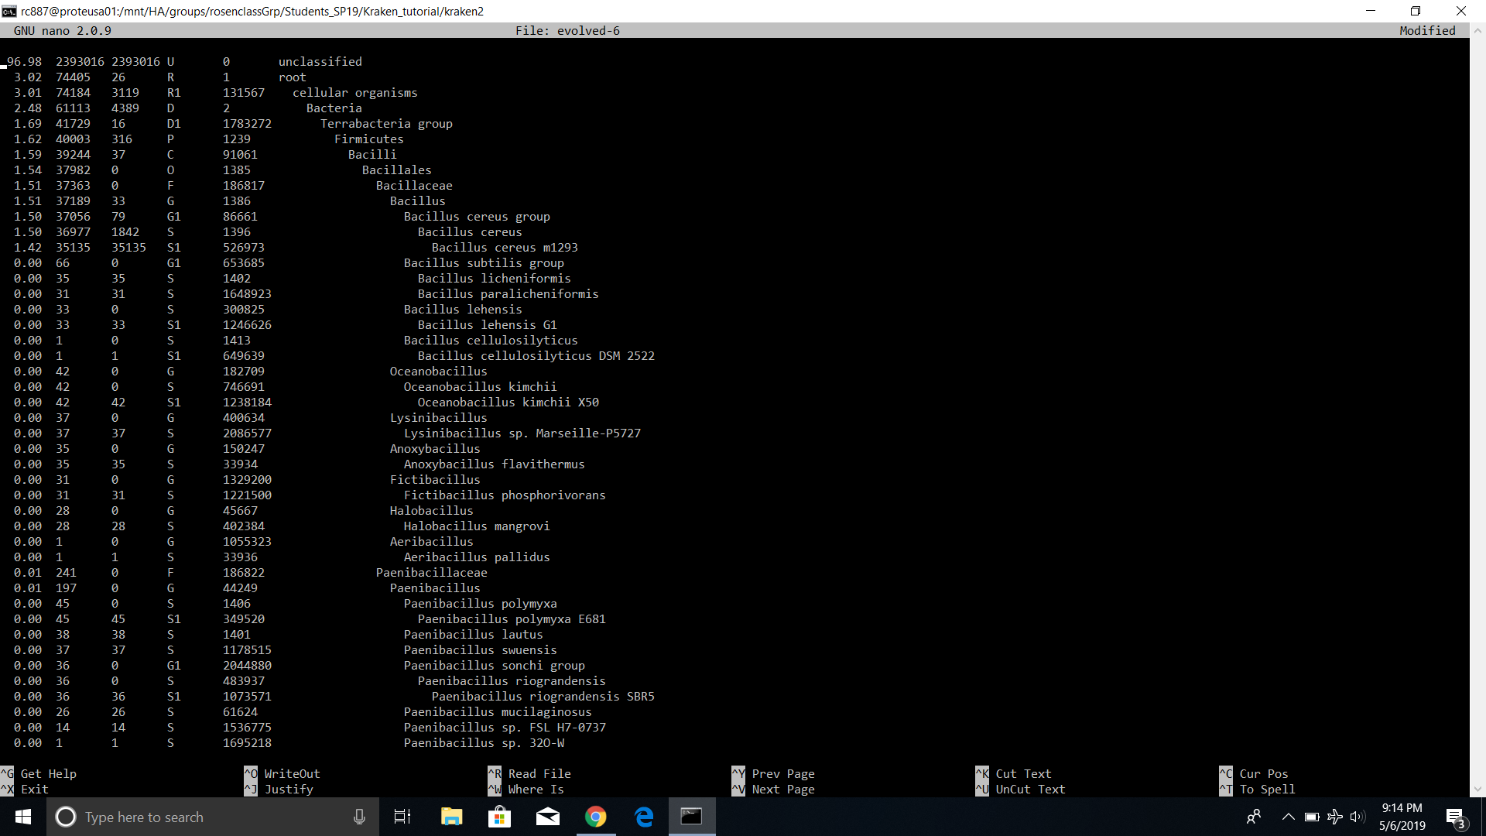
Result - Kraken Report

Slide 15
Kraken report format
The output of kraken-report is tab-delimited, with one line per taxon. The fields of the output, from left-to-right, are as follows:
Percentage of reads covered by the clade rooted at this taxon
Number of reads covered by the clade rooted at this taxon
Number of reads assigned directly to this taxon
A rank code, indicating (U)nclassified, (D)omain, (K)ingdom, (P)hylum, (C)lass, (O)rder, (F)amily, (G)enus, or (S)pecies. All other ranks are simply “-“.
NCBI Taxonomy ID
The indented scientific name

Slide 16
Reference
Kraken: ultrafast metagenomic sequence classification using exact alignments
(https://genomebiology.biomedcentral.com/articles/10.1186/gb-2014-15-3-r46)
Kraken Tutorial
(https://genomics.sschmeier.com/ngs-taxonomic-investigation/index.html)
Github
(add github link here)

