Slide 1
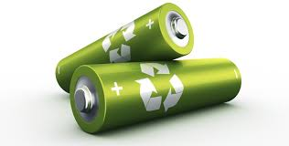
Battery
Dr. P. G. Umape
Basic Sciences and Engineering Department
Pune Institute of Computer Technology

Slide 2
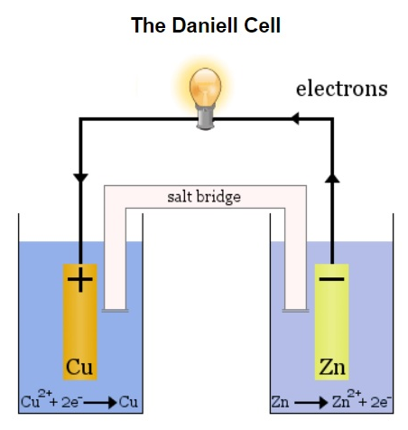
Introduction
An electrochemical cell involves the conversion of chemical energy into electrical energy (or vice versa)
through redox (reduction-oxidation) reactions.
An electrochemical cell consists of two half-cells, each
containing an electrode (usually a metal) immersed in
an electrolyte solution.
The key components and principles of an electrochemical cell are:
Electrodes
Electrolytes
Salt Bridge

Slide 3
Introduction
Electrodes
Anode: The electrode where oxidation occurs (loss of electrons). Electrons flow away from the anode in the circuit.
Cathode: The electrode where reduction occurs (gain of electrons). Electrons flow towards the cathode in the circuit.
Electrolytes
The solutions in which the electrodes are immersed contain ions that can conduct electricity. The electrolytes help in the movement of ions between the two half-cells, completing the circuit internally.

Slide 4
Introduction
Salt Bridge
In many electrochemical cells (like galvanic cells), a salt bridge is used to maintain electrical neutrality by allowing the flow of ions between the two electrolyte solutions, preventing charge buildup.

Slide 5
Working
Redox Reactions:
At the anode, the oxidation half-reaction occurs where a substance loses electrons.
At the cathode, the reduction half-reaction occurs where a substance gains electrons. These reactions are complementary and drive the flow of electrons through the external circuit, generating an electric current.
Electrons flow from the anode to the cathode through an external circuit, producing electrical energy that can be harnessed to do work

Slide 6
Types of Cell
Types of Electrochemical Cells:
Galvanic (Voltaic) Cell: Converts chemical energy into electrical energy spontaneously. For example, a battery.
Electrolytic Cell: Uses electrical energy to drive non-spontaneous chemical reactions.

Slide 7
Battery
Definition of Battery
A battery is a device that stores chemical energy and converts it into electrical energy through electrochemical reactions. It consists of one or more electrochemical cells that can generate a flow of electrons through an external circuit, providing power to electrical devices.
Types of battery
Primary (Non-Rechargeable) Batteries
Secondary (Rechargeable) Batteries
Flow Batteries
Solid-State Batteries

Slide 8
Types of Battery
Primary (Non-Rechargeable) Batteries
These batteries are designed for single-use, meaning they cannot be recharged once depleted. Once the chemical reactions inside them are complete, they need to be replaced.
Examples:
Alkaline Battery: Commonly used in household devices,
Zinc-Carbon Battery: Inexpensive and used in low-drain devices
Lithium Battery: Used in small electronics like watches and calculators due to long life and stability.

Slide 9
Types of Battery
Secondary (Rechargeable) Batteries
These batteries can be recharged and used multiple times. They allow the chemical reactions to be reversed by applying an external electrical current, restoring the original chemical state.
Examples
Nickel-Metal Hydride (NiMH) Battery: Used in hybrid vehicles and other consumer electronics; it offers better environmental safety than Ni-Cd.
Lead-Acid Battery: Common in automobiles for starting engines; known for high power output and reliability.
Lithium-Ion (Li-ion) Battery: Widely used in mobile phones, laptops, and electric vehicles (EVs) due to high energy density and long cycle life.
Nickel-Cadmium (Ni-Cd) Battery: Used in industrial applications and some cordless tools; it is known for durability but has environmental concerns due to toxic cadmium.

Slide 10
Types of Battery
Flow Batteries
A special type of rechargeable battery where energy is stored in liquid electrolytes that flow through a system. These are scalable and often used for large energy storage applications like grid energy storage.
Examples Fuel cells
Vanadium Redox Flow Battery (VRFB): Suitable for large-scale energy storage, such as solar or wind farms.
Solid-State Batteries
These are advanced batteries where both the electrolyte and electrodes are solid rather than liquid or gel-based. Solid-state batteries promise higher energy density and improved safety compared to traditional batteries. They are still largely in development.

Slide 11
Characteristics of Battery
Voltage (Nominal Voltage)
Definition: The electrical potential difference between the positive and negative terminals of the battery. It is a measure of the battery's ability to drive electric current.
Typical Values: Varies based on the battery type (e.g., 1.5V for alkaline batteries, 3.7V for lithium-ion batteries).
Capacity (Ah or mAh)
Definition: The amount of charge a battery can store, usually expressed in ampere-hours (Ah) or milliampere-hours (mAh).
Significance: The larger the capacity, the longer the battery can power a device before needing a recharge or replacement.
Energy Density
Definition: The amount of energy stored in a battery relative to its weight (specific energy, in Wh/kg) or volume (energy density, in Wh/L).
Significance: Higher energy density means the battery can store more energy in a smaller or lighter package. This is critical for portable devices and electric vehicles.

Slide 12
Characteristics of Battery
Power Density
Definition: The amount of power (energy per unit time) that a battery can deliver relative to its weight (W/kg) or volume (W/L).
Significance: Batteries with high power density can deliver large amounts of power quickly, useful in applications requiring high bursts of energy, such as electric cars during acceleration.
Cycle Life (Charge/Discharge Cycles)
Definition: The number of charge and discharge cycles a battery can undergo before its capacity drops below a specified level (usually 80% of its original capacity).
Significance: A longer cycle life means the battery can be used more times before it needs to be replaced. It is a key metric for rechargeable batteries like lithium-ion.

Slide 13
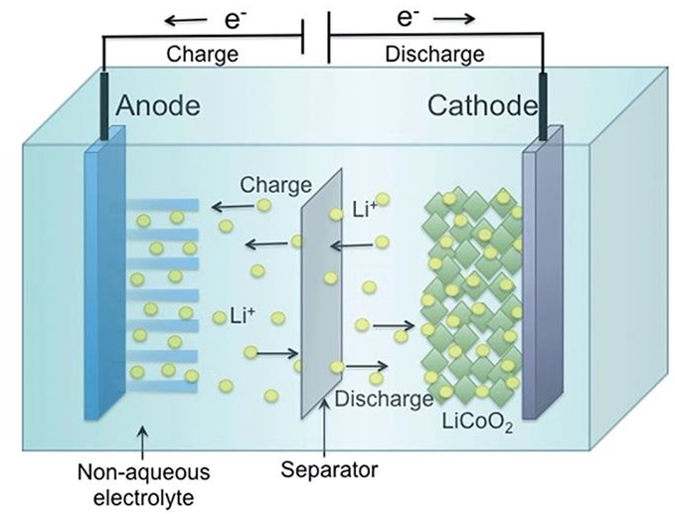
Li-Ion battery

Slide 14
Li-Ion battery
Construction of a Lithium-ion Battery
A Lithium-ion (Li-ion) battery consists of the following key components:
Anode (Negative Electrode):
  Typically made of graphite.
  During charging, lithium ions move from the cathode and are stored between the layers of the graphite (Intercalated).
  Cathode (Positive Electrode):
  Commonly made from lithium metal oxides, such as lithium cobalt oxide (LiCoO₂), lithium iron phosphate (LiFePO₄), or lithium nickel manganese cobalt oxide (LiNiMnCoO₂).
  This electrode serves as the source of lithium ions.

Slide 15
Li-Ion battery
Construction of a Lithium-ion Battery
Electrolyte:
A liquid or gel-like substance that facilitates the movement of lithium ions between the anode and cathode.
Commonly made from lithium salts, such as lithium hexafluorophosphate (LiPF₆), dissolved in organic solvents like ethylene carbonate or dimethyl carbonate.
Separator:
A thin, porous membrane placed between the anode and cathode.
Prevents the electrodes from coming into direct contact while allowing lithium ions to pass through.
Current Collectors:
Made from copper (at the anode) and aluminum (at the cathode), these collect and transfer electrons to the external circuit.

Slide 16
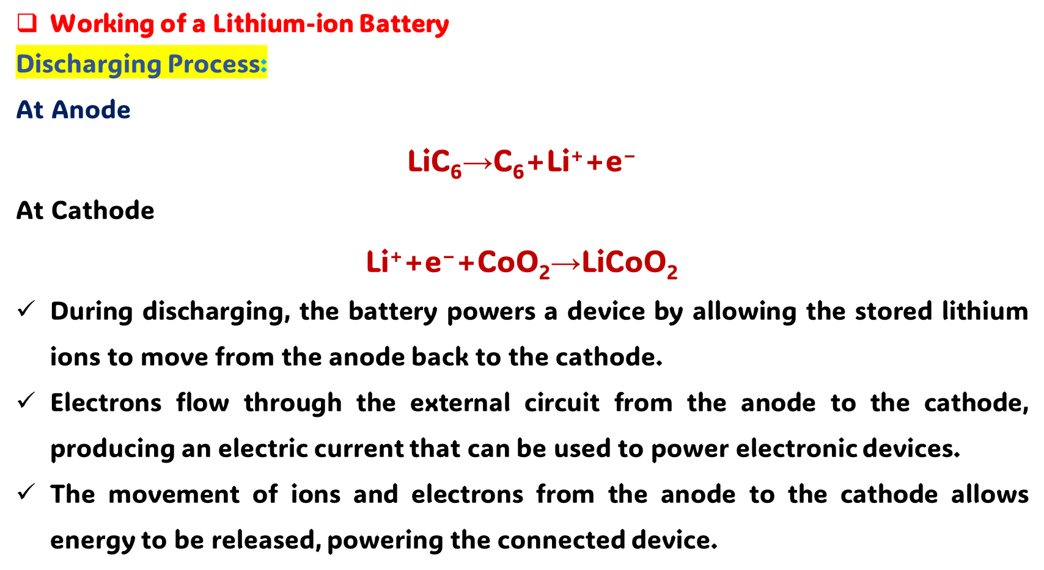
Li-Ion battery

Slide 17
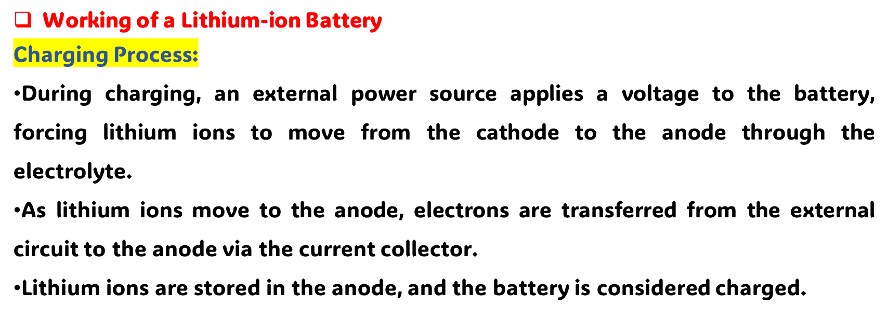
Li-Ion battery
At Cathode
LiCoO₂ ​→ Li⁺+e⁻+CoO₂
At Anode
C₆​+Li⁺+e⁻ ​→LiC₆

Slide 18
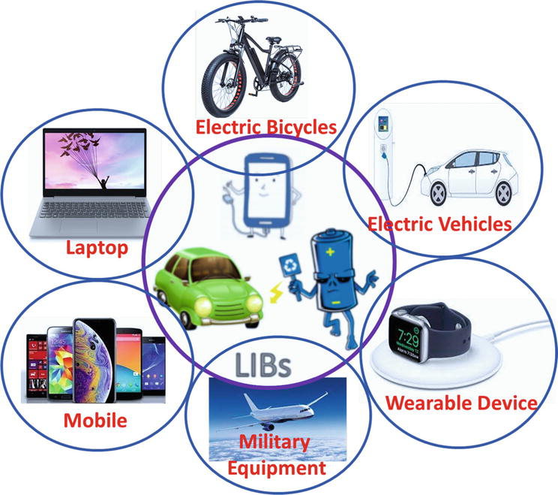
Li-Ion battery
Li-ion batteries are popular due to their high energy density, long cycle life, and lightweight characteristics, making them ideal for use in portable electronics, electric vehicles, and renewable energy storage systems.

