Slide 1
TCS Stock Performance Analysis
Financial Analytics | Ritesh Deepak Mengade
End-to-end stock market analysis using Python and Power BI to evaluate price trends, volatility, and investment signals.

Slide 2
Business Objective & Data Pipeline
Business Objectives :-
Track historical stock price performance
Analyze volatility and return patterns
Identify trend direction and momentum
Support data-driven investment insights
Analytical Approach :-
Time-series preprocessing and validation
Feature engineering for returns and trends
SQL-backed data consistency checks
Power BI financial dashboard creation
Visual analytics for market behavior

Slide 3
Advanced Dashboard Capabilities
Key Features :-
Dynamic KPI monitoring and interactive filtering
Time-series trend analysis for performance tracking
Top-N entity analysis for concentration insights
Advanced visual analytics for pattern detection
SQL validation and data quality checks
Executive-ready visual storytelling

Slide 4
Key Insights & Business Impact
Strategic Findings :-
Stock shows identifiable long-term trend phases
Volatility clusters during market stress periods
Price momentum provides actionable signals
Dashboard supports quick investor assessment
Framework extensible for predictive modeling
Prepared by Ritesh Deepak Mengade | Data Analyst Portfolio

Slide 5
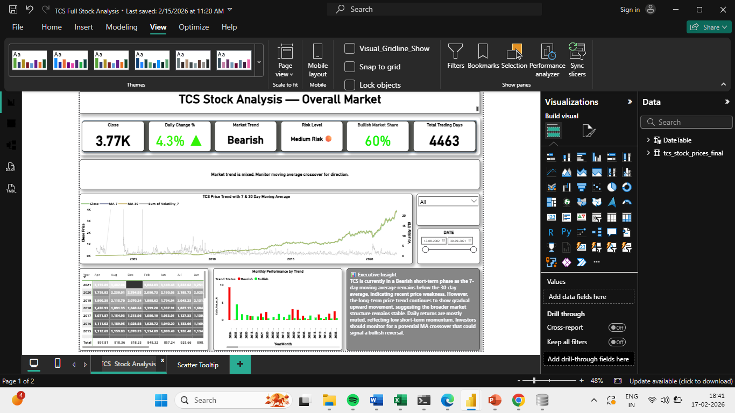
TCS Stock Analysis

Slide 6
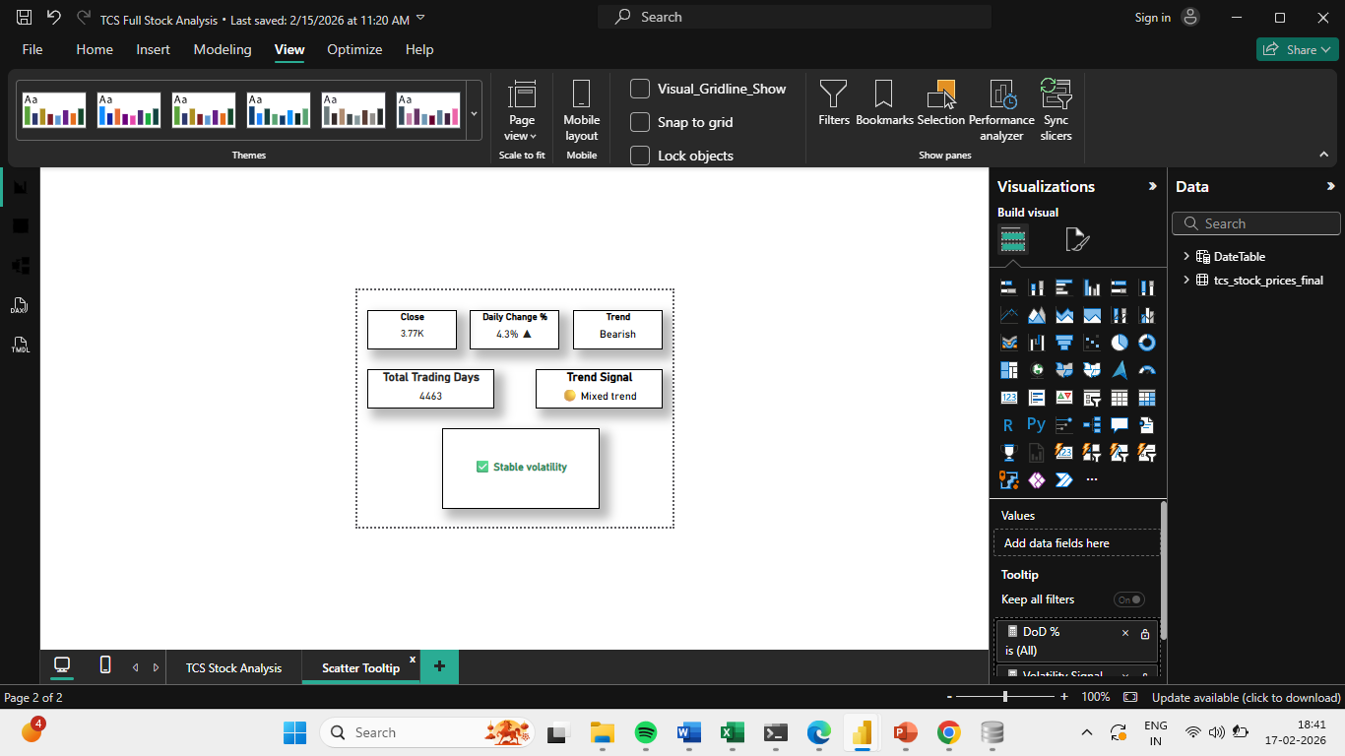
Scatter ToolTip

