Slide 1
Uber Sales Analysis Dashboard
Ride Analytics | Ritesh Deepak Mengade
Comprehensive ride analytics using Python, SQL, and Power BI to uncover demand patterns, revenue drivers, and operational insights.

Slide 2
Business Objective & Data Pipeline
Business Objectives :-
Analyze ride demand trends across time and locations
Identify peak hours and high-demand zones
Evaluate revenue and trip performance
Support operational decision-making
Analytical Approach :-
Data cleaning and transformation using Python
SQL aggregation for trip validation
Time-based feature engineering
Interactive Power BI dashboard design
Performance-focused modeling

Slide 3
Advanced Dashboard Capabilities
Key Features :-
Dynamic KPI monitoring and interactive filtering
Time-series trend analysis for performance tracking
Top-N entity analysis for concentration insights
Advanced visual analytics for pattern detection
SQL validation and data quality checks
Executive-ready visual storytelling

Slide 4
Key Insights & Business Impact
Strategic Findings :-
Ride demand shows strong time-of-day seasonality
Peak hours contribute disproportionate revenue share
Location-based demand varies significantly
Data-driven insights support fleet optimization
Dashboard enables real-time operational visibility
Prepared by Ritesh Deepak Mengade | Data Analyst Portfolio

Slide 5
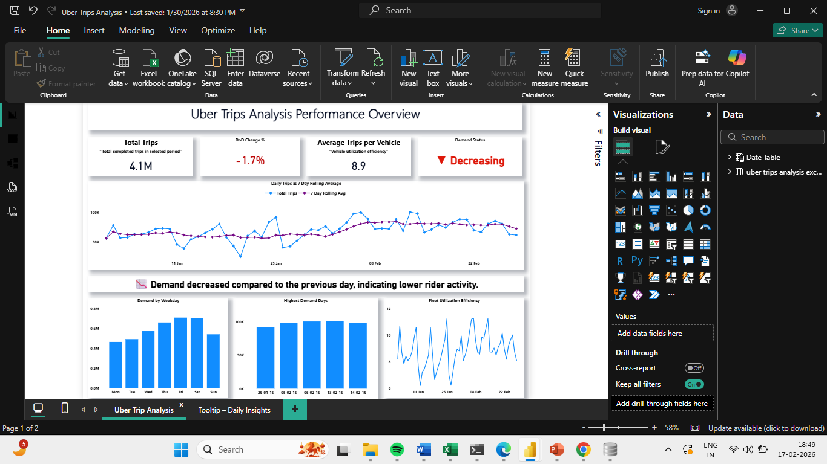
Uber Trip Analysis

Slide 6
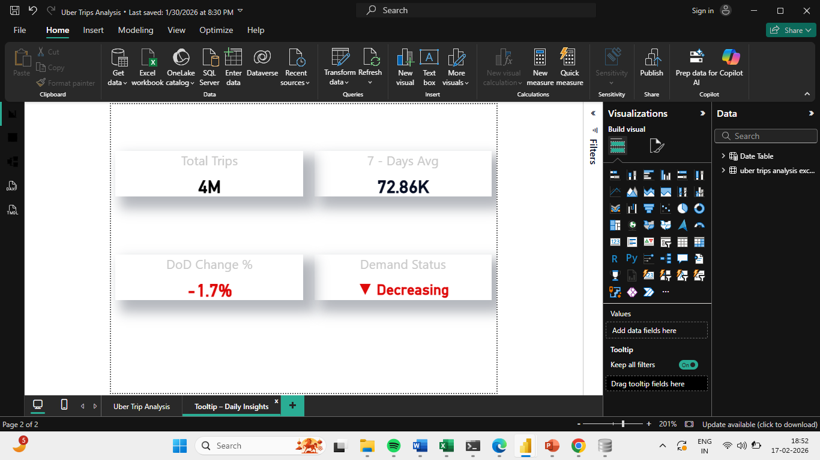
Tooltip – Daily Insights

