Slide 1

TIME MANAGEMENT STRATEGIES I USED TO IMPROVE MYSELF
By Ritesh Jha

Slide 2


IMPORTANCE OF GOOD TIME-MANAGEMENT
By consciously managing time, individuals can make the most of their day, accomplish goals more effectively, and create opportunities for personal and professional growth.
Effectively managing time not only enhances productivity but also reduces stress, enabling individuals to strike a harmonious balance between work, leisure, and personal well-being.
Therefore,Time is a precious resource and managing it wisely is the key to success.

Slide 3
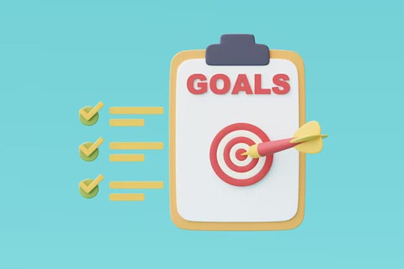


STRATEGIES TO IMPROVE TIME MANAGEMENT
SET CLEAR GOALS
Establish specific, achievable, and time-bound goals.
CREATE A TO-DO LIST
Maintain an updated, prioritized task list to manage important tasks effectively.
On your smartphone / a diary
MINIMIZE DISTRACTIONS
Cut distractions for improved focus: silence notifications, find quiet spaces, or use apps to block distracting sites.

Slide 4

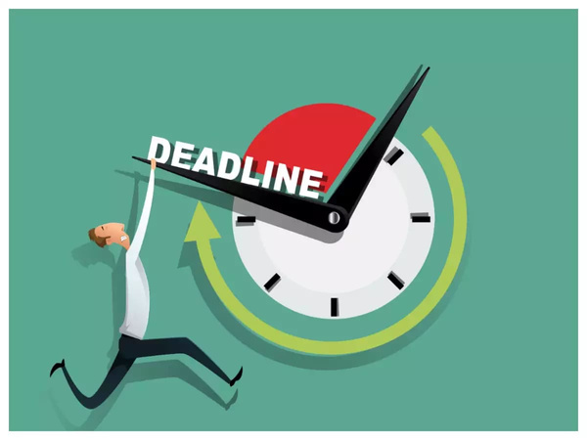

LIMIT MULTITASKING
Single-tasking enhances productivity and reduces errors from divided attention.
SET REALISTIC DEADLINES
Set ‘achievable’ deadlines to manage time effectively and create a sense of urgency.
TAKE REGULAR BREAKS
Take breaks to maintain productivity by prioritizing your well-being.

Slide 5

Pomodoro Technique
A FEW OF THE FAMOUS TIME-MANAGEMENT TECHNIQUES ARE MENTIONED HERE FOR THOSE OF YOU WHO ARE INTERESTED IN READING ABOUT THEM
The Ivy Lee Method
Timeboxing
Pareto Principle (80/20 Rule)
Urgent-Important Matrix
Zen to Done (ZTD) Approach

Slide 6

KEY TAKEAWAYS :
Effective strategies transformed my productivity.
Prioritization, scheduling, and goal-setting drive success.
Self-assessment and adaptation are vital for ongoing improvement.
VISIBLE EFFECTS :
Increased Productivity
Improved Decision Making
Self-Discipline and Focus
Improved Quality of Work
Work-Life Balance
Stress Reduction

Slide 7
CONCLUSION
CONTINUAL JOURNEY
Practice and staying determined help time management skills get better over time.
Regular practice and a flexible mindset are key for improving time management skills and maintaining ongoing success.
Being flexible and improving strategies is really important for continued success.
“YOU WILL NEVER FIND TIME FOR ANYTHING. IF YOU WANT TIME YOU MUST MAKE IT."
- Charles Buxton

Slide 8
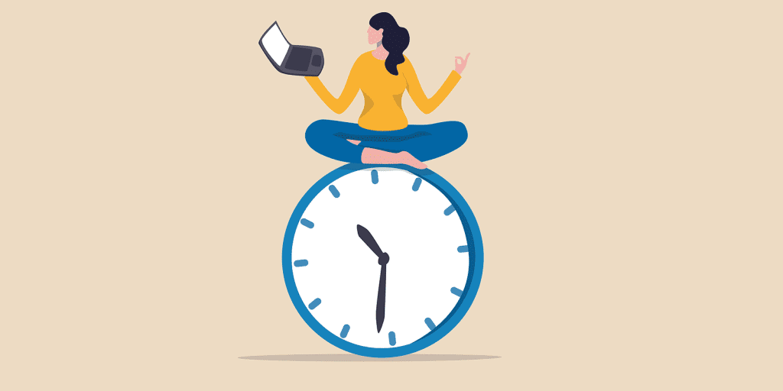
THANK YOU

