Slide 1
AWS Training topics
CI/CD pipeline
CI Tools basics (Jenkin/bamboo/concourse)
CD Tools Basic (Anisible/Chef/pupet)
Automation build tools(Terraform/Packer)
GIT/CodeCommit/CodeDepoly OverView

Slide 2
                Infra automation - Terraform
Terraform is a tool for building, changing, and versioning infrastructure safely and efficiently. Terraform can manage existing and popular service providers as well as custom in-house solutions.
The key features of Terraform are:
»Infrastructure as Code
Infrastructure is described using a high-level configuration syntax. This allows a blueprint of your datacenter to be versioned and treated as you would any other code. Additionally, infrastructure can be shared and re-used.
»Execution Plans
  Terraform has a "planning" step where it generates an execution plan. The execution plan shows what Terraform will do when you call apply. This lets you avoid any surprises when Terraform manipulates infrastructure.
»Resource Graph
  Terraform builds a graph of all your resources, and parallelizes the creation and modification of any non-dependent resources. Because of this, Terraform builds infrastructure as efficiently as possible, and operators get insight into dependencies in their infrastructure.
»Change Automation
  Complex changesets can be applied to your infrastructure with minimal human interaction. With the previously mentioned execution plan and resource graph, you know exactly what Terraform will change and in what order, avoiding many possible human errors.

Slide 3
Installation:
Terraform is packaged as a zip archive.
After downloading Terraform, unzip the package. Terraform runs as a single binary named terraform. Any other files in the package can be safely removed and Terraform will still function.
The final step is to make sure that the terraform binary is available on the PATH.
Setting env on windows :
  goto control panel -> System -> Advanced System settings* -> Environment Variables -> Scroll down in system variables until you find PATH click edit and change accordingly. BE SURE to include a semicolon at the end of the previous as that is the delimiter ie c:\path;c:\path2;/d/terraform
  You will need to launch a new console for the settings to take effect.
Setting env on Linux :
  You need to add it to your ~/.profile or ~/.bashrc file.
  export PATH=$PATH:/path/to/dir
  Depending on what you're doing, you also may want to symlink to binaries:
  cd /usr/bin
  sudo ln -s /path/to/binary binary-name
  Verify Terraform installation :
    $ terraform
    Usage: terraform [--version] [--help] <command> [args]
  Configuration:
  provider "aws" {
  access_key = "ACCESS_KEY_HERE"
  secret_key = "SECRET_KEY_HERE"
  region = "us-east-1"
  }

Slide 4
https://github.com/hashicorp/terraform → Open issue / closed
https://www.hashicorp.com/blog/category/terraform --> Posted Blogs
https://www.hashicorp.com/blog/terraform-announcement TF announce
https://www.terraform.io/downloads.html → TF documentation https://www.terraform.io/downloads.html - New version download https://releases.hashicorp.com/terraform/ - Older version download
Configuration Syntax
The syntax of Terraform configurations is called HashiCorp Configuration Language (HCL). It is meant to strike a balance between human readable and editable as well as being machine-friendly. For machine-friendliness, Terraform can also read JSON configurations.
Sample Example
  # An AMI
  variable "ami" {
  description = "the AMI to use"
  }
  /* A multi
  line comment. */
  resource "aws_instance" "web" {
  ami = "${var.ami}"
  count = 2
  source_dest_check = false
  connection {
  user = "root"
  }
  }

Slide 5
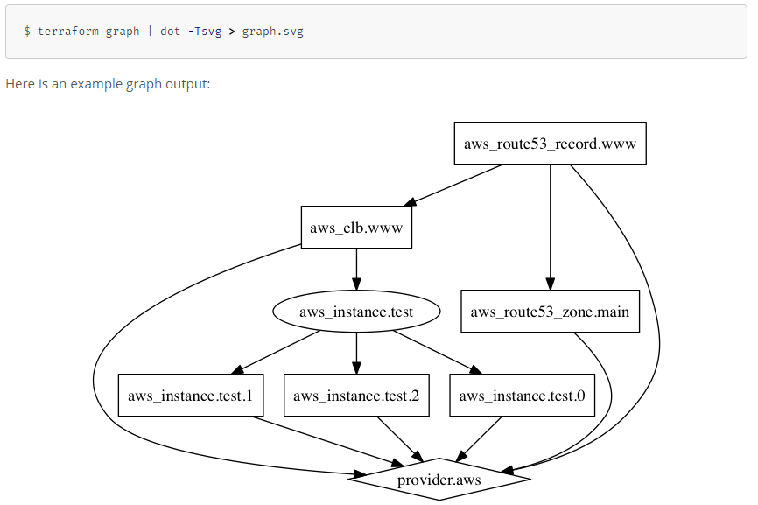
To get help for any specific command, pass the -h flag to the relevant subcommand. For example, to see help about the graph subcommand:

Slide 6
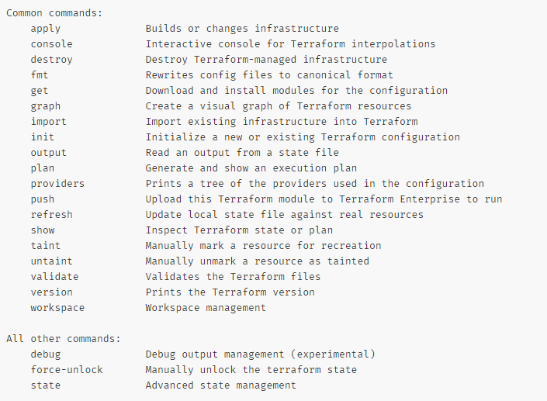
https://www.terraform.io/docs/providers/aws/
https://github.com/terraform-aws-modules/terraform-aws-ec2-instance/blob/master/examples/basic/main.tf

Slide 7
AWS code Build
AWS CodeBuild is a fully managed build service that compiles source code, runs tests, and produces software packages that are ready to deploy. With CodeBuild, you don’t need to provision, manage, and scale your own build servers. CodeBuild scales continuously and processes multiple builds concurrently, so your builds are not left waiting in a queue. You can get started quickly by using prepackaged build environments, or you can create custom build environments that use your own build tools.
  Pay as You Go
    With AWS CodeBuild, you are charged based on the number of minutes it takes to complete your build. This means you no longer have to worry about paying for idle build server capacity.
  Secure
    With AWS CodeBuild, your build artifacts are encrypted with customer-specific keys that are managed by the AWS Key Management Service (KMS). CodeBuild is integrated with AWS Identity and Access Management(IAM), so you can assign user-specific permissions to your build projects.
  Continuous Scaling
    AWS CodeBuild scales automatically to meet your build volume. It immediately processes each build you submit and can run separate builds concurrently, which means your builds are not left waiting in a queue.
  Fully Managed Build Service
    AWS CodeBuild eliminates the need to set up, patch, update, and manage your own build servers and software. There is no software to install or manage.

Slide 8
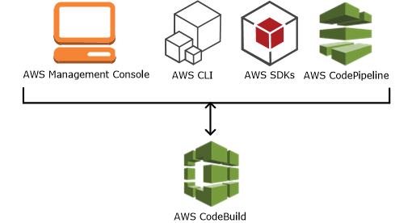
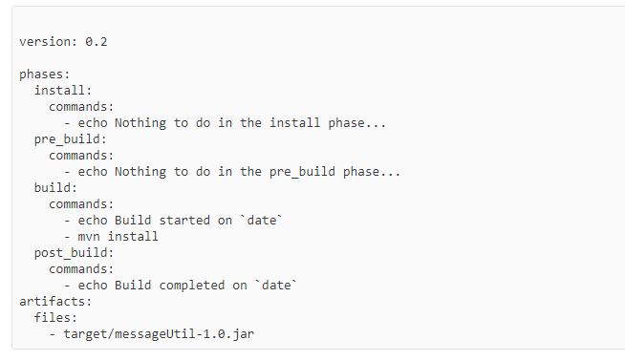
Run AWS CodeBuild:
To run AWS CodeBuild by using the AWS CodeBuild console, AWS CLI, AWS SDKs,

Slide 9
Step 1: Create or Use Amazon S3 Buckets to Store the Build Input and Output
Step 2: Create the Source Code to Build
Step 3: Create the Build Spec
Step 4: Add the Source Code and the Build Spec to the Input Bucket
Step 5: Create the Build Project
Step 6: Run the Build
Step 7: View Summarized Build Information
Step 8: View Detailed Build Information
Step 9: Get the Build Output Artifact

Slide 10
AWS CodeDeploy:
AWS CodeDeploy is a deployment service that automates application deployments to
EC2/On Instances
Serverless Lambda functions.
Benefits of AWS CodeDeploy
  Server and serverless applications.
  Automated deployments.
  Minimize downtime.
  Stop and roll back.
AWS CodeDeploy is able to deploy applications to two compute platforms:
EC2/On-Premises
AWS Lambda
AWS CodeDeploy provides two deployment type options:
In-place deployment:
  The application on each instance in the deployment group is stopped, the latest application revision is installed, and the new version of the application is started and validated. You can use a load balancer so that each instance is deregistered during its deployment and then restored to service after the deployment is complete.
Note
AWS Lambda compute platform deployments cannot use an in-place deployment type.
Blue/green deployment:
The behavior of your deployment depends on which compute platform you use:
Blue/green on an EC2/On-Premises compute platform: The instances in a deployment group (the original environment) are replaced by a different set of instances (the replacement environment)

Slide 11
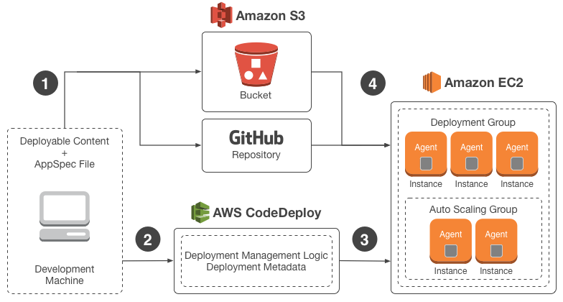


Slide 12
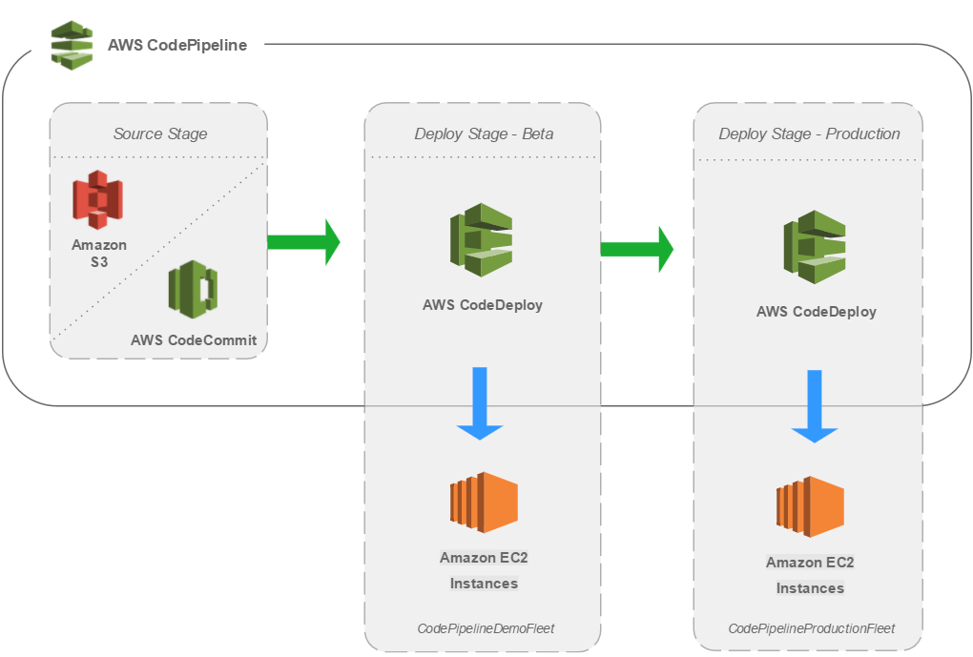
CI – CD Pipeline
A pipeline helps you automate steps in your software delivery process, such as initiating automatic builds and then deploying to Amazon EC2 instances. You will use AWS CodePipeline, a service that builds, tests, and deploys your code every time there is a code change, based on the release process models you define.
Use CodePipeline to orchestrate each step in your release process. As part of your setup, you will plug other AWS services into CodePipeline to complete your software delivery pipeline.

Slide 13
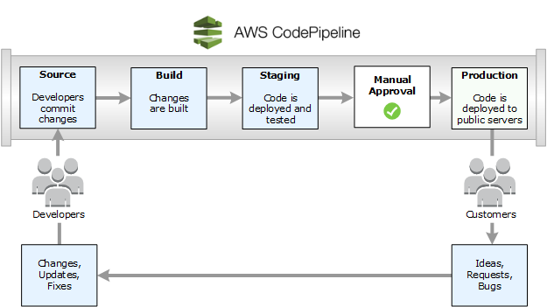
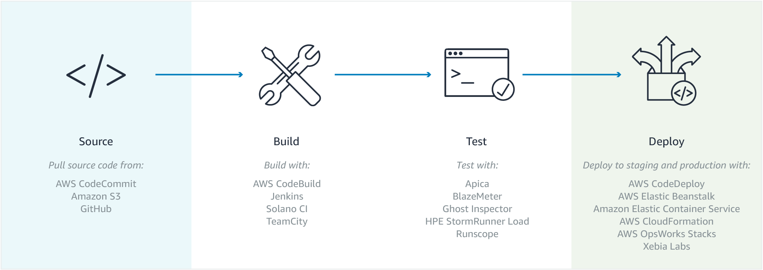

Slide 14
Can do with AWS CodePipeline
You can use AWS CodePipeline to help you automatically build, test, and deploy your applications in the cloud. Specifically, you can:
  Automate your release processes: AWS CodePipeline fully automates your release process from end to end, starting from your source repository through build, test, and deployment. You can prevent changes from moving through a pipeline by including a manual approval action in any stage except a Source stage. You can automatically release when you want, in the way you want, on the systems of your choice, across one instance or multiple instances.
  Establish a consistent release process: Define a consistent set of steps for every code change. AWS CodePipeline runs each stage of your release according to your criteria.
  Speed up delivery while improving quality: You can automate your release process to allow your developers to test and release code incrementally and speed up the release of new features to your customers.
  View progress at-a-glance: You can review real-time status of your pipelines, check the details of any alerts, retry failed actions, view details about the source revisions used in the latest pipeline execution in each stage, and manually rerun any pipeline.
  View pipeline history details: You can view details about executions of a pipeline, including start and end times, run duration, and execution IDs.

Slide 15
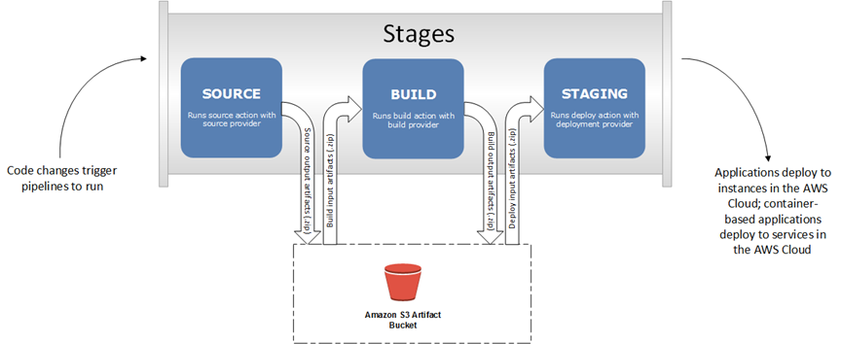
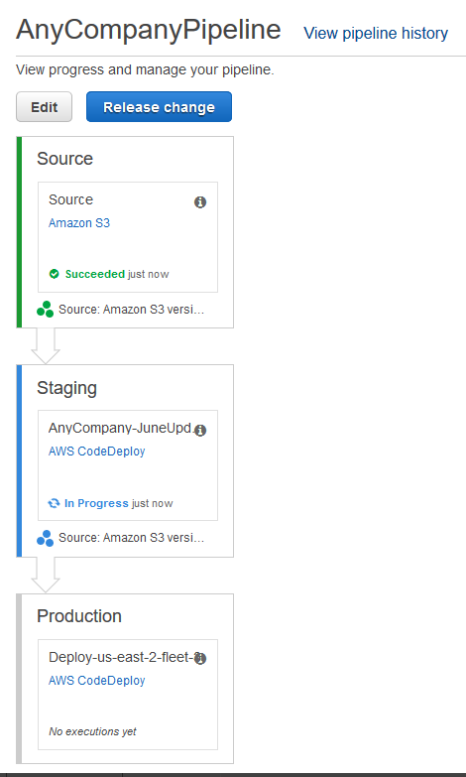

Slide 16
Continuous delivery is a software development methodology where the release process is automated. Every software change is automatically built, tested, and deployed to production. Before the final push to production, a person, an automated test, or a business rule decides when the final push should occur. Although every successful software change can be immediately released to production with continuous delivery, not all changes need to be released right away.
Continuous integration is a software development practice where members of a team use a version control system and frequently integrate their work to the same location, such as a master branch. Each change is built and verified to detect integration errors as quickly as possible. Continuous integration is focused on automatically building and testing code, as compared to continuous delivery, which automates the entire software release process up to production.
    10 popular CI/CD tools
      Jenkins
      TeamCity
      Travis
      Go CI-CD
      Bamboo
      GitLab
      Circle CI-CD
      Codeship
      Concourse
      codefresh

Slide 17
CI Tools basics – Jenkins
Jenkins is the most popular tool to do Continuous Integration and Continuous Delivery of your software:
It’s free and open source
It has a strong community with thousands of plugins you can use
Jenkins is used in a lot of companies, from startups to enterprises
integrate Jenkins Pipelines with popular software tools, like:
  Docker
  GitHub / Bitbucket
  JFrog Artifactory
  SonarQube
  Onelogin (Using SAML)
  Maven
  Ant
  Jira
  Confluence
If you’re looking for DevOps space, Jenkins is a must have skill.

Slide 18
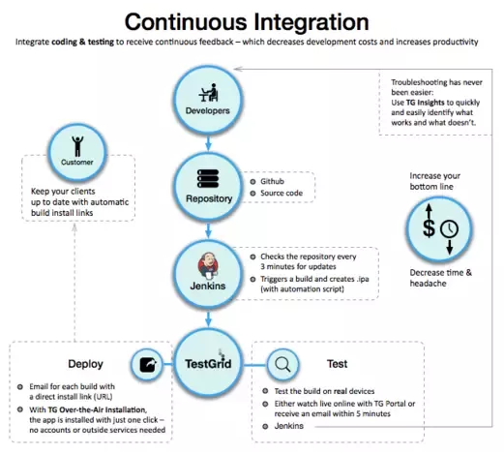

Slide 19
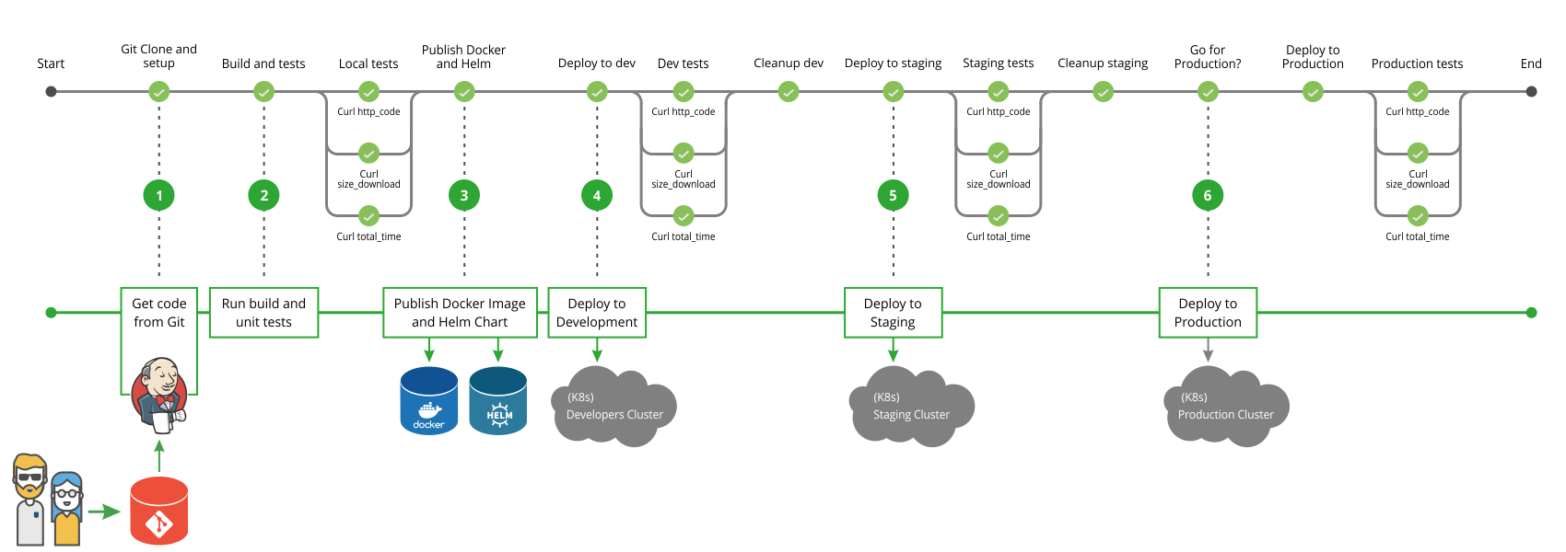

Slide 20
Get code from Git
  Developer pushes code to Git, which triggers a Jenkins build webhook.
  Jenkins pulls the latest code changes.
Run build and unit tests
  Jenkins runs the build.
  Application’s Docker image is created during the build.- Tests run against a running Docker container.
Publish Docker image and Helm Chart
  Application’s Docker image is pushed to the Docker registry.
  Helm chart is packed and uploaded to the Helm repository.
Deploy to Development
  Application is deployed to the Kubernetes development cluster or namespace using the published Helm chart.
  Tests run against the deployed application in Kubernetes development environment.
Deploy to Staging
  Application is deployed to Kubernetes staging cluster or namespace using the published Helm chart.
  Run tests against the deployed application in the Kubernetes staging environment.
[Optional] Deploy to Production
  The application is deployed to the production cluster if the application meets the defined criteria. Please note that you can set up as a manual approval step.
  Sanity tests run against the deployed application.
  If required, you can perform a rollback.

Slide 21
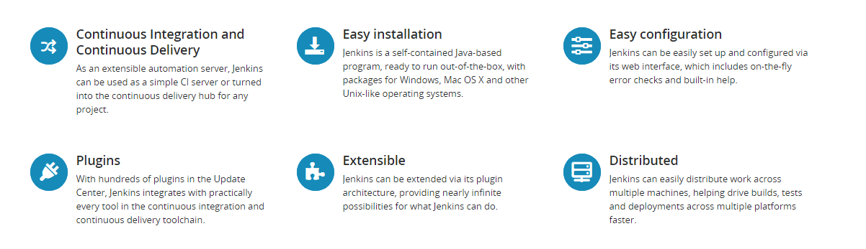

Slide 22
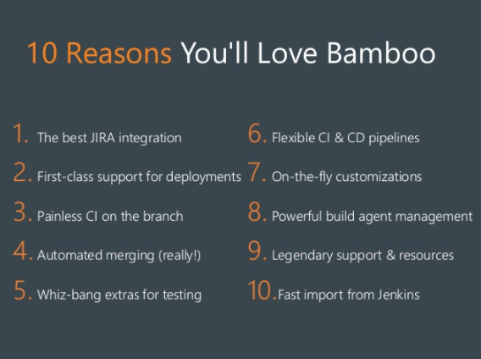
Bamboo:
Bamboo is a continuous integration server from Atlassian. Its purpose is to provide developers with an environment which quickly compiles code for testing so that release cycles can be quickly implemented in production, while giving full traceability from the feature request all the way to its deployment.
Benefits :
Atlassian’s Bamboo really shines for developers who are using other Atlassian products such as Jira and Stash. Bamboo is also quite easy to use and supports Continuous Integration to Continuous Delivery.

Slide 23
                Concourse
Concourse is a CI/CD system remastered for teams that practice agile development and need to handle complex delivery permutations. Concourse was conceived because of Pivotal engineers’ frustrations with existing continuous integration (CI) systems. Discover a fresh approach with Concourse when you need to:
Automate test-driven development
Maintain compatibility between multiple build versions
Target multiple platforms and configurations such as different clouds
Deliver frequently—weekly, daily, or even multiple times a day

Slide 24
AWS CodeCommit
AWS CodeCommit is a version control service hosted by Amazon Web Services that you can use to privately store and manage assets (such as documents, source code, and binary files) in the cloud
With AWS CodeCommit, we can do below:
  Benefit from a fully managed service hosted by AWS.
  Store your code securely.
  Work collaboratively on code.
  Easily scale your version control projects.
  Store anything, anytime.
  Integrate with other AWS and third-party services. AWS Cloud9, CloudWatch Events AWS CodeStar,…etc
  Easily migrate files from other remote repositories.

Slide 25
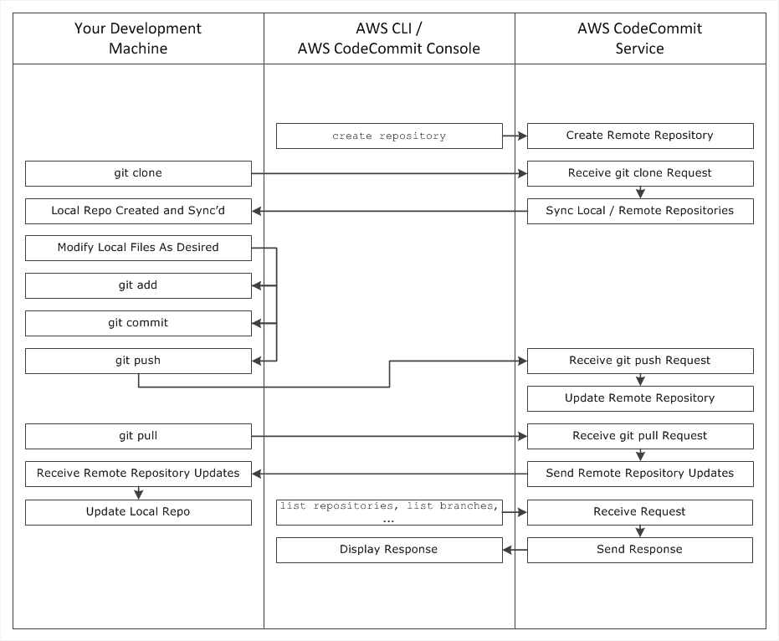
AWS CodeCommit Work

Slide 26
Create tag for the commit:
    VEERAMX1@IP-AC1FBC35 MINGW64 /d/Muniyappan/commit-TF/tf-vpc (feature/BIS-28-versioned-modules)
    $ git tag 1.0.0
    VEERAMX1@IP-AC1FBC35 MINGW64 /d/Muniyappan/commit-TF/tf-vpc-peer (feature/BIS-28-versioned-modules)
    $ git push origin : 1.0.0
    Counting objects: 1, done.
    Writing objects: 100% (1/1), 168 bytes | 0 bytes/s, done.
    Total 1 (delta 0), reused 0 (delta 0)
    To ssh://bitbucket.aipadmin.com/bis/tf-vpc-peer.git
    * [new tag] 1.0.0 -> 1.0.0
Multiple commit into single commit:
  git rebase -i HEAD~8
Branch rebase :
git clone -b “xxxxxxx” repository-url
git checkout "master"
git rebase master
git rebase master bugfix/BIS-1598-remove-duplicate-file-upload-bucket
git rebase --continue
git add .
git commit -m "Rebased"
git push

Slide 27
Change git commit message after push:
VEERAMX1@IP-AC1FBC35 MINGW64 /d/working/Nov/nov-06/bis-infra-aws (bugfix/BIS-2168-dq-analysis-priority-queue)
$ git commit --amend -m "BIS-2721 Added data-quality bucket access for DQ compute env instance role"
[bugfix/BIS-2168-dq-analysis-priority-queue 3c00c41] BIS-2721 Added data-quality bucket access for DQ compute env instance role
Date: Mon Nov 6 12:34:20 2017 +0530
1 file changed, 25 insertions(+)
VEERAMX1@IP-AC1FBC35 MINGW64 /d/working/Nov/nov-06/bis-infra-aws (bugfix/BIS-2168-dq-analysis-priority-queue)
$ git push -f
Counting objects: 3, done.
Delta compression using up to 2 threads.
Compressing objects: 100% (3/3), done.
Writing objects: 100% (3/3), 449 bytes | 0 bytes/s, done.
Total 3 (delta 2), reused 0 (delta 0)
remote:
remote: View pull request for bugfix/BIS-2168-dq-analysis-priority-queue => master:
remote: https://bitbucket.aipadmin.com/projects/BIS/repos/bis-infra-aws/pull-requests/214
remote:
To ssh://bitbucket.aipadmin.com/bis/bis-infra-aws.git
+ 3635acb...3c00c41 bugfix/BIS-2168-dq-analysis-priority-queue -> bugfix/BIS-2168-dq-analysis-priority-queue (forced update)

