Slide 1
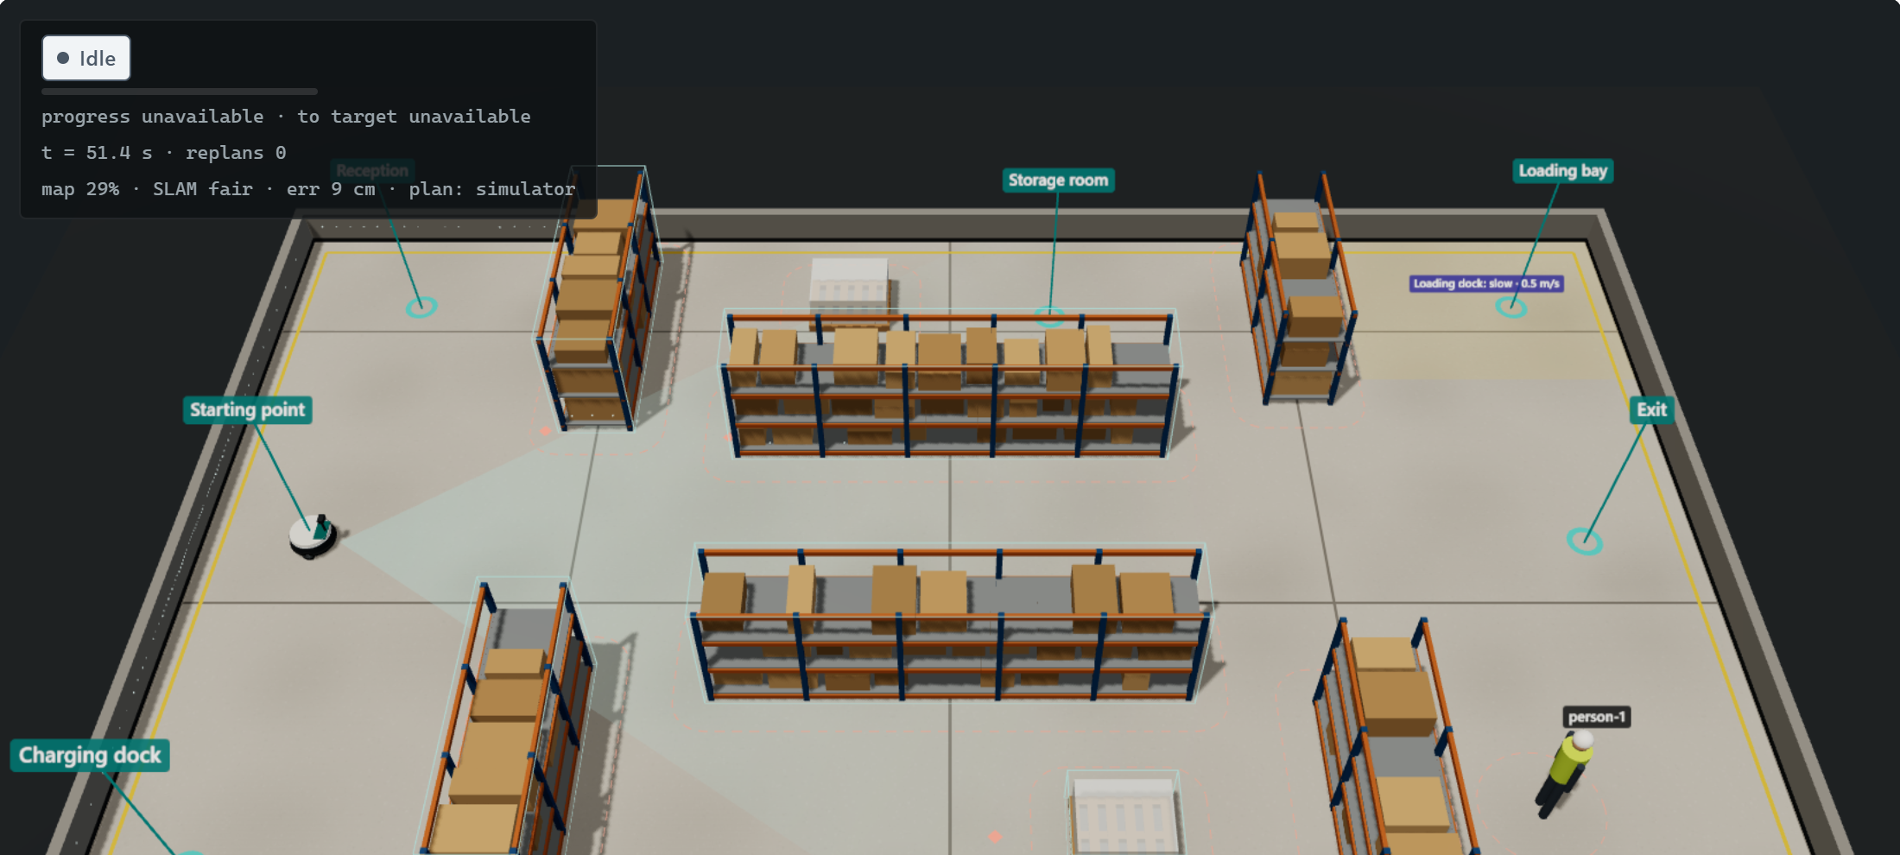
Hack in Hills 2026 | Team Hack01
VISTARA-X
An indoor robot that predicts where people are walking and plans around them.
Screenshot of our 3D digital twin (warehouse scenario)
Ritesh Kumar
backend, AI/ML, hardware design
Kainat Afrazi
frontend, dashboard
Notes:
We are Team Hack01. VISTARA-X is an autonomous navigation system for indoor robots that share corridors with people, like hospital or warehouse delivery robots. The picture is a screenshot of our own 3D digital twin.

Slide 2
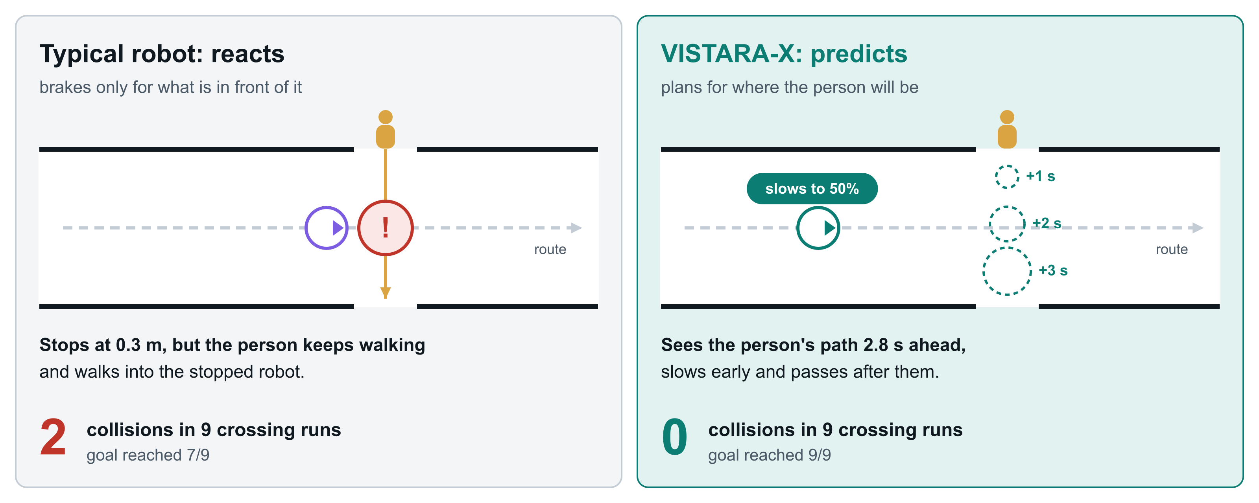
Robots react too late
Numbers from our own evaluation script: same crossing corridor, 9 runs per mode, fixed seeds.
Notes:
Most robots brake only for what is directly in front of them. In a hospital corridor people walk across and do not give way, and stopping does not stop someone walking into you. In our test the reactive robot was hit twice in nine runs; ours predicted the person's path and slowed early, with zero collisions.

Slide 3
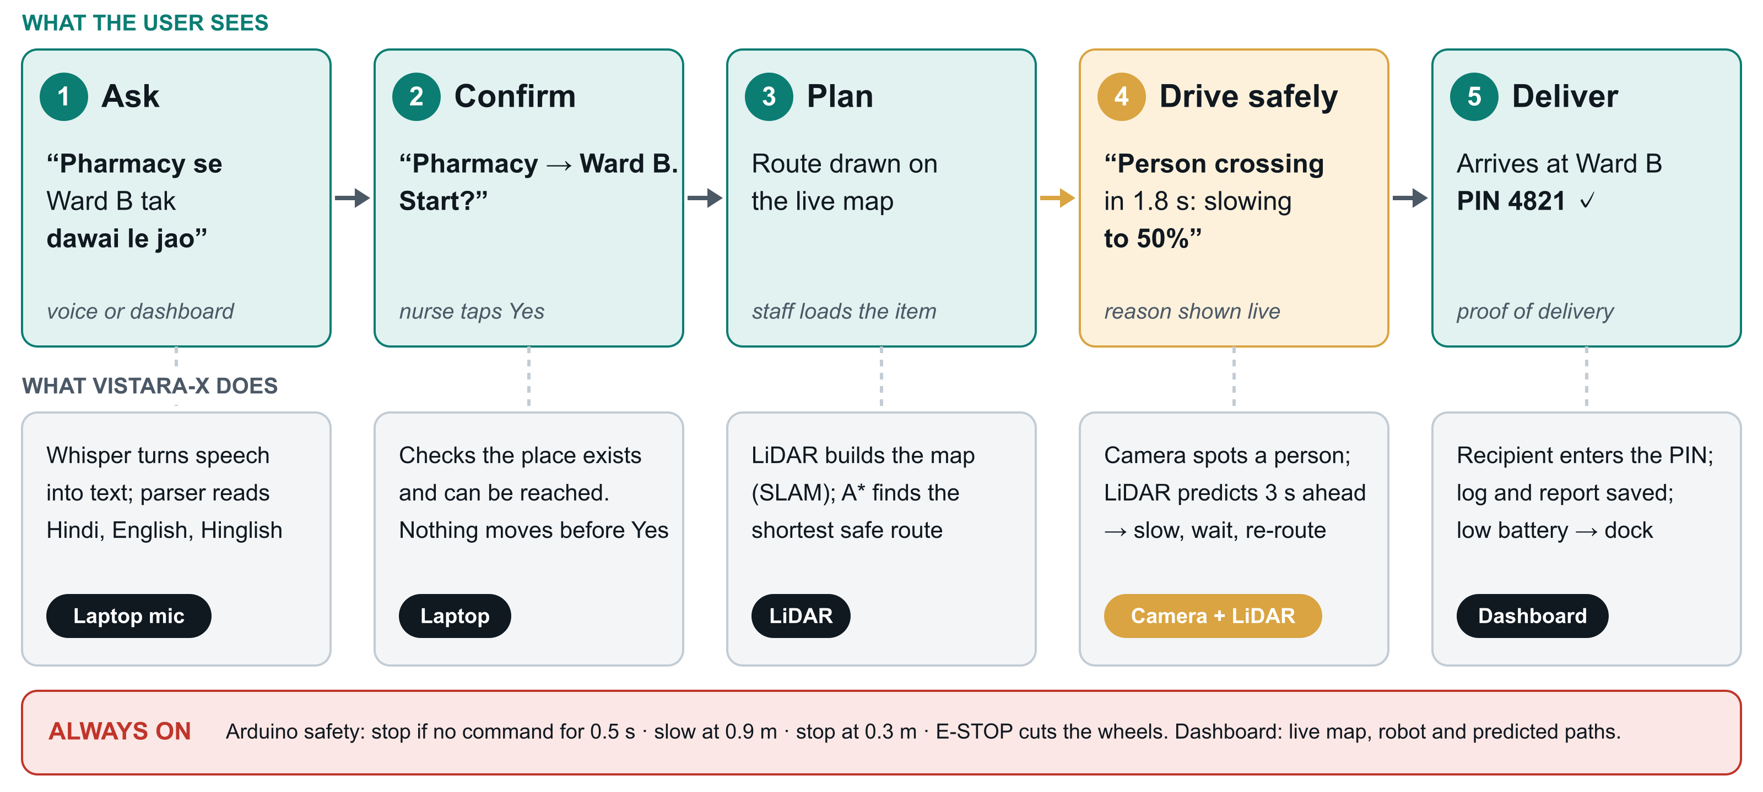
One delivery, step by step
Notes:
This is the product from the user's side. A nurse says, in Hinglish, take the medicine from the pharmacy to Ward B. The robot confirms, plans a route on its map, drives there while predicting the people around it, and the recipient enters a PIN as proof of delivery. The Arduino safety layer is always on underneath.

Slide 4
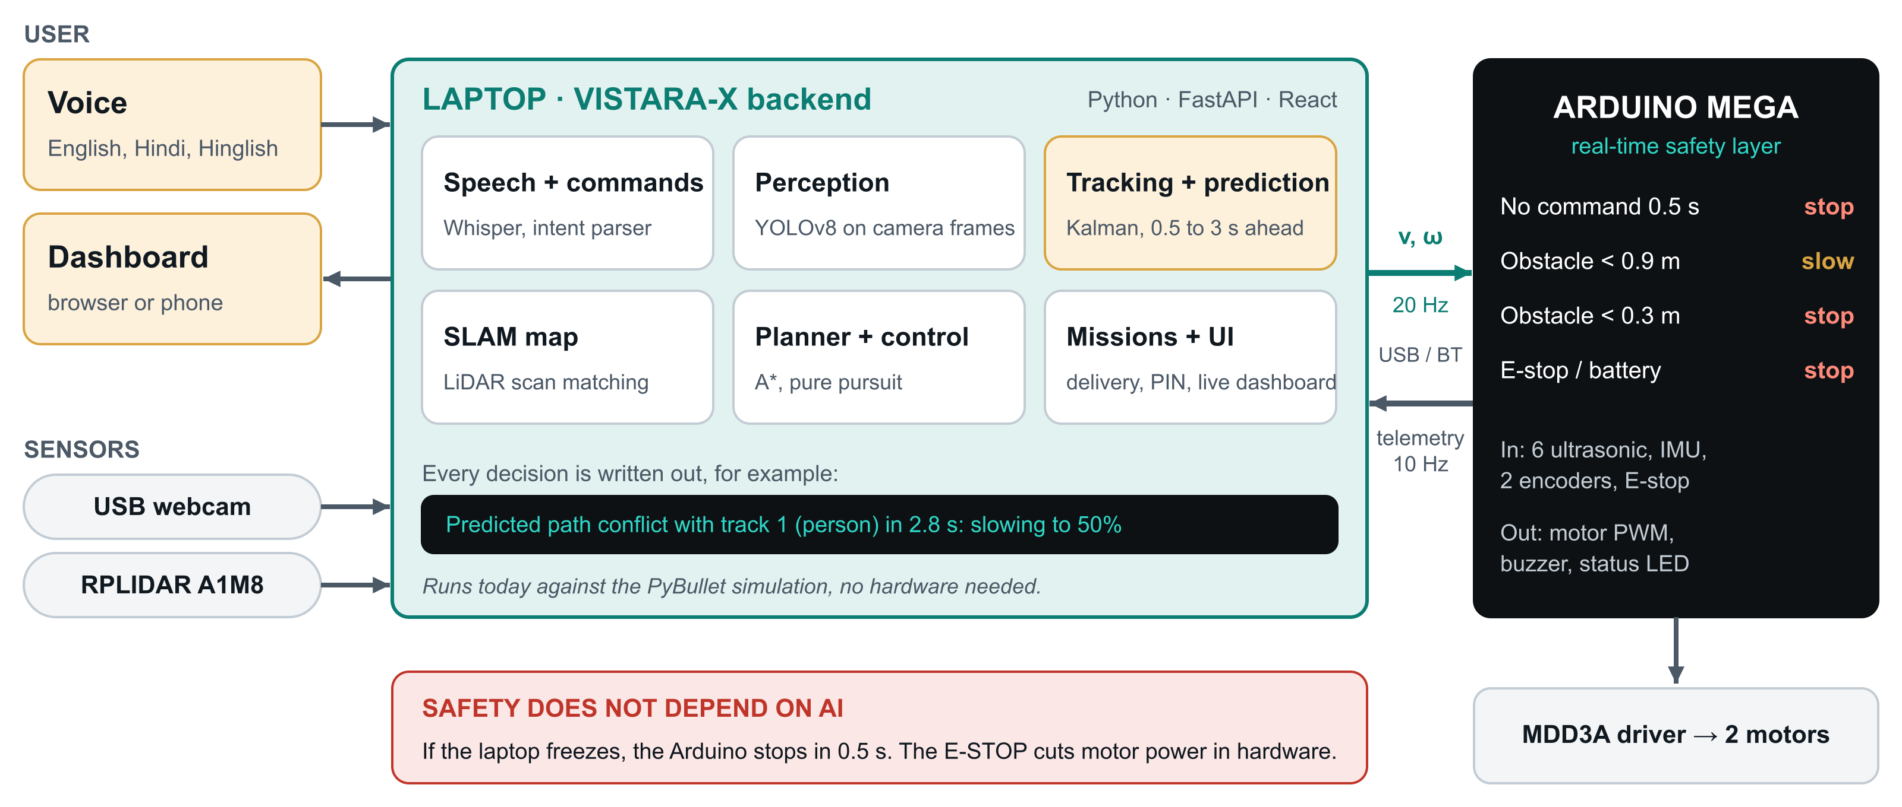
System architecture
Notes:
The laptop runs our Python backend: speech commands, YOLO perception, LiDAR tracking and prediction, SLAM, A-star planning and the delivery missions. It sends a speed command twenty times a second to an Arduino Mega, which keeps the robot safe on its own: if the laptop freezes it stops in half a second, and the E-stop cuts motor power in hardware.

Slide 5
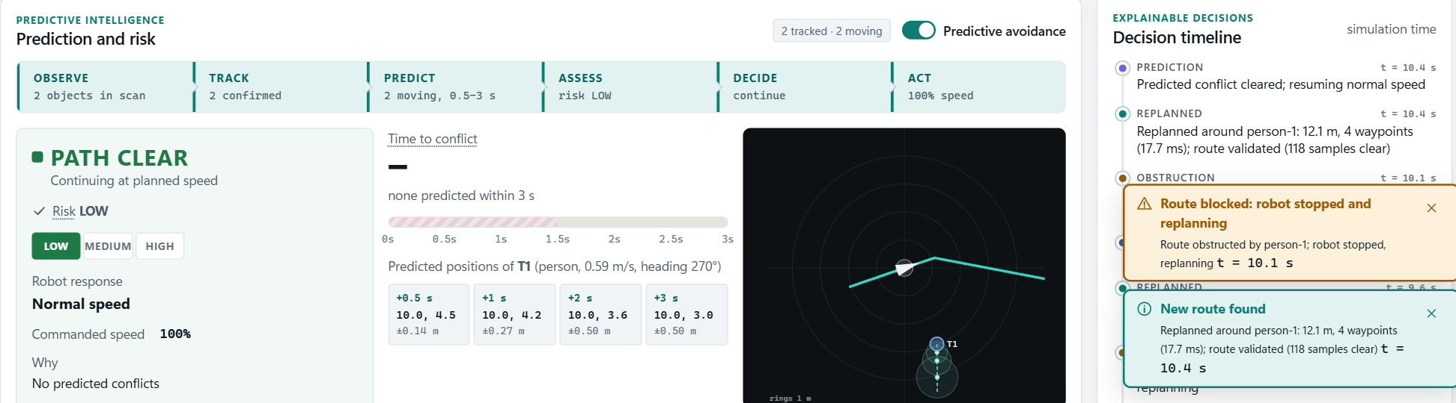
Prediction running in our dashboard
1
4
3
2
1
Pipeline
2
Person T1
3
Radar
4
Decision timeline
each stage lights up from live data
where it will be in 0.5 to 3 s, with uncertainty
robot, route and predicted path
every action logged with its reason
Captured from the running app during the judge demo.
Notes:
This is a real screenshot from our dashboard during the demo. The pipeline strip lights up only from live state. The boxes show where person T1 will be from half a second to three seconds ahead, with growing uncertainty. The radar shows the robot, its route and the predicted path, and the decision timeline logs every action with its reason.

Slide 6
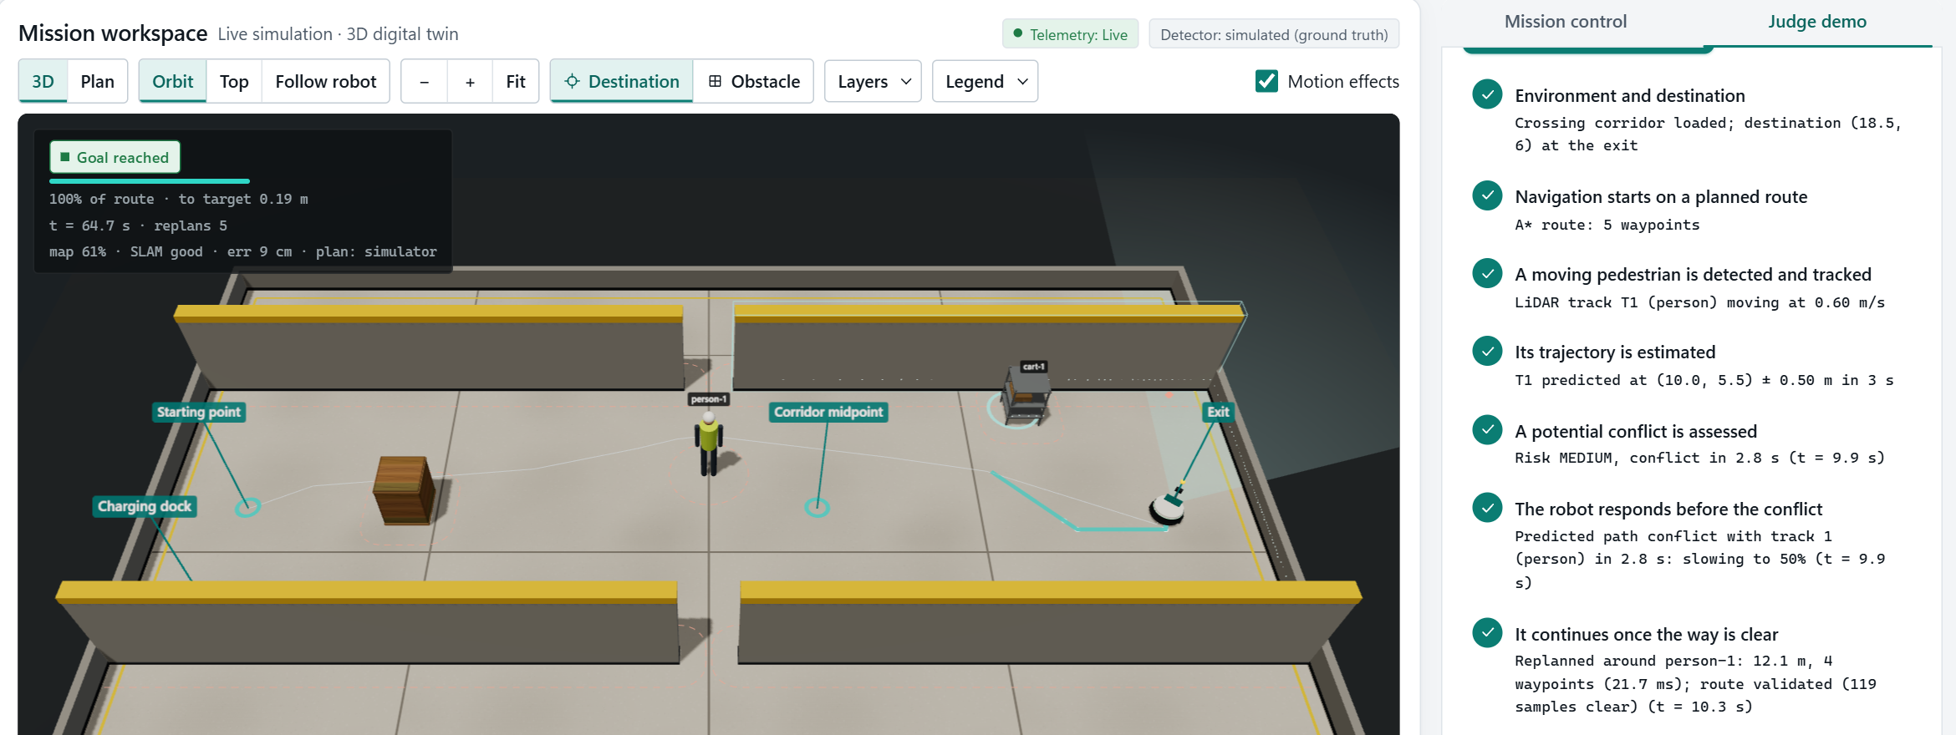
Judge demo: a person crosses the corridor
Person detected
Path predicted
Slows to 50%
Re-routes
Goal, 0 collisions
Notes:
This is our judge demo running in the browser. A person crosses without giving way and a cart turns. Each step on the right is ticked only from real telemetry: the pedestrian is tracked, its path predicted, the robot slows to fifty percent, re-routes and reaches the goal with zero collisions.

Slide 7
Results: predictive vs reactive, 9 runs each
0.60 m
closest approach to the person, worst run
reactive: −0.03 m (contact)
1.36 m
average closest approach
reactive: 1.01 m
+1.5 s
longer per mission
the cost of slowing early
Source: backend/evaluation/results.md (python -m app.evaluation). Simulation only, not a safety certification.
Notes:
Our evaluation script runs the same nine crossing variants with prediction on and off. Predictive: nine of nine goals, zero collisions, zero near misses. Reactive: two collisions and three near misses. The cost is about one and a half seconds per mission. These are simulation results.

Slide 8
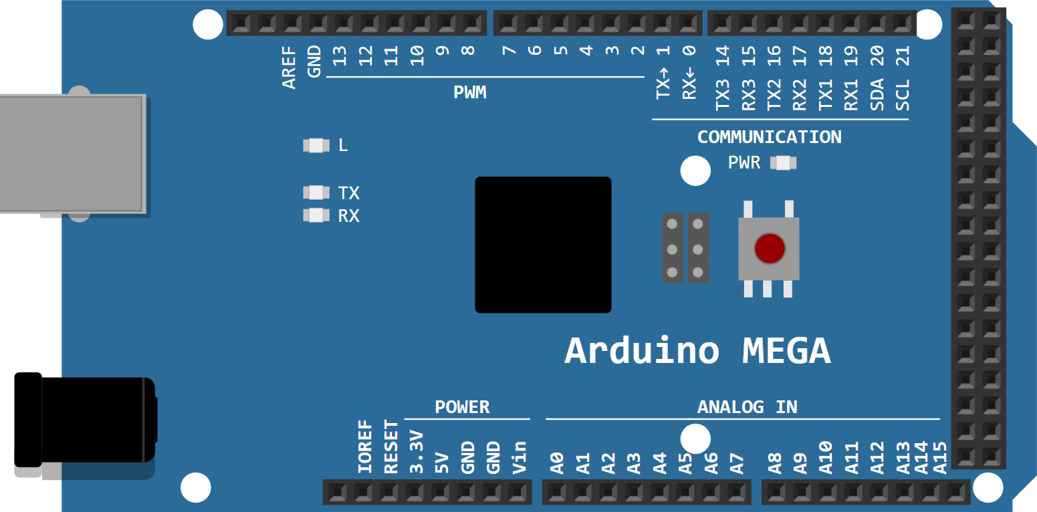
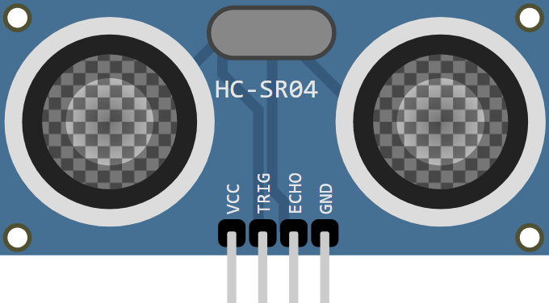
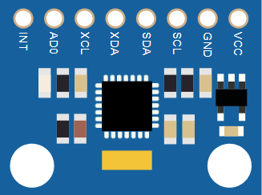


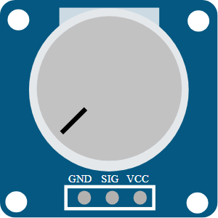
Hardware we use
Electronics (same parts as in our Wokwi simulation)
Bought off the shelf
Part | Job | ₹
Laptop | runs the backend | owned
RPLIDAR A1M8 | 360° LiDAR, 12 m | 8,500
USB webcam | camera for YOLOv8 | 1,600
2 × JGB37 motors + MDD3A | drive wheels | 2,900
3S Li-ion pack + charger | motor power | 1,800
Chassis, wheels, casters | body | 2,200
Electronics on the left | control, safety | 2,100
Cables, USB hub, misc. |  | 1,800
Total |  | ≈ 20,900
HC-SR04 × 6
distance all around
Arduino Mega 2560
controller and safety
MPU6050
E-stop
Buzzer
Battery sense
IMU, turning rate
cuts motor power
danger alarm
knob in Wokwi
Full specs and wiring: hardware/README.md
Notes:
The electronics on the left are exactly the parts in our Wokwi simulation: an Arduino Mega, six ultrasonic sensors, an IMU, the emergency stop, a buzzer and the battery sense. The laptop we already own runs the backend. The rest is off the shelf: a 360-degree LiDAR, a webcam, two encoder gearmotors with a driver, a battery and the chassis, about twenty-one thousand rupees in total.

Slide 9
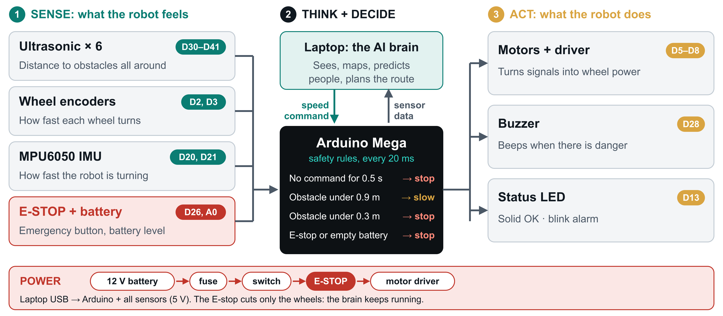
How the circuit works
Notes:
Read it left to right. Sense: ultrasonic sensors, encoders, IMU, E-stop and battery level go into the Arduino. Think: the laptop sends a speed command and the Arduino checks four safety rules every twenty milliseconds. Act: it drives the motors, the buzzer and the status LED. The power path is separate, so the E-stop cuts only the wheels.

Slide 10
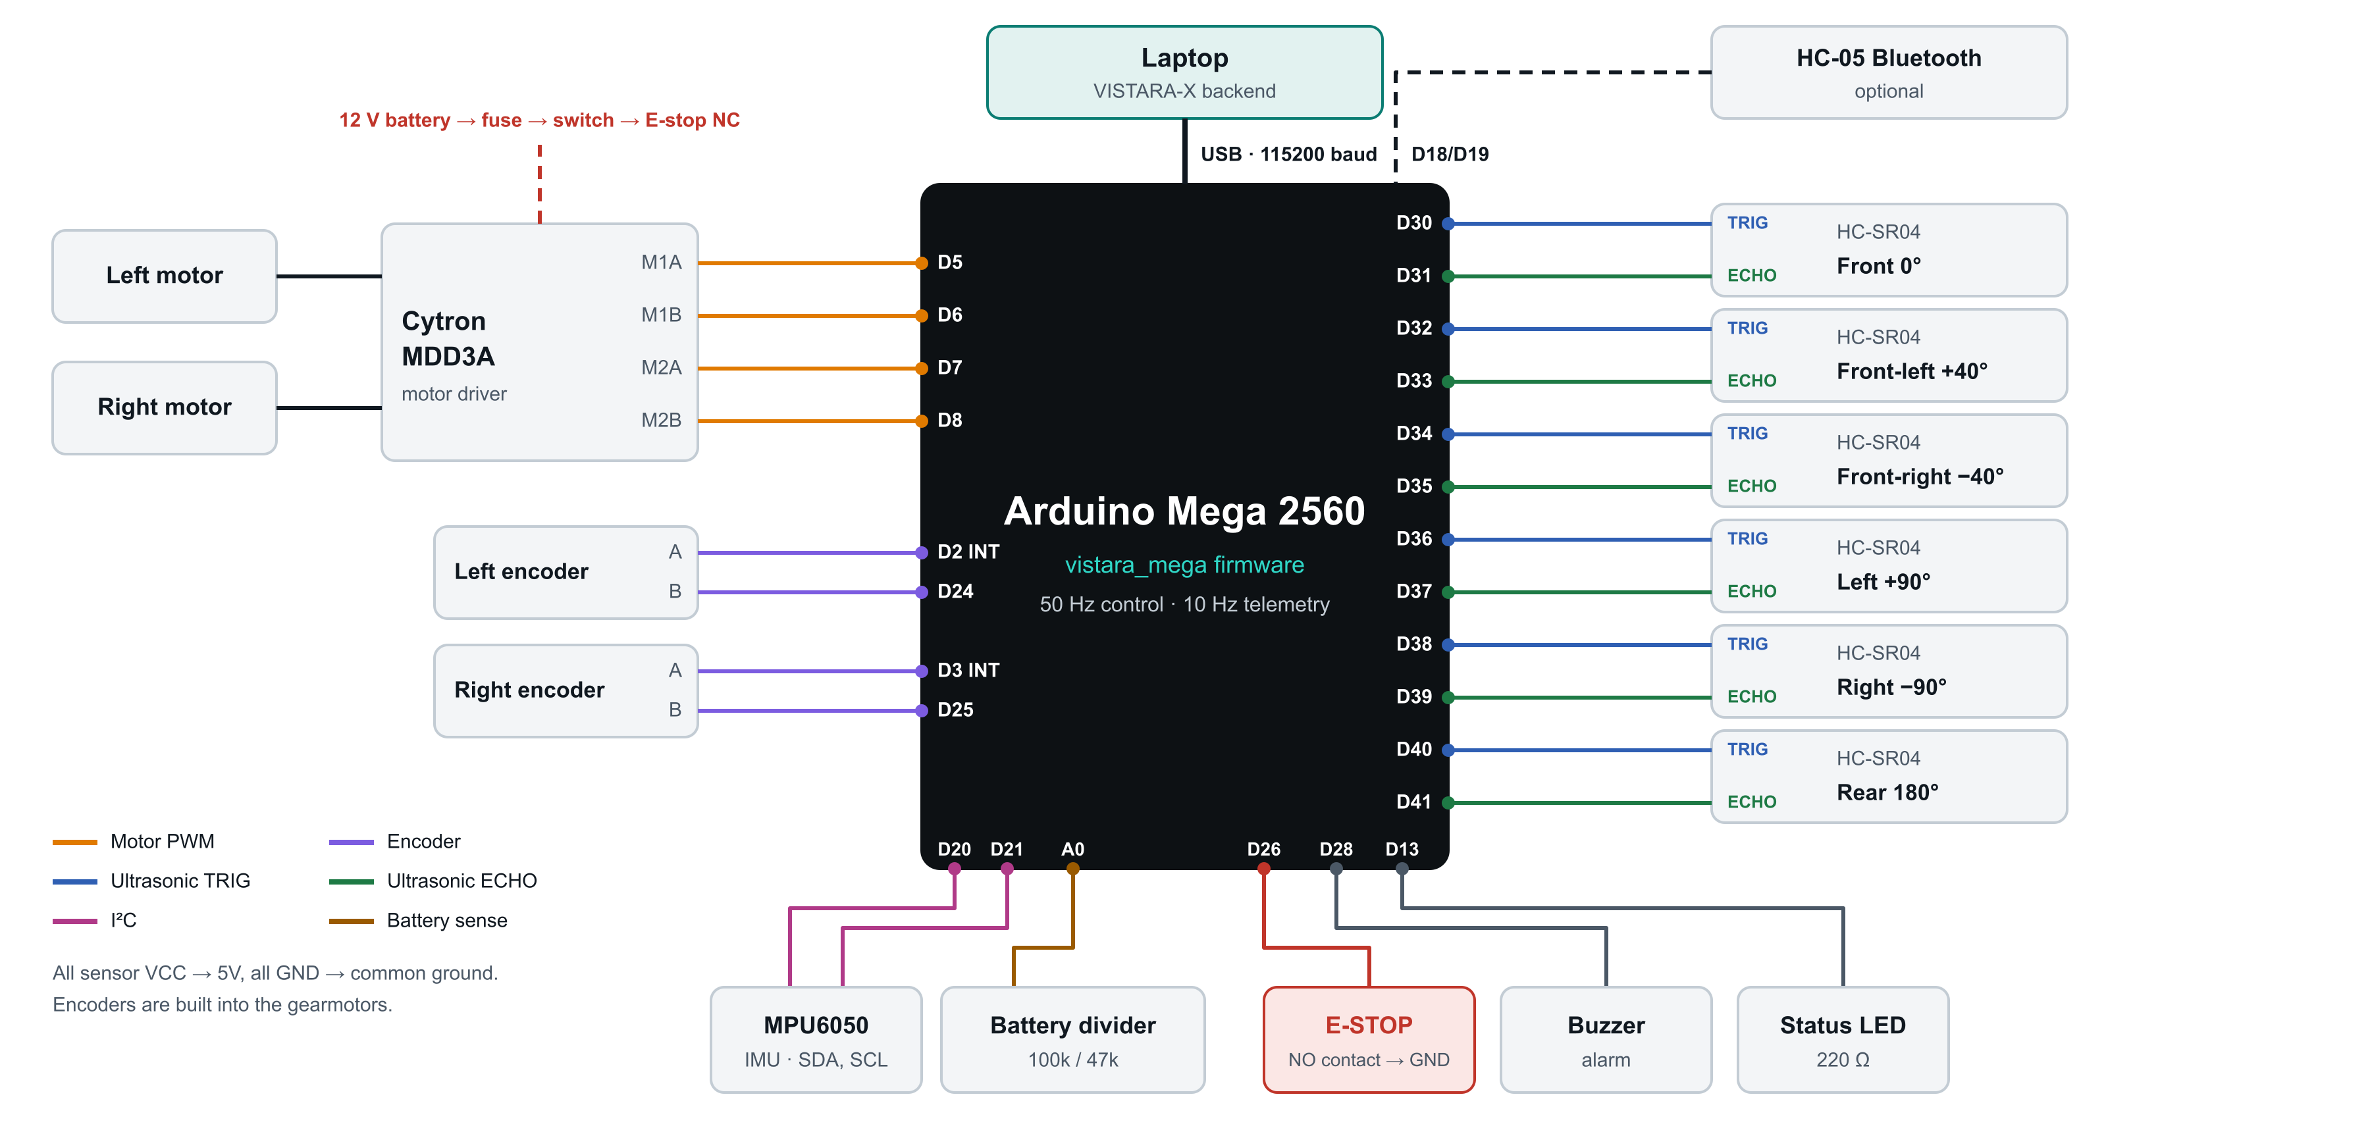
Pin wiring
Notes:
Every connection with its pin: motor driver on 5 to 8, wheel encoders on interrupt pins 2 and 3, the six ultrasonic sensors on 30 to 41, the IMU on I2C, battery on A0, E-stop on 26.

Slide 11
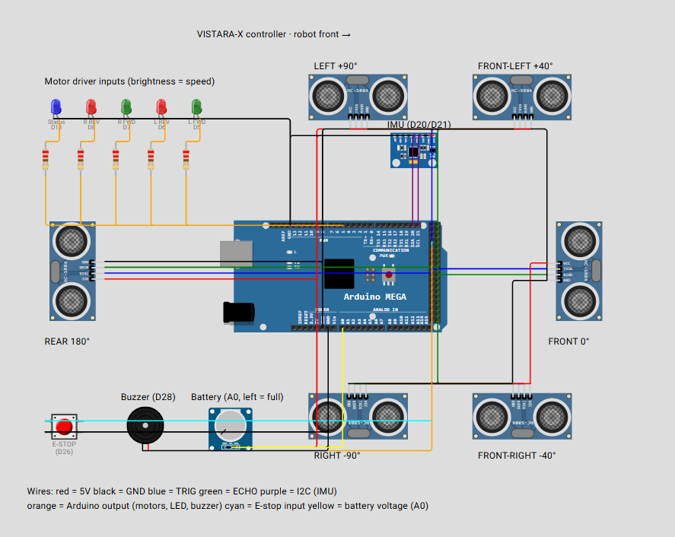
Simulated in Wokwi
Press Start: a 46 s tour runs itself
1
Drive forward
green motor LEDs light up
2
A person walks in front
slows at 0.9 m, stops at 0.3 m
3
Laptop freezes
watchdog stops it in 0.5 s
4
Battery low, then empty
half speed, then motors off
5
E-STOP pressed
instant stop until reset
Each step is explained in the serial monitor. Sliders, knob and button also work by hand.
Notes:
The firmware runs in Wokwi with the same pin map as the real robot. When you press Start, an automatic tour shows every safety rule in about 46 seconds and explains each step in the serial monitor. The robot's front points right, and each ultrasonic sensor sits on the side it faces. The motor LEDs show the PWM; moving a sensor's distance slows or stops the robot, the E-stop cuts everything at once and stays latched, and the battery knob triggers the low-battery rules.

Slide 12
Cost and runtime
≈ ₹21,000
full build, using a laptop we already have
+ ₹14,400
optional OAK-D Lite depth camera
≈ 2 hours
per charge, limited by the laptop battery
Approximate Indian retail prices, October 2026.
Notes:
Because the laptop does the computing, the robot costs about twenty-one thousand rupees. The LiDAR is the biggest single part. A depth camera is an optional upgrade. It runs about two hours per charge, and the software already sends it back to the dock when the battery is low.

Slide 13
From simulation to a real robot
Week 1
Weeks 2–3
Week 4
Weeks 5–6
Weeks 7–8
Weeks 9–10
Bench test
Drive base
Laptop link
Mapping
Prediction
Field trial
Arduino + sensors pass the Wokwi tests
chassis, motors, E‑stop, speed control
serial bridge, real sensors on the dashboard
real LiDAR SLAM, 10/10 goals
crossing test with a real person
supervised runs in a real corridor
Works today
backend, dashboard, evaluation, Wokwi firmware
Needs the robot
real motors, real sensor noise, field trial
Notes:
Getting to a real robot takes about ten weeks. Week one is already de-risked because the same Arduino firmware runs in Wokwi today. The navigation code does not change, only the sensor source and the motor output.

Slide 14

Thank you
Code, evaluation results, hardware design, circuit and Wokwi simulation are all on GitHub.
github.com/RiteshKumar2e/VISTARA-X
Scan for the repository
Team Hack01 | Ritesh Kumar, Kainat Afrazi
Notes:
Thank you. Everything is on GitHub: the code, the evaluation, the hardware design and the Wokwi simulation. The QR code opens the repository.

